Slide 1
Latin American
Governments
Brazil, Mexico, & Cuba

Slide 2
Let’s Review
Government Systems – Who has the power?
Unitary--power is held by one central authority
Confederation--association of independent states that agree to certain limitations on their freedoms by joining together
Federal--power is divided between central authority & several regional authorities

Slide 3
Let’s Review
Government Types – how do citizens participate?
Autocracy-- 1 person possesses unlimited power & citizens have limited role in government
Oligarchy-- small group exercises control & citizens have limited role in government
Democracy--supreme power is vested in the people & exercised by them directly or indirectly through a system of representation involving free elections

Slide 4
Let’s Review
Two Types of Democratic Governments:
Parliamentary– citizens elect members of Parliament, and then the members select the leader
Leader works with or through the legislature
Presidential--system of government in which the leader is constitutionally independent of the legislature; citizens directly elect leader
Leader works separate from legislature

Slide 5
Federative
Republic
Of Brazil
Presidential Representative Democratic Republic

Slide 6
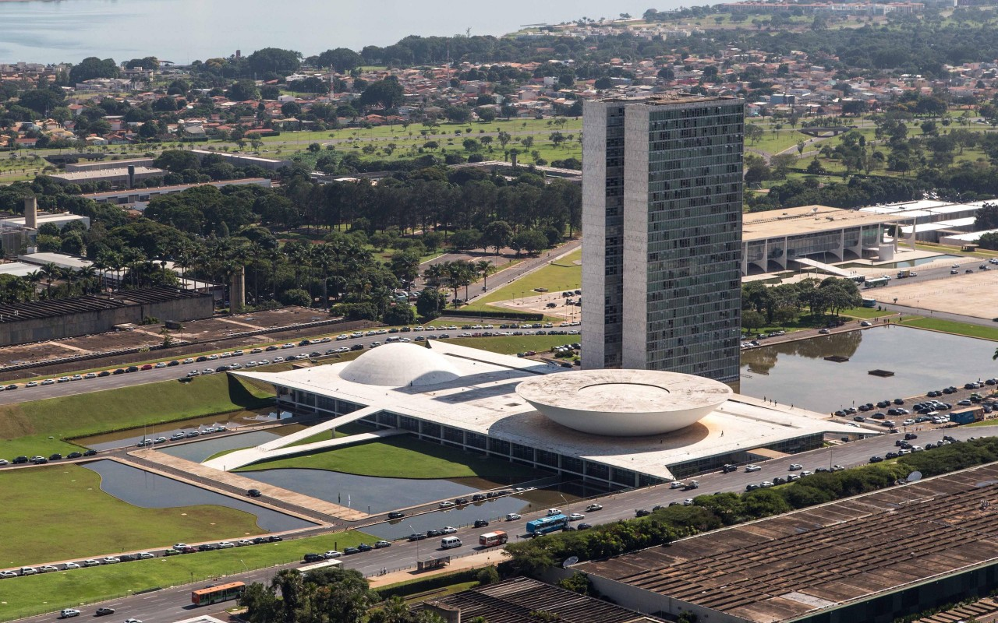
Brazil’s National Congress Building

Slide 7
Federal System
Brazil has a federal system, which means that the national government and the state governments SHARE power.
There are 26 states in Brazil.

Slide 8
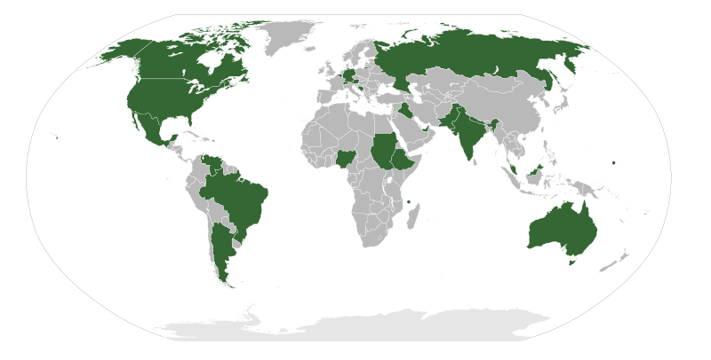
Federal Governments

Slide 9
Leadership
1. President: holds the most political power; the president is both the chief executive and the head of state.
2. Vice President: helps in the day-to-day running of the government; performs ceremonial duties.

Slide 10
Dilma Rouseff
Brazil’s President

Slide 11
Michel Temer
Brazil’s Vice-President

Slide 12
How Leaders
Are Chosen
President: elected by popular vote for a single four-year term
Vice President: runs on the same ticket as the president

Slide 13
Legislature
The National Congress is the country’s bicameral legislature.
It consists of:
Senate (81 seats) – 3 members elected from each state.
Chamber of Deputies (513 seats) – members are elected by proportional representation.
Members serve four and eight-year terms.

Slide 14
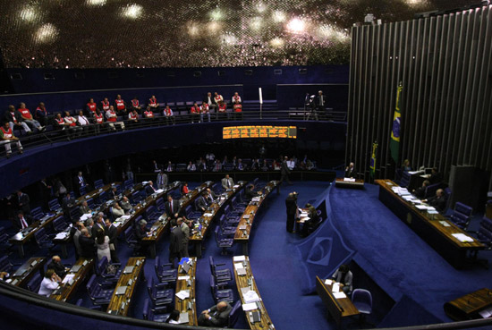
Inside Brazil’s Senate

Slide 15
Presidential
Democracy
The citizens directly elect the president (every four years).
The last election was in October 2010 (next to be held in 2014).
The president works separately from Brazil’s Congress.

Slide 16
Role of the Citizen
Citizens have many freedoms and they also have the right to vote.
Men and women who are 16 years of age may choose to vote, but citizens 18-70 are required by law to vote in national elections.
Citizens can choose representatives from many political parties.

Slide 17
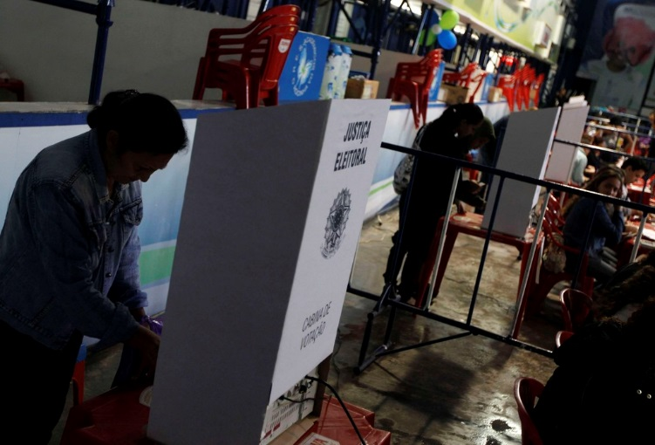
Voting in Brazil – October 2010

Slide 18
United
Mexican
States
Federal Republic

Slide 19
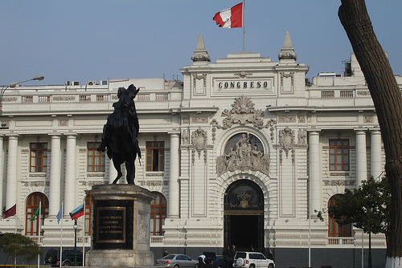
Mexico’s National Congress Building

Slide 20
Federal System
Mexico has a federal system, which means that the national government and the state governments SHARE power.
There are 31 states in Mexico.

Slide 21
Leadership
President: holds the most political power; the president is both the chief executive and the head of state.

Slide 22
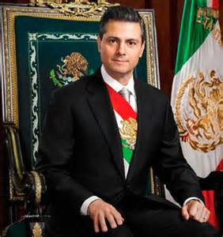
Enrique Pena Nieto
Mexico’s President

Slide 23
How Leaders
Are Chosen
President: elected by popular vote for a single six-year term

Slide 24
Legislature
The National Congress of Mexico is the country’s bicameral legislature.
It consists of:
Senate (128 seats) – elected by popular vote to serve six-year term.
2. Chamber of Deputies (500 seats) – members elected by popular vote to serve three-year terms.

Slide 25
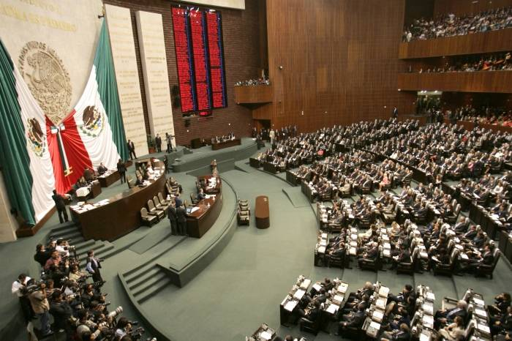
National Congress Chamber

Slide 26
Presidential
Democracy
The citizens directly elect the president (every six years).
The last election was in July 2012 (next to be held in 2018).
The president works separately from Mexico’s Congress.

Slide 27
Role of the Citizen
Citizens of Mexico have many freedoms, and they also have the right to vote.
It is universal and compulsory (but not enforced) that citizens who are 18 or older vote in national elections.
There are many political parties in Mexico.

Slide 28
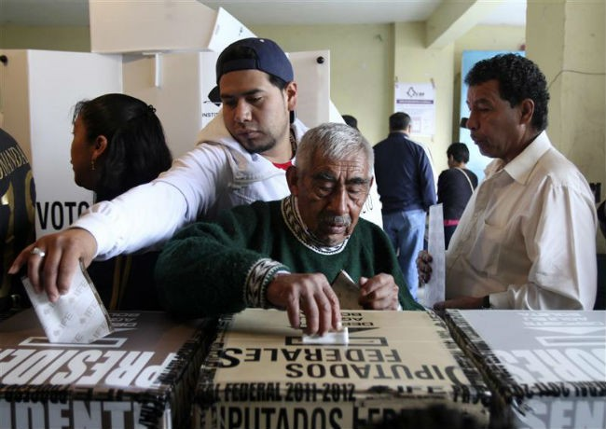
Voting in Mexico – July 2012

Slide 29
Republic
of Cuba
Unitary Socialist Republic

Slide 30
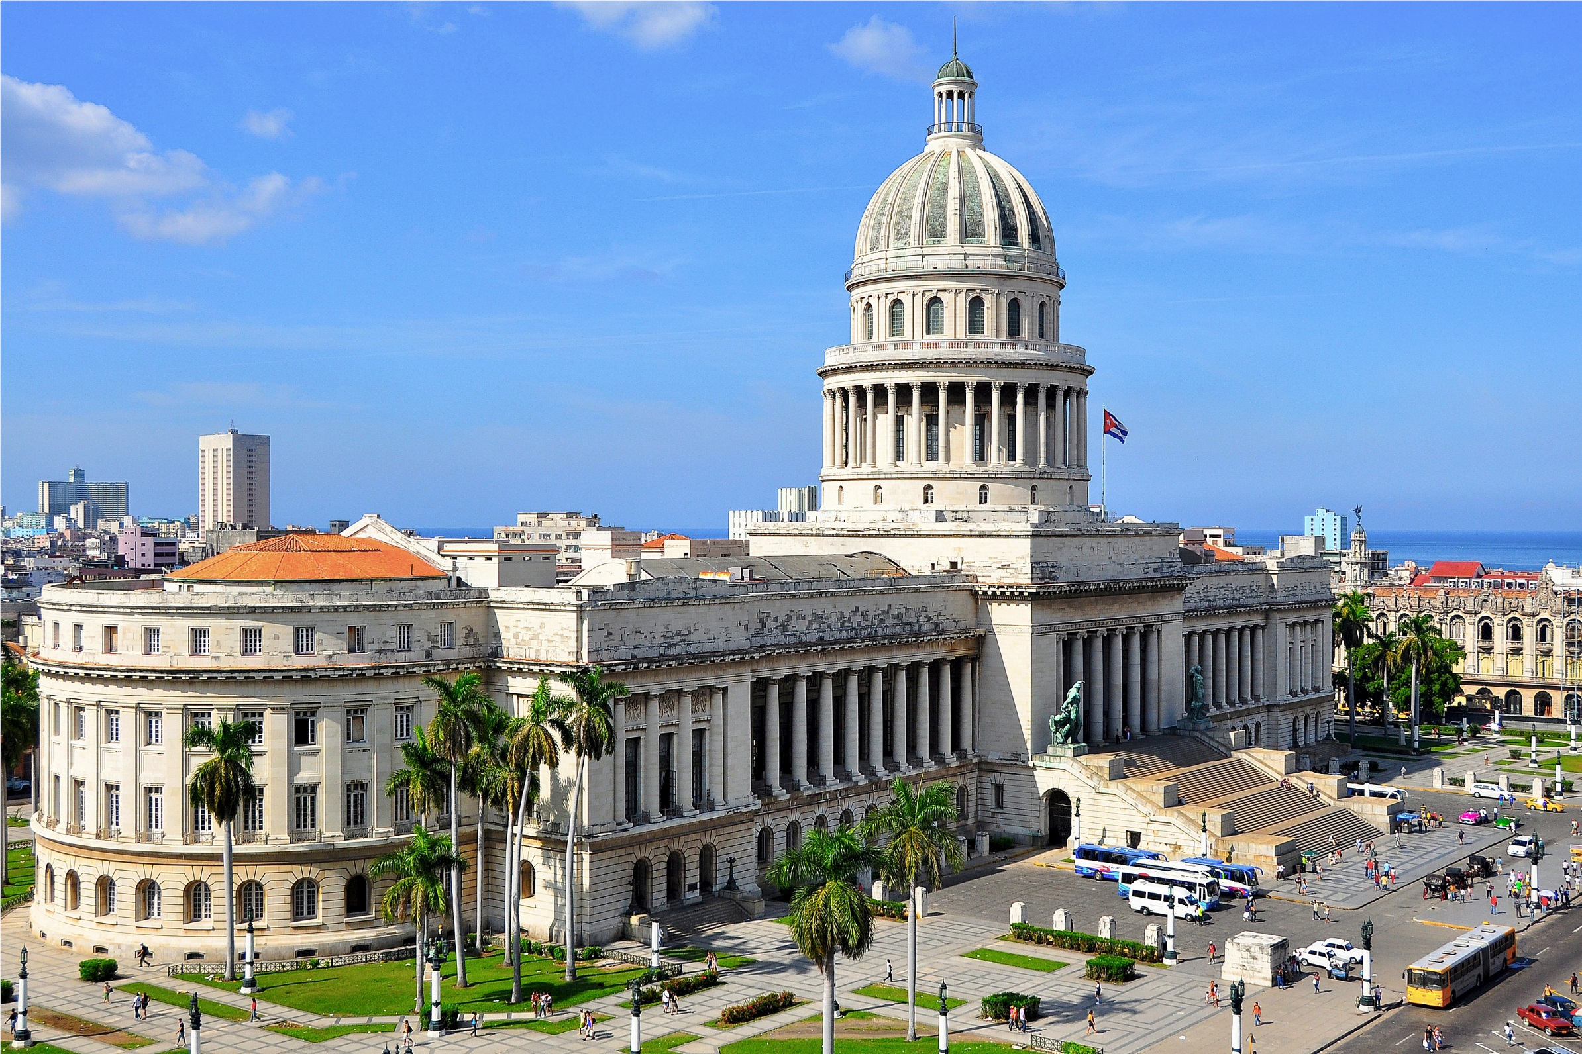
Capitol Building in Havana, Cuba

Slide 31
Unitary System
Cuba has a unitary system, which means that the national (central) government holds all of the power.
The provinces are under central government control.
There are 15 provinces in Cuba.

Slide 32
Unitary Governments

Slide 33
Leadership
President: holds the most political power; the president is both the chief executive and the head of state.

Slide 34
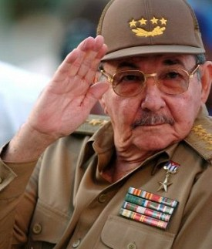
Raul Castro
Cuba’s President

Slide 35
How Leaders
Are Chosen
President: elected* by National Assembly for a five-year term.
*Cuba's Communist Party is the only legal party, and officially sanctioned candidates run unopposed.

Slide 36
Legislature
The National Assembly of People’s Power is the country’s unicameral legislature.
The number of seats is based on Cuba’s population.
As of the most recent election in February 2013, there were 614 seats.
Candidates are selected and approved by the government before the people can vote for them.
Members serve five-year terms.

Slide 37
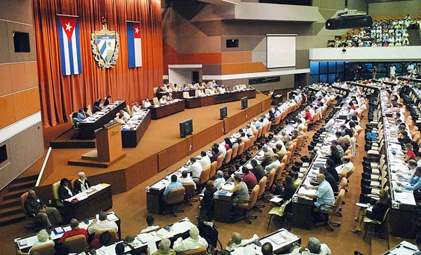
Cuba’s National Assembly

Slide 38
Autocracy
Cuba has been an autocratic dictatorship since Fidel Castro used military force to overthrow the government in 1959.
Since this time, there has been one leader (Fidel or Raul) who holds unlimited power over the country.
Even though citizens get to “vote”, they do not get to select the candidates or make the laws.

Slide 39
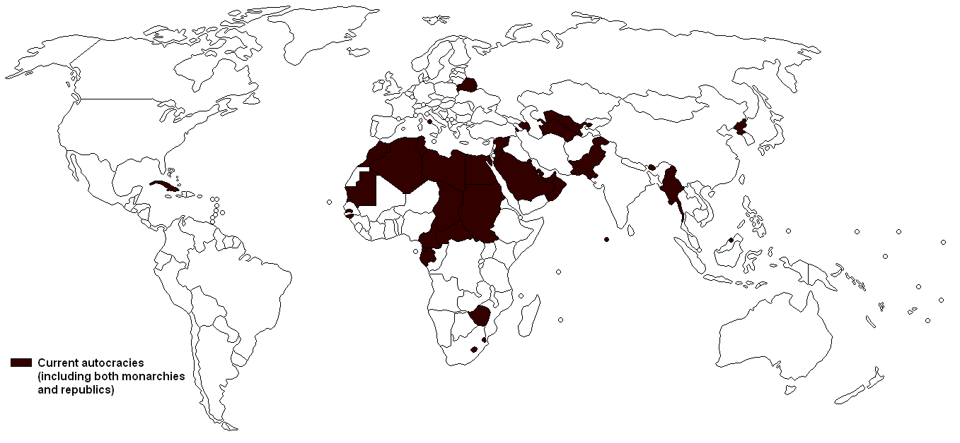
Autocratic Governments

Slide 40
Role of the Citizen
Citizens have few freedoms.
Men and women aged 16 and over may choose to vote, but have few choices.
There is only one political party (the Communist Party) that is allowed in Cuba.
It has been controlled by Fidel Castro and his brother, Raul, since 1959.

Slide 41
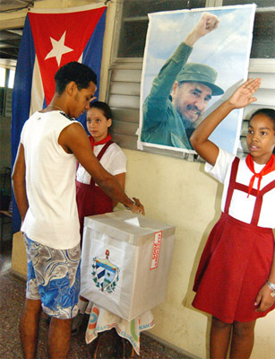
Voting in Cuba

