Slide 1


Latin
American
Economies
Brazil & Cuba

Slide 2
Let’s Review
Economic Systems
Do you remember the three questions that every country must answer when developing its economic plan?
    What goods/services will be produced?
    How will goods/services be produced?
    Who will consume the goods/services?
The way a country answers these questions determines what kind of economic system it will have:
Traditional Command Market

Slide 3
Traditional Economy
All economic decisions are based on customs, traditions, & beliefs of the past.
People will make what they always made & do the same things their parents did.
The exchange of goods is done through bartering.
    Bartering = trading without using money
Some examples: villages in Africa & South America, the Inuit in Canada, Aborigines in Australia

Slide 4
Command Economy
All economic decisions are made by the Government.
  The government owns most of the property, sets the prices of goods, determines the wages of workers, plans what will be made…everything.
This system has not been very successful. More and more countries are abandoning it.
This system is very harsh to live under; because of this, there are no PURE command countries in the world today.
  Some countries are close: Cuba, former Soviet Union, North Korea, former East Germany, etc.
All of these countries have the same type of government: Communist! The government is in control of everything.

Slide 5
Market Economy
Economic decisions are made based on the changes in prices that occur as buyers & sellers interact in the market place.
The government has no control over the economy; private citizens answer all economic questions.
In a truly free market economy, the government would not be involved at all. Scary…
  There would be no laws to make sure goods/services were safe. *Food! Medicine!
  There would be no laws to protect workers from unfair bosses.
Because of this, there are no PURE market economies, but some countries are closer than others.
    Some Examples: US, UK, Australia, etc.

Slide 6
Hmmm…
Since there are no countries that are purely command or purely market, what does that make them?
Most democratic countries have some characteristics of both systems, so we keep it simple and call them: MIXED
Of course, most countries’ economies are closer to one type of system than another.

Slide 7
Let’s Review
Factors of Production
There are 4 factors of production that influence economic growth within a country:
      Natural Resources available
      Investment in Human Capital
      Investment in Capital Goods
      Entrepreneurship
The presence or absence of these 4 factors determine the country’s Gross Domestic Product (GDP) for the year.

Slide 8
Gross Domestic
Product
GDP is the total value of all the goods and services produced in that country in one year.
It measures how rich or poor a country is.
It shows if the country’s economy is getting better or worse.
Raising the GDP of a country can improve the country’s standard of living.

Slide 9
Natural Resources
“Gifts of Nature”
Natural resources are important to countries because without them, countries must import the resources they need (can be costly).
A country is better off if it can use its own resources to supply the needs of its people.
If a country has many natural resources, it can trade/sell them with other countries.

Slide 10
Capital Goods
To increase GDP, countries must invest in capital goods:
  All of the factories, machines, technologies, buildings, and property needed by businesses to operate.
If a business is to be successful, it cannot let its equipment break down or have its buildings fall apart.
New technology can help a business produce more goods for a cheaper price.

Slide 11
Human Capital
To increase GDP, countries must invest in human capital.
Human capital is the knowledge and skills that make it possible for workers to earn a living producing goods and services.
This includes education, training, skills, and healthcare of the workers in a business or country.

Slide 12
Entrepreneurship
People who provide the money to start and operate a business are called entrepreneurs.
  These people risk their own money and time because they believe their business ideas will make a profit.
Entrepreneurs must organize their businesses well for them to be successful .
  They bring together natural, human, and capital resources to produce foods or services to be provided by their businesses.

Slide 13
Specialization
Not every country can produce all of the goods and services it needs.
  Countries specialize in producing those goods and services they can provide best and most efficiently.
  They look for others who may need these goods and services so they can sell their products.
  The money earned by such sales then allows the purchase of goods and services the first county is unable to produce.
In international trade, no country can be completely self-sufficient (produce all the goods and services it needs).
Specialization creates a way to build a profitable economy and to earn money to buy items that cannot be made locally.

Slide 14
Brazil’s
Economy

Slide 15
Economic System
Like most countries with democratic governments, Brazil has a mixed economic system.
  It’s actually closer to a market system than it is to a command one; however, there is some government regulation and control among industries (like healthcare and the postal service).
Brazil has strong agricultural, mining, manufacturing, and service sectors.
  It has the strongest economy in South America.

Slide 16
GDP
Brazil’s GDP is $2.396 trillion (US dollars).
  It is ranked 8th in the world!
  Brazil has the highest GDP in Latin America.
The GDP per capita (value of goods and services produced per person) is $12,100.

Slide 17
Natural Resources
What are Brazil’s major natural resources?
  bauxite, gold, iron ore, manganese, nickel, phosphates, platinum, tin, rare earth elements, diamonds, uranium, petroleum, hydropower, timber

Slide 18
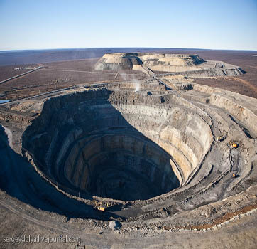
Diamond Mine in Brazil

Slide 19
Land Use
What percentage of the land is arable (capable of being farmed)?
  8.5%
What are the major agricultural products?
  coffee, soybeans, wheat, rice, corn, sugarcane, cocoa, citrus, beef

Slide 20
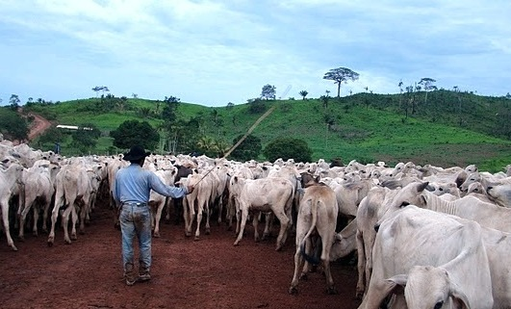
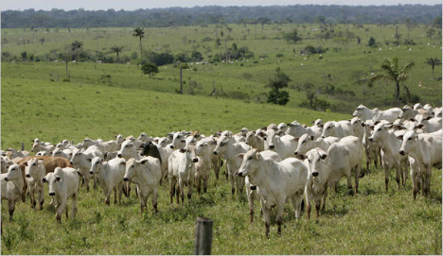
Brazilian Cattle Ranch

Slide 21
Industries
What’s produced in Brazil’s factories?
  textiles, shoes, chemicals, cement, lumber, iron ore, tin, steel, aircraft, motor vehicles and parts, other machinery and equipment
The service industry accounts for 69% of Brazil’s economy – areas such as insurance, banking, retail, and tourism.

Slide 22
Specialization
Brazil’s chief exports include:
  transport equipment, iron ore, soybeans, footwear, coffee, & automobiles
Brazil has specialized in the development of its agriculture, mining, & manufacturing sectors, and therefore has the largest economy in South America.

Slide 23
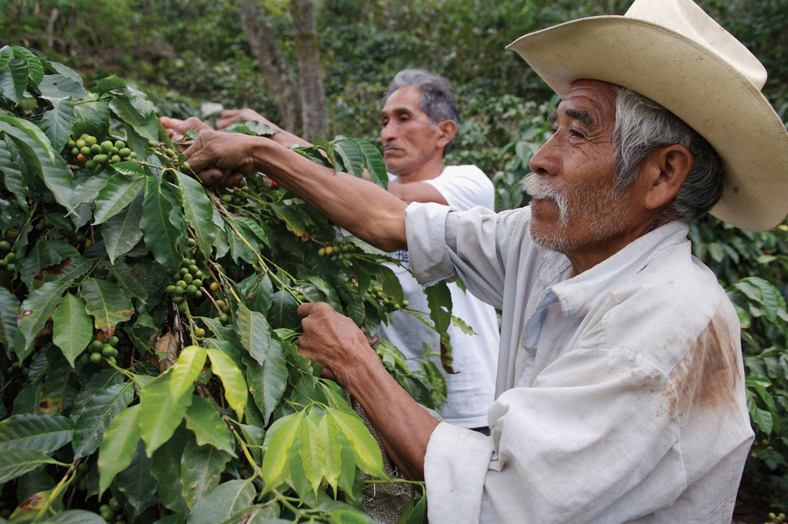
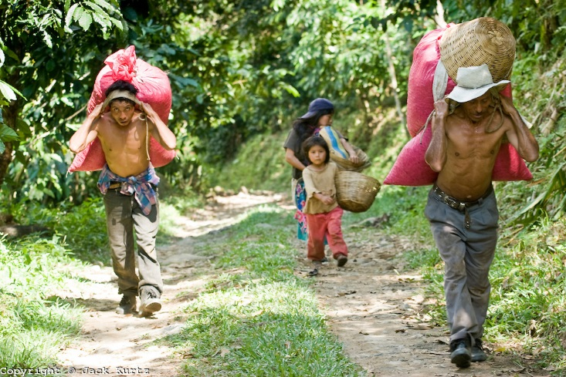
Harvesting Coffee in Brazil

Slide 24
Literacy Rate
What percentage of the population over the age of 15 can read and write?
  90.4%
How long are students expected to stay in school?
  Most students stay in school until they are 14-15 years old.

Slide 25
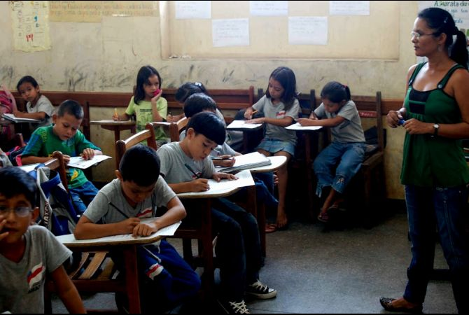
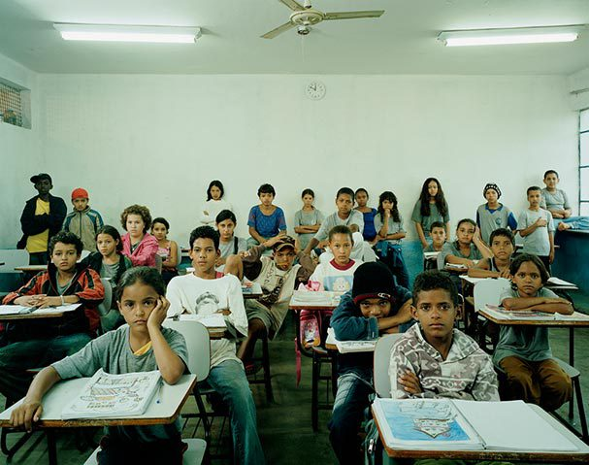
Brazilian Schools

Slide 26
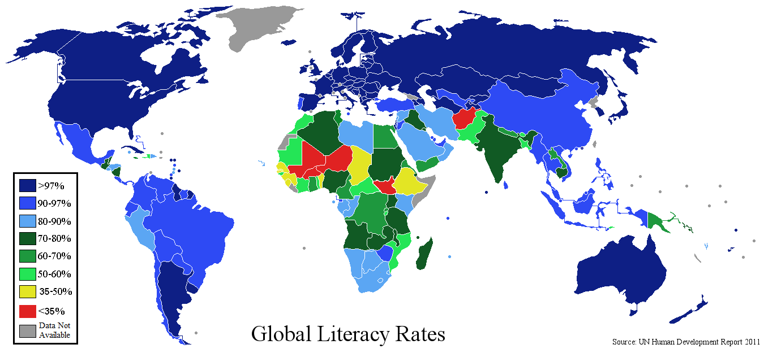

Slide 27
Unemployment Rate
What percentage of people do not have jobs?
  5.5% of Brazil’s workforce is unemployed.
What percentage of people live in poverty?
  21.4% of Brazil’s population live below the poverty line and cannot meet basic needs.

Slide 28
Cuba’s
Economy

Slide 29
Economic System
Like all countries with Communist governments, Cuba has a command economic system.
  The government owns all resources and property, and decides what and how much are to be produced.
Cuba’s economy has struggled since the fall of the Soviet Union because it was Cuba’s main trading partner.

Slide 30
GDP
Cuba’s GDP is $72.3 billion (US dollars).
  It is ranked 67th in the world.
The GDP per capita (value of goods and services produced per person) is $10,200.

Slide 31
Natural Resources
What are Cuba’s major natural resources?
  cobalt, nickel, iron ore, chromium, copper, salt, timber, silica, petroleum, & arable land

Slide 32
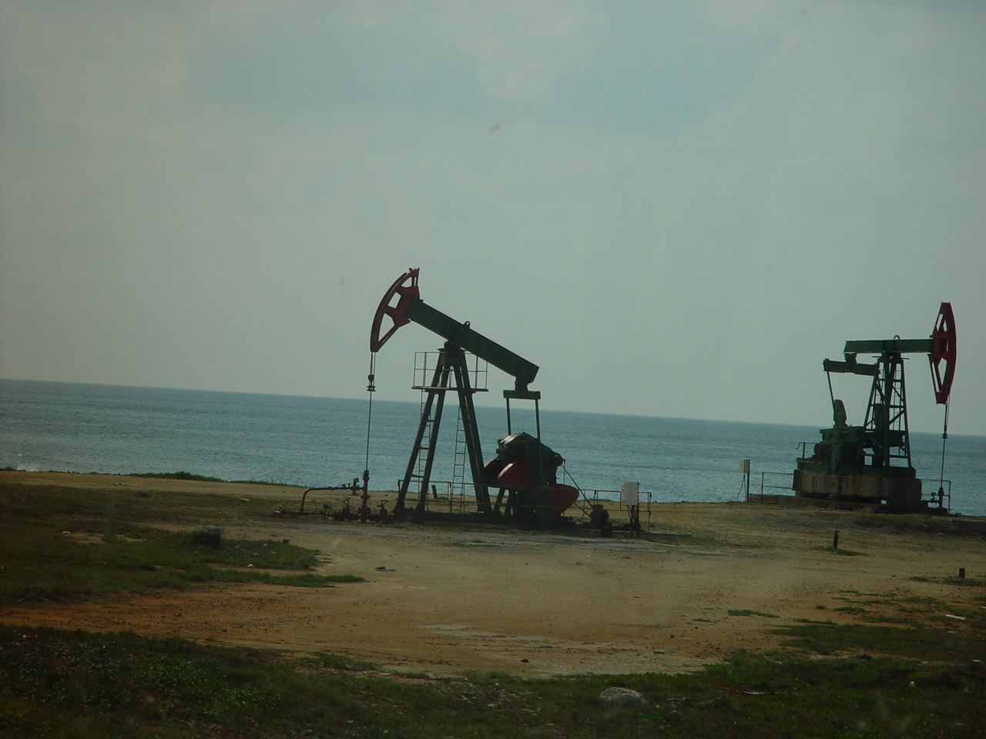
Oil Field in Cuba

Slide 33
Land Use
What percentage of the land is arable (capable of being farmed)?
  32.3%
What are the major agricultural products?
  sugar, tobacco, citrus, coffee, rice, potatoes, beans, & livestock

Slide 34
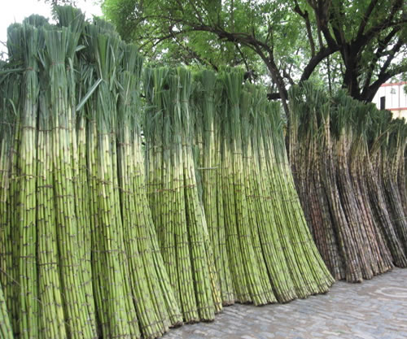
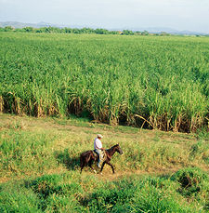
Cuban Sugarcane

Slide 35
Industries
What’s produced in Cuba’s factories?
  petroleum, nickel/cobalt, pharmaceuticals, tobacco, construction, steel, cement, agricultural machinery, & sugar

Slide 36
Specialization
Cuba’s chief exports include:
  petroleum, nickel, medical products, sugar, tobacco, fish, citrus, & coffee

Slide 37
Literacy Rate
What percentage of the population over the age of 15 can read and write?
  99.8%
How long are students expected to stay in school?
  Males – 15 years old
  Females – 16 years old

Slide 38
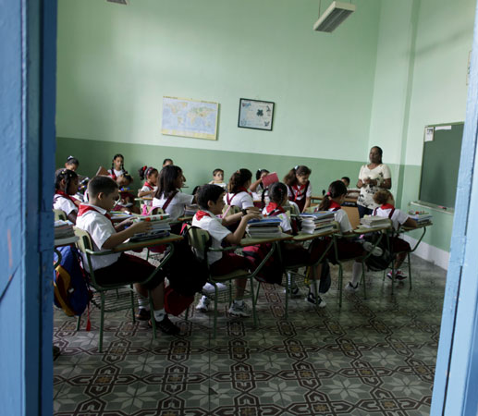
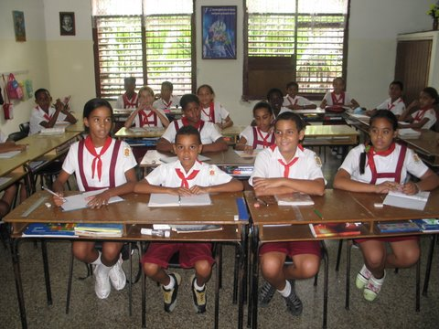
Cuban Schools

Slide 39
Unemployment Rate
What percentage of people do not have jobs?
  3.8% of Cuba’s workforce is unemployed.
  *Note: these are “official” rates put out by Cuba’s government; unofficial estimates are about double the official figure
What percentage of people live in poverty?
  Cuba’s government does not make this information available.

Slide 40
Currency Exchange
Currency exchange is the price of one country’s currency compared to another.
  1 US dollar = 2.33 Brazilian reals
  1 US dollar = 26.5 Cuban pesos
  1 Brazilian real = 11.33 Cuban pesos
What does this mean?
  Brazil’s economy is stronger than Cuba’s, but the US’s economy is stronger than both.

