Slide 1
Pollution in EUROPE

Slide 2
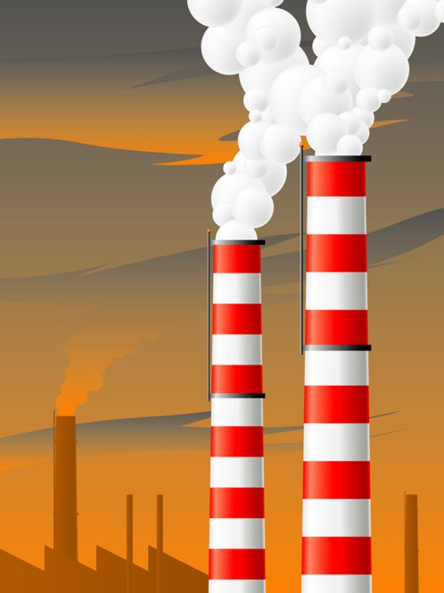
What is smog?
Smog is air pollution caused by sunlight acting on the gases from automobiles and factory exhaust.
Smog often hangs over cities in the United Kingdom.
London smog happens when water in the air mixes with smoke particles from a coal fire.

Slide 3
Great Smog of 1952
Smog was so dense that for four days the people couldn’t see what was in front of them.
Transportation slowed
Crime increased
Thousands died from the pollution
People around the world suddenly were frightened
They begin to worry about the quality of the air they were breathing.

Slide 4
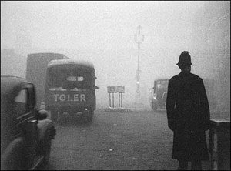
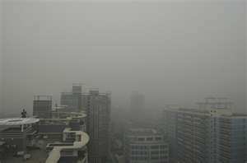
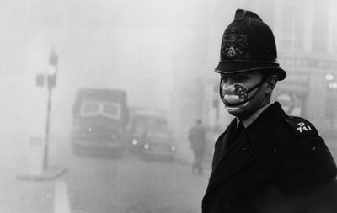

Slide 5
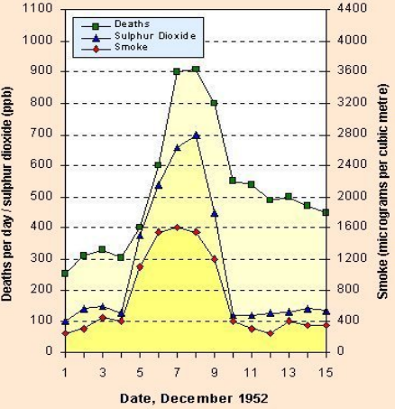

Slide 6
Major sources of air pollution
(PAST)
Smoke and sulfur dioxide from burning coal or other fossil fuels.
Major sources of air pollution
(PRESENT)
Exhaust and diesel-powered vehicles

Slide 7
Effects of Air Pollution
Asthma
Pneumonia
Burns the lungs, nose, and eyes
Endangers human life
Keeps children and senior citizens indoors
Blackens buildings
Threatens wildlife

Slide 8
Methods to deal with air pollution today
Cleaner coals
Increased use of electricity
Use of gas
Government sets limits for industry
Laws have forced automakers to build vehicles that produce less harmful exhaust
Government checks air quality
Government asks citizens to drive less
Government asks citizens to use cleaner forms of energy.

Slide 9
Air pollution in the United Kingdom causes…
ACID RAIN
…for the rest of Europe.
IS THIS FAIR????????

Slide 10
ACID RAIN
Rain that is formed when burning fossil fuels mix with water vapor.
Major Sources
Coal burning power plants and factories
Gasoline burning cars

Slide 11
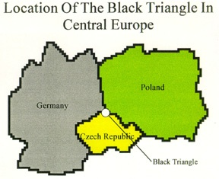
The Black Triangle of Europe
The Black Triangle is one of Europe’s most industrialized and polluted areas.
It is located where Germany, Poland, and the Czech Republic come together.

Slide 12
Effects of Acid Rain
Can make lakes unfit for fish and other animals
Can kill certain kinds of plants.
Can damage statues, monuments, and buildings

Slide 13
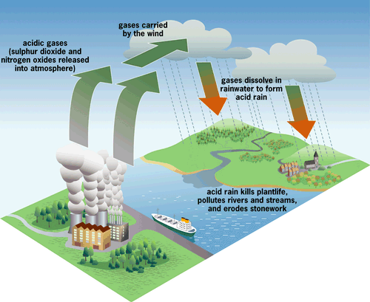

Slide 14
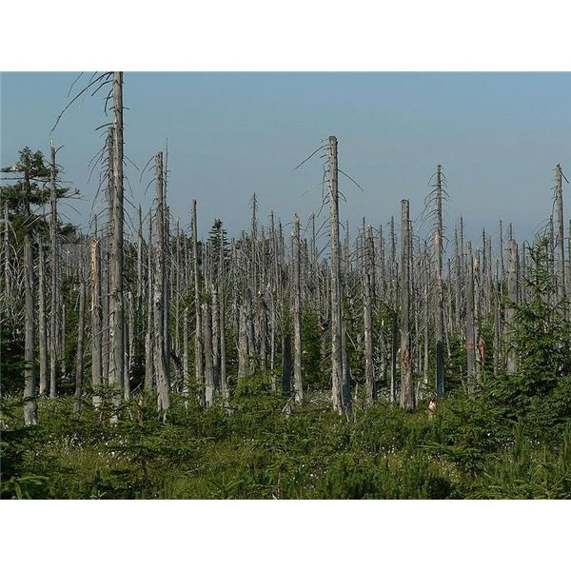
Effects on trees

Slide 15
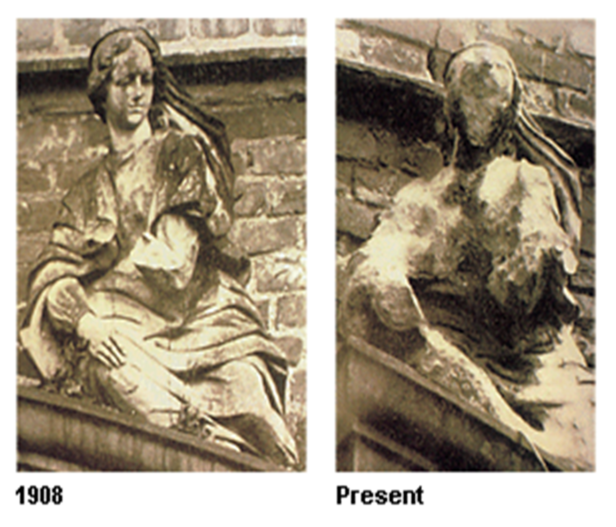
Effects on statues

Slide 16
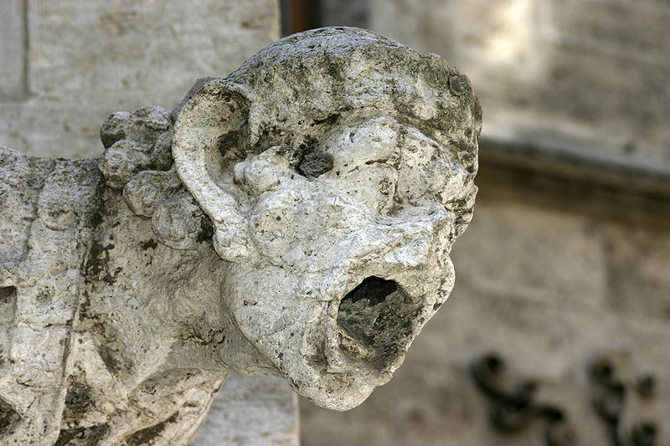
Effects on statues

