Slide 1
Atlantic Slave Trade
The continents involved are North/South America, Africa and Europe

Slide 2
Quiz
Incan ruler who was held for ransom, baptized, and killed
Spanish explorer and soldier who conquered the Aztec
Aztec ruler who believed the Spanish to be gods, was arrested and killed
The exchanging of plants, animals, diseases, and people between the Old World and the New World
Spanish explorer and soldier who conquered the Inca, was killed by his partner
Cortez
Pizarro
Montezuma
Atahualpa
Columbian Exchange

Slide 3
The New World traded with the Old World and this was called The Columbian Exchange. (Diseases, Slaves, Animals, Food)

Slide 4
Document

Slide 7
A major impact in the slave trade has been further blending of Latin America

Slide 9
The growth in slavery was caused by the colonies usage of plantations.

Slide 11
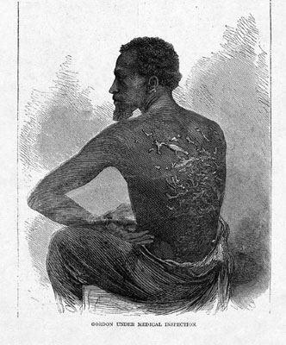

Slide 14
Document

Slide 15
Quiz Directions
Get out a blank sheet of paper
Clear your desk of everything but this paper and something to write with
Put your name and class period on it
Title the paper “New World Quiz”
Number the paper 1-5

