Slide 1
Welcome!
The Topic For Today Is…AUSTRALIA

Slide 2
Australia
Physical Features | Geography | Climate | Aborigines | Random
200 | 200 | 200 | 200 | 200
400 | 400 | 400 | 400 | 400
600 | 600 | 600 | 600 | 600
800 | 800 | 800 | 800 | 800
1000 | 1000 | 1000 | 1000 | 1000
Bonus Question: 5000 pts

Slide 3
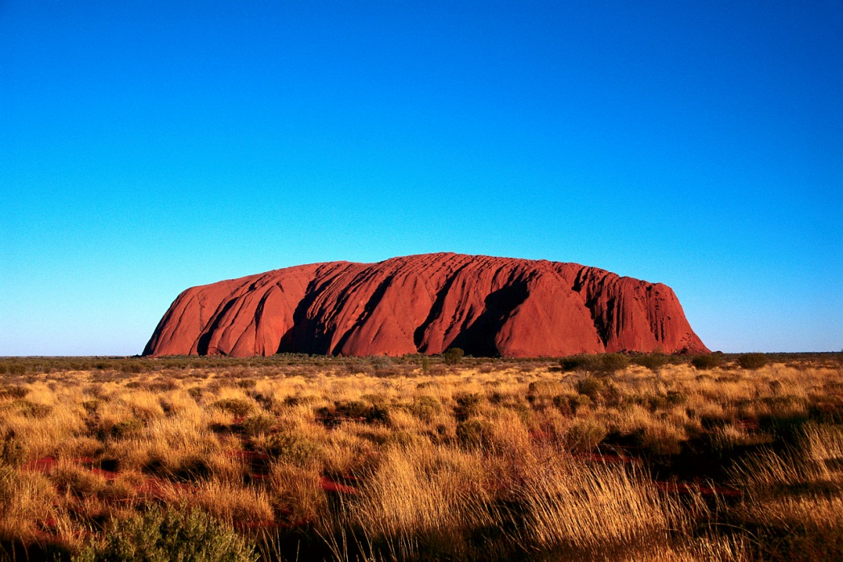
Topic 1: 200
Question:
What does the picture show?
Answer
Ayers Rock (Uluru)
Back

Slide 4
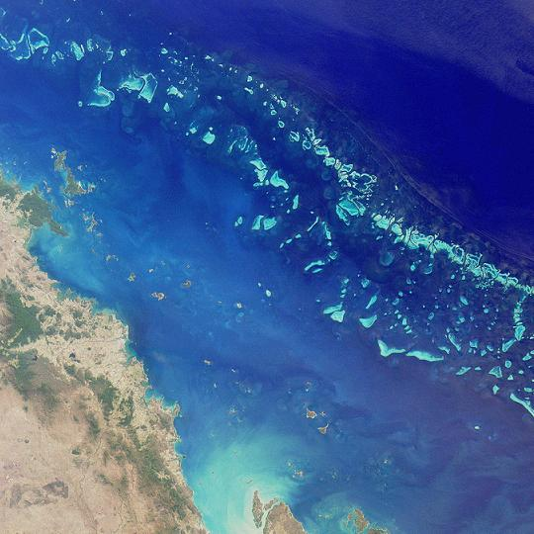
Topic 1: 400
Question:
This picture shows which physical feature of Australia?
Answer
Great Barrier Reef
Back

Slide 5
Topic 1: 600
Question:
What is the name of the desert that stretches across 160,000 miles of Australia?
Answer
Great Victoria Desert
Back

Slide 6
Topic 1: 800
Question:
The sea to the north-east of Queensland is called?
Answer
Coral Sea
Back

Slide 7
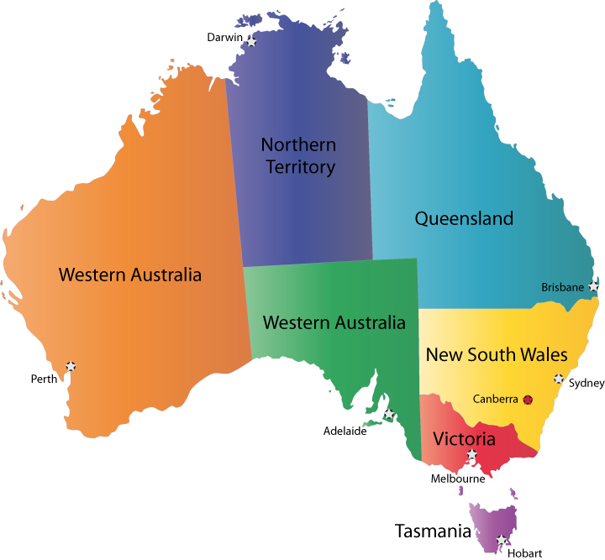
Topic 1: 1000
Question:
Which number symbolizes Ayers Rock on the map provided?
Answer
2
3
2
5
1
Back
4

Slide 8
Topic 2: 200
Question:
How many states are in Australia?
Answer
8
Tasmania, Victoria, New South Wales, Queensland, Northern Territory, Australian Capital Territory, Western Australia, South Australia
Back

Slide 9
Topic 2: 400
Question:
Where do most of the Australian peoples live within Australia?
Answer
The coast
Eastern coast
Back

Slide 10
Topic 2: 600
Question:
In which Australian state do most people live?
Answer
New South Wales
Back

Slide 11
Topic 2: 800
Question:
Australia is not only a country, it is also considered a (blank)
Answer
Continent
Back

Slide 12
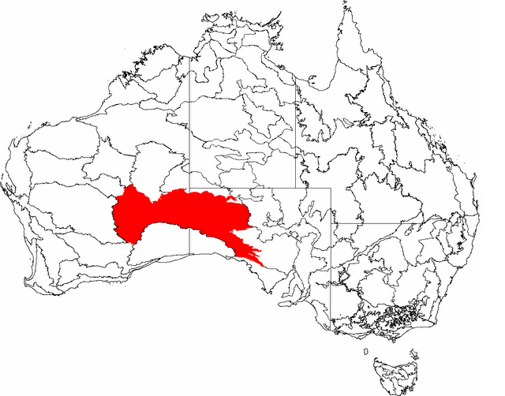
Topic 2: 1000
Question:
What does the red on the map symbolize?
Answer
Great Victoria Desert
Back

Slide 13
Topic 3: 200
Question:
What two words describe the climate in most of Australia?
Answer
Hot and Dry
Back

Slide 14
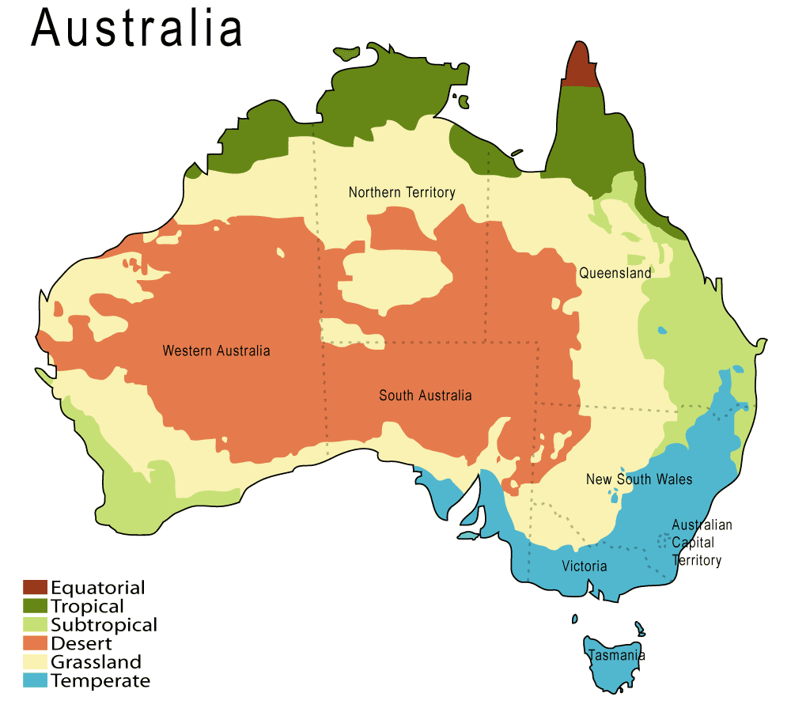
Topic 3: 400
Question:
According to the map, which states have a temperate climate?
Answer
South Australia, Tasmania, Victoria, New South Wales, Queensland
Back

Slide 15
Topic 3: 600
Question:
About how much rain does Australia get each year?
Answer
8-10 inches
Back

Slide 16
Topic 3: 800
Question:
Why is it that most Australians live in a particular area of Australia instead of living all over such a large country?
Answer
People like to live in the temperate (milder) climate along the coast to avoid the heat of Australia’s center
Back

Slide 17
Topic 3: 1000
Question:
Because Australia is south of the Equator, the months of December, January, February, and March are during what season?
Answer
Summer
Back

Slide 18
Topic 4: 200
Question:
Native Australians and called what?
Answer
Aborigines
Back

Slide 19
Topic 4: 400
Question:
In what state do most Aborigines live?
Answer
Northern Territory
Back

Slide 20
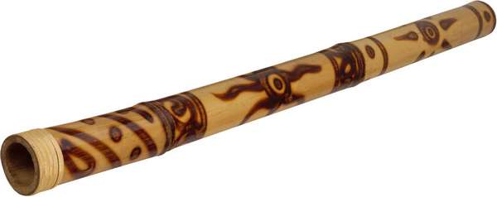
Topic 4: 600
Question:
The musical instrument played by the Aborigines is called a?
Answer
Didgeridoo
Back

Slide 21
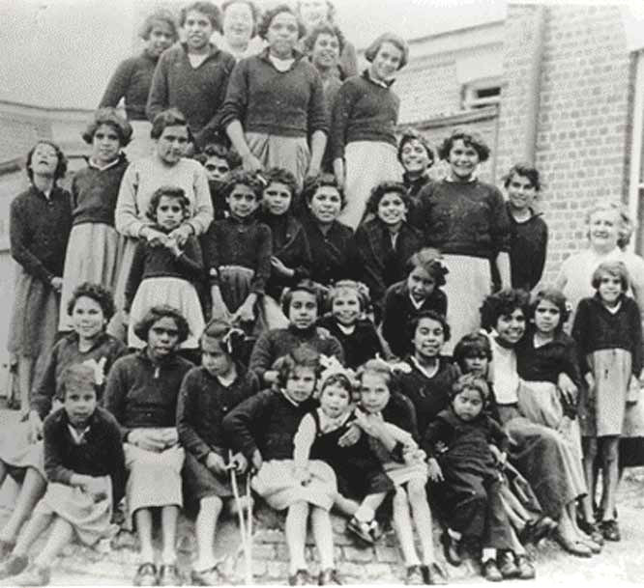
Topic 4: 800
Question:
The aborigines are often called “The (blank) Generation”
Answer
Stolen
Back

Slide 22
Topic 4: 1000
Question:
What happened to the Australian Aborigines for them to be called “The Stolen Generation?”
Answer
The British colonists stole them from their families and forced them to learn english and live like ‘civilized’ humans
Back

Slide 23
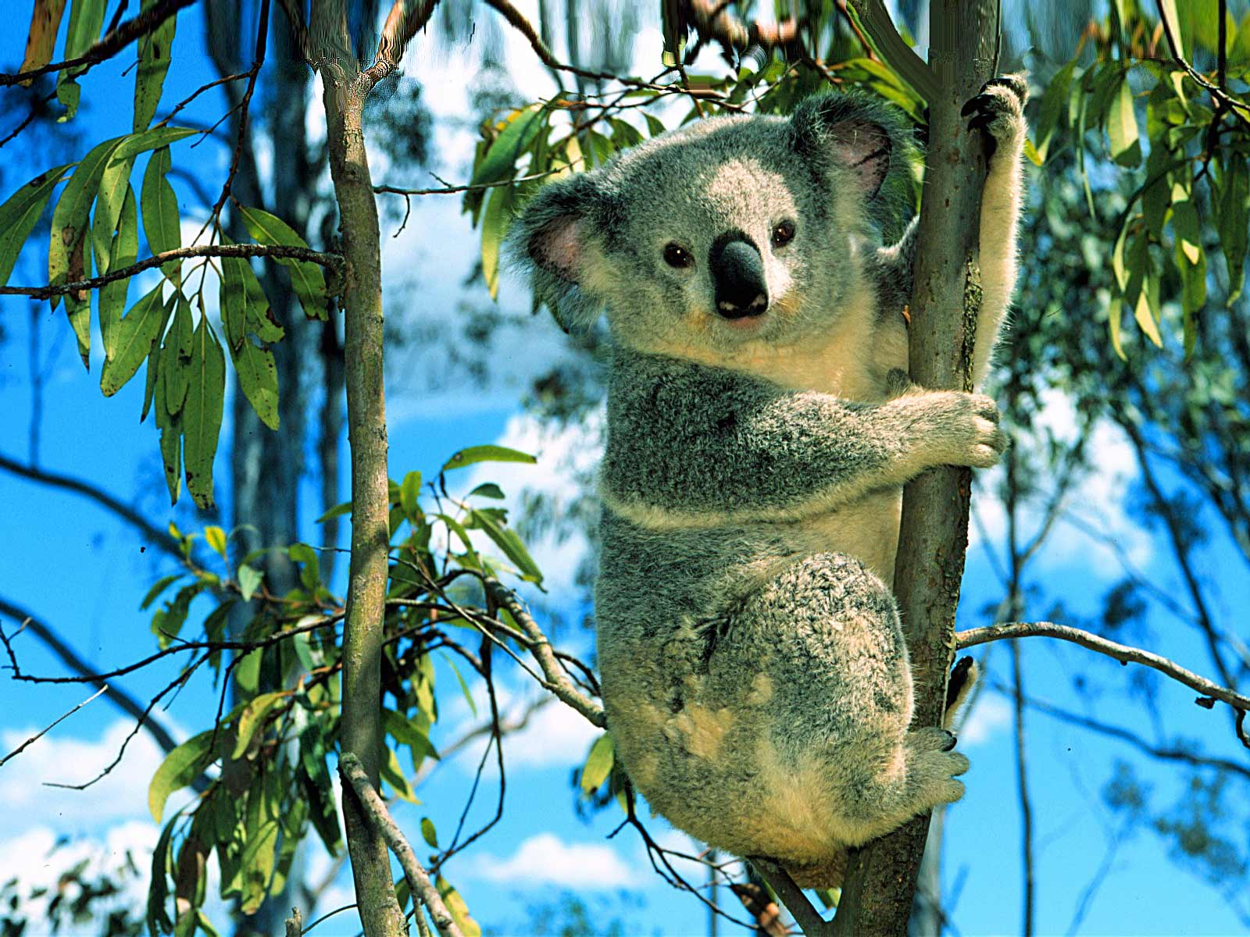
Topic 5: 200
Question:
What is this animal?
Answer
Koala
Back

Slide 24
Topic 5: 400
Question:
What animal lives only on Tasmania?
Answer
Tasmanian Devil
Back

Slide 25
Topic 5: 600
Question:
Out of all the Team 6C students who gave their best Aussie accent, who did Mr. S think was the best?
Answer
Shanton
Back

Slide 26
Topic 5: 800
Question:
In what city is the Australian national capital?
Answer
Canberra
Back

Slide 27
Topic 5: 1000
Question:
Aussie! Aussie! Aussie!
Answer
Oi! Oi! Oi!
Back

Slide 28
Bonus Question: 5000 pts.
Question:
You can ask a question here, Since this is the Bonus Q. it should be the hardest question.
Answer
…
(The answer here!)
Back

Slide 29
Daily Double
The Winner Of The Last Round
Write Down How Much Money
You Are Willing To Risk
If You get the Question write you win that money
If you get it wrong you Loss the money!

Slide 30
Daily Double
The Winner Of The Last Round
Write Down How Much Money
You Are Willing To Risk
If You get the Question write you win that money
If you get it wrong you Loss the money!

