Slide 1
Early Civilizations
of
Latin America
Part One

Slide 2
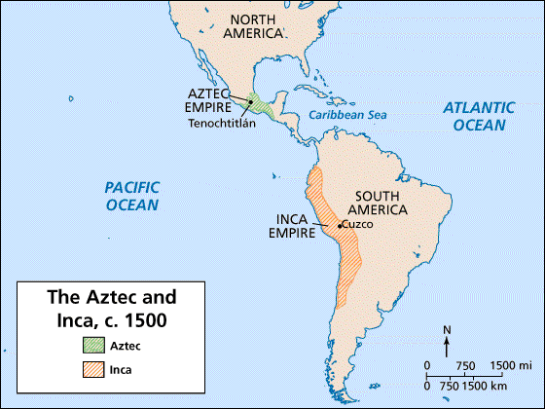

Slide 3
The Aztecs

Slide 4
Aztec Civilization
Aztecs arrived in the Valley of Mexico in 1100s (central Mexico, including present day Mexico City).
They wandered about looking for a home site until 1325.
Aztecs finally settled on an island in the middle of Lake Texcoco.
They built a magnificent city called Tenochtitlan (now Mexico City).

Slide 5
Aztec Temple

Slide 6
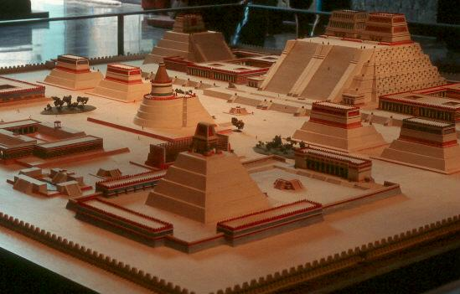
Diorama of Tenochtitlan

Slide 7
Tenochtitlan
This was the Aztec’s capital.
It was created in the center of a lake!
They built floating islands called “chinampas” by piling rich earth from the bottom of the lake onto rafts made of wood.
Roots of plants grew down to bottom, anchoring the rafts .

Slide 8
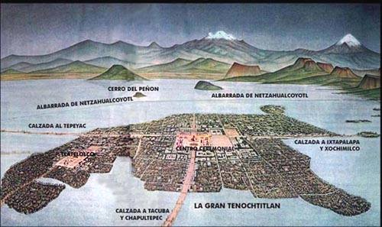
Tenochtitlan

Slide 9
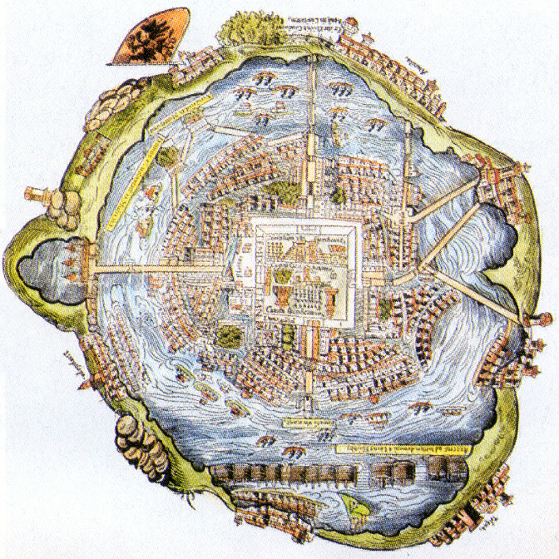

Slide 10
Chinampas

Slide 11
Expanding Empire
In the 1400s, Aztec warriors began conquering other people.
They made them pay taxes; noble Aztecs grew rich.
Aztecs had an emperor; the nobles and priests helped the emperor—all were very wealthy.
Not everyone was rich—most people were farmers.

Slide 12
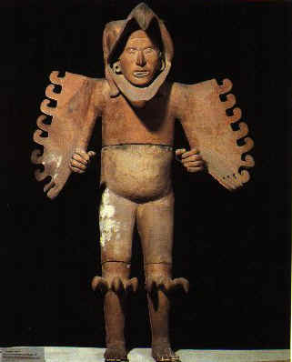
Eagle Warrior
Sculpture

Slide 13
Men’s Work
The Aztec were very involved in agriculture.
They used chinampas (man-made floating islands) to grow crops of vegetables, flowers, grasses, and medicinal plants.
They also hunted and fished.

Slide 14
Women’s Work
The Aztec women spent the day taking care of the children, cooking, knitting, and doing housework.

Slide 15
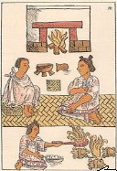
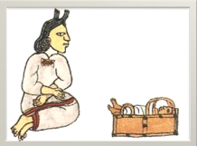
Women’s Work

Slide 16
Achievements
Doctors developed 1,000s of medicines from plants.
Astronomers predicted movements of the planets; designed an accurate calendar!
Priests kept extensive records using hieroglyphics.
Schooling - Boys studied either religion or military skills; girls learned cloth spinning and cooking.

Slide 17
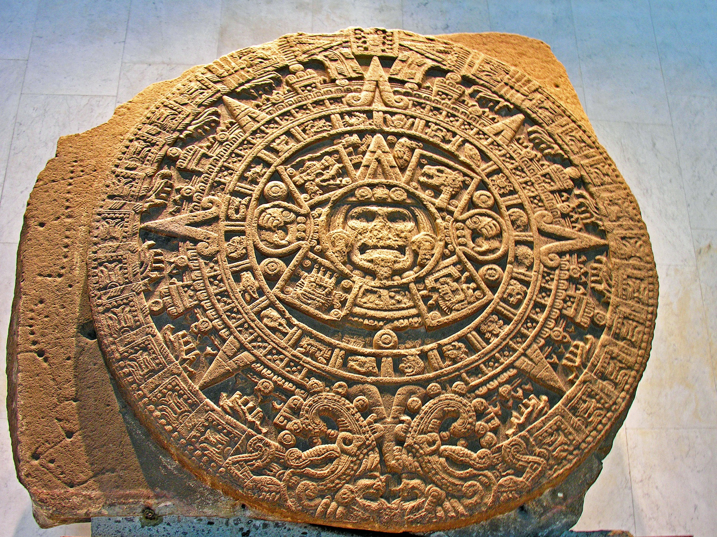
Aztec Sun Stone (Calendar)

Slide 18
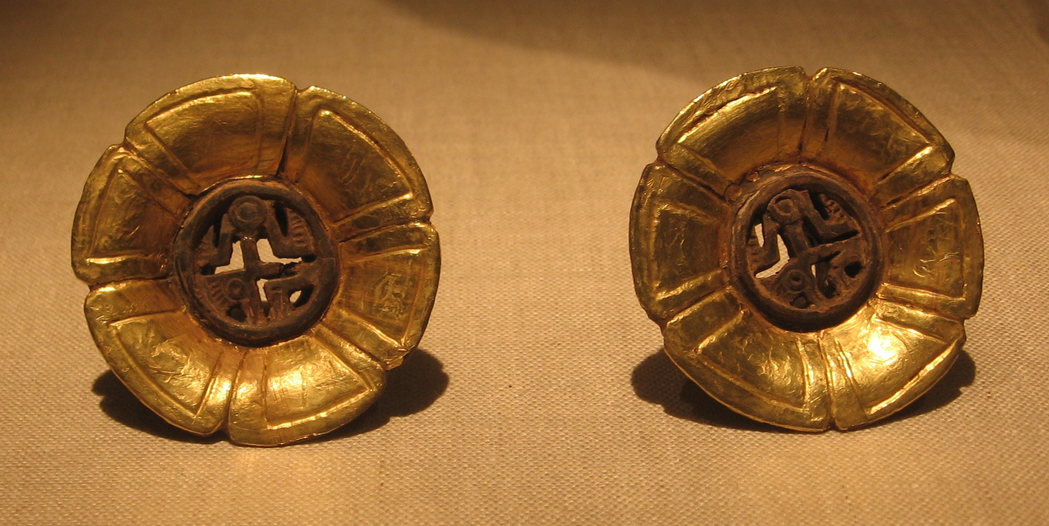
Aztec Golden “Ear Flares”

Slide 19
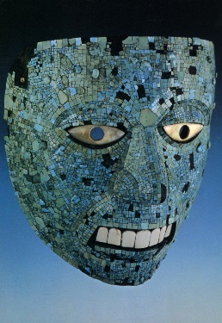
Mosaic Mask Inlaid
with Turquoise

Slide 20
Discipline
How did the Aztecs discipline children?
Some punishments included making them inhale smoke, holding them over fire in which spicy peppers where thrown, and puncturing their skin with thorns!
Maybe that’s what made the warriors so tough!

Slide 21
Aztec Discipline

Slide 22
Religion
Cities were religious centers; they worshipped their gods in pyramid-shaped temples.
Sacrifice was an important part of the religious ceremonies (meant to honor the gods).
Polytheistic (worshipped many gods): Sun, Death, Maize, Rulers, Rain, etc.

Slide 23
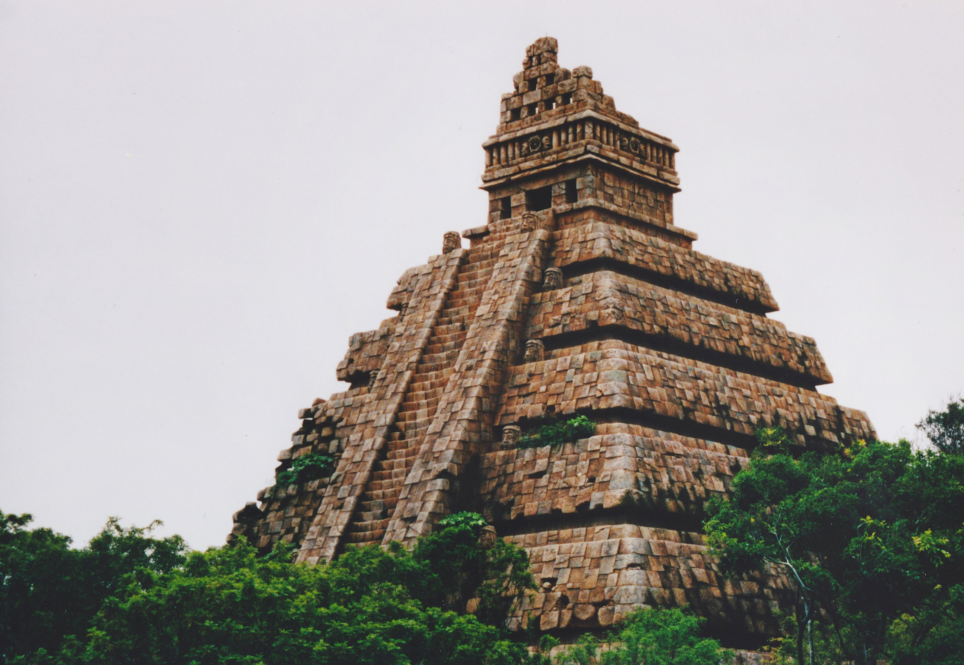
Aztec Temple

Slide 24
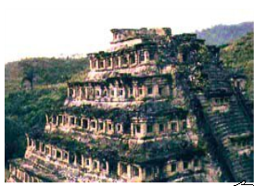
Temples
Instead of tearing down old temples, Aztec would just keep adding levels to the existing one.
This one was built over 6 times!
Rooms for sacrificing are at the top.

Slide 25
Aztec Temple

Slide 26
Religious Ceremonies
The bath was an important part of daily life--not only to be cleaned, but also to be religiously purified.
Most homes had a steam room attached to living quarters.
Other religious ceremonies included human sacrifices:
usually children or prisoners of war
felt that human hearts and blood strengthened the gods

Slide 27
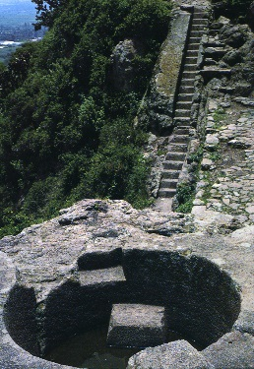
Aztec Bath

Slide 28
Aztec human sacrifice was on a greater scale than anywhere or any time in human history.

Slide 29
Be the Thing…
Your Task: Write a short personal response as if you were a specific object from history. Your response should include both emotional and physical feelings of the object. Imagine you are the thing!
Your Response Must:
-Be at least a paragraph in length.
-Describe the purpose and function of the object.
-Describe how the object might feel or what it might be thinking.
-Mention the Aztec civilization
Choose:
Chinampas, Temple, Calendar, OR do you have a better idea???

Slide 30
Example
I am a chinampa of the Aztec civilization. Every day I float on a lake and keep the city whole. I hate staying in place while I let plants grow through my face. Farmers come to harvest crops, only for me to feel the painful sting of having plants ripped off of me. Every time someone steps on me, I feel as if I will sink. This is another pain that I must face.

Slide 31
Example
I am the hat on the head of the highest priest in all of the Aztec race. Pretty much every week I have to witness the sacrificing of little innocent children, animals, and prisoners. I hate hearing the dreadful screams, cries, and pleas of the sacrifices. And then, eeeeeKKK!! I see a cherry red organ in my owner’s hand, rapidly dripping blood. After that, I hear the thumpity-thump of the sacrifice’s head rolling down each narrow stair step of the enormous temple. I myself am filled with grief. I think I am going to perch myself on top of one of the women that have to work in the house all day. At least I know the only thing they are killing is dinner…

Slide 32
The Inca

Slide 33
Rise of the Inca
In 1200 AD, Incas settled in Cuzco, a village in the Andes Mountains (now in Peru).
Most were farmers.
In 1438 AD, Pachacuti became ruler of the Incas and conquered more lands/people.
The empire stretched 2,500 miles and ruled 12 million people.
They used runners to spread news—at a rate of 250 miles a day!

Slide 34
Aztec Temple

Slide 35
Aztec Temple
Machu
Picchu

Slide 36
Cuzco
The jaguar was an important symbol to the Incans.
Cuzco (capital city) was built in the shape of a jaguar!

Slide 37
Aztec Temple

Slide 38
Accomplishments
They were excellent farmers, builders, and managers.
Roads and aqueducts:
Incans built more than 19,000 miles of roads (over mountains)!
They also built canals and aqueducts to carry water to dry areas.
aqueduct—pipe or channel designed to carry water to a distant source; irrigates dry land

Slide 39
Aztec Temple

Slide 40
Aqueduct

Slide 42
Accomplishments
Farming:
The Inca cut terraces into the Andes to create farmland.
They developed a large variety of foods.
They also discovered ways to store and preserve food.
The potato was a staple food (due to it being able to grow in the high altitudes of the Andes).
Other foods: tomatoes, maize, lima beans, peppers, grains

Slide 43
Aztec Temple
Terrace Farming

Slide 44
Aztec Temple
Terrace Farming

Slide 45
Architecture
Incan ruins are some of the most impressive works of architecture in the world.
They cut stone with such precisions that each block fit exactly with its neighbor.
The fit was so tight, even a thin knife wouldn’t fit in the cracks.

Slide 46
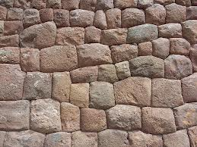

Slide 47
Aztec Temple

Slide 48
Aztec Temple

Slide 49
Record Keeping
The nobles conducted a census to count people so they could be taxed.
They did not have a written language.
They recorded information on knotted strings called quipus.
Each color represented a different item and knots of different sizes at different intervals stood for numbers.

Slide 50
Aztec Temple
Quipu

Slide 51
Religion
Like the Aztec, the Inca were also polytheistic.
The main god was the sun god.
Sacrifice was a big part of their religion—usually a white llama was used, but sometimes they sacrificed small children.
They also believed in reincarnation.

Slide 52
Sun God

Slide 53
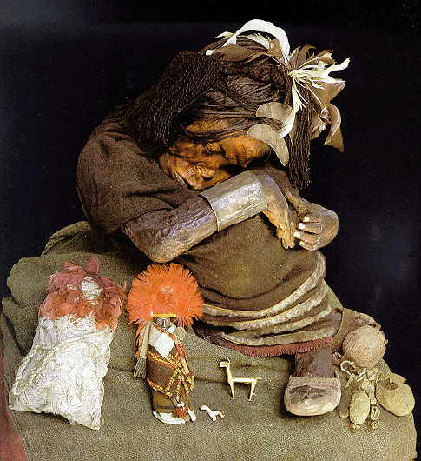
Incan Mummy
(Over 500 Years Old!)

Slide 54
History Advertisement
Your Task: Create an advertisement for a technological advance in the Inca civilization. This should be a 1 page advertisement that could be in a magazine or newspaper.
Advertisement must include:
Colorful drawing
Why people should be interested…
Price
List of what the item does
“Quote” from an Inca living at the time
Choose one of the following:
Quipu, terrace, jaguar, aqueduct, runner, better idea??

Slide 57
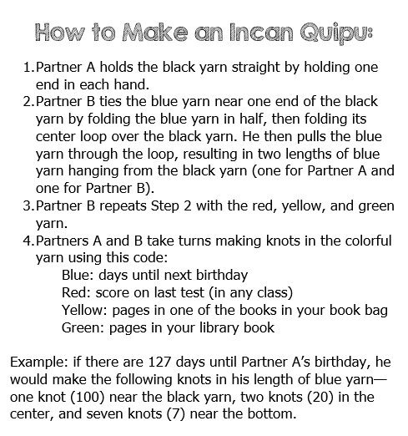

Slide 58
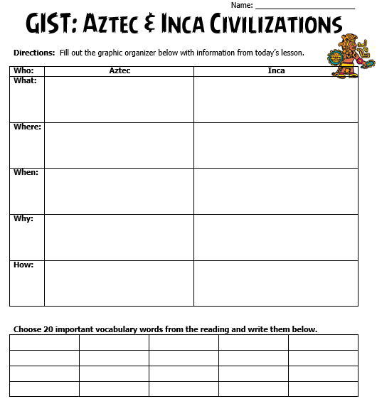

Slide 59
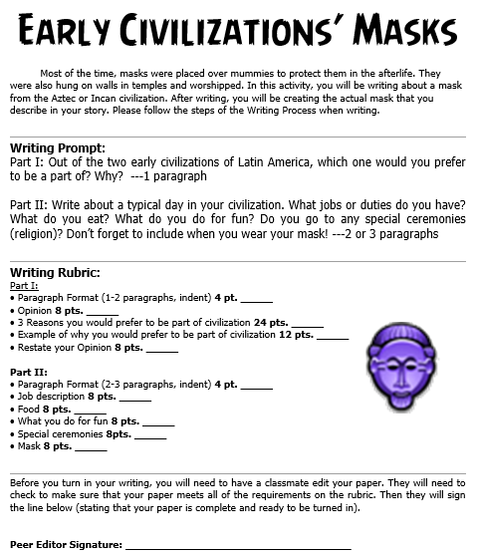

Slide 60
Part Two
Fall of the
Aztec & Inca Civilizations

Slide 61
Teachers
Print off the following page slide for each student. They should complete the chart while discussing the presentation.

Slide 62
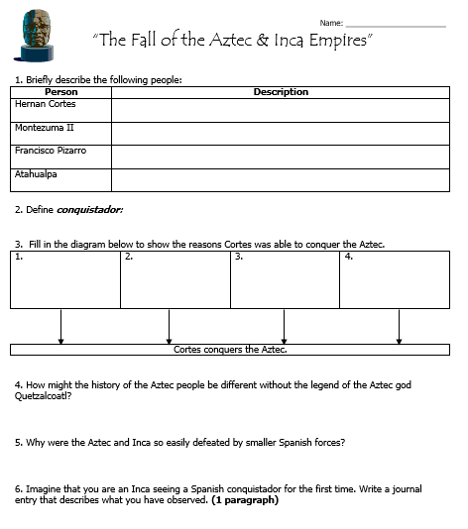

Slide 63
Fall of the
Aztec &
Incan Empires
Part Two

Slide 64
Let’s Review
Discuss with your Elbow Buddy:
Describe the Incan Empire.
Describe the Aztec Empire.
How are they similar and different?

Slide 65
Spain Vs. Portugal
Christopher Columbus asks both countries to sponsor his voyage--Spain agrees.
Portugal soon saw the wealth that Spain was gaining, and wanted to be part of the action.
The two countries became rivals and tried to stop each other from claiming land in the Americas.

Slide 66
Spain Vs. Portugal
In 1494, the countries signed Treaty of Tordesillas.
This set the Line of Demarcation (imaginary line from the North Pole to the South Pole at 50 degrees longitude).
Spain got everything to the west, while Portugal got everything to the east.
What language is spoken in most of Latin America today?
What language is spoken in Brazil?

Slide 67
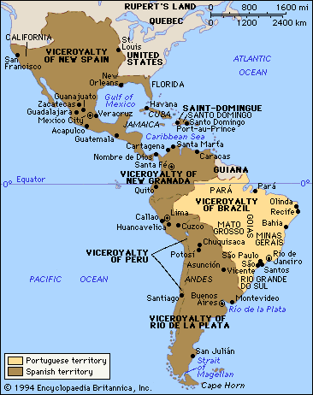
Aztec Temple

Slide 68
Spanish Conquistadors
“Conquistadors” = soldier-explorers who settled in the Americas in hopes of finding treasure
They were inspired by Columbus to seek fortune in the New World.
Many came from the part of Spain called Extremadura.
Poor soil, icy winters, & blistering hot summers held little chance for wealth.
Hernan Cortes and Francisco Pizarro were born in this province.

Slide 69
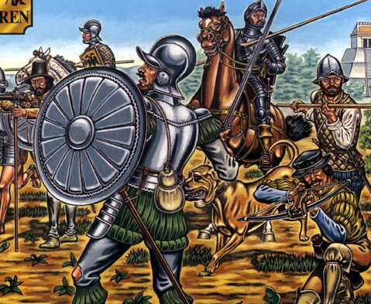
What are some words that describe us?
Aztec Temple
Terrace Farming

Slide 70
Fall of
the Inca

Slide 71
The Inca
In the 1530s, the Incan empire was HUGE!
Inca thought they ruled most of the world; two threats from the north soon proved they did not...
1.They couldn’t stop the spread of smallpox.
2. They couldn’t scare away Pizarro.

Slide 72
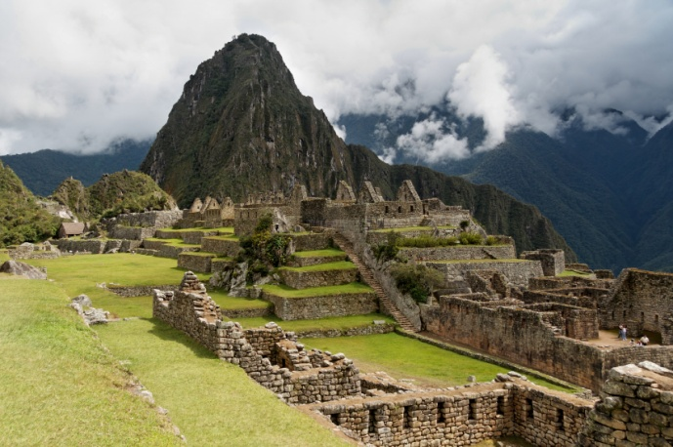
Aztec Temple
Terrace Farming

Slide 73
Francisco Pizarro
Pizarro was from the Extremadura.
He was not of noble birth; could not even write his name.
At age 16, Pizarro fled a job herding pigs in Italy.
In 1502, he arrived in the Americas and became very wealthy by exploring Panama.
He heard a rumor that there was a great empire filled with gold in the mountains of South America…

Slide 74
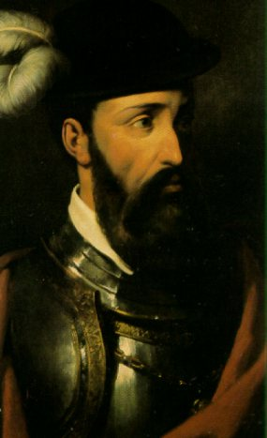

Slide 75
Pizzaro & the Inca
Pizarro led 160 soldiers to the Incan homeland.
They raided Incan storehouses & fired guns at villagers.
Incan emperor, Atahualpa, thought Pizarro was crazy. How could he stand up to an army of 80,000 Incan warriors?
In 1532, Pizarro came up with a plan to defeat the Inca...

Slide 76
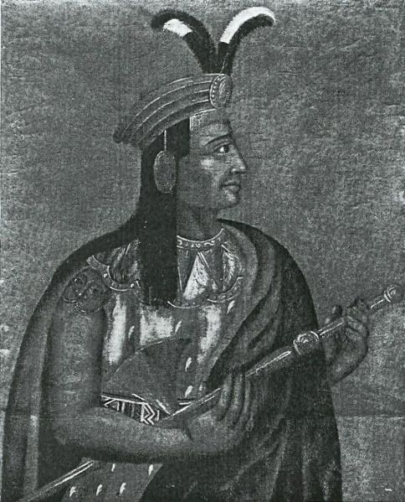
Atahualpa

Slide 77
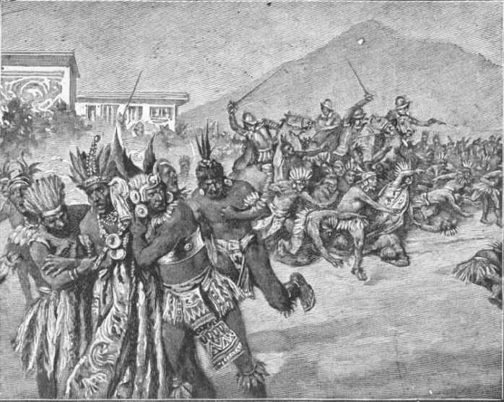
Aztec Temple
Terrace Farming

Slide 78
Pizzaro Defeats the Inca
Spanish messengers invited Atahualpa to a meeting.
He agreed & left most of his army behind--brought only 5,000 bodyguards.
Pizarro’s 160 soldiers attacked the Inca & kidnapped Atahualpa.
Pizarro offered to free Atahualpa if he filled one room with gold & one with silver.
Atahualpa kept his end of the bargain, but Pizarro killed him in 1533.

Slide 79
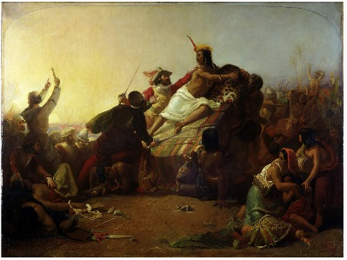
Aztec Temple
Terrace Farming

Slide 80
After Conquering the Inca
The Spanish king made Pizarro the governor of Peru.
Pizarro’s conquest of Peru opened most of South America to Spanish rule.
Spain controlled a vast territory covering 375,000 miles with almost seven million inhabitants.

Slide 81
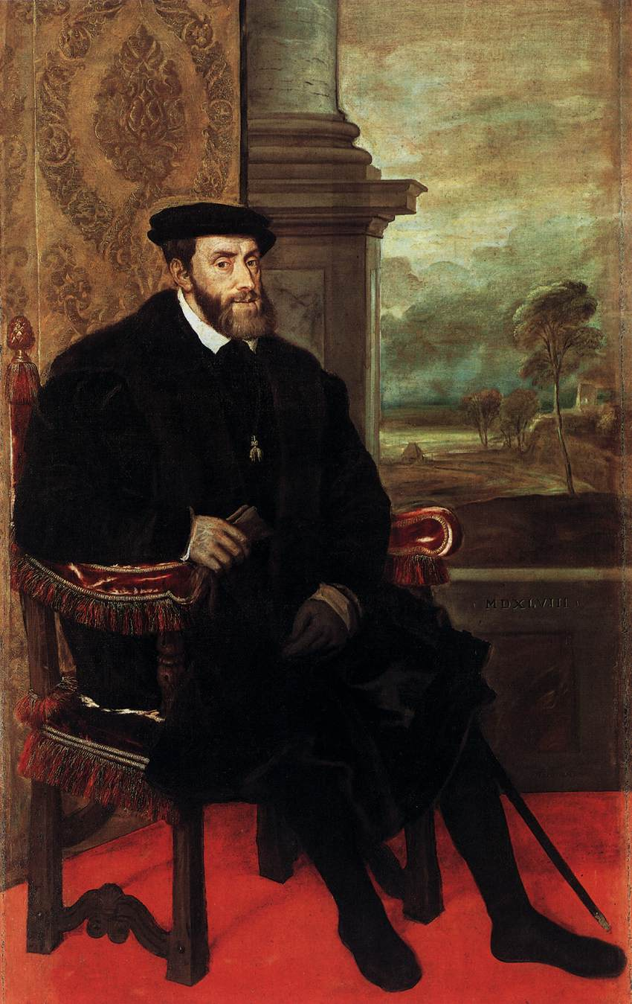

Slide 82
Fall of
the Aztec

Slide 83
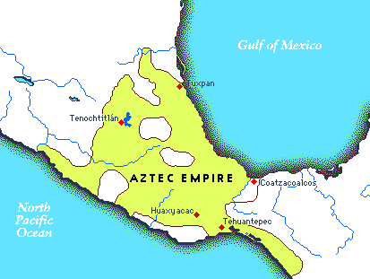

Slide 84
Hernan Cortes
Cortes was a Spanish conquistador who reached Mexico in 1519 in search of treasure.
He arrived in Mexico with only 550 soldiers, 16 horses, 14 cannons, & a few dogs.
His group was met by Aztec emperor, Montezuma II…

Slide 85
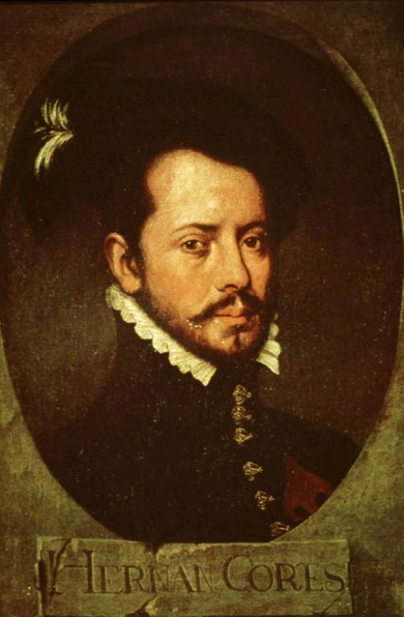

Slide 86
Cortes Invades Mexico
How could such a small force conquer a huge empire?
1. Cortes knew how to use Spanish horse and guns to shock Aztecs.
2. Malintzin (a Mayan woman) gave Cortes the inside scoop on the Aztec empire & helped him form alliances against Montezuma.
3. Cortes had invisible help--diseases that killed more Aztecs than Spanish swords.
4. Montezuma believed Cortes to be Quetzalcoatl--an important Aztec god.

Slide 87
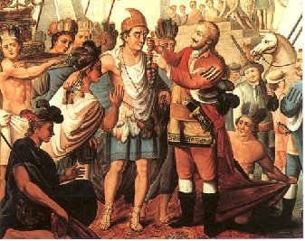

Slide 88
Cortes Defeats Aztecs
Cortes traveled 400 miles to reach Tenochtitlan.
Montezuma did not attack right away because he first thought Cortes was Quetzalcoatl.
The Spanish were able to take control of the city & took Montezuma hostage.
Cortes ordered the Aztec to stop sacrificing people.

Slide 89
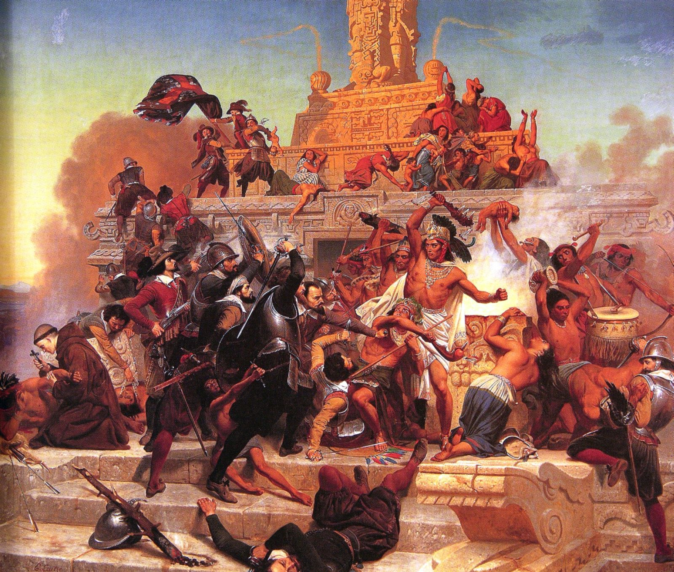
Aztec Temple

Slide 90
Cortes Defeats Aztecs
Cortes’ orders angered the Aztecs, so they planned a rebellion.
Fighting broke out & Montezuma was killed.
The Spanish were outnumbered, so they fled the city.
Before they could prepare a 2nd attack, smallpox broke out in Tenochtitlan & greatly weakened the large Aztec empire.
In 1521, the Spanish destroyed the Aztec capital.

Slide 91
After Conquering the Aztec
Cortes took part in one more expedition to Honduras.
He served as Governor General of New Spain.
He returned to Spain a very wealthy man.
He died in Seville, Spain in 1547.

Slide 92
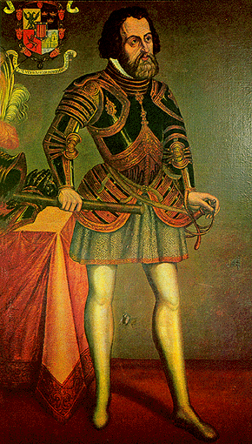

Slide 93
Aztec Civilization Recipe
Your Task: Write a “recipe” for the Aztec civilization.
Include the “ingredients” that went into forming that civilization.
Write the special instructions for bringing the “ingredients” together.

Slide 94
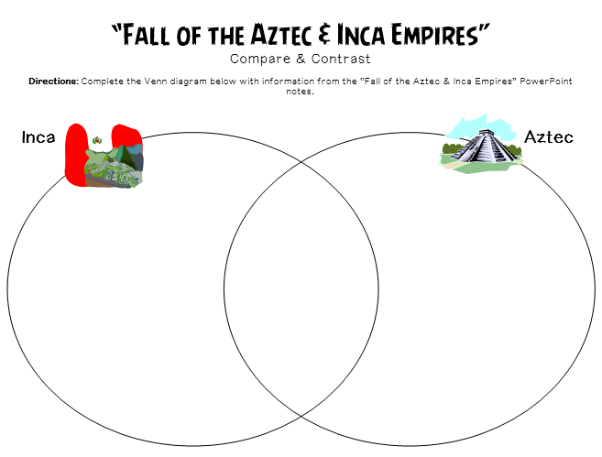

Slide 95
HIS-story
Your Task: Imagine that you are one of the following men: Hernan Cortes, Montezuma, Francisco Pizarro, or Atahualpa.
Write a journal entry that details the experience of the man on the day that the corresponding civilization fell.

Slide 96
Teachers
Alphabet Sentences:
Place alphabet letters into a container and have each student draw one letter from the container.
Tell students to create a sentence that begins with that letter to summarize either the Aztec or Incan civilization.
Allow students to share their sentences.
Have the class determine whether the sentence was written for the Aztecs or the Incas.
(Note: You may want to exclude letters that may be difficult for students to use at the beginning of their sentences.)

Slide 97
Alphabet Sentences
Your Task:
Draw one letter from the container.
Write a sentence that begins with that letter to summarize either the Aztec or Incan civilization.
Next, you will share your sentence.
Finally, The class will determine whether the sentence was written for the Aztecs or the Incas.

Slide 98
Teachers
Cut out the cards below and tape them on students’ backs. The students will walk around the classroom and “collect” clues from other students until they can guess the name on the card.

Slide 99
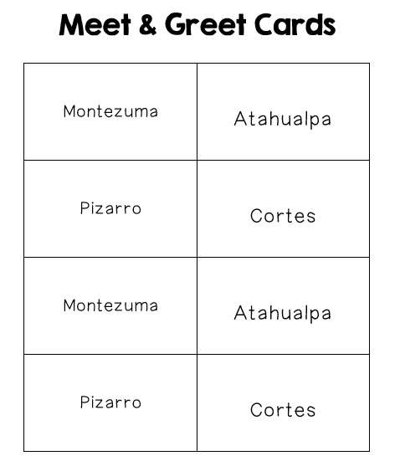

Slide 100
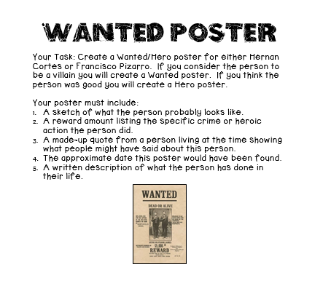

Slide 102
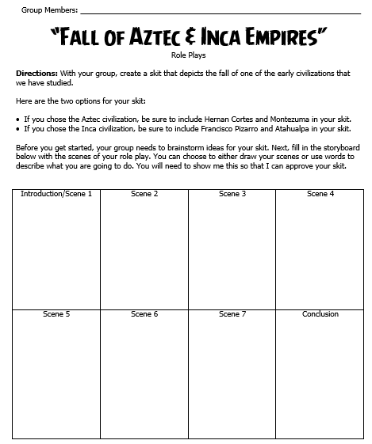

Slide 103
Teachers
Thank you for downloading this file. I hope you enjoy using it with your students, and I can’t wait to read your feedback in my TPT store! ☺
For more social studies materials, please visit my store: http://www.teacherspayteachers.com/Store/Brain-Wrinkles
I teach 6th grade Language Arts and Social Studies in Georgia, so my products are aligned with Common Core (LA) and Georgia Performance Standards (SS).
© Copyright 2013. Brain Wrinkles. All rights reserved. Permission is granted to copy pages specifically designed for student or teacher use by the original purchaser or licensee. The reproduction of any other part of this product is strictly prohibited. Copying any part of this product and placing it on the Internet in any form (even a personal/classroom website) is strictly forbidden. Doing so makes it possible for an Internet search to make the document available on the Internet, free of charge, and is a violation of the Digital Millennium Copyright Act (DMCA).

Slide 104
Credits:
All photos were found via Creative Commons and labeled for reuse.
Fonts:
Backgrounds & Graphics:

