Slide 1
The Aztecs and the Incas: Spanish Invasion
SS6H1: Describe the encounter and consequences of the conflict between the Spanish and the Aztecs
and Incas and the roles of Cortes, Montezuma, Pizarro, and Atahualpa

Slide 2
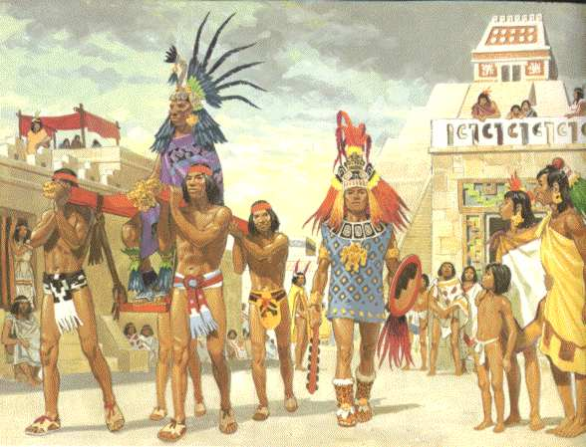
Aztecs
Rulers: Montezuma II
Location: Central America/ Mexico
Achievements: Floating Gardens, Gold, Canals, Corn farming
Consequences of Spanish Invasion: Rulers were killed, people enslaved, city destroyed, gold taken.

Slide 3
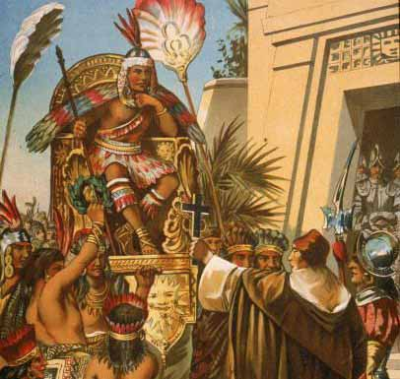
INCAS
Rulers: Atahualpa
Location: Western coast of South America (Peru, Bolivia, Chile, Ecuador, Argentina)
Achievements: Terrace farming, Roads, Stairs, Stonework
Consequences of Spanish Invasion: Cities, Art, temples, language, customs, and culture destroyed. People enslaved. Religion abandoned.

Slide 4
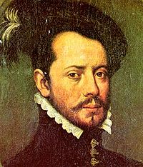
Hernán Cortés
Role in Spanish Invasion:
Rich and powerful Spanish explorer & soldier
Conquered the Aztecs
Burned all his ships so his men would not try to leave. He wanted success or death to be the options.
- Destroyed capital city of Tenochtitlan and built Mexico City in its place.

Slide 5
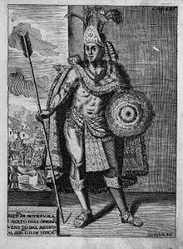
Montezuma II
Role in Spanish Invasion:
Aztec leader
said to believe the Spanish
were gods upon arrival.
- Gave them gifts of gold.
Held hostage by Cortes in his own palace.
Later killed when battle broke out between Aztec warriors and Spanish troops.

Slide 6
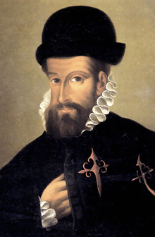
Francisco Pizarro
Role in Spanish Invasion:
Spanish explorer and soldier
conquered the Incas
Killed Atahualpa
He grew wealthy by taking gold and silver from the Incas
Later killed in an attack when men tried to take over his palace in Peru.

Slide 7
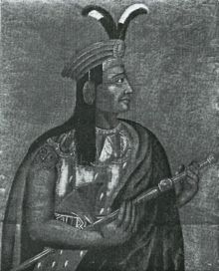
Atahualpa
Role in Spanish Invasion:
Sapa Inca
Captured and held for ransom by Pizarro for gold.
24 tons of gold and silver were brought by the Incas in exchange for his life.
Ordered to death by Pizarro
and the Inca empire ended.
Notes:
Sapa Inca: thought to be a living descendant of the sun god.

