Slide 1
Introduction to the provinces and territories of Canada

Slide 3
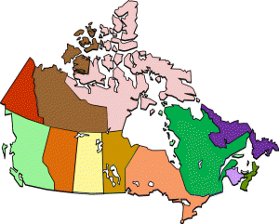
10 Provinces
Alberta
British Columbia
Manitoba
New Brunswick
Newfoundland
Nova Scotia
Ontario
Prince Edward Island
Quebec
Saskatchewan

Slide 4
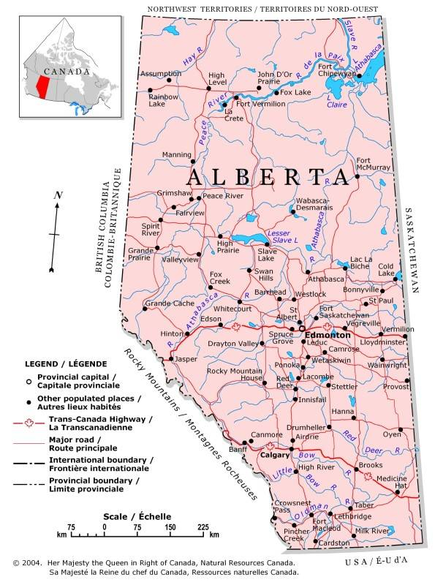
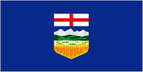
Alberta
Alberta is a western Canadian prairie province and home of the Calgary Stampede. Rich in oil and gas resources, Alberta has supported conservative political parties since the 1920s.
Major industries: Agriculture, forestry, telecommunications and oil and gas

Slide 5
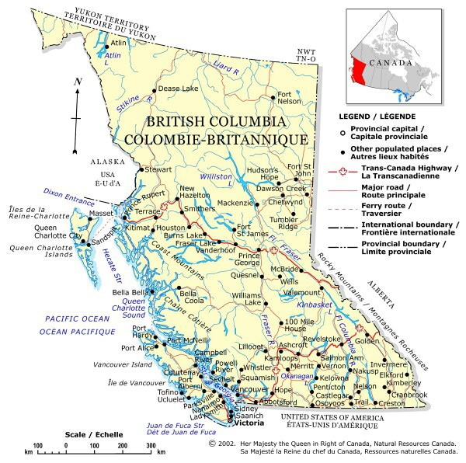
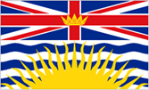
British Columbia
On the west coast of Canada, British Columbia is the third largest Canadian province. British Columbia has three main mountain ranges and is two-thirds covered in forest.
Major industries: Forestry, mining, fisheries, agriculture, energy, and transportation

Slide 6
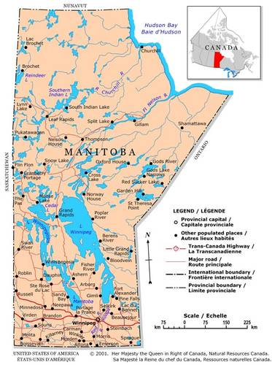
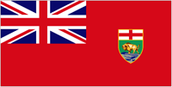
Manitoba
Manitoba, a prairie province in the heart of Canada, is called the "Land of 100,000 Lakes." Manitoba has a diversified economy, led by manufacturing, then agriculture, hydroelectricity and mining.
Major industries: Manufacturing, agriculture, hydroelectricity and mining

Slide 7
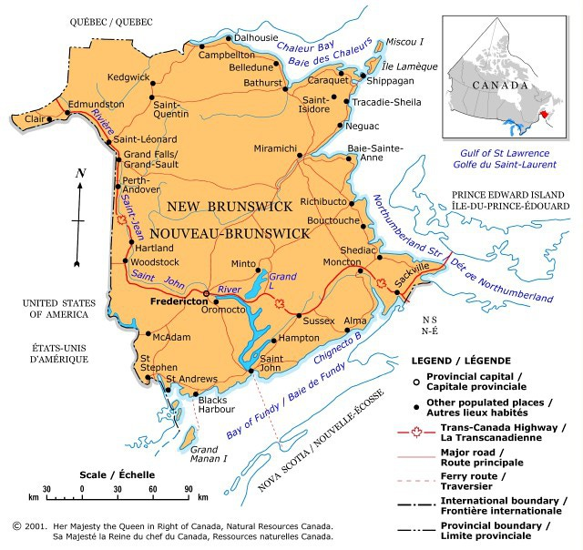
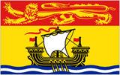
New Brunswick
One of the original provinces of Canada. New Brunswick has eight major cities, including Fredericton, its capital.
Highest and wildest tides in the world
More kinds of whales more often than anywhere else in the world

Slide 8
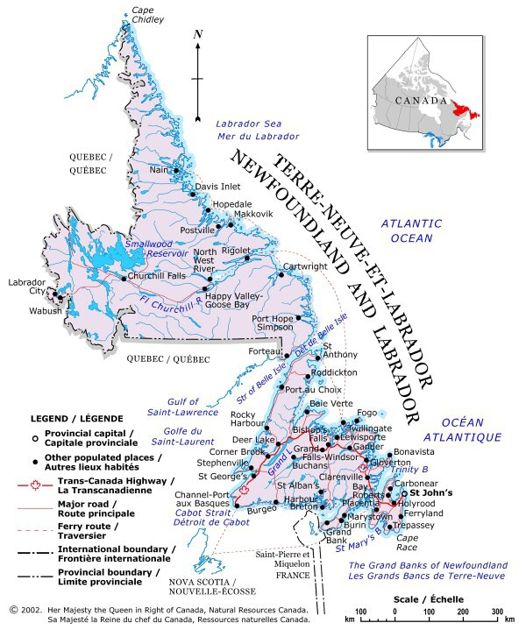
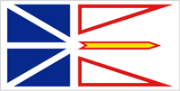
Newfoundland & Labrador
Newfoundland and Labrador tends to attract a more adventurous, outdoorsy type of visitor. Not that you can't find fine dining or a boutique hotel, but the major attractions of Newfoundland and Labrador are the natural surroundings, which are gorgeous, and the people, who are laid back and not pretentious.
Some of the most popular things to do in Newfoundland and Labrador include scenic drives, whale watching, iceberg viewing, bird watching, kayaking, camping and enjoying a sundowner with your mates at the end of the day.

Slide 9
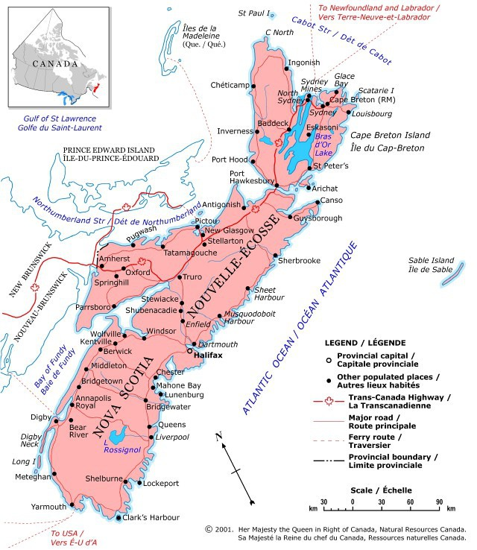
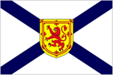
Nova Scotia
A founding province of Canada, Nova Scotia is nearly surrounded by the Atlantic Ocean, and is known for its high tides, lobster, fish, blueberries and apples.
Major industries: Manufacturing, agriculture, fisheries, mining, forestry, transportation, energy

Slide 10
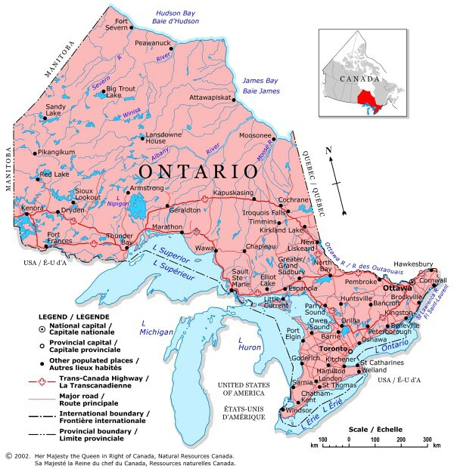
Ontario
Ontario is the second largest province in Canada and about a third of Canada's population lives here. The economy in northern Ontario centers on natural resources, especially forestry and mining. The south is heavily industrialized, serving both Canadian and U.S. markets. Ontario accounts for about a quarter of all farm revenue in Canada, and service industries are also growing rapidly.

Slide 11
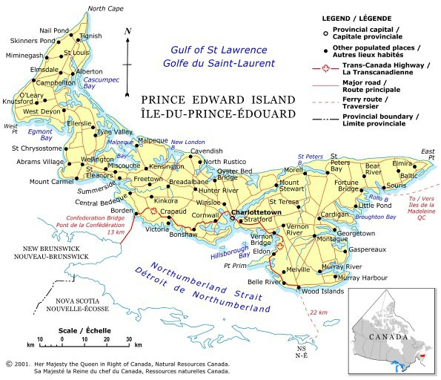
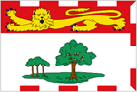
Prince Edward Island
The smallest province in Canada, Prince Edward Island is famous for red sand beaches, red soil, potatoes, and the irrepressible Anne of Green Gables. It also is known as the "Birthplace of Confederation." The Confederation Bridge which joins Prince Edward Island to New Brunswick takes just ten minutes to cross, with no wait times.

Slide 12
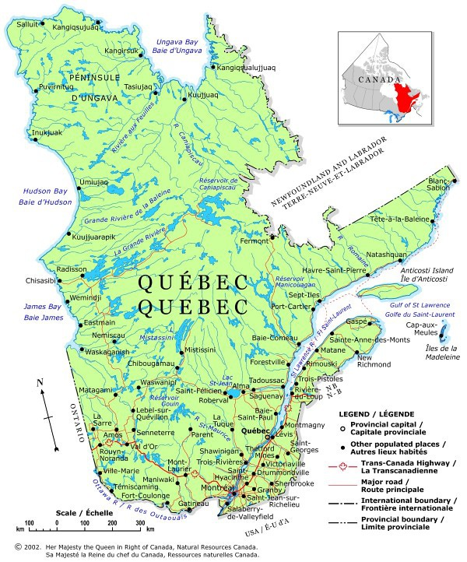
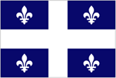
Quebec
Quebec is the largest Canadian province in area, and the second largest in population. Quebec is a mainly French-speaking society. The citizens defend its language and culture.
Major industries: Agriculture, manufacturing, energy, mining, forestry, transportation

Slide 13
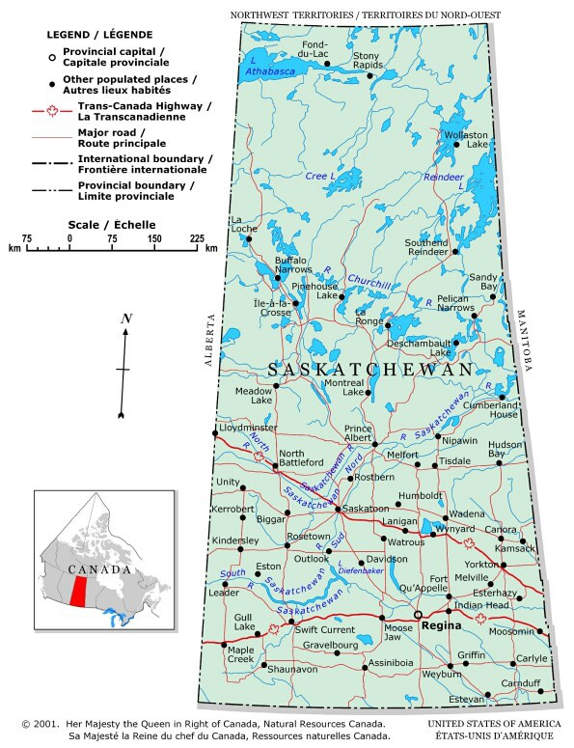
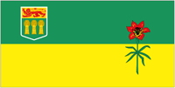
Saskatchewan
The prairie province of Saskatchewan produces more than half of the wheat grown in Canada. Saskatchewan is the birthplace of Canadian Medicare and home of the RCMP (Mounty) training academy.
Major industries: Agriculture, services, mining

Slide 14
3 Territories
Northwest Territories
Nunavut
Yukon

Slide 15
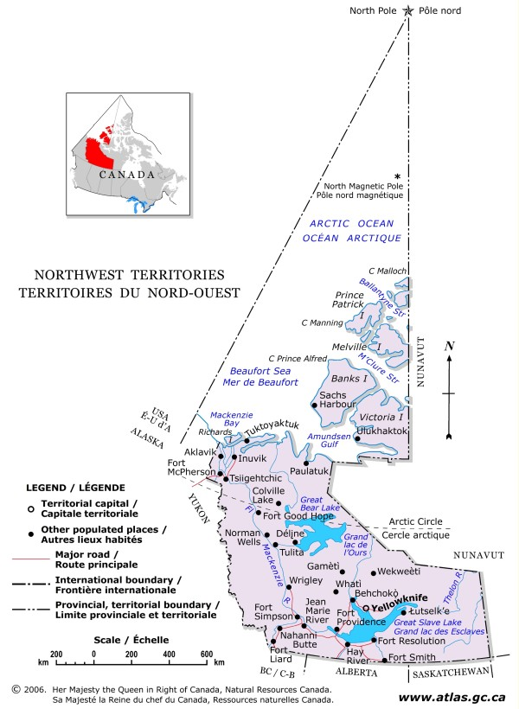
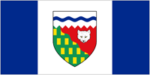
Northwest Territories
The Northwest Territories in the western Arctic of Canada has a consensus system of government with no political parties. Mining, tourism and government are the key sectors in the Northwest Territories economy.

Slide 16
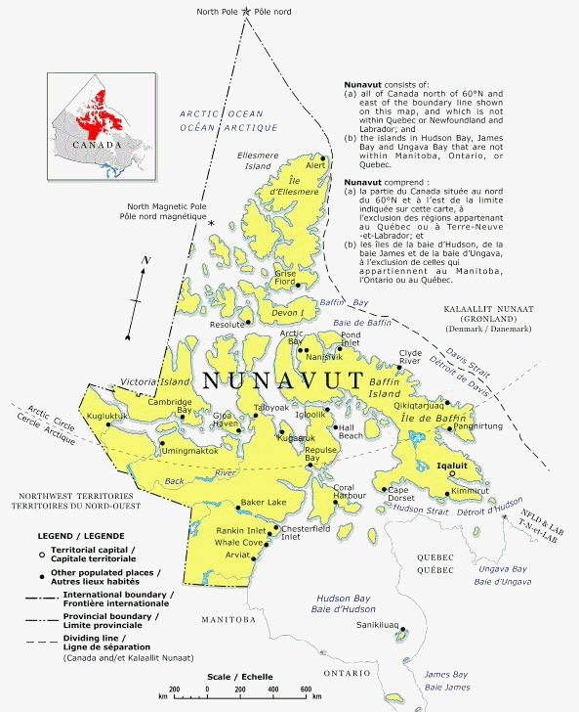
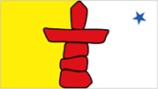
Nunavut
In 1999 Nunavut became the largest and newest territory in Canada. Formed from the eastern part of the Northwest Territories, this huge Canadian Arctic territory has just 30,000 residents, about 80 percent of whom are Inuit (First Nations peoples).

Slide 17
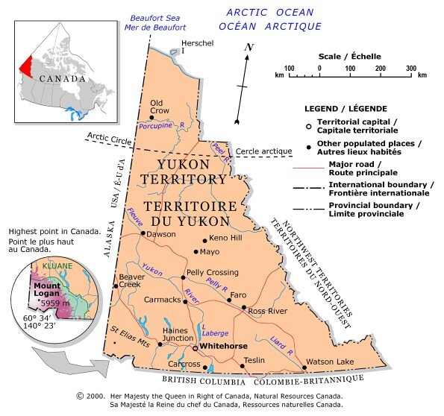
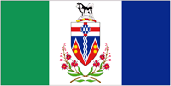
Yukon
About a fifth of Yukoners are of aboriginal descent and belong to one of 14 Yukon First Nations. More than 80 percent of Yukon is still wild, with majestic mountains, glaciers, rivers and exciting wildlife, including caribou, mountain sheep, grizzly bears and birds. Thousands of kilometers of highways provide some of the most spectacular drives in the country.

Slide 18
Now you must make a decision
Alberta
British Columbia
Manitoba
New Brunswick
Newfoundland & Labrador
Northwest Territories
Nova Scotia
Nunavut
Ontario
Prince Edward Island
Quebec
Saskatchewan
Yukon

