Slide 1
The
Creation
Israel
of
The Fall of the Ottoman Empire, Zionism, the Holocaust, & the Birth of a New Country

Slide 2
Standards
SS7H2 The student will analyze continuity and change in Southwest Asia (Middle East) leading to the 21st century.
a. Explain how European partitioning in the Middle East after the breakup of the Ottoman Empire led to regional conflict.
b. Explain the historical reasons for the establishment of the modern State of Israel in 1948; include the Jewish religious connection to the land, the Holocaust, anti-Semitism, and Zionism in Europe.
c. Describe how land and religion are reasons for continuing conflicts in the Middle East.

Slide 3
The
Creation
Israel
of
The Fall of the Ottoman Empire, Zionism, the Holocaust, & the Birth of a New Country

Slide 4
Ottoman Empire
The Ottoman Turks began as small warrior bands that raided villages on the Byzantine frontier.
They eventually developed into one of the largest and longest standing empires in the world.
The Ottoman Empire was ruled by one family from 1299 CE until 1923 CE!
The Ottoman Turks were known for their ruthless pursuit of land.
At its height, the Ottoman Empire’s lands stretched from Yemen, to Hungary, to Persia, and as far north as Russia.

Slide 5
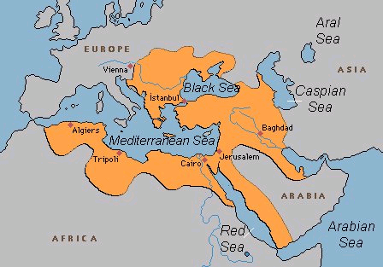
Ottoman Empire – 1500s to 1918

Slide 6
Ottoman Empire
The Ottoman Turks were very wealthy.
They gained their wealth through trade and taxation.
They controlled most of the sea trade with their navy.
They taxed their people heavily, especially Jews and Christians because they did not practice Islam.
The Turks were well known for their incredible architecture and art.
The Mosque of Suleiman is still one of the most beautiful buildings in all of Istanbul.

Slide 7
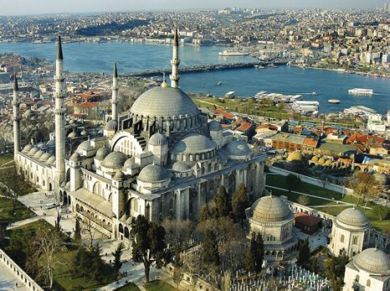
Mosque of Suleiman

Slide 8
Ottoman Empire
Over time, the Ottoman sultans were not very capable of ruling and the empire began to decline.
During World War I, the Ottoman Empire sided with the Central Powers. Bad idea…
After the war, the government collapsed and the land of the former Ottoman Empire was divided among the victorious European countries:
France: Syria, Lebanon, Algeria, Morocco, Tunisia
Great Britain: Egypt, Sudan, Jordan, Palestine
Italy: Libya

Slide 9
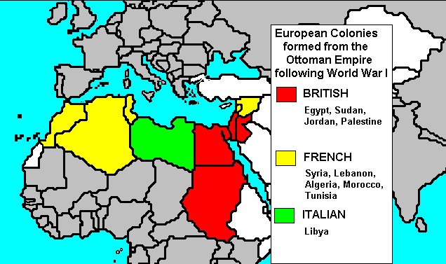

Slide 10
New Borders
As the European countries divided the land, they drew borders that were not based on ethnic or religious groups or historical boundaries.
This caused some ethnic and religious groups to be separated by boundaries, while grouping other groups together.
This causes future conflicts that are still occurring today.

Slide 11
Britain’s Involvement
During World War I, Great Britain realized that it needed to protect its connection to India.
The British promised the Arabs their own state (stretching from Syria to the Arabian peninsula) if they helped defeat the Ottomans.
At the same time, Britain was also making promises with the Jews.
In the Balfour Declaration (1917), the British promised their support for the establishment of a Jewish homeland in Palestine.
In 1918, the Ottoman Empire collapsed and the Arab sections of the empire were taken over by Great Britain and France.

Slide 12
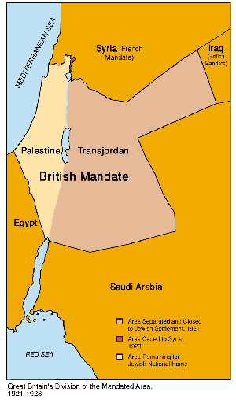

Slide 13
Palestine
Great Britain officially took control of Palestine as a mandate (similar to a colony).
Arabs felt betrayed that they were not given the area like they were promised, especially since they made up the largest part of the population.
Under British occupation, the number of Jewish settlers increased greatly.
In 1920, there was 1 Jew to every 10 Arabs. By 1947, there was 1 Jew for every 2 Arabs.
The Arabs felt that they were loosing control of their land.
As Jewish immigration continued, tension between Arabs and Jews increased.

Slide 14
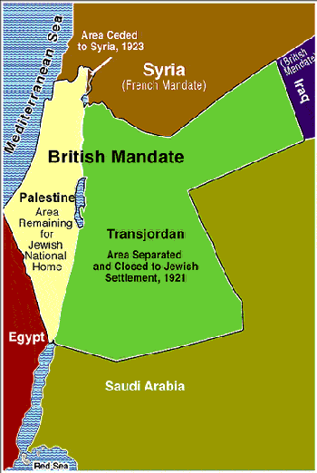

Slide 15
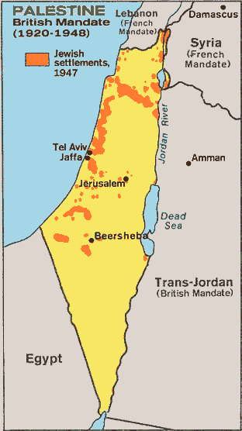

Slide 16
Zionism
Zionism was a movement to establish a Jewish homeland in Palestine.
During this time period, there was an increase in anti-Semitism (discrimination and violence towards Jews).
The Jewish people believed that this was a good time to return to Zion (the holy land).
Tens of thousands of Jews began moving to Palestine after the Zionist movement began in Europe.

Slide 17
Jewish Land
The Jewish connection with this land did not begin with Zionism, but actually dates back over 4,000 years.
According to Jewish and Christian sacred text, God commanded Abraham to leave his land in Mesopotamia and go to the land that is present-day Israel.
Jews believe that if any nation has a right to claim land, then they should be able to claim this area as their own country.
They argue that they did not leave the land voluntarily, but were forced out by Roman persecution.

Slide 18
Holocaust
More than six million Jews were killed in the Holocaust during World War II.
Anti-Semitism (discrimination against Jews) and the Holocaust led the Jewish people to seek a place of their own.
The Zionist movement gained more support from others around the world to create a Jewish homeland.

Slide 19
The Partition
In 1947, Great Britain asks the United Nations for help in dividing up the land that was promised to both the Jews and the Arabs.
The United Nations felt it was right to create a Jewish state in Palestine due to their suffering in the Holocaust.
Jews agreed, but Arabs vowed to do anything needed to prevent the U.N. plan from being carried out.
The Jews were outnumbered in Palestine, but their armies were much more advanced because of involvement in World War II.
Despite the bloodshed, the State of Israel was created on May 14, 1948.
That night, a combined Arab force of Egyptians, Iraqis, Jordanians, Syrians, Lebanese, Saudi, and Yemeni troops attacked…

Slide 20
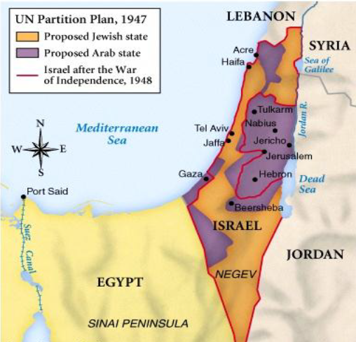

Slide 21
Arab-Israeli War
That night, a combined Arab force of Egyptians, Iraqis, Jordanians, Syrians, Lebanese, Saudi, and Yemeni troops attacked…
The Arab-Israeli War (or Israeli War for Independence) lasted for 8 months, during which time the Jews not only defended their land, but expanded the territory to include most of the lands the Palestinians had been offered and rejected.
The land Palestine lost was divided among their Arab neighbors, leaving Palestine with nothing.
This created over 780,000 refugees who were displaced.
Many of them left Israel, but some had nowhere to go and ended up in refugee camps along Arab borders.

Slide 22
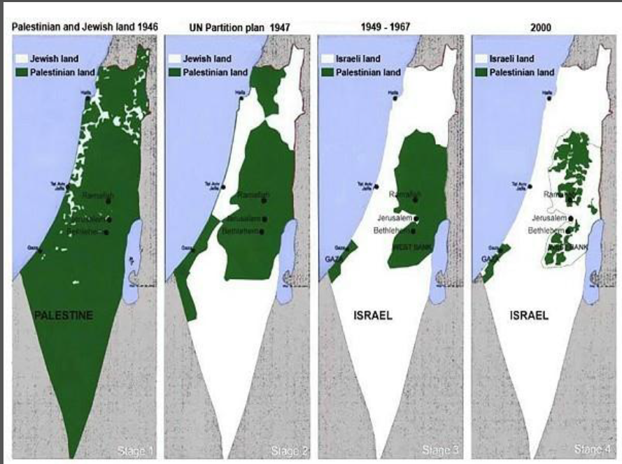

Slide 23
Arab-Israeli Conflict
CAUSES:
EFFECTS:
The Ottoman Empire fell apart.
Zionists supported the creation of a separate Jewish state.
Conflict broke out between Arabs and Jews.
Great Britain took control of Palestine.
The British pledged their support of the Zionists and creation of Israel.
The Arabs were displaced to West Bank and Gaza Strip.

