Slide 1
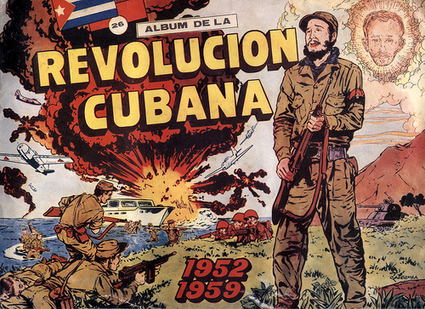
The Cuban Revolution

Slide 2
Background Info…
Cuba gained its independence from Spain in 1898.
In the 1900s, Cuba’s wealth was controlled by American companies.
  The main businesses in Cuba were sugar and mining companies.
The dictator of Cuba until 1959 was Fulgencio Batista.

Slide 3
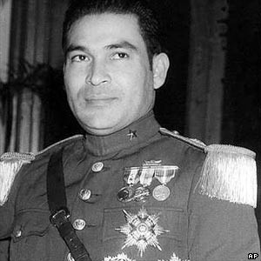
Fulgencio Batista

Slide 4
Cuban Revolution
Batista had originally been elected as president, but made himself dictator
Many people were unhappy with his rule:
  poverty, education was poor, and healthcare was limited
Batista also cancelled all free elections.
Fidel Castro led a group of rebels against Batista’s government.

Slide 5
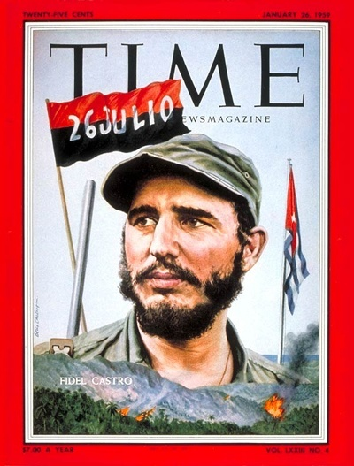
Fidel Castro

Slide 6
Cuban Revolution
Castro attempted to overthrow Batista’s government for seven years.
Castro and his “army” lost many battles to Batista – he was even arrested and sentenced to 15 years in jail!
Castro was released in 1955 after only two years and fled to Mexico to put together a new group of rebel fighters.
He defeated the Batista government and made himself dictator of Cuba in 1959.
  The US originally backed Castro because he promised to make the country a democracy.
  US sent him supplies to help defeat Batista.

Slide 7
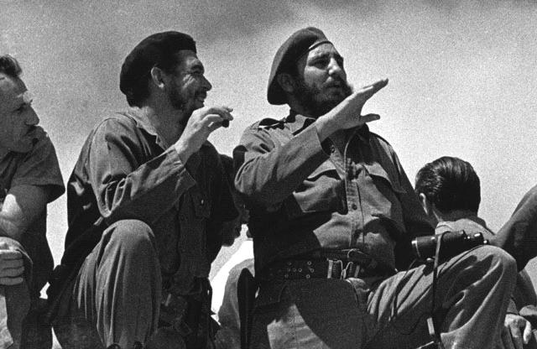
Fidel Castro (right)

Slide 8
Castro’s Government
Castro began organizing a communist government right away:
  declared all property belonging to Americans now belonged to the government
  all farms, factories, & businesses now belonged to the government
  Cubans no longer had the right to protest against the government
  Cuban newspapers, radio, & TV were shut down
    government became only source for news
  churches were closed & property was taken over by government

Slide 9
Cuba Vs. US
Castro’s government & the US government did not get along so well.
US did not like having a communist country so close.
Americans who owned land/businesses in Cuba lost their property.
Castro forced American civilians to leave Cuba.
US did not like Cuba being “friends” with the Soviet Union (Cold War…).

Slide 10
Cuba: Bay of Pigs
The purpose was to overthrow Castro.
The plan was to arm Cuban exiles living in Florida.
  Once the exiles arrived in Cuba, unhappy Cubans would join them at the Bay of Pigs and overthrow Castro.
The invasion was a disaster because Castro’s forces intercepted the plan and captured the invaders.
  No rebellion against Castro occurred, but this sparked a deep hatred for US.

Slide 11
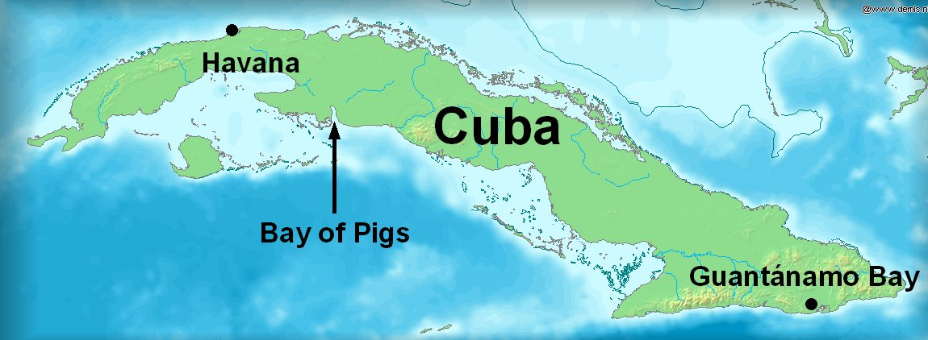
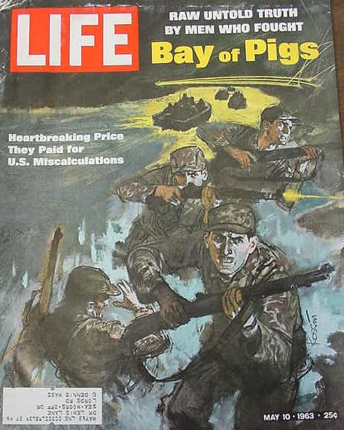

Slide 12
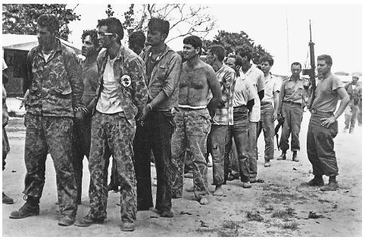
Captured During the Invasion…

Slide 13
Cuban Missile Crisis
In October of 1962, US planes spotted secret Soviet missile bases in Cuba.
  10/22: President Kennedy announced that the Soviets had placed long-range missiles in Cuba.
  Extremely TENSE time…could have led to WWIII
Resolution:
  President Kennedy agreed not to invade Cuba and to remove US missiles from Turkey; in return, Khrushchev agreed to remove the missiles from Cuba.

Slide 14
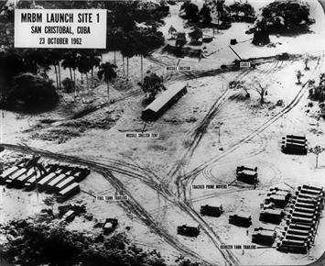

Slide 15
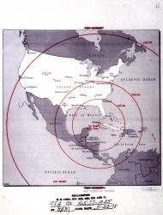

Slide 16
Cuban Missile Crisis
Results:
  A hot line is a direct line of communication between two parties.
A hot line was set up between President Kennedy and the Soviet Premier so that they could contact each other more quickly.
The Limited Test Ban Treaty was agreed upon between US, USSR, and Great Britain to stop above ground testing of nuclear weapons.

Slide 17
Castro’s Impact on Cuba’s Economy
Due to the harsh events, US placed an embargo on goods from Cuba in 1962:
  Cuba’s sugar cane crop could no longer be sold in the US, which hurt Cuba’s economy.
  It’s still in place today.
As a result of the embargo, poor harvests, and bad government planning, Cuba’s economy has become very poor.

Slide 18
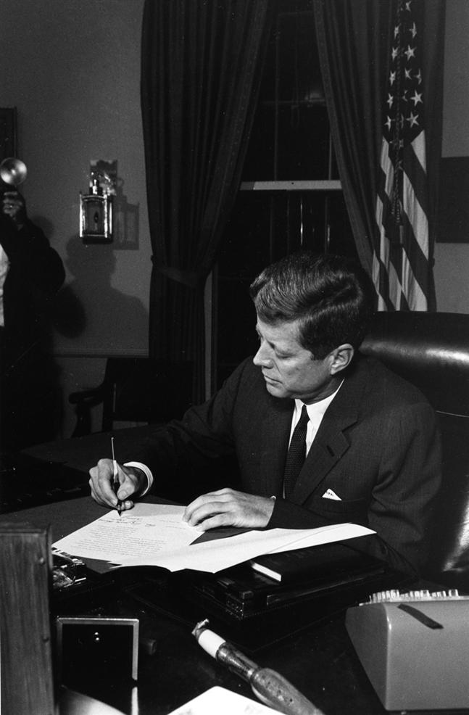
President Kennedy
signing the bill to
place a trade
embargo on
Cuba…10/23/62

Slide 19
US-Cuban Relations
Relations have not improved much over the past 50 years.
There is still an embargo on goods from Cuba.
In the early 1980s & 1990s, there were periods in which large numbers of Cubans escaped their island for America.
  thousands left because Castro would not allow free elections, freedom of speech, freedom of press, etc
1994—now the US only accepts 20,000 immigrants per year

Slide 20
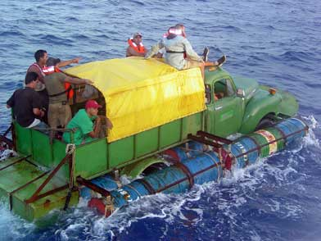
Cuban Refugees

Slide 21
Castro Update
After a decline in health, Fidel Castro gave up the Cuban presidency on February 19, 2008. His brother, Raul, is now the Cuban leader.
There is much speculation about whether or not Fidel Castro is actually alive today.

Slide 22
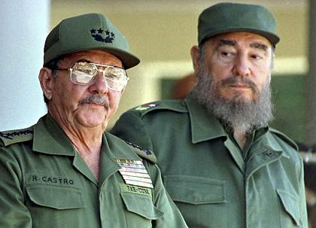
Fidel & Raul Castro

Slide 23
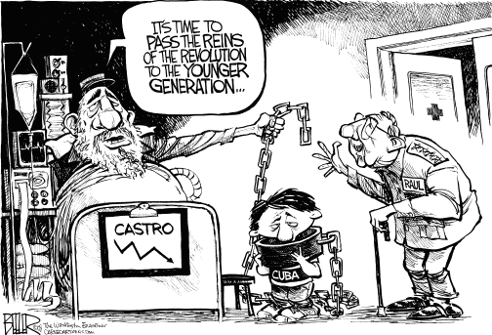
Castro Resigns…

