Slide 1
Ss7cg4a/b/c Unit 3 notes
Dylan Fayad
10-16-18
Mr.Calloway
Social Studies

Slide 2
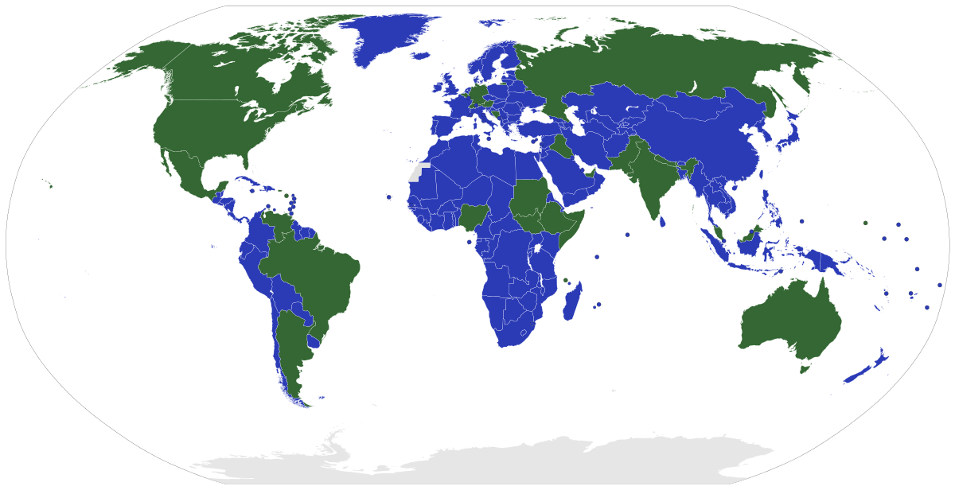
the ways government systems distribute power
Unitary:
Blue is unitary.
Green is federal.
forming a single or uniform entity.
Some example country's can be France, China and Japan.
A unitary state is a state governed as a single power in which the central government is ultimately has all the control.
The advantages of unitary government are it is single and decisive legislative.

Slide 3
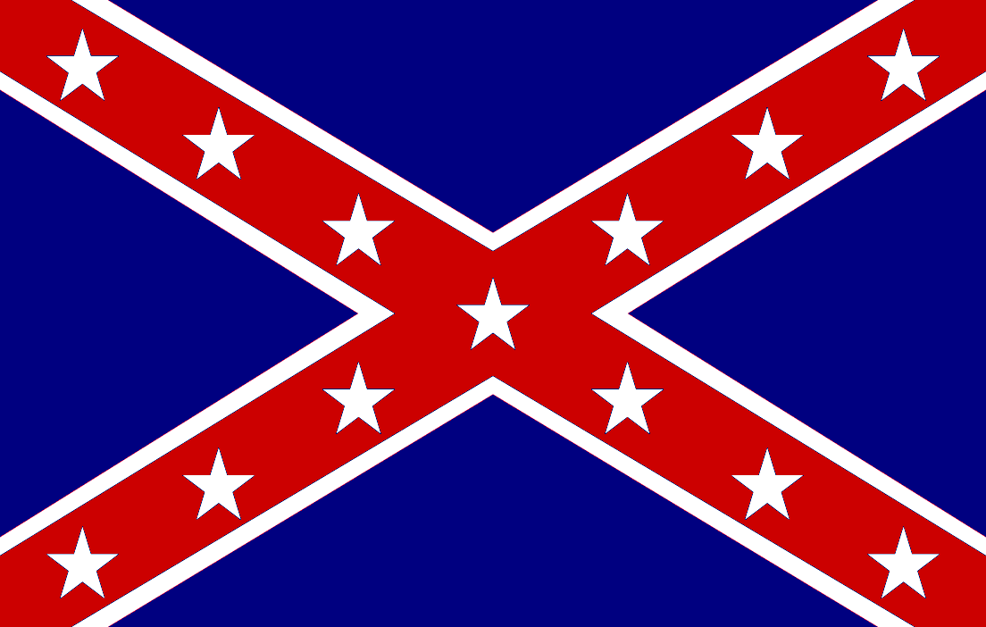
The Ways Government systems distribute power
Confederation:
a more or less permanent union of countries with some or most political power vested in a central authority.
Whereas a federation has a strong central government.
Decisions are made by the government and the council.
Its was originally The Articles of confederation which served as the first constitution of the newly formed United States.

Slide 4
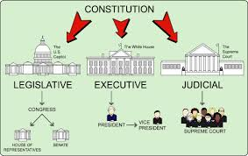
The Ways Government systems distribute power
Federal:
A federal government is a system that divides up power between a strong national government and smaller local government.
Has 3 branches called: Legislative make laws which has the congress( house of representatives) and the senate, Executive carries out the laws which has (president, vice president and cabinet) and Judicial interprets the laws which has (Supreme Court).

Slide 5
governments determine citizen participation
Autocratic:
An autocracy is a system of government in which supreme power is concentrated in the hands of one person.
Examples are: Cuba, Saudi Arabia, and Syria….
All it is basically dictatorship.

Slide 6
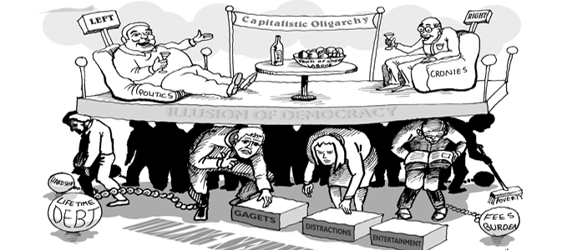
governments determine citizen participation
Oligarchic:
a form of government run by a small number of people such as wealthy landowners, royalty or powerful military figures.
Did you know that The political term, oligarchic, comes to English from the Greek with its meaning intact?
Example: China, North Korea, and Venezuela.

Slide 7
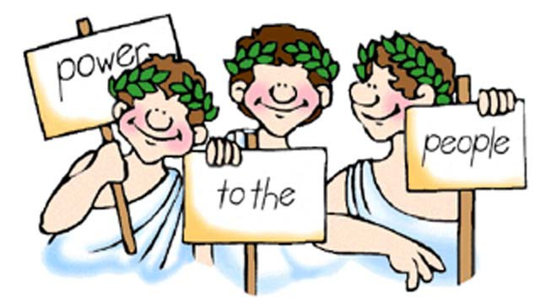
governments determine citizen participation
Democratic:
A system of government in which power is vested in the people, who rule either directly or through freely elected representatives. In other words is what we have.
This is where the people elect representatives to run the government. Another name for this type of democracy is a democratic republic.
Some characteristics of an democracy government is: established popular sovereignty, majority rule, individual rights, free and open elections, citizen involvement and open compromise.

Slide 8
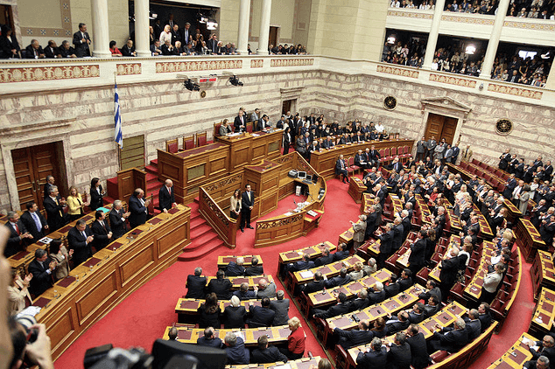
predominant forms of democratic governments
Parliamentary:
It represents the legislature branch it helps which is the prime minister or chancellor. It also chooses the executive branch from within the parliament.
Examples: United Kingdom and Japan

Slide 9
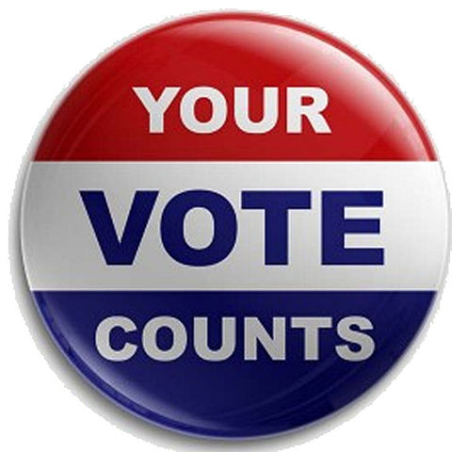
predominant forms of democratic governments
Presidential:
A presidential democracy is a system of government in which also called an executive branch exist but is separate from the legislature.
Did you know in the presidential democracy the executive is chosen by directly by the president?

