Slide 1
Economics and Africa
SS7E1a,b,c
SS7E2a,b,c
SS7E3a,b,c,d
MAD 2011

Slide 2
SS7E1a: Compare how traditional, command, and market economies answer the economic questions of :
(1) what to produce
(2) how to produce
(3) for whom to produce
Concept:
Production – Distribution – Consumption
Agenda: Economic Systems in South Africa and Nigeria
Warm-Up: What are the 4 main types of economic systems?

Slide 3
ECONOMIC SYSTEMS
TRADITIONAL
ECONOMIC
SYSTEMS
MARKET
COMMAND

Slide 4
What is a Traditional Economy?
A pure traditional economy answers the basic economic questions according to tradition. Things are done as they were in the past, based on tradition, custom, and beliefs (like religious beliefs).
Resources are inherited and there is a strong social system.
It is based on primitive methods and tools.
It is strongly connected to subsistence farming.
Usually developing countries.

Slide 5
What is a Market economy?
National and state governments play a minor role.
Capitalism is a pure market economy.
Consumers and what they buy drives the economy.
The market is freely chosen between buyers and sellers of goods and services.
The market plays a major role in deciding the right path for a country’s economic development.

Slide 6
What is a Command economy?
The government controls the production and makes all decisions.
This could be one person, a small group, or central planners who decide what resources to use at each step of production and the distribution of goods and services.
The government decides the role everyone will play. It guides the people into certain jobs.

Slide 7
What is a Mixed economy?
Many economists doubt that “pure” economic systems ever existed.
A mixed economy contains elements of the market, command, and traditional economies.
In some countries there is some private ownership of businesses, such as in China.

Slide 8
What is a Continuum?
A continuum is the range between two things, usually opposites of extremes.
  On an economic continuum the range is from a pure market economy on one far end to a pure command economy on the other end.
  Almost all countries have a mixed economy that falls somewhere in the middle or closer to one end than the other.

Slide 9
ECONOMIC CONTINUUM
MIXED ECONOMY
Individuals and private businesses AND governments DECIDE what is produced, how it is produced, and who they will sell to
PURE COMMAND ECONOMY
The Government DECIDES what is produced, how it is produced, and who they will sell to
PURE MARKET ECONOMY
Individuals and private businesses DECIDE what is produced, how it is produced, and who they will sell to

Slide 10
ECONOMIC CONTINUUM
Where do the economies of South Africa and Nigeria fall on an economic continuum?
?
?
PURE COMMAND ECONOMY
MIXED ECONOMY
PURE MARKET ECONOMY

Slide 11
ECONOMIC CONTINUUM
Where do the economies of South Africa and Nigeria fall on an economic continuum?
Nigeria
South
Africa
PURE COMMAND ECONOMY
MIXED ECONOMY
PURE MARKET ECONOMY

Slide 12
South African Economy
Area of Comparison | South Africa
Type of economy | A technologically advanced market economy with some government control. One of the strongest economy in the region.
Goods produced | Mining (platinum, diamonds, and gold), automobile assembly, machinery, textiles, iron and steel, chemicals, fertilizer
Leading exports | Gold, diamonds, platinum, other minerals, machinery and equipment
GDP per capita | $9,800
Labor Force | Agriculture – 9%, Industry – 26%, Services – 65%
Unemployment rate | 24%

Slide 13
Nigerian Economy
Area of Comparison | Nigeria
Type of economy | Poorly organized economy after a long period of military dictatorship and corruption. They are now trying to reorganize with more private enterprise allowed. They want to be able to take advantage of a strong world oil market.
Goods produced | Oil and petrochemicals are the primary market goods. Nigeria once exported food and other agricultural products but now must import them.
Leading exports | Oil and petrochemical products
GDP per capita | $2,400
Labor Force | Agriculture – 17%, Industry – 52%, Services – 30%
Unemployment rate | 4.9%

Slide 14
Economic Systems
SOUTH AFRICA
NIGERIA
MIXED with more of a MARKET ECONOMY
Natural Resources
Gold and Diamonds
GOV’T CONTROLS
BASIC SERVICES
MODERN
INFRASTRUCTURE
MODERATE
ENTREPRENEURSHIP
APARTHEID STRUGGLES
COMMERCIAL FARMING
MIXED with elements of COMMAND and MARKET ECONOMIES
Oil and Natural Gas Resources
GOV’T CONTROLS OIL INDUSTRY AND OTHER SERVICES
SUBSISTENCE FARMING
POOR INFRASTRUCTURE
GOV’T INSTABILITY (Civil War and Corruption)
LIMITED ENTREPRENEURSHIP
NATURAL
RESOURCES
HIGH
UNEMPLOYMENT
PAST
CONFLICTS

Slide 15
Voluntary Trade and Specialization
Voluntary Trade
Specialization
Voluntary trade is a key to a healthy market economy.
VT goes on when both parties in the transaction see that they will be able to gain something for the exchange.
Ideally, this happens without government restrictions or regulations.
Voluntary trade encourages specialization and usually means production that is more efficient and more profitable.
Not every country can produce all of the goods and services it needs.
Because of this, countries specialize in producing those goods and services they can produce most efficiently.
In international trade, no country can be completely self-sufficient.
Specialization in those products a country makes best and that are in demand on the world market creates a way to earn money to buy items that cannot be made locally.

Slide 16
Trade Barriers
Trade barriers are anything that slows down or prevents one country from exchanging goods with another.
  Tariff: is a tax placed on goods when they are imported to make them more expensive than a similar item made locally.
  Quota: sets a specific limited amount or number of a particular product can be imported or acquired in a given period which forces consumers to buy locally.
    Nigeria is a major producer of oil and a member of OPAC. OPAC places quotas on how much oil each member can produce for the world market to keep the prices at levels they want.
  Embargo: is when one country announces that it will no longer trade with another country. The goal is to isolate the country and cause problems with that county’s economy.
    Many countries placed embargos on South Africa in protest to Apartheid.

Slide 17
Exchanging Currencies
In order for countries to trade with each other, a system of exchanging currencies is necessary.
Most countries have their own individual type of money.
Parts of Africa have already begun to use a currency that can be exchanged between nations. This currency is called the CFA franc.

Slide 18
Human Capital and GDP
Human capital means the knowledge and skills that make it possible for workers to earn a living producing goods or services.
The more skills and education workers have, the better jobs they have. They also tend to make fewer mistakes and can learn new advances in technology more quickly.
GDP is the total value of all goods and services produced by a country in a single year
GDP per Capita is determined by taking the GDP and dividing that number by the total population.

Slide 19
Human Capital and GDP
South Africa
Nigeria
South Africa has invested heavily in human capital. They have a diversified economy and one of the highest GDPs on the continent.
The electronics industry in South Africa requires workers with skills and training. The mining industry relies on workers who can deal with technology that is more sophisticated.
In spite of these positive factors, South Africa still has one of the highest unemployment rates. Over 25% of their population is unemployed.
Nigeria is an example of a country that should have a strong economy because they have rich deposits of oil and an educated population.
However, years of government corruption, civil war, and military rule have left Nigeria poor.
Nearly 70% of the population have to live on less than one dollar a day.
Even though it has good farmland, it must import food to keep its people from starving.

Slide 20
Capital Investments and GDP
Capital goods are the factories, machines, and technology that people use to make products to sell.
Technology can increase production and make that production more efficient.
Producing more goods for sale in a quicker and more efficient way leads to economic growth and greater profits which leads to a higher GDP.

Slide 21
Capital Investments and GDP
South Africa
Nigeria
South Africa is an example of a country that has invested in capital goods.
The equipment needed to get gold, diamonds, and platinum from deep in the earth required both investment in machinery and in worker training.
The same is true for South Africa’s iron and steel production and assembling automobiles and trucks.
Nigeria has invested heavily in capital goods for its oil industry.
New technology is required in order to compete in the global oil market.
The concentration on capital goods for this segment of the economy, however, has left many Nigerians without proper food or housing.

Slide 22
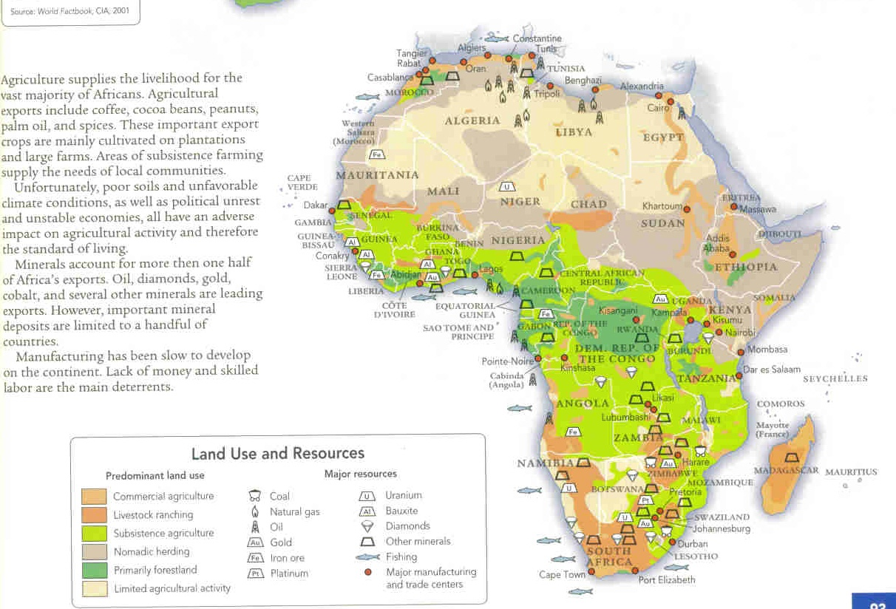

Slide 23
Uranium and Oil
Uranium:
Uranium is an element that is an essential part of nuclear weapons.
For that reason, there has been a brisk undercover trade in uranium between countries.
Uranium is also used as a fuel component in nuclear power plants and to determine the age of artifacts.
It is even used in some photographic chemicals.
Africa currently supplies about 20% of the world’s uranium.
Oil:
Another of Africa’s natural resources is oil.
Some researchers estimate that about 30% of newly discovered oil deposits in the world today are going to come from Africa.
Most of the know reserves are in African countries along the Mediterranean coast.
Oil reserves should guarantee a country economical prosperity. However, this has not been the case in Sub-Saharan Africa.
Profits from oil sales often go into the pockets of corrupt politicians and businessmen.

Slide 24
Gold and Diamonds
The discovery of gold and diamonds in Africa has been a mixed blessing. In some areas, the wealth from diamond mining has been used for the good of the country.
The dominate diamond company in South Africa is DeBeers. They regulate trade and the country is enjoying the benefits. Despite this, there is still a great deal of poverty in South Africa.
In other African countries, diamond wealth has led to chaos. Stolen or smuggled diamonds have been sold on the world market to provide money for weapons for soldiers in a number of different wars and conflicts. This trade is called “conflict diamonds” and has been a major provider of the money needed for arms and ammunition.
South Africa has lead the African nations in the mining and sale of gold. South Africa is believed to have approximately 40% of the world’s gold. The South African government has been able to use much of the gold profit to improve the country and help its people.

Slide 25
Entrepreneurs in Africa
Entrepreneurs are creative, original thinkers who are willing to take risks to create new businesses and products.
Many of the nations on the continent of Africa are ready for development, and many African governments want to do whatever they can to encourage bold and innovative business people.

Slide 26
Egypt in Chaos & Revolution
http://www.youtube.com/watch?v=-ecE5aPiAy8
http://www.youtube.com/watch?v=Rg4GHi7Najo
http://www.youtube.com/watch?v=V_MTDWdsr40

