Slide 1
Environmental Issues
of Canada
Acid Rain and Pollution of the Great Lakes, the Extraction and Use of Natural Resources on the Canadian Shield, and Timber Resources

Slide 2
Standards
SS6G7 The student will discuss environmental issues in Canada.
a. Explain the major environmental concerns of Canada regarding acid rain and pollution of the Great Lakes, the extraction and use of natural resources on the Canadian Shield, and timber resources.

Slide 3
Teachers
Print off the following slide for each student. They should complete the chart while discussing the presentation.

Slide 4
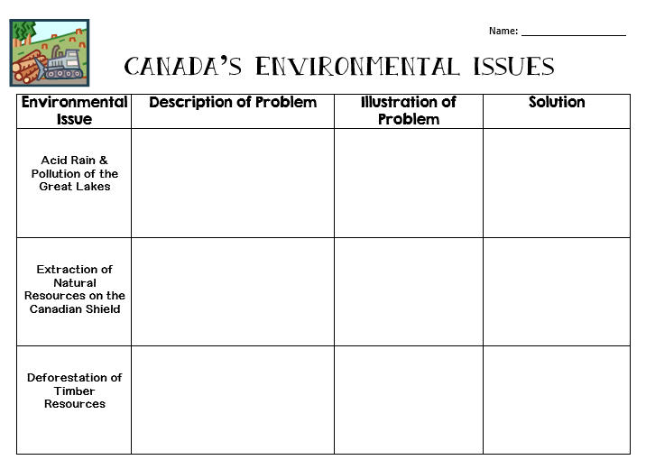

Slide 5
Environmental Issues
of Canada
Acid Rain and Pollution of the Great Lakes, the Extraction and Use of Natural Resources on the Canadian Shield, and Timber Resources

Slide 6
Acid Rain
Coal-burning factories, cars, & trucks release chemicals that pollute the air.
The pollutants mix with water molecules in clouds and turn the water acidic.
High levels of acid in rain can damage or kill trees and pollute lakes enough to kill fish.
Houses, buildings, and statues can also be damaged.

Slide 7
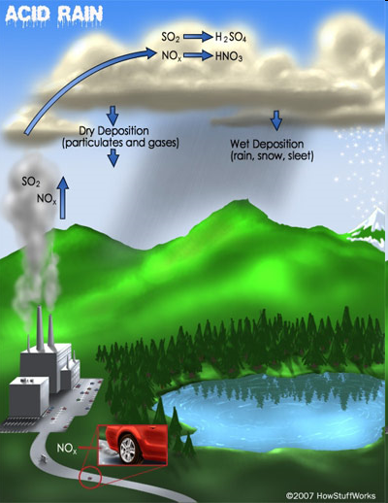

Slide 8
Acid Rain
Southern Canada (near the Great Lakes region) experiences the highest levels of acid rain.
50-75% of the pollution that causes acid rain actually comes from the US.
Wind patterns tend to move the pollution from the US north into Canada.

Slide 10
Acid Rain - Solution
Canada’s government has done several things to reduce pollution:
They are building factories that don’t pollute the air.
Laws have been passed that require cars to produce less pollution.
They are encouraging people to walk or ride bikes/buses, rather than driving.

Slide 12
Pollution – Great Lakes
In the 1970s, the Great Lakes had high levels of water pollution.
Fishing was unsafe; tons of animals and plants were harmed or killed.
Factories around the region used the lakes as a place to dump wastes.
Factories also used the chemical phosphorus when producing things like toothpaste, fertilizer, pesticides, detergents, etc.
This was really bad for lakes because it caused a rapid increase in algae.

Slide 15
Pollution – Solution
In 1971, the Great Lakes Water Quality Agreement was signed by US and Canada (renewed in 2002).
The goal was to restore the lakes’ environment and to prevent further damage.
The countries are working together to reduce the amount of human wastes dumped in lakes.
They’re working to make sure that chemicals (like phosphorus) are not put into lakes.

Slide 16
Extraction of Resources
The Canadian Shield is a large area of thin, rocky soil that surrounds the Hudson Bay.
Beneath the soil is one of Canada’s most valuable resources: minerals (gold, silver, copper, zinc, lead, iron ore, uranium, & nickel).
Mineral deposits are very important to Canada’s economy because they provide jobs.
1.5 million people make their living in the mining industry in this area.

Slide 17
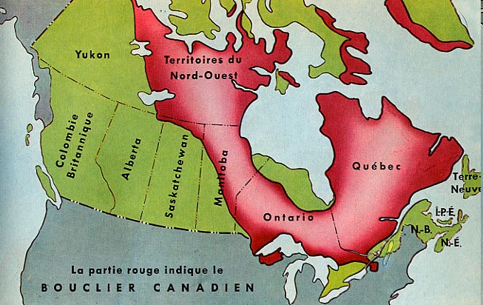

Slide 18
Extraction of Resources
Blasting & digging with heavy machinery causes the land around mines to be damaged and the environment is often ruined.
Slag, or leftover rock from the smelting process, is often dumped in any convenient place.
Mining processes release harmful chemicals into the air, which causes acid rain.

Slide 19
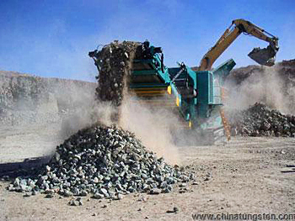

Slide 20
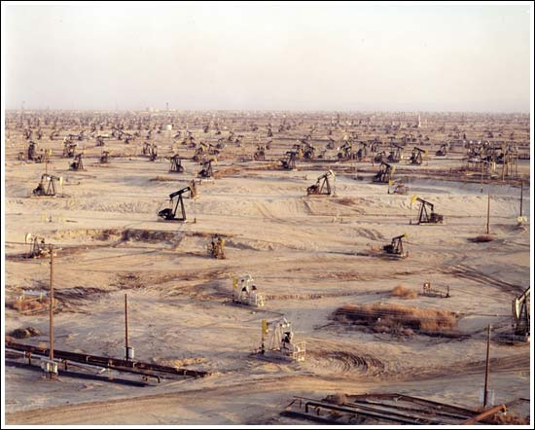

Slide 21
Extraction - Solution
Canada’s government has made new rules about mining.
Some rules reduce the amount of pollution allowed in waterways.
The government hopes to keep its fish alive and safe to eat.

Slide 22
Timber Industry
With almost half its land covered in forests, Canada is a leading producer of timber products.
These products include lumber, paper, plywood, and wood pulp.
The major timber-producing provinces include British Columbia, Quebec, and Ontario.

Slide 23
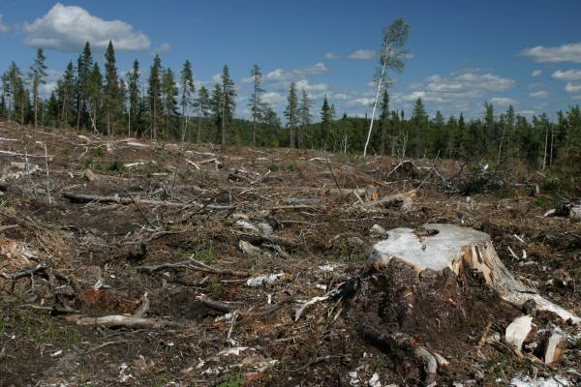

Slide 24
Timber Industry
Citizens are concerned that logging is destroying the forests.
Most timber companies cut all the trees in a given area, leaving large treeless gaps in the forest (called “clear-cutting”).
This reduces water quality, causes erosion, & kills animals’ habitats.
Heavy machinery leaves the forest floor compacted and makes it hard for new growth to start.
Cutting trees down quicker than they can be re-grown is called “deforestation”.
Trees are a limited resource.
If they continue to be overused, they will not be renewed.

Slide 25
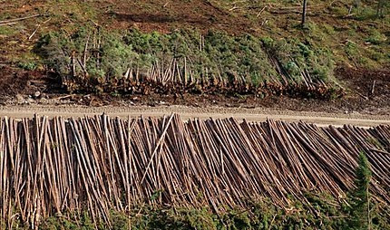

Slide 26
Timber - Solution
Government and industries are working together to manage use of the forests.
Hundreds of millions of seedlings are planted each year.
Billions of dollars are spent on managing and protecting the forests.
Over $100 million is spent each year by the logging industry to protect wildlife & their habitats.

Slide 28
Teacher Directions – “In My Opinion” Ticket Out the Door
Have the students write down their opinions about one (or all) of Canada’s Environmental Concerns. The key is to have them explain why they feel this way.
*There are two per page.

Slide 29
In My Opinion…
In My Opinion…
What’s your opinion about the topic of today’s lesson? Why do you feel this way? Briefly explain.
What’s your opinion about the topic of today’s lesson? Why do you feel this way? Briefly explain.

Slide 30
Teachers
I give my students the following handout at the beginning of our Canada unit. I tell them to keep it handy in their Interactive Notebook, and whenever we discuss any words that begin with certain letters, they are to write them down. The first person to complete the chart wins a prize. *The words have to be things that we’ve discussed in class, not things that they already know, so they must always pay attention!

Slide 32
Teachers
Thank you for downloading this file. I hope you enjoy using it with your students, and I can’t wait to read your feedback in my TPT store! ☺
For more social studies materials, please visit my store: http://www.teacherspayteachers.com/Store/Brain-Wrinkles
I teach Language Arts and Social Studies in Georgia, so my products are aligned with Common Core (LA) and Georgia Performance Standards (SS).
© Copyright 2013. Brain Wrinkles. All rights reserved. Permission is granted to copy pages specifically designed for student or teacher use by the original purchaser or licensee. The reproduction of any other part of this product is strictly prohibited. Copying any part of this product and placing it on the Internet in any form (even a personal/classroom website) is strictly forbidden. Doing so makes it possible for an Internet search to make the document available on the Internet, free of charge, and is a violation of the Digital Millennium Copyright Act (DMCA).

Slide 33
Credits:
All photos were found via Creative Commons and labeled for reuse.
Fonts:
Backgrounds & Graphics:

