Slide 1


Air Pollution
Mexico City, Mexico
Santiago, Chile

Slide 2

What is air pollution?
Dust, fumes, gas, odor, smoke or vapor in the air that can be harmful to living things
Smog: fog made heavier and darker by smoke and chemical fumes (as noted above)
Smog contains ozone,a pollutant that can harm our health
Ozone is a odorless, colorless gas composed of three atoms of oxygen
In earth’s lower atmosphere, ozone is formed when pollutants given off by cars, power plants, refineries and factories react chemically in the presence of sunlight

Slide 3
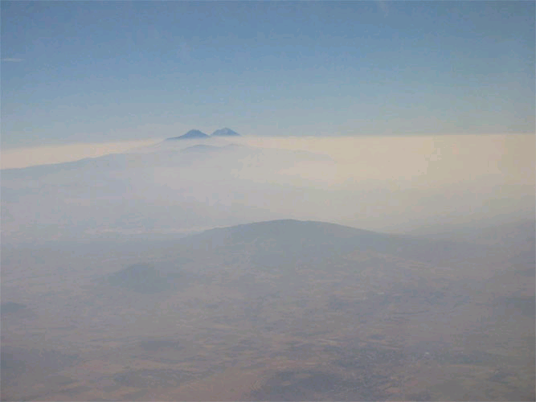
Mexico City, Mexico
Famous for its size, its history, and the warmth of its people, Mexico City is also well known for its air pollution.
The air pollution in Mexico City is one of the most severe air pollution cases in the world.
Many factors have contributed to this situation: industrial growth, a population boom and a large increase in vehicles.
Children in Mexico City rarely use the color blue when they paint the sky in their city. Most pick colors like gray, brown or even black to depict the smog that hangs over the city of roughly 18 million people. Many days students are banned from playing outside and because the smog is so bad.
Pollutants can irritate eyes and cause or aggravate many heart and lung problems. People die sooner than they would if they lived in a pollution free environment.
.

Slide 4
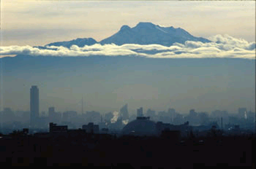
Why Mexico City?
Geography (location) along with human activity(industry and vehicles) increases the problem of air pollution in Mexico City. Located in the crater of an extinct volcano, Mexico City is about 2,240 m above sea level. The lower oxygen levels at this altitude causes smog to develop easily. In turn, the smog prevents the sun from heating the atmosphere enough to penetrate the pollution blanketing the city.
The Mexican government is working to solve the problem. The Metropolitan Environmental Commission is focused on improving the air quality in Mexico City.
The US state department warning: Air pollution in Mexico City is severe, especially from December to May, and combined with high altitude could affect travelers with underlying respiratory problems.

Slide 5

Santiago, Chile
The five million inhabitants of Santiago, Chile are exposed to high levels of air pollution. Santiago ranks as one of the most polluted cities in the world and frequently has air-quality alerts and pollution emergencies.
Air pollution in Santiago results in damaging respiratory diseases and a large number of premature deaths.
Air pollution in Santiago is caused by factories, rapid urban expansion and an increasing rate of automobile use.
Chile is the world's largest producer of copper. In Santiago, the process of copper mining contributes a considerable amount of pollutants to both the air and water; pollutants include sulfur dioxide, arsenic and suspended particulate matter.
A copper mine (right) in Chile shows how air quality is effected.

Slide 6

Why Santiago?
Geography (location) effects Santiago’s air quality. Santiago is located in an enclosed valley with limited wind and little rain. Thus air pollutants stay in the valley.
In an effort to reduce air pollution, the city authorities have restricted the operation of motor vehicles, keeping one fifth of all vehicles off the streets each weekday. Public transportation is provided by a subway and bus system.
The US State Department has issued a warning to travelers: Air pollution is a major source of health concern in Santiago. The most severe air pollution occurs during the winter (May through August).

Slide 7
Oil-Related Pollution in Latin America

Slide 8
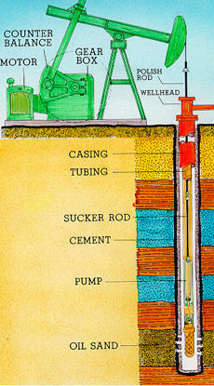
Background Info. About Oil
-Within Latin America, oil has been found in Mexico, Venezuela, and Ecuador
-These countries’ economies depend on this business
-Oil is used to produce many items, including:
*gasoline *medicine
*plastics *paint
*cosmetics *diapers
*medicine *toothpaste
- Significant problems have arisen from the extraction, production, and distribution of oil

Slide 9
More Facts about Oil
The United States has 5% of the world’s total population, yet uses 25% of the oil produced
The U.S. buys more oil from Latin American countries than from all Middle Eastern countries combined
However, there is a greater supply of oil in the Middle East than in Latin America, which is why the U.S. is so involved in that area of the world.

Slide 10
Impact on Forests
Forests are harmed even before oil is drilled
  Roads are constructed into remote areas for exploration
  Construction destroys habitats, and roads increase traffic in fragile areas
  Texaco constructed oil roads in Ecuador that opened 2.5 million acres of forest to colonization
Deforestation
  The Amazon Basin has the greatest diversity of plants in So. America
  Ecuador's rainforests are being cut down by oil corps at a rate of 340,000 hectares a year
  Animals which indigenous people hunt have migrated deeper into the forests

Slide 11

Pollution of Water
Drilling produces waste mud and other crude materials that are stored in pits
  Unlined pits leak wasted into water supplies, rivers (such as the Amazon), and lakes
  Oil placed on roads to prevent dust also flows into rivers
  As a result, the drinking, bathing, and fishing water sources in the Amazon have toxin levels much higher than EPA standards; fish in Gulf of Mexico have high mercury levels
Oil spills also poison water
Effects of water contamination
  Increased risks of cancer
  Infection
  Headache and nausea
  Dead fish and other water animals
www.panda.org/about-wwf/what_we_d0/freshwater/prolems.cfm

Slide 12
Pollution of Air and Soil
1. Oil wells burn off natural gas polluting air and making constant noise
2. Gas flares produce soot which is deposited on roofs
  Also reduces crop growth and affects wildlife
3. Rain washes soot off of the rooftops
  Chemicals in soot can be detrimental to soil’s fertility
4. Oil spills contaminate top soil so that plants cannot grow

Slide 13
Oil Spills
Oil spills occur during accidents involving tankers, barges, and pipelines usually when the oil is being transported to other countries
Causes of spills
  Natural disasters
  Carelessness
  Illegal dumpers
  Equipment breaking
    Pipelines are supposed to be buried to reduce risk of breaking and spilling…
    but they are often above ground and run though villages

Slide 14
Effects of Oil Spills
Spills can leave soil economically useless
Oil floats on water spreading out into a thin layer
Oil destroys insulation of fur and water repellent in feathers of animals
Many animals ingest oil when they try to clean themselves

Slide 15
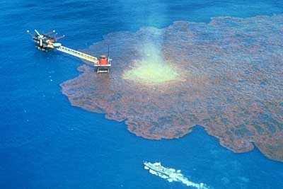
Oil Spills
This oil well off the coast of Ciudad del Carmen, Mexico blew up on June 3, 1979. By the time the well was brought under control over seven months later, an estimated 140 million gallons of oil had spilled into the bay. This was one of the largest oil spills ever.
140 million gallons! Just how much oil is that anyway? Can you figure out a way to help somebody understand just how much 140 million gallons really is?
Notes:
15

Slide 16
140 million gallons. That’s something like…
Filling the average-sized bathtub up around 2 million times. To do this, you would have to fill up your bathtub 10 times a day, every day for about 550 years in a row! Don’t skip a day, now!
Or, filling up your classroom about 5,500 times! That’s something like once a day, every day, for 15 years!
Notes:
16

Slide 17
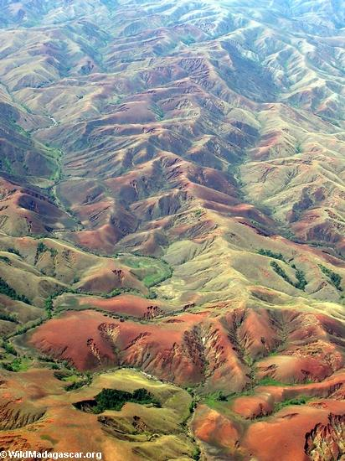
DEFORESTATION of the Amazon

Slide 18
WHY ARE RAINFORESTS BEING DESTROYED?
Every year an area of rainforest the size of New Jersey is cut down and destroyed. The plants and animals that used to live in these forests either die or must find a new forest to call their home. Why are rainforests being destroyed?
Humans are the main cause of rainforest destruction or deforestation. Humans are cutting down rainforests for many reasons, including:
wood for both timber and wood for making fires;
agriculture for both small and large farms;
land for poor farmers who don't have anywhere else to live;
grazing land for cattle; and
road construction

Slide 19
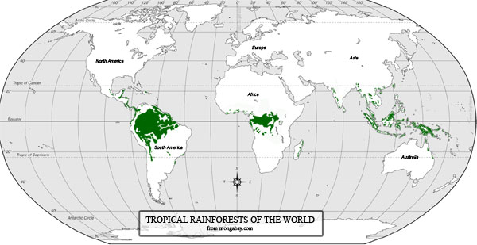
TROPICAL RAINFORESTS OF THE WORLD

Slide 20
LOGGING AND TIMBER HARVESTING IN THE RAINFOREST
One of the leading causes of rainforest destruction is logging. Many types of wood used for furniture, flooring, and construction are harvested from tropical forests in Africa, Asia, and South America. By buying certain wood products, people in places like the United States are directly contributing to the destruction of rainforests.
Research has found that the number of species found in logged rainforest is much lower than the number found in untouched primary rainforest. Many rainforest animals cannot survive in the changed environment.
Local people often rely on harvesting wood for rainforests for fire wood and building materials. In the past such practices were not particularly damaging to the ecosystem. However, today in areas with large human populations, the sheer number of people collecting wood from an area rainforest can be extremely damaging. For example the forests around the refugee camps in Central Africa (Rwanda and Congo) were virtually stripped of all trees in some areas.

Slide 21
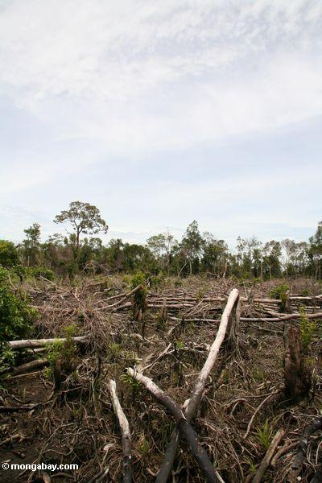

Slide 22
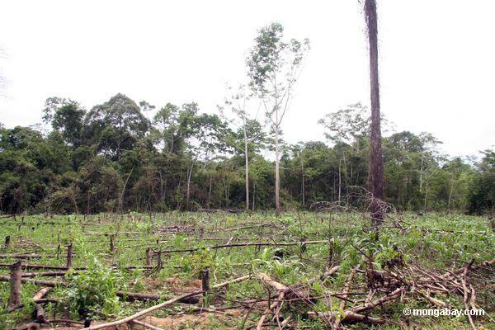
CATTLE IN THE RAINFOREST
Clearing for cattle pasture is the leading cause of deforestation in the Amazon and Brazil now produces more beef than ever before. Besides raising cattle for food, many landowners use cattle to expand their land holdings. By simply placing cattle on an area of forest land, landowners can gain ownership rights to that land.

Slide 23
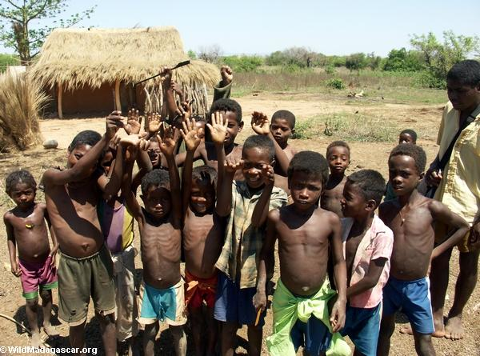
THE ROLE OF POVERTY IN DEFORESTATION
Poverty plays a major role in deforestation. The world's rainforests are found in the poorest areas on the planet. The people who live in and around rainforests rely on these ecosystems for their survival. They collect fruit and wood, hunt wildlife to put meat on the table, and are paid by companies that extract resources from forest lands.
Most rural poor never have the options that we in Western countries take for granted. These people almost never have a choice to go to college or become a doctor, factory worker, or secretary. They must live off the land that surrounds them and make use of whatever resources they can find. Their poverty costs the entire world through the loss of the tropical rainforests and wildlife. Without providing for these people rainforests cannot be saved.

Slide 24
BIBLIOGRAPHY
All information and pictures from
http://kids.mongabay.com/elementary/

