Slide 1
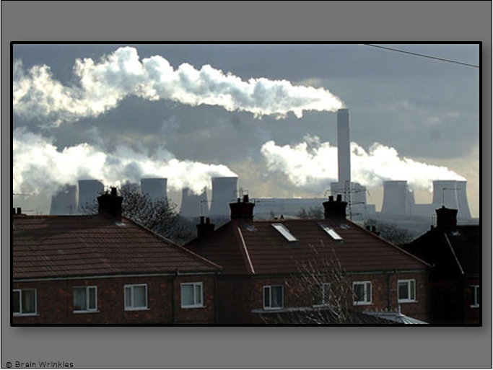
Europe’s
ENVIRONMENTAL ISSUES
ENVIRONMENTAL
ISSUES
Presentation, Graphic Organizers, & Activities

Slide 2
STANDARDS:
SS6G8 Explain environmental issues in Europe.
Explain the causes and effects of acid rain in Germany.
Explain the causes and effects of air pollution in the United Kingdom.
Explain the causes and effects of the nuclear disaster in Chernobyl, Ukraine.
© Brain Wrinkles

Slide 3
TEACHER INFO: CLOZE Notes
The next pages are handouts for the students to use for note-taking during the presentation. (Print front to back to save paper and ink.)
Check the answers as a class after the presentation.
© Brain Wrinkles

Slide 4
ACID RAIN IN GERMANY
Acid Rain
Over the past 30 years, acid rain has been ______________________________ .
It contaminates soil, ______________________________ , eats holes in the surfaces of buildings & statues, pollutes rivers, and harms wildlife.
What is Acid Rain?
Acid rain is a result of ______________________________ .
When any type of fuel is burned, a lot of different ______________________________ and released into the air.
The chemicals mix with water in the clouds and ______________________________ .
The rain that falls has weak ______________________________ mixed in.
It’s not acidic enough to burn your skin, but it is ______________________________ for the environment.
Causes
The main source of acid rain is ______________________________ (burning fuels like natural gas, coal, & oil).
______________________________ also produce harmful gases.
Effects
Acid rain can ______________________________ in several different ways.
It dissolves & ______________________________ and minerals in the soil.
It also causes the ______________________________ such as aluminum into the soil.
Black Forest
Acid rain has destroyed nearly ______________________________ in Germany!
This has really ______________________________ because one of its major natural resources is timber.
Effects
Acid rain causes the water in rivers and lakes to become ______________________________ .
______________________________ that live in these waters are dying, as well as the animals that drink from these waters.
It also causes people to face harmful ______________________________ because the rain contaminates the drinking water in fresh water reservoirs.
______________________________ in acid rain are eating away at many of Germany’s landmarks, causing buildings and artwork to deteriorate.
Concrete, metals, limestone, and marble are all susceptible to acid rain, and many of Germany’s cultural objects that are hundreds of years old are ______________________________ .
© Brain Wrinkles
Europe’s Environmental Issues
CLOZE Notes 1

Slide 5
Germany’s Solution
In Germany, power ______________________________ are replacing many coal-burning factories.
They are developing ______________________________ , such as wind turbines and solar power.
Germany’s government has passed laws to ______________________________ from cars and factories.
AIR POLLUTION IN THE UNITED KINGDOM
Air Pollution
Many of the world’s largest and most ______________________________ are in Europe.
Paris, ______________________________ , Berlin, Rome, Amsterdam
These cities tend to have a ______________________________ , a lot of traffic, and produce a lot of air pollution.
A country that has been ______________________________ by this problem is the UK.
UK’s Air Pollution
London, the capital of UK, is ______________________________ .
The word “smog” was first used in 1905 to describe air in London (______________________________ ).
Thick London smog happens when sunlight acts on the gases from factory or automobile exhausts, or when water in the ______________________________ .
Causes
In the past, the major source of air pollution was smoke from ______________________________ in factories.
The air quality in the UK began diminishing due to the ______________________________ emitted from the burning coal.
Today, ______________________________ is the big problem.
Emissions from automobiles contain carbon monoxide and nitrous oxide, which stay close to the ground and contribute to ______________________________ .
Effects
______________________________ are linked to vehicle emissions.
Air pollution ______________________________ , nose, and eyes, and endangers human life.
When air pollution levels are high, children, sick people, and the elderly ______________________________ to avoid breathing the hazardous air.
Air pollution also ______________________________ .
Vegetation exposed to polluted air for long periods of time ______________________________ and is more susceptible to disease and insects.
This causes a major ______________________________ production.
© Brain Wrinkles
Europe’s Environmental Issues
CLOZE Notes 2

Slide 6
UK’s Solution
Starting in the 1950s, UK’s government has created ______________________________ in London where only smokeless fuels could be used.
______________________________ has also been used more in factories and homes.
Laws have been created that require automobile makers to build cars that ______________________________ .
People have been asked to ______________________________ and are encouraged to use public transportation or walk.
WHAT IS EUROPE DOING OT FIX THESE PROBLEMS?
Environmental Policies
In Western Europe, nations are trying to ______________________________ .
They are spending money and ______________________________ to produce power that cause less environmental damage.
In Eastern Europe, ______________________________ are researching new technologies.
They have ______________________________ .
European Union
Most countries in Europe are members of a group called the ______________________________ .
Since its formation in 1993, the ______________________________ designed to fight acid rain, improve air quality, restrict toxic waste, and reduce pollution.
NUCLEAR DISASTER IN CHERNOBYL, UKRAINE
Nuclear Power
Between 1922 and 1991, Ukraine was ______________________________ and was known for its fertile farmland and successful agricultural industry.
During the 1980s, many countries in Europe began using ______________________________ to produce cleaner and cheaper energy in order to rely less on fossil fuels.
Many European countries had strict regulations on nuclear power use; however, ______________________________ .
Chernobyl was a growing city in Ukraine, and it was home to the ______________________________ in Europe.
Unlike other nuclear power plants, Chernobyl was used to produced ______________________________ material.
Chernobyl
In 1986, the Soviet Union ______________________________ of the world’s nuclear power.
On April 26, 1986, one of the reactors at the Chernobyl nuclear ______________________________ .
The explosion released large amounts of ______________________________ into the atmosphere.
© Brain Wrinkles
Europe’s Environmental Issues
CLOZE Notes 3

Slide 7
Soviet Reaction
The morning after the explosion, there was ______________________________ .
______________________________ of being exposed to radiation, the people were finally told to pack their clothing and evacuate their homes.
There was an ______________________________ .
Worldwide Impact
Nearly ______________________________ of radioactive material (90 times as much as the Hiroshima bomb) was hurled into the sky.
Over the following days, winds mostly blowing north and west, carried fallout into Belarus, as well as Russia, Poland, & other ______________________________ .
Effects
In the first months after the accident, ______________________________ from acute radiation syndrome.
Doctors have noticed an increase in ______________________________ who lived nearby.
Many ______________________________ or got sick.
Fish in nearby rivers were ______________________________ for many years.
Millions of acres of ______________________________ .
The people exposed to the high levels of radiation developed a high level of ______________________________ , including thyroid cancer, autoimmune disorders, birth defects, and other health issues.
Chernobyl Today
Chernobyl continued to produce electricity for ______________________________ , until international pressure forced its closure in 2000.
An ______________________________ around the plant remains in place, extending for 18 miles.
It is one of the most ______________________________ on Earth.
In 2011, Ukraine opened up an area so tourists can see ______________________________ of the disaster.
Forests surrounding the city have repopulated with a ______________________________ and vegetation.
Radiation levels are still so high that humans cannot live here for ______________________________ !
© Brain Wrinkles
Europe’s Environmental Issues
CLOZE Notes 4

Slide 8
Europe’s
Environmental
Issues
Acid Rain in Germany, Air Pollution in the United Kingdom, & the Nuclear Disaster in Chernobyl, Ukraine
© Brain Wrinkles

Slide 9
Acid Rain
in
Germany
© Brain Wrinkles

Slide 10
Acid Rain
Over the past 30 years, acid rain has been damaging Germany.
It contaminates soil, kills trees, eats holes in the surfaces of buildings & statues, pollutes rivers, and harms wildlife.
© Brain Wrinkles

Slide 11
© Brain Wrinkles

Slide 12
What is Acid Rain?
Acid rain is a result of air pollution.
When any type of fuel is burned, a lot of different chemicals are produced and released into the air.
The chemicals mix with water in the clouds and come down with rain.
© Brain Wrinkles

Slide 13
© Brain Wrinkles

Slide 14
What is Acid Rain?
The rain that falls has weak levels of acid mixed in.
It’s not acidic enough to burn your skin, but it is very harmful for the environment.
© Brain Wrinkles

Slide 15
Left Branch shows needle loss and discoloration due to acid rain.
© Brain Wrinkles

Slide 16
Causes
The main source of acid rain is smoke from factories (burning fuels like natural gas, coal, & oil).
Cars and buses also produce harmful gases.
© Brain Wrinkles

Slide 17
Effects
Acid rain can effect trees in several different ways.
It dissolves & washes away the nutrients and minerals in the soil.
It also causes the release of harmful substances such as aluminum into the soil.
© Brain Wrinkles

Slide 18
Black Forest
Acid rain has destroyed nearly half of the Black Forest in Germany!
This has really harmed Germany’s economy because one of its major natural resources is timber.
© Brain Wrinkles

Slide 19
© Brain Wrinkles

Slide 20
Effects
Acid rain causes the water in rivers and lakes to become more acidic.
Fish and other animals that live in these waters are dying, as well as the animals that drink from these waters.
It also causes people to face harmful health hazards because the rain contaminates the drinking water in fresh water reservoirs.
© Brain Wrinkles

Slide 21
Effects
Nitrogen and sulfur in acid rain are eating away at many of Germany’s landmarks, causing buildings and artwork to deteriorate.
Concrete, metals, limestone, and marble are all susceptible to acid rain, and many of Germany’s cultural objects that are hundreds of years old are slowly corroding away.
© Brain Wrinkles

Slide 22
Acid Rain Can Cause Erosion in Stone Statues & Buildings
© Brain Wrinkles

Slide 23
Germany’s
Solution
In Germany, power plants that use water power are replacing many coal-burning factories.
They are developing new types of energy, such as wind turbines and solar power.
Germany’s government has passed laws to reduce emissions from cars and factories.
© Brain Wrinkles

Slide 24
Air Pollution
in the
United Kingdom
© Brain Wrinkles

Slide 25
Air Pollution
Many of the world’s largest and most industrialized countries are in Europe.
Paris, London, Berlin, Rome, Amsterdam
These cities tend to have a lot of factories, a lot of traffic, and produce a lot of air pollution.
A country that has been greatly effected by this problem is the UK.
© Brain Wrinkles

Slide 26
© Brain Wrinkles

Slide 27
UK’s Air Pollution
London, the capital of UK, is famous for air pollution.
The word “smog” was first used in 1905 to describe air in London (thick fog + smoke).
Thick London smog happens when sunlight acts on the gases from factory or automobile exhausts, or when water in the air mixes with smoke particles.
© Brain Wrinkles

Slide 28
© Brain Wrinkles

Slide 29
Causes
In the past, the major source of air pollution was smoke from burning coal in factories.
The air quality in the UK began diminishing due to the smoke and air pollutants emitted from the burning coal.
© Brain Wrinkles

Slide 30
© Brain Wrinkles

Slide 31
Causes
Today, exhaust from automobiles is the big problem.
Emissions from automobiles contain carbon monoxide and nitrous oxide, which stay close to the ground and contribute to low-lying smog.
© Brain Wrinkles

Slide 32
© Brain Wrinkles

Slide 33
Effects
Asthma and pneumonia are linked to vehicle emissions.
Air pollution burns the lungs, nose, and eyes, and endangers human life.
When air pollution levels are high, children, sick people, and the elderly have to stay inside to avoid breathing the hazardous air.
© Brain Wrinkles

Slide 34
© Brain Wrinkles

Slide 35
Effects
Air pollution also harms vegetation.
Vegetation exposed to polluted air for long periods of time grows more slowly and is more susceptible to disease and insects.
This causes a major decrease in crop production.
© Brain Wrinkles

Slide 36
UK’s Solution
Starting in the 1950s, UK’s government has created smokeless zones in London where only smokeless fuels could be used.
Electricity has also been used more in factories and homes.
Laws have been created that require automobile makers to build cars that produce less exhaust.
People have been asked to drive less and are encouraged to use public transportation or walk.
© Brain Wrinkles

Slide 37
What is Europe
doing to fix
these problems?
© Brain Wrinkles

Slide 38
Environmental
Policies
In Western Europe, nations are trying to lessen pollution.
They are spending money and researching new ways to produce power that cause less environmental damage.
In Eastern Europe, few nations are researching new technologies.
They have less money.
© Brain Wrinkles

Slide 39
European Union
Most countries in Europe are members of a group called the European Union.
Since its formation in 1993, the EU has passed policies designed to fight acid rain, improve air quality, restrict toxic waste, and reduce pollution.
© Brain Wrinkles

Slide 40
Nuclear
Disaster
in
Chernobyl,
Ukraine
© Brain Wrinkles

Slide 41
© Brain Wrinkles

Slide 42
Nuclear Power
Between 1922 and 1991, Ukraine was part of the Soviet Union and was known for its fertile farmland and successful agricultural industry.
During the 1980s, many countries in Europe began using nuclear power plants to produce cleaner and cheaper energy in order to rely less on fossil fuels.
© Brain Wrinkles

Slide 43
Nuclear Power
Many European countries had strict regulations on nuclear power use; however, Ukraine did not.
Chernobyl was a growing city in Ukraine, and it was home to the largest nuclear power plant in Europe.
Unlike other nuclear power plants, Chernobyl was used to produced nuclear weapons material.
© Brain Wrinkles

Slide 44
Chernobyl
In 1986, the Soviet Union generated 10% of the world’s nuclear power.
On April 26, 1986, one of the reactors at the Chernobyl nuclear power plant exploded.
The explosion released large amounts of deadly radioactive nuclear material into the atmosphere.
© Brain Wrinkles

Slide 45
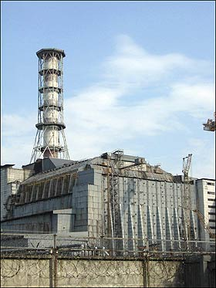
Before…
© Brain Wrinkles

Slide 46
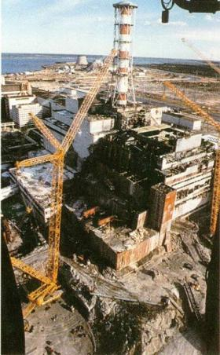
After
© Brain Wrinkles

Slide 47
Soviet Reaction
The morning after the explosion, there was no hint of a disaster.
After 36 hours of being exposed to radiation, the people were finally told to pack their clothing and evacuate their homes.
There was a 18 mile evacuation zone.
© Brain Wrinkles

Slide 48
Worldwide Impact
Nearly nine tons of radioactive material (90 times as much as the Hiroshima bomb) was hurled into the sky.
Over the following days, winds mostly blowing north and west, carried fallout into Belarus, as well as Russia, Poland, & other countries around the world.
© Brain Wrinkles

Slide 49
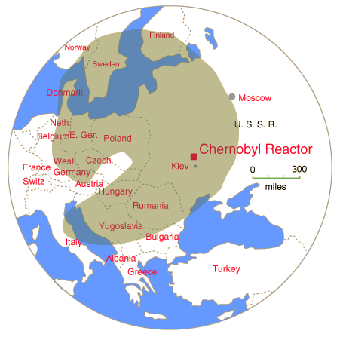
© Brain Wrinkles

Slide 50
Effects
In the first months after the accident, 28 emergency workers died from acute radiation syndrome.
Doctors have noticed an increase in cases of cancer who lived nearby.
Many animals died or got sick.
Fish in nearby rivers were unsafe to eat for many years.
Millions of acres of farmland have been poisoned.
© Brain Wrinkles

Slide 51
Radiation Suits Worn By Workers
© Brain Wrinkles

Slide 52
Effects
The people exposed to the high levels of radiation developed a high level of health problems, including thyroid cancer, autoimmune disorders, birth defects, and other health issues.
© Brain Wrinkles

Slide 53
© Brain Wrinkles

Slide 54
Chernobyl Today
Chernobyl continued to produce electricity for another 14 years, until international pressure forced its closure in 2000.
An official exclusion zone around the plant remains in place, extending for 18 miles.
It is one of the most radioactive spots on Earth.
© Brain Wrinkles

Slide 55
Chernobyl Today…A Ghost Town
© Brain Wrinkles

Slide 56
Chernobyl Today
In 2011, Ukraine opened up an area so tourists can see first-hand the effects of the disaster.
Forests surrounding the city have repopulated with a variety of wildlife and vegetation.
Radiation levels are still so high that humans cannot live here for 20,000 years!
© Brain Wrinkles

Slide 57
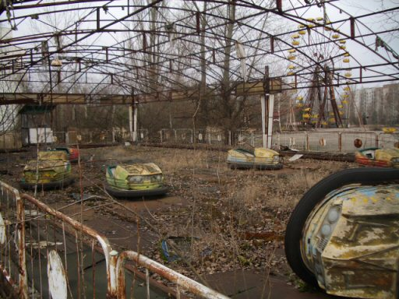
Amusement Park
© Brain Wrinkles

Slide 58
Hospital (Baby Room)
© Brain Wrinkles

Slide 59
School Classroom
© Brain Wrinkles

Slide 60
School Classroom
© Brain Wrinkles

Slide 61
Grocery Store
© Brain Wrinkles

Slide 62
TEACHER INFO:
Print off the following slide for each student.
They should complete the chart after discussing the presentation.
Check answers as a class when finished. If time, have students color their pictures.
© Brain Wrinkles

Slide 63
© Brain Wrinkles
ILLUSTRATION
SOLUTION
EFFECTS
CAUSES
Acid Rain in Germany
Directions: Complete the chart below with information that you learn during the presentation. If time allows, color your illustrations.
Europe’s Environmental Issues
Air Pollution in the United Kingdom
Nuclear Disaster in Chernobyl, Ukraine

Slide 64
 | Factories have started using water power & alternative fuels, stricter emissions testing on automobiles, Germany has agreed to cleaner energy sources, like wind and solar, instead of burning fossil fuels | Destroyed over half of the Black Forest, contaminating rivers and lakes, thus harming fish and wildlife, corroding buildings and statues, contaminating drinking water | Factories, power plants, and automobiles burn fossil fuels and give off smoke and emissions; rain and pollutants mix in the air
 | Government has created smokeless zones in London; factories and homes are using more electricity and burning less fossil fuels; laws require automakers to build cars that produce less exhaust; people are asked to use public transportation | Causes health hazards such as asthma and pneumonia, burns eyes, nose, & lungs; harms vegetation which results in slower growing & makes it more susceptible to diseases and insects; decreases crop production | Factories, homes, and automobiles burn fossil fuels and give off smoke and emissions; Smoke and emissions contain pollutants, such as carbon monoxide, sulfur dioxide, and nitrous oxide, which are released into the air
 | Plant was closed in 2000; Chernobyl is inhabitable today | Over 100,000 acres of land was contaminated with radioactive wastes; forests and wildlife died, water was not safe to drink and fish could not be eaten; So much land was contaminated, farmers could no long grow/sell crops, Radiation exposure causes thyroid cancer, autoimmune diseases, & birth defects | Nuclear power plant exploded and released tons of toxic radioactive waste into the atmosphere
© Brain Wrinkles
ILLUSTRATION
SOLUTION
EFFECTS
CAUSES
Acid Rain in Germany
Directions: Complete the chart below with information that you learn during the presentation. If time allows, color your illustrations.
Europe’s Environmental Issues
Air Pollution in UK
Chernobyl

Slide 65
TEACHER INFO: Political Cartoon Analysis
Print off the Political Cartoon Analysis sheet for each student.
Project the slide with the two political cartoons onto the board.
Students should choose one of the cartoons and complete the analysis for it.
© Brain Wrinkles

Slide 66
Political Cartoon Analysis
Directions: Spend some time analyzing the political cartoon, then answer the questions below.
Describe what you see in the cartoon. List the objects/people. | Which of the objects are symbols? What do you think each symbol means?
Describe the action taking place in the cartoon: | Explain the message of the cartoon:
Who would agree with the cartoon’s message? Why? | Who would disagree with the cartoon’s message> Why?
© Brain Wrinkles

Slide 67
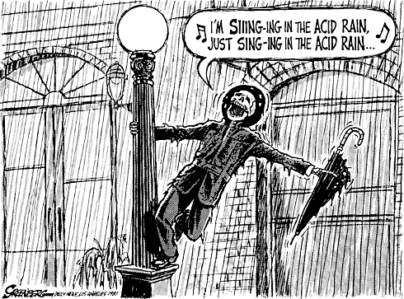
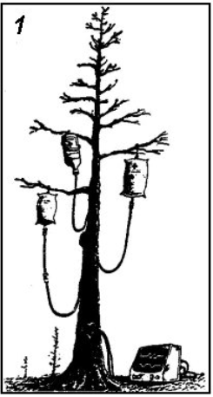
1
2
© Brain Wrinkles

Slide 68
TEACHER INFO: Political Cartoon
Print off the Political Cartoon handout for each student.
Have the students create their own political cartoon to represent one of Europe’s environmental issues.
In the textbox, the students will describe what’s happening in the cartoon and its significance to the lesson.
© Brain Wrinkles

Slide 69
Environmental Issue Political Cartoon
Directions: Design a political cartoon to represent one of Europe’s environmental issues. In the textbox, describe what’s happening in the cartoon and how it is significant to the topic.
Description:
© Brain Wrinkles

Slide 70
TEACHER INFO: Smog Blog
Print off the blank Computer Screen handout for each student and project the RED Directions slide (next page) onto the board.
The students will create a blog and write a blog post as if they are tourists visiting the site of at least one of the environmental issues in Europe.
In the blog post, the students will use descriptive words to describe the location as if they are actually there.
© Brain Wrinkles

Slide 71
The
SMOG BLOG
Post Title & Date
Author (You)
Write a blog post as if you are a tourist that is visiting at least one of the sites of the environmental issues we discussed. Use descriptive words to describe how the issue is impacting the location based on what you are “seeing”.
.
About
the
Author…
Post Body:
2 other popular post titles by the author (related to this lesson)
Significant Photo:
© Brain Wrinkles

Slide 72
The
SMOG BLOG
© Brain Wrinkles

Slide 73
TEACHER INFO: Comprehension Check
Print off the Comprehension Check handout for each student. (Print front-to-back to save paper.)
Students will complete the assignment after discussing the presentation. This can also be used as a quiz!
© Brain Wrinkles

Slide 74
What is acid rain?
2. What causes acid rain?
3. Name 3 effects of acid rain in Germany:
4. What solutions has Germany implemented to reduce acid rain?
5. What is air pollution?
6. What are the major causes of air pollution in the United Kingdom?
7. What is smog?
8. How is air pollution harmful to people and nature in the United Kingdom?
9. What solutions has the UK implemented to reduce air pollution?
© Brain Wrinkles
Europe’s Environmental Issues
Comprehension Check

Slide 75
10. What happened on April 20, 1986 in Chernobyl, Ukraine?
11. What impact did the nuclear explosion have on the environment?
12. What impact did the nuclear explosion have on humans?
13. How were other countries effected by the Chernobyl nuclear disaster?
14. What is Chernobyl like today?
© Brain Wrinkles
Europe’s Environmental Issues
Comprehension Check

Slide 76
TEACHER INFO: TICKET OUT THE DOOR
Print off the Design an App ticket for each student.
The students will design the logo for a new app that will solve one of Europe’s environmental issues.
Next, they will write a description about what the app does and how it will work to fix the issue.
© Brain Wrinkles

Slide 77
Name:
Name:
Design an App
Design an App
Design the logo for a new app that will solve one of Europe’s environmental issues. Also, write a description about what the app does and how it will work to fix the issue.
Design the logo for a new app that will solve one of Europe’s environmental issues. Also, write a description about what the app does and how it will work to fix the issue.
© Brain Wrinkles
© Brain Wrinkles

Slide 78
Thank You!
Thank you so much for downloading this file. I sincerely hope you find it helpful and that your students learn a lot from it! I look forward to reading your feedback in my store.
If you like this file, you might want to check out some of my other products that teach social studies topics in creative, engaging, and hands-on ways.
Best wishes,
Ansley at Brain Wrinkles

Slide 79
© Brain Wrinkles. Your download includes a limited use license from Brain Wrinkles. The purchaser may use the resource for personal classroom use only. The license is not transferable to another person. Other teachers should purchase their own license through my store.
This resource is not to be used:
By an entire grade level, school, or district without purchasing the proper number of licenses. For school/district licenses at a discount, please contact me.
As part of a product listed for sale or for free by another individual.
On shared databases.
Online in any way other than on password-protected website for student use only.
© Copyright Brain Wrinkles. All rights reserved. Permission is granted to copy pages specifically designed for student or teacher use by the original purchaser or licensee. The reproduction of any other part of this product is strictly prohibited. Copying any part of this product and placing it on the Internet in any form (even a personal/classroom website) is strictly forbidden. Doing so makes it possible for an Internet search to make the document available on the Internet, free of charge, and is a violation of the Digital Millennium Copyright Act (DMCA).
Thank you,
Ansley at Brain Wrinkles
Terms of Use
Clipart, fonts, & digital papers for this product were purchased from:

