Slide 1
EUROPE: Location, Climate, Natural Resources, & Trade
6th Grade Social Studies
Unit 1: Geography of Europe

Slide 2
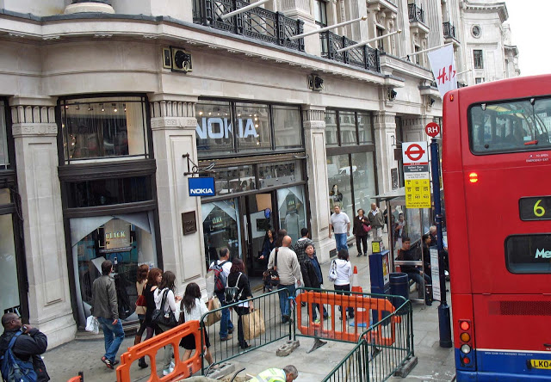
Welcome to the UNITED KINGDOM! England, Scotland, Wales, & Northern Ireland
Location
The U.K. is located northwest of the European mainland.
Most Britons live in the lowland zone of Great Britain (south & east) or urban areas.

Slide 3
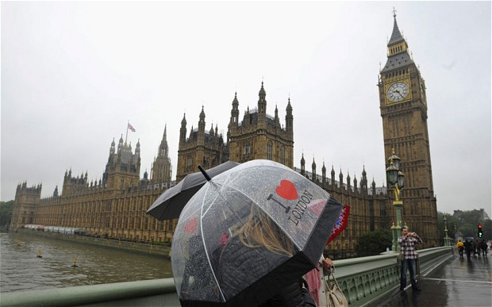
CLIMATE
Temperatures are mild due to the warm ocean water.
Moist climate with plenty of rain.

Slide 4
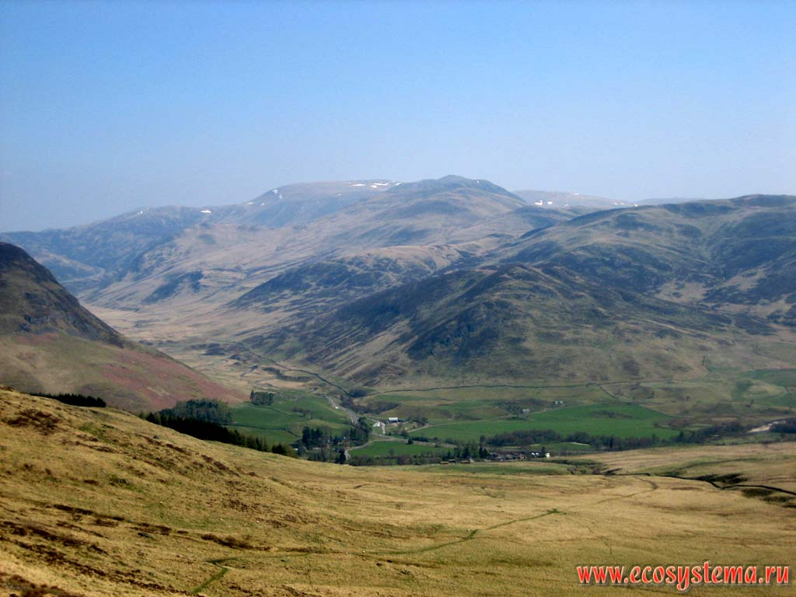
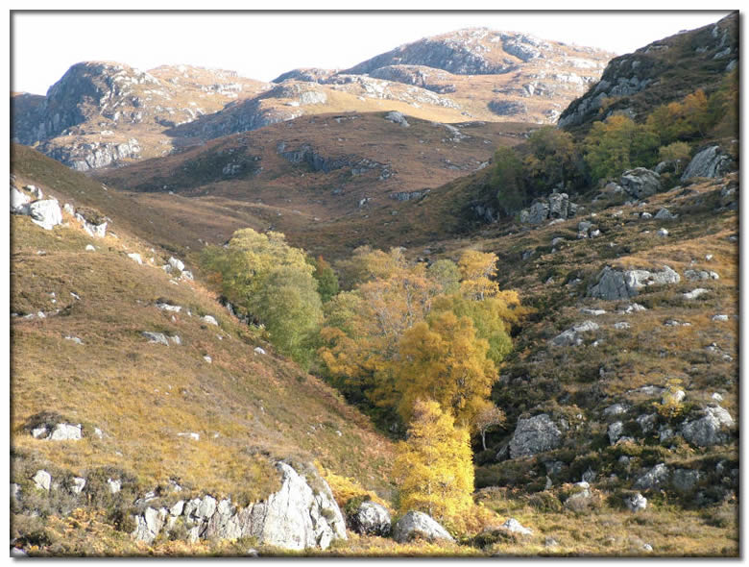
Natural Resources
Coal
Oil
Natural Gas
Most of these natural resources are found in the highland zone (north & west).
Only about 1% of Britons work in agriculture.

Slide 5
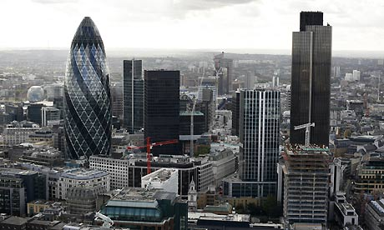
Trade & Industries/Jobs
Trade: Capital city of London is a world center for trade and banking.
Many Britons work in service industries like banking, insurance, and tourism.
Great Britain has thriving manufacturing industries including iron & steel productions & electronics.

Slide 6
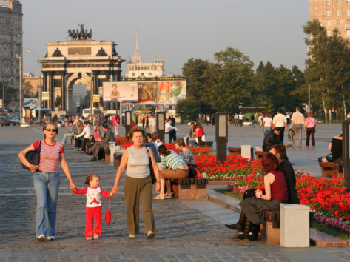
The Big Country – RUSSIA
Location: Russia is in both Europe and Asia.
Most citizens live in western Russia on the European Plain where Russia’s major cities and farms are located.

Slide 7
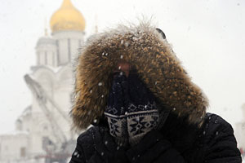
CLIMATE
Russia has a very cold climate. Arctic Ocean is nearby.
Not much rainfall. Only 10% of land suitable for agriculture.

Slide 8
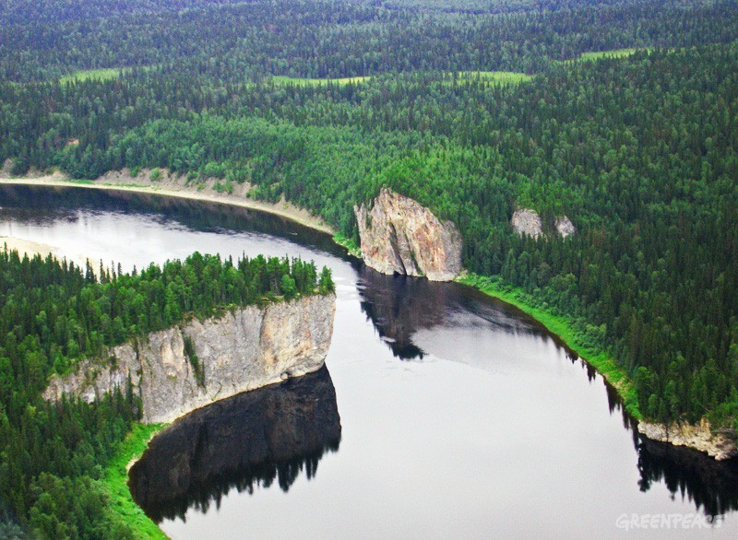
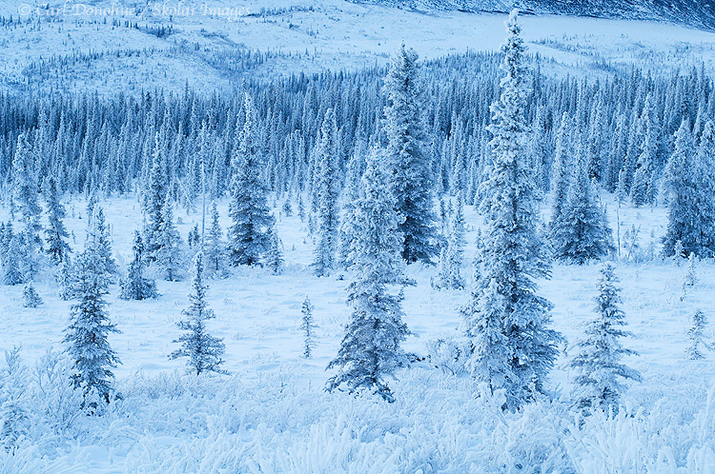
Natural Resources
Rich in mineral resources (coal, oil, natural gas, & forests)

Slide 9
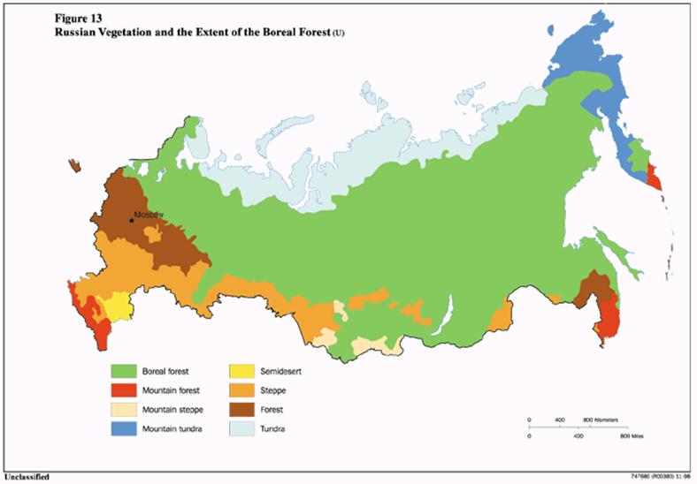

Slide 10
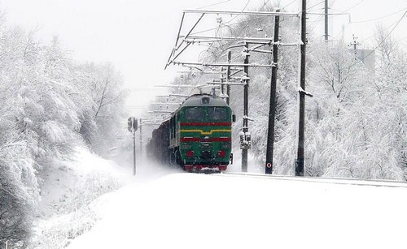
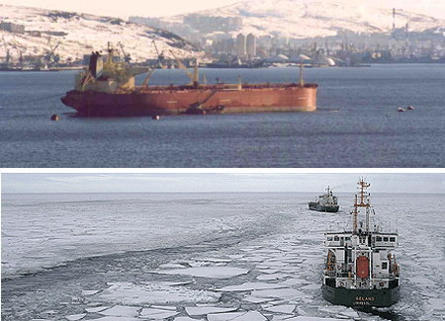
Trade & Industries/Jobs
Trade: Difficult to harvest and transport resources due to the harsh climate and remote location.
Many Russian goods are transported by railroads because rivers and major ports are blocked by ice in the winter.
Mining, manufacturing, and fishing industries.

Slide 11
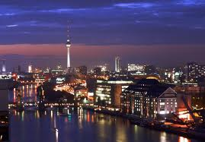
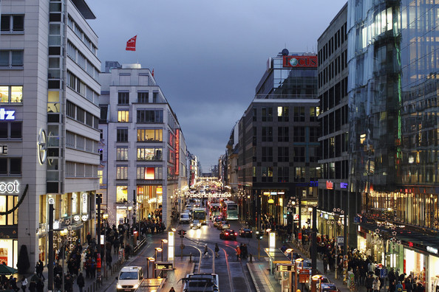
GERMANY
Location
Most Germans live in the cities & towns of western Germany.

Slide 12
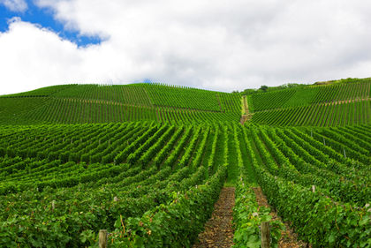
CLIMATE
Moderate climate
Warm, mild summers
Cool winters
Climate good for agriculture industry which uses half of Germany’s land.

Slide 13
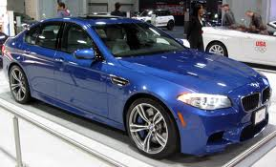
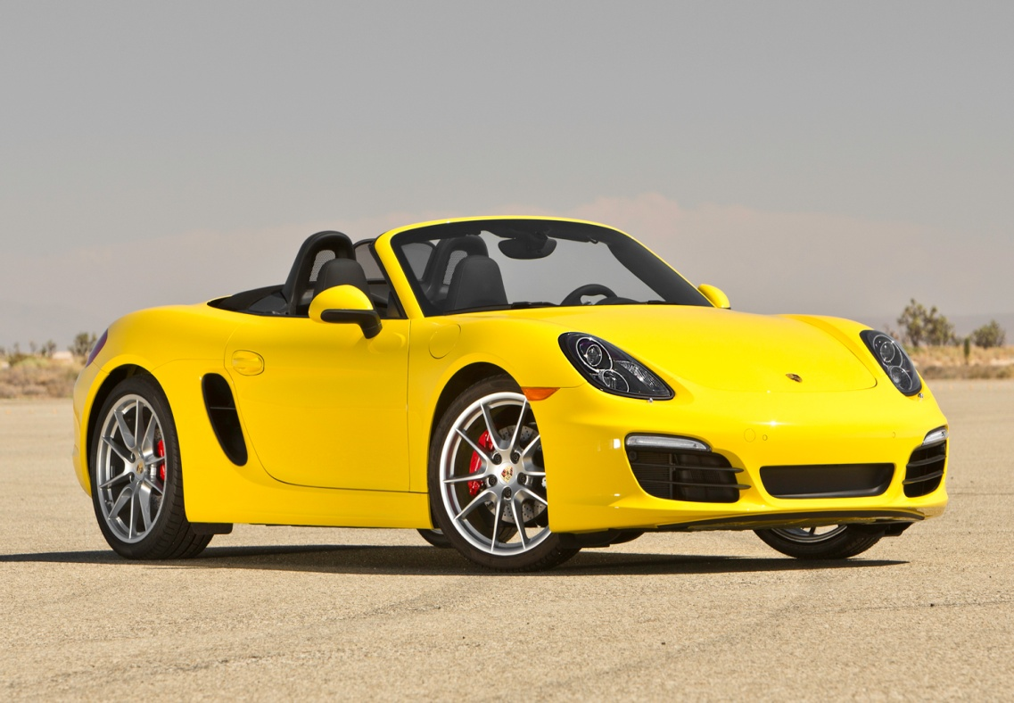
Natural Resources
Coal & Iron Ore
Huge manufacturing industry that produces steel & automobiles.

Slide 14
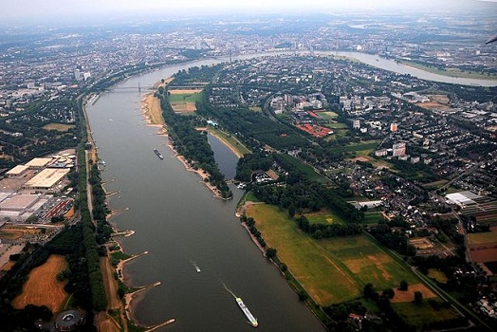
Trade & Industries/Jobs
Trade: Manufacturing products transported on the Rhine River then to the North Sea and Atlantic Ocean.
Manufacturing & Agriculture Industries

Slide 15
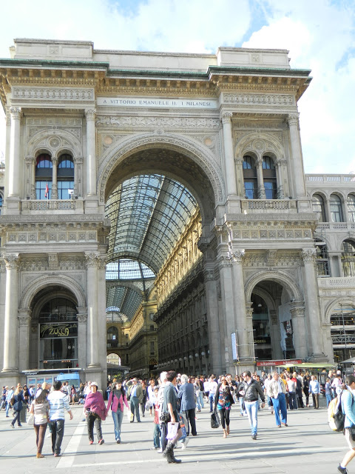
ITALY
Location
2/3 of Italians live in the northern part of the country.

Slide 16
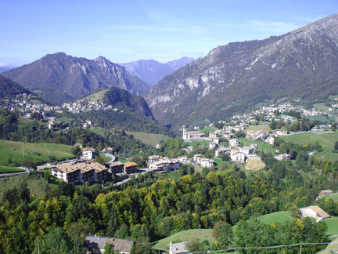
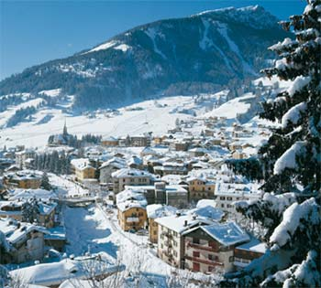
CLIMATE
Moderate climate
Warm summers
Cool winters (colder in mountain regions)
Mountains cover 70% of the country

Slide 17
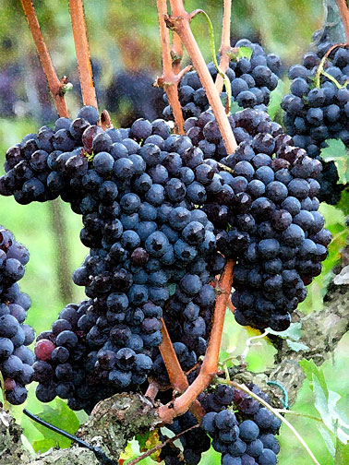
Natural Resources
Most valuable crop: Grapes
Grown along the mountainside
Few mineral resources
Must import raw materials for industry

Slide 18
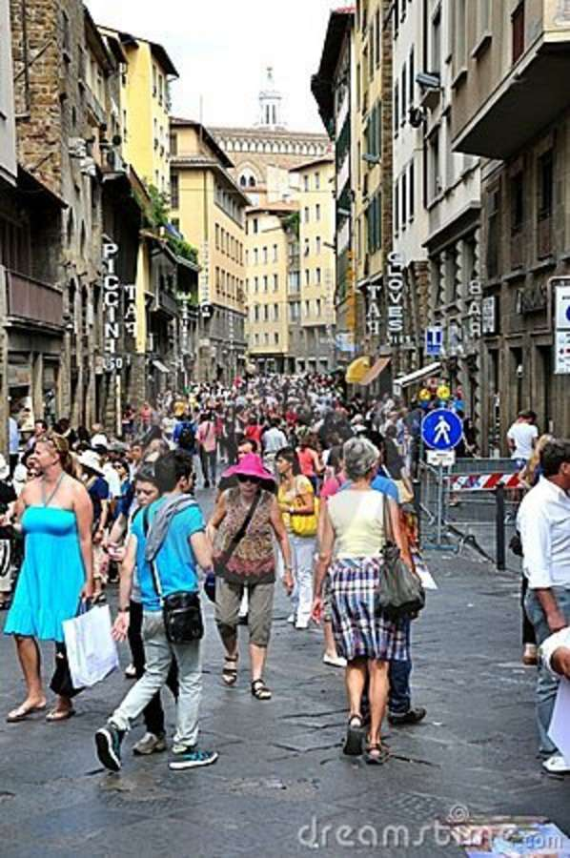
Trade & Industries/Jobs
Trade: Location close to central Europe so it is easier to trade with other European countries.
Tourism is the most important industry

