Slide 1
Three
Monotheistic
Religions
Notes on Judaism, Islam, & Christianity

Slide 2
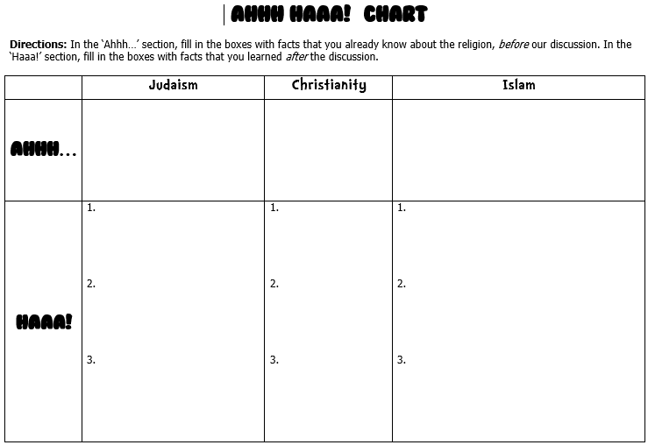
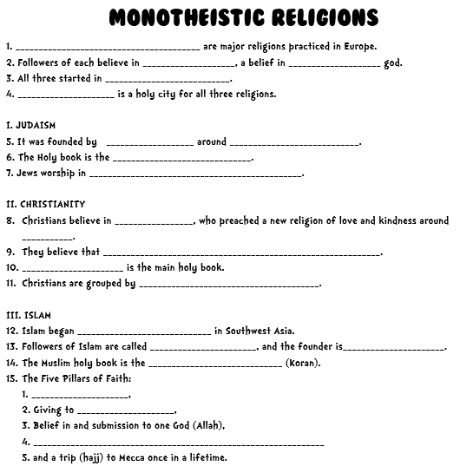
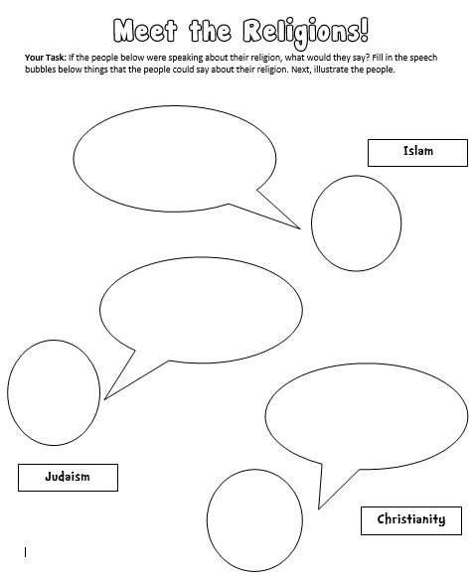
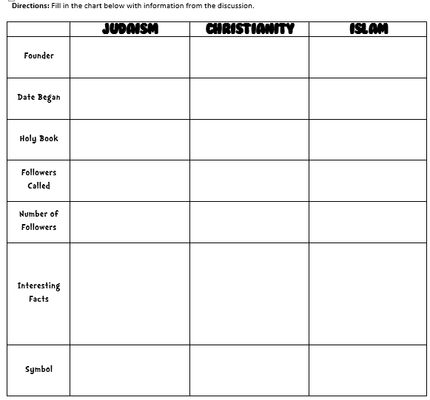
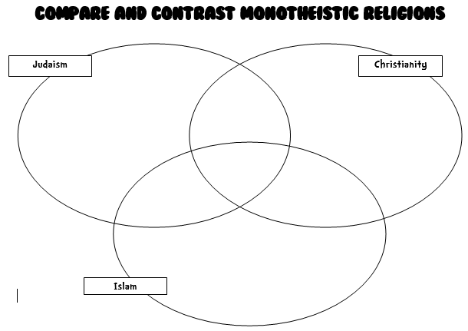
Three
Monotheistic
Religions
Notes on Judaism, Islam, & Christianity

Slide 3
Monotheism
Judaism, Christianity, & Islam are major religions practiced in Europe.
Followers of each believe in monotheism, a belief in one god.
What else do they have in common?

Slide 4
Similarities
Believe in one god (monotheistic)
Started in Southwest Asia
Trace their roots to Abraham as the father of their faith
Jerusalem is the holiest city in the world for Jews and Christians, and the third holiest city for Muslims
All 3 have an important messenger and book of teachings

Slide 5
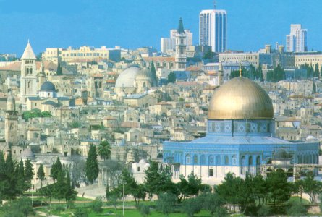
Jerusalem, Israel

Slide 6
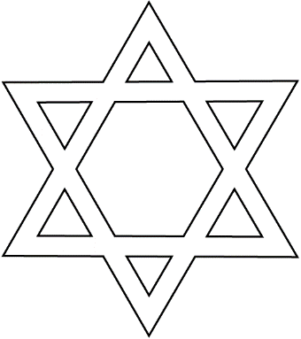
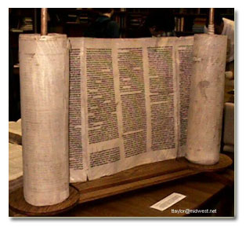
Judaism
Religion of Jews
Founded by Abraham around 2000 BCE.
Jews believe that God gave Moses the Ten Commandments.
Holy book is the Torah, which is the
oral and written laws of the Jews

Slide 7
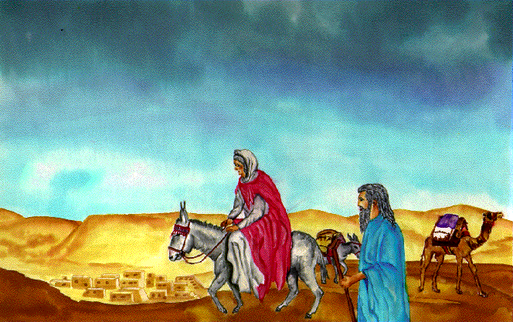
Judaism
Believe that they descended from Abraham and Sarah, the first people to worship Yahweh (God).
Abraham lived at least 3,700 years ago in what is now Iraq.

Slide 8
Judaism
Jews worship in synagogues and temples.
They believe that a messiah (savior) will lead them to the Promised Land.
“What is hateful to you, do not to your neighbor.”
How do you feel about this?

Slide 9
Christianity
Has its roots in Judaism.
Christians believe in Jesus, who preached a new religion of love and kindness around 30 CE.
They believe that Jesus was the messiah (savior).

Slide 10
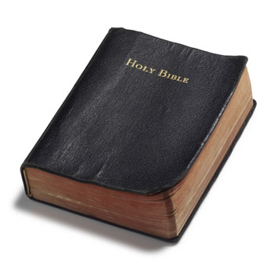
Christianity
The Bible is the main holy book.
It consists of the Old Testament and the New Testament.

Slide 11
Christianity
Christians are grouped by many denominations.
Examples in Europe include: Catholicism, Orthodoxy, and Protestantism
They all follow the teachings of Jesus.
Christians worship in churches and chapels.

Slide 12
Islam
Began around 610 CE in Southwest Asia.
In Arabic, Islam means “surrender” to the will of Allah (God).
Followers of Islam are called Muslims, and the founder is Muhammad.
Believe that Muhammad is the last and greatest prophet of Islam, which included Abraham & Jesus.

Slide 13
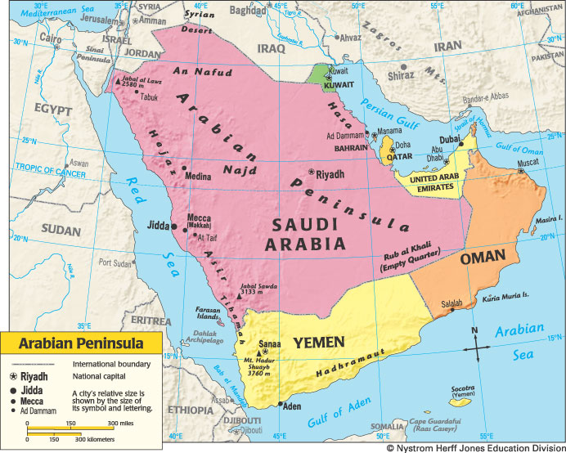

Slide 14
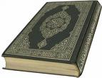
Islam
The Muslim holy book is the Qur’an (Koran).
It states how people should live their lives.
It describes the Five Pillars of Faith (obligations all Muslims must fulfill in their lifetime).

Slide 15
Islam
Five Pillars of Faith
(the main duties of Muslims)
1. Prayer,
2. Giving to charity,
3. Belief in and submission to one God (Allah),
4. Fasting during the month of Ramadan,
5. and a trip (hajj) to Mecca once in a lifetime.

Slide 16
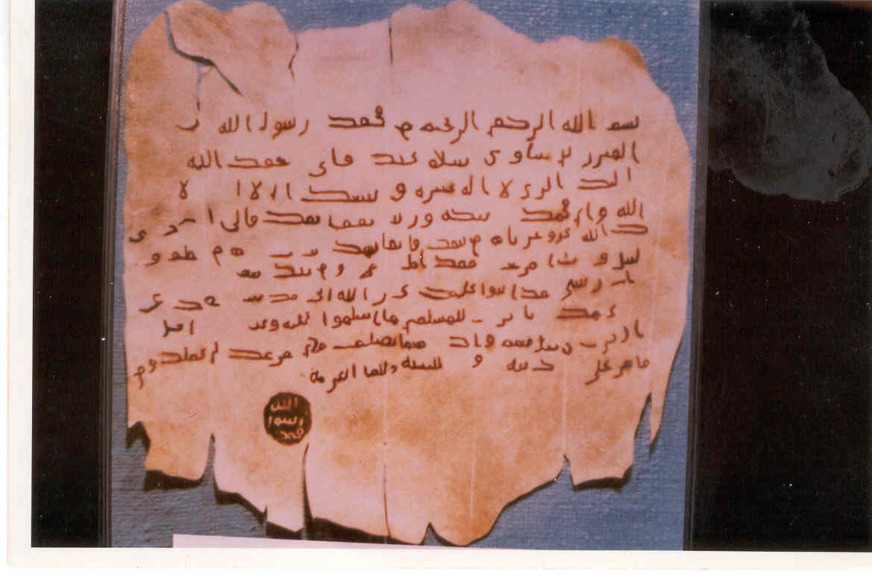
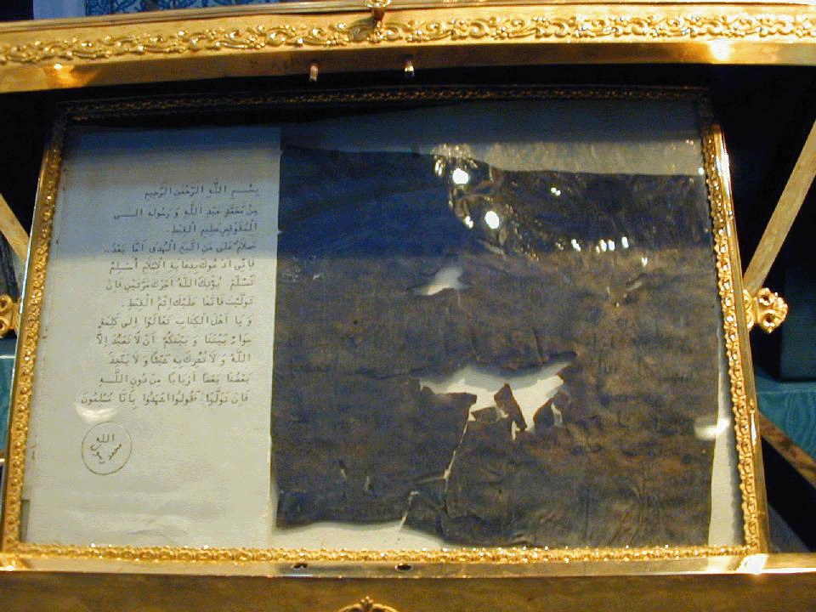
Two letters written by Muhammad…so old!

Slide 17
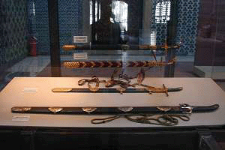
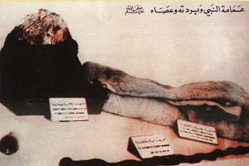
Muhammad’s Hat, Robe, & Staff
Muhammad’s Swords

Slide 18
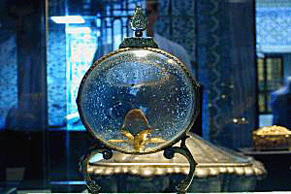
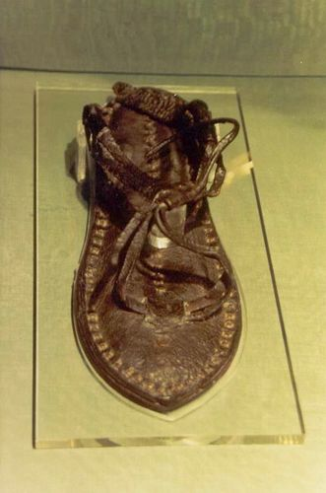
A piece of Muhammad’s hair
One of Muhammad’s sandals

Slide 19
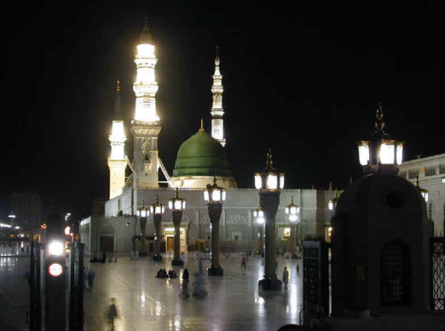
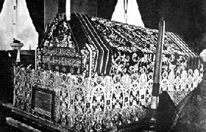
The Green Dome in Madinah
Muhammad’s grave lies under the Green Dome. (Above is his casket.)

Slide 20
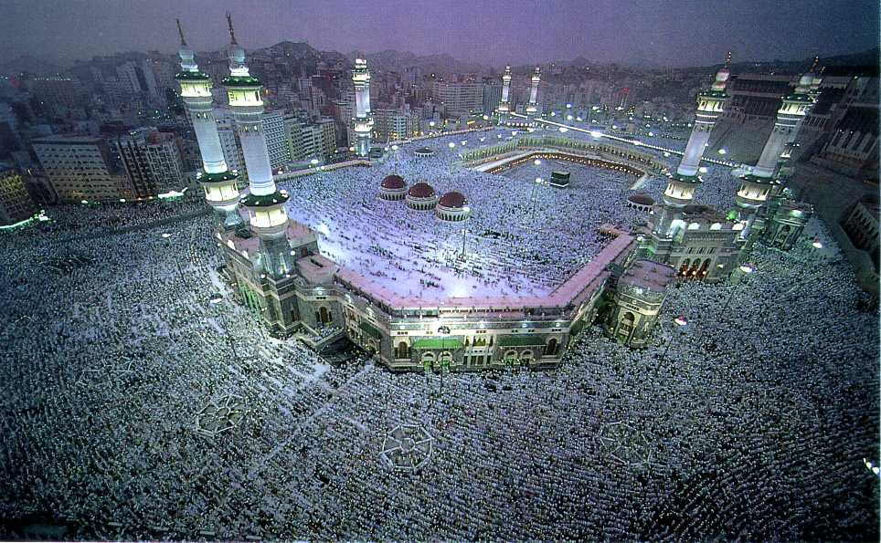
The Grand Mosque in Mecca

