Slide 1
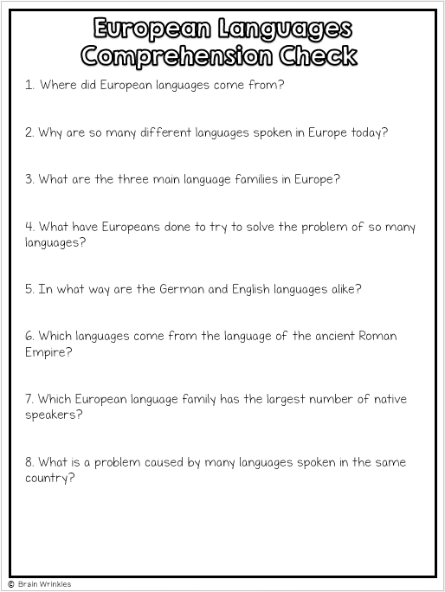
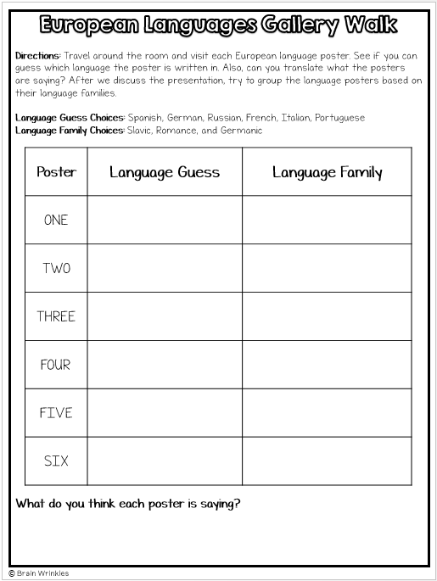
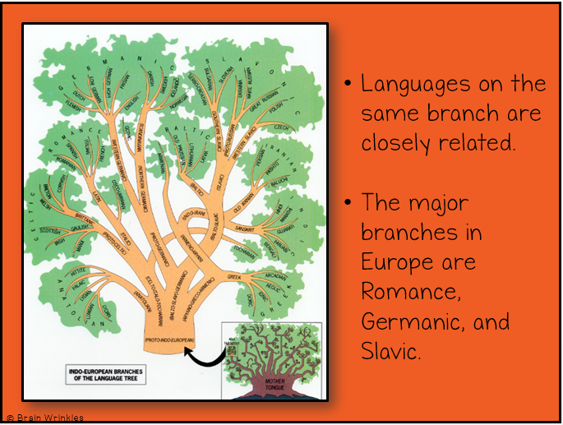
LANGUAGES
IN EUROPE
LANGUAGES
IN EUROPE
Presentation, Graphic Organizers, & Activities
Student Copy

Slide 2
STANDARDS:
SS6G10 Describe selected cultural characteristics of Europe.
a. Describe the diversity of languages spoken within Europe.
© Brain Wrinkles

Slide 3
© Brain Wrinkles

Slide 4
Activity 1: Languages Gallery Walk
Print off the following 6 slides and post them around the room.
Remote alternative: Breakout Rooms
Print off the European Languages Gallery Walk handout for each student/ group in the Breakout Rooms.
SW travel to each poster in the assigned room. Each group will read it and one recorder will write down what the group thinks the language is on the poster. *The timer will be set so the students know when to return to their seats/ GENERAL ROOM.
At the end of today’s lesson, students will go back and classify each poster by language family
© Brain Wrinkles

Slide 5
ONE
Hallo! Ich bin froh dass Sie in meiner Gemeinschaftskunde-Klasse sind. Auf Wiedersehen!
© Brain Wrinkles

Slide 6
TWO
Olá! Estou contente de que você esteja na minha classe de Estudos Social. Adeus!
© Brain Wrinkles

Slide 7
THREE
¡Hola! Me alegro de que usted esté en mi clase de Estudios Social. ¡Hasta la vista!
© Brain Wrinkles

Slide 8
FOUR
Здравствуйте! Я рад, что Вы находитесь в моем классе Общественных наук. До свидания!
© Brain Wrinkles

Slide 9
FIVE
Bonjour! Je suis heureux que vous soyez dans ma classe de Sciences humaines. Au revoir!
© Brain Wrinkles

Slide 10
SIX
Ciao! Sono contento che tu sia nella mia classe Studi Sociali. Arrivederci!
© Brain Wrinkles

Slide 11
European Languages Gallery Walk
Directions: Travel around the room and visit each European language poster. See if you can guess which language the poster is written in. Also, can you translate what the posters are saying? After we discuss the presentation, try to group the language posters based on their language families.
Language Guess Choices: Spanish, German, Russian, French, Italian, Portuguese
Language Family Choices: Slavic, Romance, and Germanic
Poster | Language Guess | Language Family
ONE
TWO
THREE
FOUR
FIVE
SIX
What do you think each poster is saying?

Slide 12
Instructions: CLOZE Notes
The next pages are handouts for the students to use for note-taking during the presentation.
Check your answers and re-read them to study for the Unit Test.
© Brain Wrinkles

Slide 13
Many Languages
Europe is full of ___________________ languages.
There are over ____________________ major languages in Europe.
Some examples include English, ____________________ , Italian, and French.
Even though they are different, many European languages have the ____________________ —the early Indo-European language.
Same Roots
The term “Indo-European” refers to the ancient people who lived in ____________________ over 5,000 years ago.
____________________ tribes migrated into Europe and settled throughout the continent.
Over thousands of years, their language ____________________ into the many languages spoken in Europe today.
Languages on the same branch are ____________________ .
The major branches in Europe are Romance, ____________________ , and Slavic.
Germanic
The Germanic language family has the ____________________ speakers.
Most live in northwest and ____________________ Europe
____________________ & German are part of this family.
About ____________________ of Europeans speak one of these two languages.
Most Europeans learn English as a ____________________ in their schools.
Other examples include ____________________ , Dutch, and Swedish.
Romance
The Romance language family includes French, ____________________ , Spanish, Portuguese, and Romanian.
Most speakers live in the ____________________ of Europe.
These languages come from Latin, the language of the ancient______________ .
____________________ Languages
Slavic
The Slavic language family is mostly found in central and ____________________ Europe.
This family includes ____________________ , as well as Polish, Czech, Ukrainian, and Croatian.
These languages are written with a ____________________ alphabet.
European Languages CLOZE Notes 1

Slide 14
Diversity Today
Many European countries have ____________________ official language.
This is a part of life in many countries due to the ____________________ of the people living there.
Also, many countries ____________________ and people move back and forth across them.
About ____________________ people in the world speak English because it is often the choice for a 2nd language.
Over ½ of all Europeans speak ____________________ .
Having speakers of so many ____________________ in one area can be a problem.
____________________ make it difficult to live, work, and trade with people who cannot communicate with each other.
So…
____________________ 1 or 2 other languages besides their own.
European Union has ____________________ to make sure that people can understand laws and decisions made by the government.
European Languages CLOZE Notes 2

Slide 15
EUROPEAN
LANGUAGES
EUROPEAN
LANGUAGES
© Brain Wrinkles

Slide 16
Many Languages
Europe is full of diverse languages.
There are over twenty major languages in Europe.
Some examples include English, Spanish, Italian, and French.
Even though they are different, many European languages have the same roots—the early Indo-European language.
© Brain Wrinkles

Slide 17
Same Roots
The term “Indo-European” refers to the ancient people who lived in Central Asia over 5,000 years ago.
Indo-European tribes migrated into Europe and settled throughout the continent.
Over thousands of years, their language changed and developed into the many languages spoken in Europe today.
© Brain Wrinkles

Slide 18
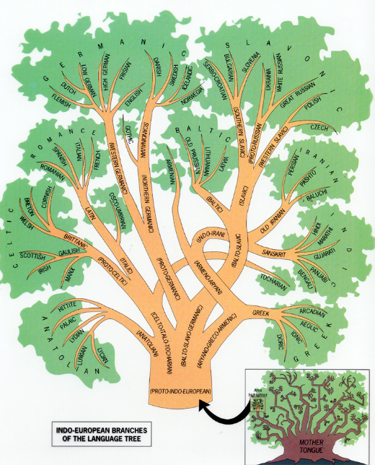
Languages on the same branch are closely related.
The major branches in Europe are Romance, Germanic, and Slavic.
© Brain Wrinkles

Slide 19
Germanic
The Germanic language family has the most native speakers.
Most live in northwest and central Europe
English & German are part of this family.
About 20% of Europeans speak one of these two languages.
Most Europeans learn English as a 2nd language in their schools.
Other examples include Danish, Dutch, and Swedish.
© Brain Wrinkles

Slide 20
Romance
The Romance language family includes French, Italian, Spanish, Portuguese, and Romanian.
Most speakers live in the south and west of Europe.
These languages come from Latin, the language of the ancient Roman Empire.
Romance Languages
© Brain Wrinkles

Slide 21
Slavic
The Slavic language family is mostly found in central and eastern Europe.
This family includes Russian, as well as Polish, Czech, Ukrainian, and Croatian.
These languages are written with a Cyrillic alphabet.
© Brain Wrinkles

Slide 22
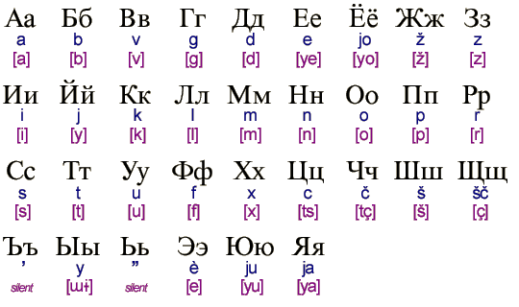
Brain Break
If possible, write your name on your paper using the Cyrillic alphabet.
© Brain Wrinkles

Slide 23
Diversity Today
Many European countries have more than one official language.
This is a part of life in many countries due to the ethnic background of the people living there.
Also, many countries share borders and people move back and forth across them.
About 400 million people in the world speak English because it is often the choice for a 2nd language.
Over ½ of all Europeans speak English.
© Brain Wrinkles

Slide 24
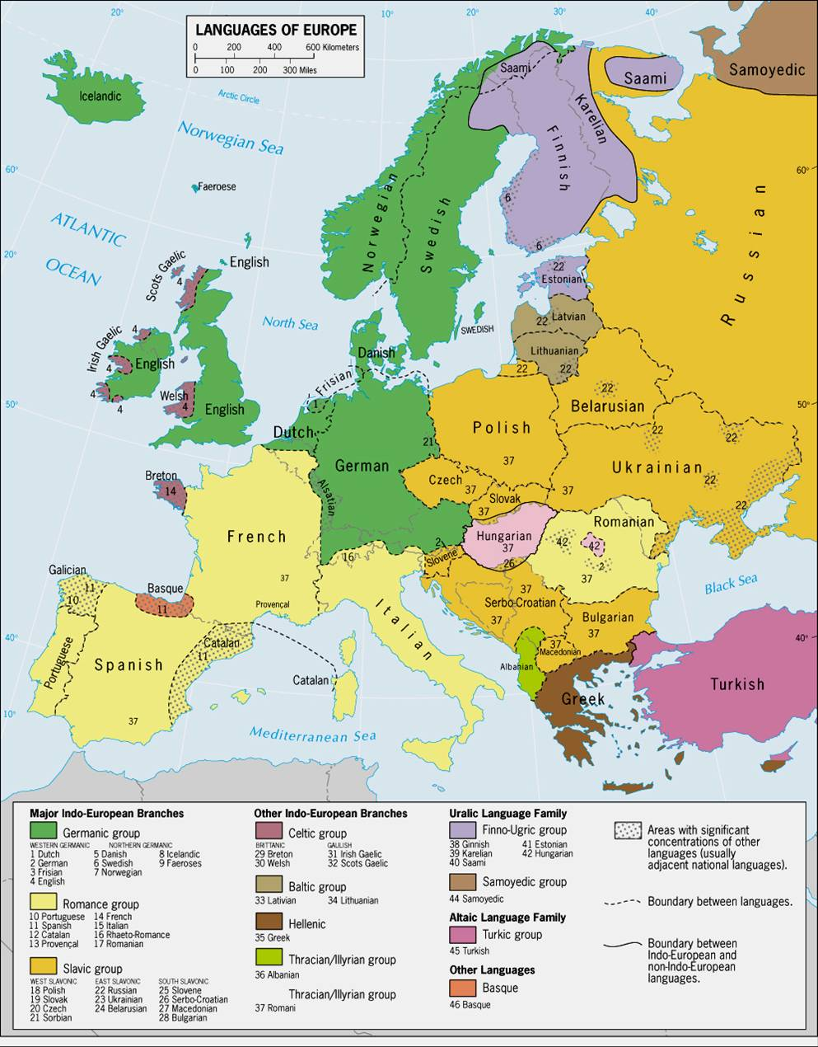
© Brain Wrinkles

Slide 25
Diversity Today
Having speakers of so many different languages in one area can be a problem.
Language barriers make it difficult to live, work, and trade with people who cannot communicate with each other.
So…
Schoolchildren learn 1 or 2 other languages besides their own.
European Union has 23 “official” languages to make sure that people can understand laws and decisions made by the government.
© Brain Wrinkles

Slide 26
TEACHER INFO: Comprehension Check
Print off the Comprehension Check for each student.
After the lesson, have the students answer the questions. *This could also be used as a quiz.
© Brain Wrinkles

Slide 27
Where did European languages come from?
2. Why are so many different languages spoken in Europe today?
3. What are the three main language families in Europe?
4. What have Europeans done to try to solve the problem of so many languages?
5. In what way are the German and English languages alike?
6. Which languages come from the language of the ancient Roman Empire?
7. Which European language family has the largest number of native speakers?
8. What is a problem caused by many languages spoken in the same country?
© Brain Wrinkles
European Languages
Comprehension Check

Slide 28
TEACHER INFO: TICKET OUT THE DOOR
Print out the exit slip page for each student.
Have students write down their opinions to the questions on the ticket.
Collect the tickets and briefly discuss the answers during the next class.
© Brain Wrinkles

Slide 29
Name:_______________________
In My Opinion…
Why do you think speaking more than one language is more common in Europe than in the US? Why might it be important for Americans to be bilingual?
© Brain Wrinkles

