Slide 1
Formation of the Modern Middle East
The Middle East After 1919

Slide 2
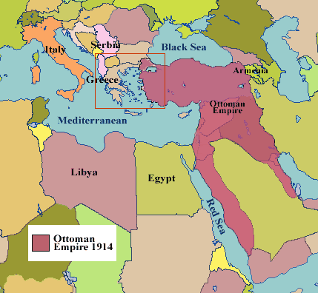
The Middle East in WWI: The Ottoman Empire
Ottomans fought with Germany and Austria Hungary
Challenge British control of the Suez canal & their colonies
Regain territory lost to Nationalist groups in the Balkans

Slide 3
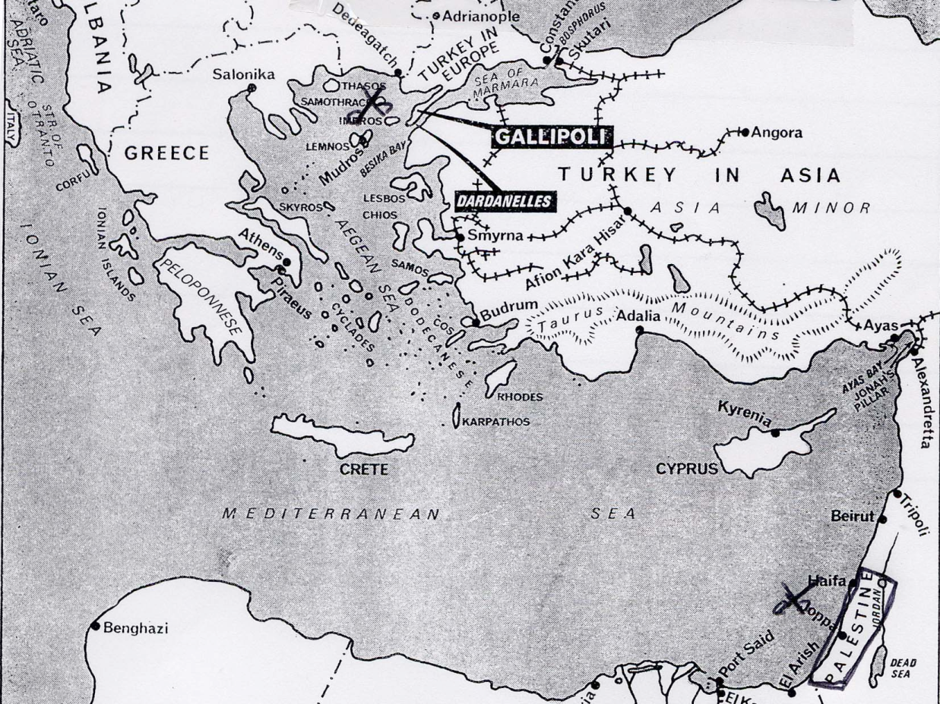
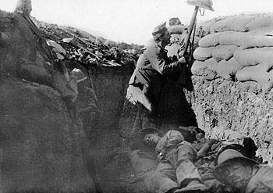
Ottoman Empire 1915-1918
Initial success in defeating British at Gallipoli and Russia to the north.

Slide 4
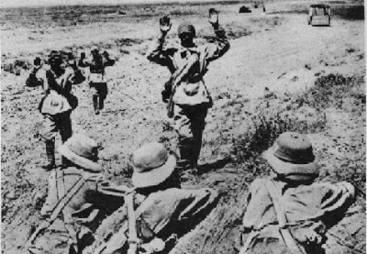
Ottoman Empire 1915-1918
Outgunned
Undermanned
Industry couldn’t keep up
Eventually defeated by British invasions into modern day Iraq and Russia from the north

Slide 5
Ottoman Empire-Collapse 1919-1922
Great Britain, and other Arabs eventually defeat the Ottomans
Empire is dissolved by British at end of war
Ottoman Empire NOT mentioned in V.T. but Great Britain gets jurisdiction over the territory.
Lands are partitioned (divided)
Nationalist Groups want independence (those that were friendly to England were put in charge.
Turkey gains independence

Slide 6
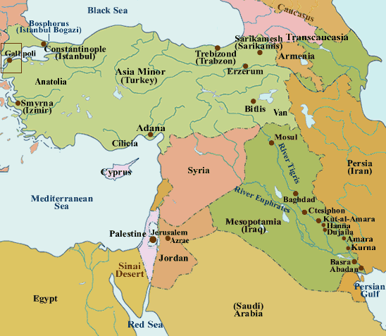
Middle East as of 1922
British divide Ottoman Empire

Slide 7
Problems with the division of the Middle East
Many Nationalist groups not granted independence
Boundaries are drawn indiscriminately
*No attention paid to tribal lands*
Result: Arabs are distrustful of European powers especially the British
British rule over all aspects of the Middle East
France meanwhile maintains its colonies in Africa.

Slide 8
Oil and the Middle East
First discovered on Masjid-I Suleiman in Persia (Iran) in 1908.
Turkish-Petroleum Co. [TPC] founded in 1911 -
drill for oil in Mosul, Mesopotamia (Iraq).
Britain signed a secret agreement with the sheikh of Kuwait who, while outwardly pledging allegiance to the Ottoman Sultan in Istanbul, promised exclusive oil rights to the British.
Kuwait became a British protectorate in November, 1914.
In 1927, oil was struck in Kirkuk, Iraq, and the
Iraq Petroleum Co. [IPC] was created.

Slide 9
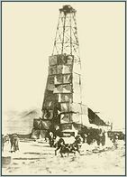
Oil and the Middle East
American oil companies
[Texaco & Chevron], gain
oil concessions in Bahrain
in 1929.
In 1933, American oil
companies win an oil
concession in Saudi Arabia.
ARAMCO [Arab-American
Oil Co,] is created in 1939.

Slide 10
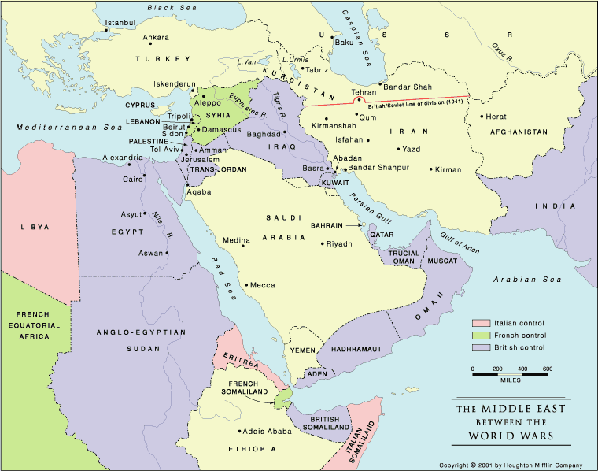
The Middle East between the Wars

Slide 11
Middle East during WW2
Germans wanted North African Colonies, the Suez Canal in order to gain access to Arabian oil fields.
Germans offered full independence to middle east and African states if they supported Axis cause
  Some political and religious leaders supported Germans in order to attain independence from British, French

Slide 12


Slide 13
Middle East Post WW2
Independence is granted to many states
-same issues arise as in Africa in many cases -tribal loyalties etc.
Cold War begins and both sides lobby for power and influence in the region.
The state of Israel is formed by a British Mandate (with support of the UN & US) in 1948. (impact of Holocaust)
-large Jewish populations of Europe leave to go back to their homeland.

Slide 14
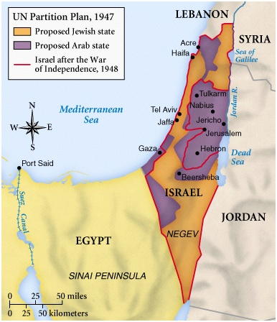

Slide 15
Arab Reaction & the Cold War
US and Western powers support Israel
USSR tries to influence Arab countries
Several Regional conflicts break out:
Arab Israel War of 1948
1967 Six day war
1968-72 War of Attrition
1981 attacked Iraq
1982 Lebanon
Israel holds its independence to this day (extreme Anti-Israeli stance in many Middle East countries)

Slide 16
Elsewhere
Iran:
1950s saw US-backed installation of a Shah
1970s: Shah forced from throne again by Fundamentalist Clerics, led by Ayatollah Khomeini

Slide 17
Elsewhere
Iraq:
1960s Baath party takes control of Iraq
Secular Government
Late 1970s: Saddam Hussein takes control

Slide 18
Elsewhere
Afghanistan:
1970s- invaded by Soviet Union
US-backed muhajideen against Soviets
After Soviet Collapse, establishment of Taliban Government

Slide 19
Elsewhere
Saudi Arabia:
people enjoy decent standards of living financial benefits from government
Little- to no social reforms
  Women can’t drive
  Limited ability to criticize govt

Slide 20
RESULTS:
US is last major super power left after 1991 with a great interest in the Middle East (no one else left to blame)
Middle Eastern countries have been pawns of the western powers since the early 20th century.
Anti-American, Anti- Western, and Anti-Israeli thought common in many countries and organizations.

