Slide 1
Essential Question:
How do ethnic and religious groups explain the diverse cultures of the Middle East (Southwest Asia)?
Notes:
Instructional Approach(s): The teacher should introduce the essential question for the lesson.

Slide 2
Standards:
SS7G8a. Explain the differences between an ethnic group and a religious group.
SS7G8b. Explain the diversity of religions within the Arabs, Persians, and Kurds.
SS7G8c. Compare and contrast the prominent religions in Southwest Asia (Middle East): Judaism, Islam, and Christianity.
SS7G8d. Explain the reason for the division between Sunni and Shia Muslims.
Notes:
Instructional Approach(s): The teacher should introduce the standards that align to the lesson essential question.

Slide 3
Ethnic Group vs. Religious Group
Ethnic groups share many common characteristics, such as language, physical appearance, customs, and traditions.
Religious groups share a common belief system, but are not necessarily composed of a single ethnic group.
Notes:
Instructional Approach(s): The teacher should present the information on the slide while the students record the important information on their graphic organizer.

Slide 4
There are 3 main ethnic groups in the Middle East:
Arabs
Persians
Kurds
Notes:
Instructional Approach(s): The teacher should present the information on the slide

Slide 5
Arabs
The majority of people in the Middle East are Arabs
Arabs are an ethnic group who speak Arabic as a native language
The majority of Arabs in the Middle East are Muslim (followers of Islam). However, not all Arabs are Muslims, and not all Muslims are Arab
Notes:
Instructional Approach(s): The teacher should present the information on the slide while the students record the important information on their graphic organizer.

Slide 6
Persians
Persians live in Iran and are sometimes also known as Iranians
They speak Farsi
Most Persians are Muslim, with a small minority following other religions (Zoroastrian, Jewish, Christian, and Baha’i).
  So…not ALL Persians are Muslim
Notes:
Instructional Approach(s): The teacher should present the information on the slide while the students record the important information on their graphic organizer.

Slide 7
Kurds
Kurds are an ethnic group that originated as a semi-nomadic, tribal people
Now they mostly live in the mountains
About 60% of Kurds are Muslim
  There are also substantial numbers of Christians and Jews
  One group is the Babis who believe that when a person dies, his or her soul enters that of another, usually a newborn baby
Notes:
Instructional Approach(s): The teacher should present the information on the slide while the students record the important information on their graphic organizer.

Slide 8
There are 3 main religious groups in the Middle East:
Judaism
Islam
Christianity
Notes:
Instructional Approach(s): The teacher should present the information on the slide.

Slide 9
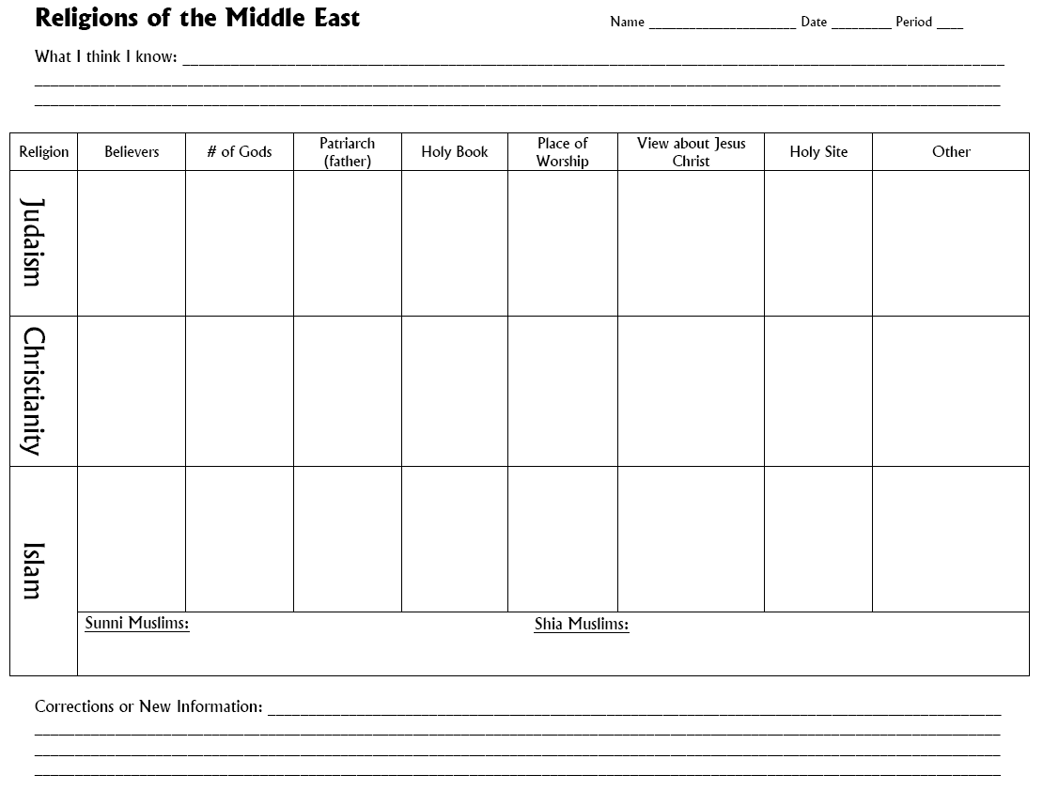
Complete the “What I Think I Know” section at the top of your Religions of the Middle East Chart.
Pair and Share when instructed
Notes:
Instructional Approach(s): The teacher should give students 1 minute or less to identify some of the facts they may already know about one or all of the religions in the Middle East. Students can then pair up to share. Partners can be determined by the students or the teacher can provide more specific directions such as turn to the person directly in front/behind you or to the right/left of you, etc. It may be necessary to have a group of three if you have an uneven number of students. Do not allow more than 30 seconds to 1 minute of discussion time. The teacher should be walking around listening and redirecting discussions as needed. The teacher can briefly discuss student responses with the class.

Slide 10
Religions of the Middle East:
All three are monotheistic (believe in one God)
All three acknowledge Abraham as the patriarch (father) of their faith
Each has a holy book and a specific place of worship
Each has a different view about Jesus Christ
Some of these religions share common holy sites in the region but also have their own unique holy sites
Notes:
Instructional Approach(s): The teacher should present the information on the slide. The students do not need to write down any information. The specifics for each religion will be covered in the following slides. However, this is the general information the state says students need to know about the religions

Slide 11

Judaism
Believers are called Jews
Monotheistic (believe in one God)
Patriarch (father) of the faith is
Abraham
Holy Books: Torah (parts of the Old
Testament) and the Talmud
Notes:
Instructional Approach(s): The teacher should present the information on the slide while the students record the important information on their graphic organizer.

Slide 12
Judaism
Place of worship is a Synagogue
View of Jesus Christ: He was an
ordinary Jew, not the Messiah. Jews
are still waiting on the Messiah.
Holy Sites: Jerusalem, Wailing Wall
(remains of a Jerusalem temple)
What does Messiah mean?
Savior or divine person
Notes:
Instructional Approach(s): The teacher should present the information on the slide while the students record the important information on their graphic organizer.

Slide 13
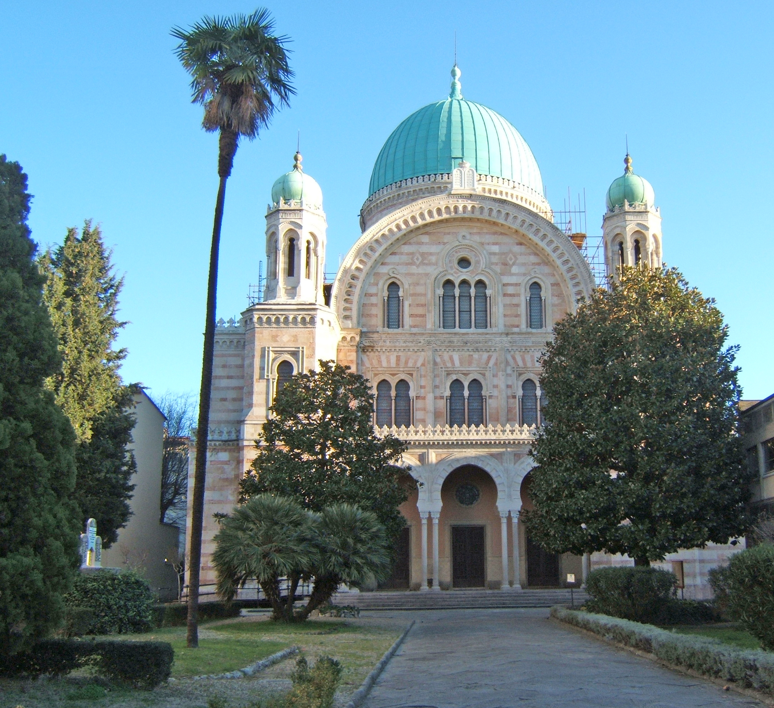
Synagogue
Notes:
Instructional Approach(s): The slide is used to illustrate a real synagogue

Slide 14

Symbols of
Judaism
Star of David
Menorah
Notes:
Instructional Approach(s): The teacher should present the information on the slide. The students can record the information in the “other” section of their graphic organizer. Students are not expected to know the information. It is additional information which many students have seen but might not have been aware of the specific religion to which it was associated. Do not go into explanations of the different symbols or traditions. If a student is interested in the additional information advise him/her to do research at home or in the library on any questions beyond what they have recorded in their notes.

Slide 15
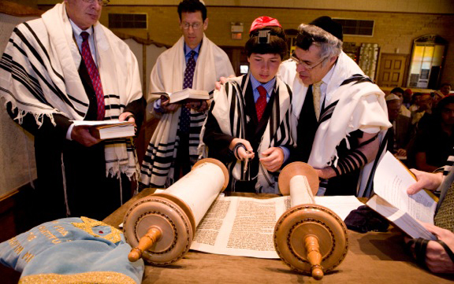
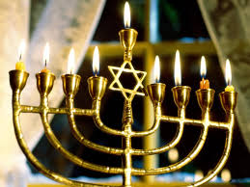
Traditions of
Judaism
Bar/Bat Mitzvah
Hanukkah
Notes:
Instructional Approach(s): The teacher should present the information on the slide. The students can record the information in the “other” section of their graphic organizer. Students are not expected to know the information. It is additional information which many students have seen but might not have been aware of the specific religion to which it was associated. Do not go into explanations of the different symbols or traditions. If a student is interested in the additional information advise him/her to do research at home or in the library on any questions beyond what they have recorded in their notes.

Slide 16

Christianity
Believers are called Christians
Monotheistic (believe in one God)
Patriarch (father) of the faith is
Abraham
Holy Books: Bible
Notes:
Instructional Approach(s): The teacher should present the information on the slide while the students record the important information on their graphic organizer.

Slide 17
Christianity
Place of worship is a Church, Chapel,
or Cathedral
View of Jesus Christ: He was the son
of God and the Messiah (savior)
Holy Sites: Jerusalem, Bethlehem,
and Vatican City (Catholic)
Notes:
Instructional Approach(s): The teacher should present the information on the slide while the students record the important information on their graphic organizer.

Slide 18
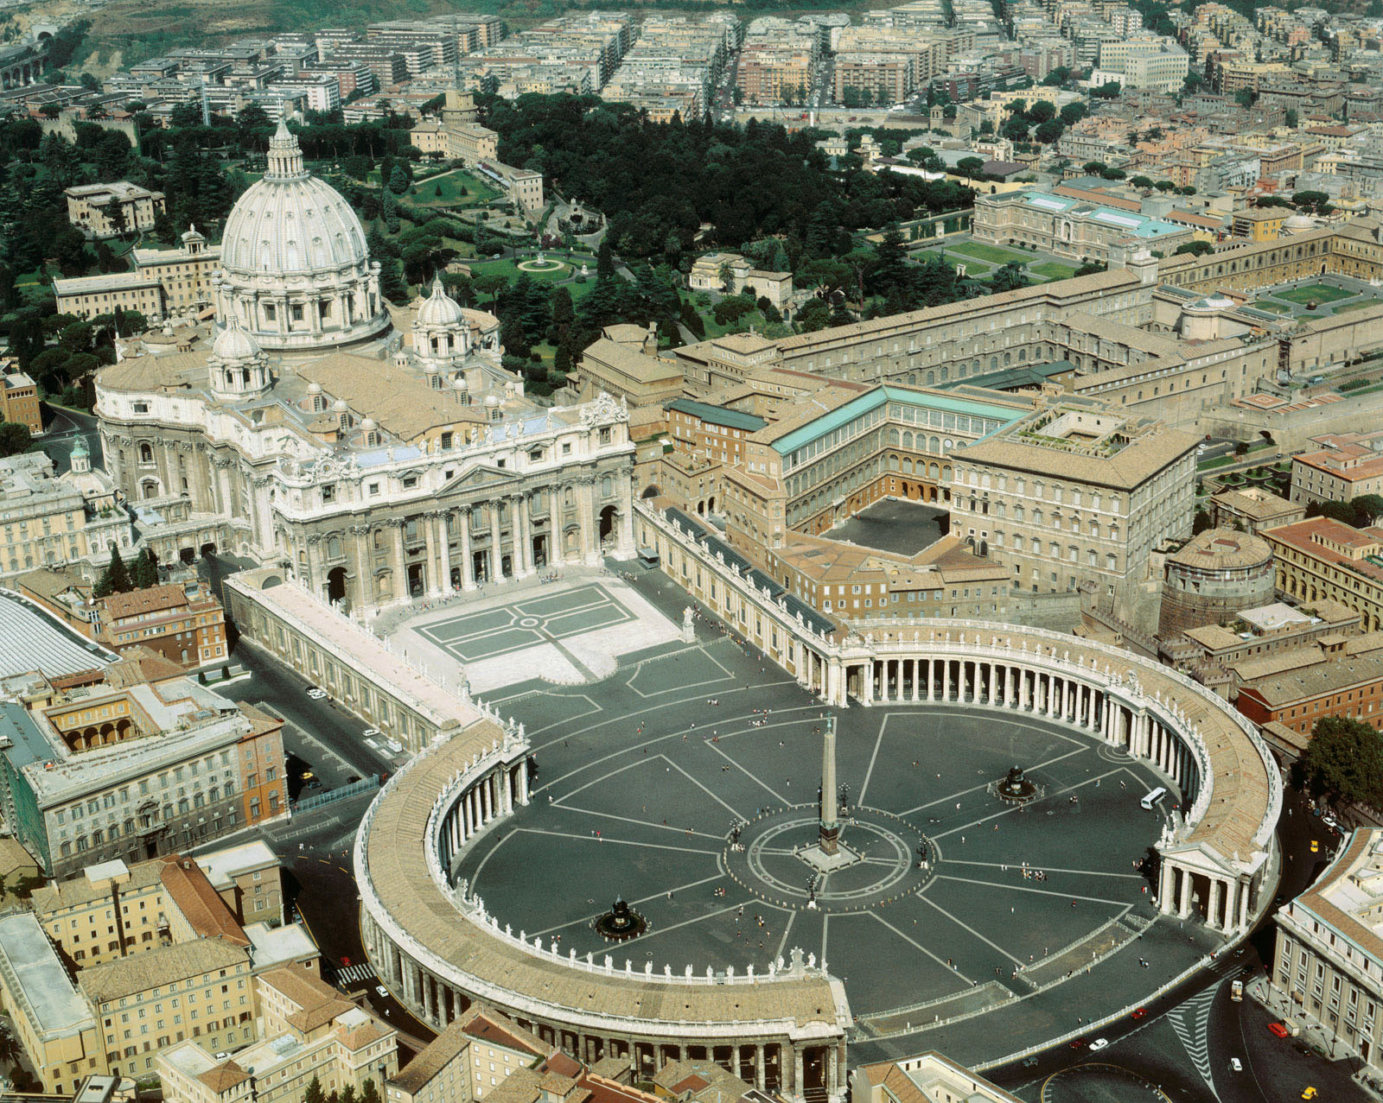
Vatican City
Notes:
Instructional Approach(s): The slide is used to show an illustration of the Vatican City

Slide 19


Symbols of
Christianity
Cross
Fish
Notes:
Instructional Approach(s): The teacher should present the information on the slide. The students can record the information in the “other” section of their graphic organizer. Students are not expected to know the information. It is additional information which many students have seen but might not have been aware of the specific religion to which it was associated. Do not go into explanations of the different symbols or traditions. If a student is interested in the additional information advise him/her to do research at home or in the library on any questions beyond what they have recorded in their notes.

Slide 20
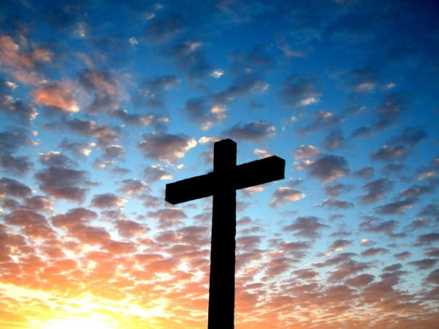
Traditions of
Christianity
Christmas
Easter
Notes:
Instructional Approach(s): The teacher should present the information on the slide. The students can record the information in the “other” section of their graphic organizer. Students are not expected to know the information. It is additional information which many students have seen but might not have been aware of the specific religion to which it was associated. Do not go into explanations of the different symbols or traditions. If a student is interested in the additional information advise him/her to do research at home or in the library on any questions beyond what they have recorded in their notes.

Slide 21

Islam
Believers are called Muslims
Monotheistic (believe in one God)
Patriarch (father) of the faith is
Abraham
Holy Books: Qur’an or Koran
Notes:
Instructional Approach(s): The teacher should present the information on the slide while the students record the important information on their graphic organizer.

Slide 22
Islam
Place of worship is a Mosque
View of Jesus Christ: He was a
prophet sent by Allah (God) but he
was not a Messiah or the son of God.
Holy Sites: Jerusalem, Mecca,
Medina
What does Prophet mean?
Messenger of God
Notes:
Instructional Approach(s): The teacher should present the information on the slide while the students record the important information on their graphic organizer.

Slide 23
Islam
Muslims believe that Abraham was
the first prophet (messenger of Allah
or God) and that Jesus Christ was a
prophet that came after Abraham
Muslims believe that Muhammad was
the last prophet of Allah. Muhammad
started the religion of Islam.
Notes:
Instructional Approach(s): The teacher should present the information on the slide while the students record the important information on their graphic organizer. *Make sure students record that Muhammad founded Islam and is considered the last prophet or Messenger of Allah.

Slide 24
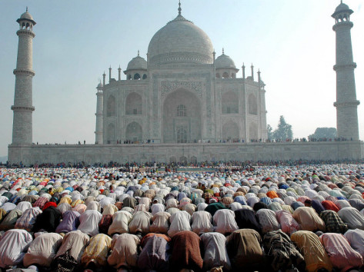
Mosque
Notes:
Instructional Approach(s): The slide is used to show an illustration of a real Mosque

Slide 25

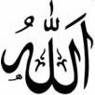
Symbols of
Islam
Star and Crescent
“Allah” in Arabic
Notes:
Instructional Approach(s): The teacher should present the information on the slide. The students can record the information in the “other” section of their graphic organizer. Students are not expected to know the information. It is additional information which many students have seen but might not have been aware of the specific religion to which it was associated. Do not go into explanations of the different symbols or traditions. If a student is interested in the additional information advise him/her to do research at home or in the library on any questions beyond what they have recorded in their notes.

Slide 26
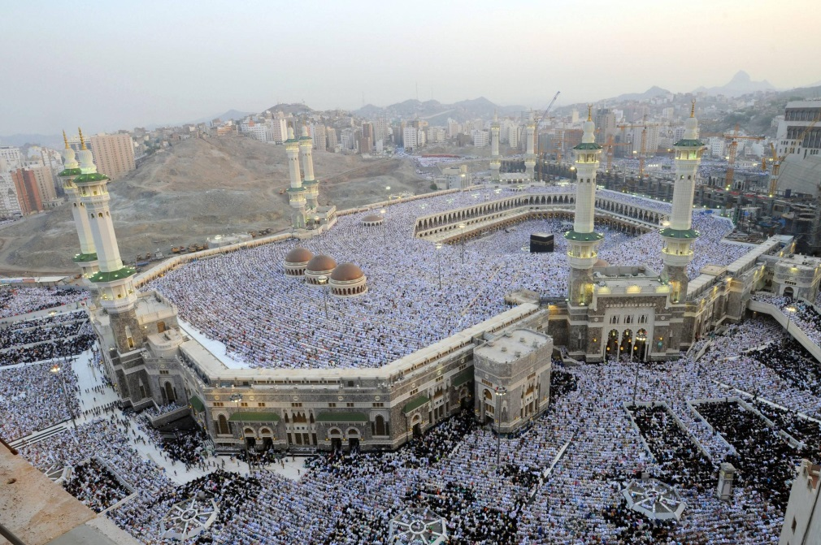
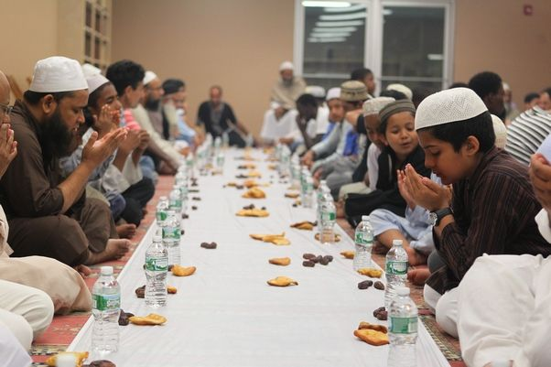
Traditions of
Islam
Ramadan (holy month of fasting)
Pilgrimage to Mecca
Notes:
Instructional Approach(s): The teacher should present the information on the slide. The students can record the information in the “other” section of their graphic organizer. Students are not expected to know the information. It is additional information which many students have seen but might not have been aware of the specific religion to which it was associated. Do not go into explanations of the different symbols or traditions. If a student is interested in the additional information advise him/her to do research at home or in the library on any questions beyond what they have recorded in their notes.

Slide 27
Diversity of Religions within the Ethnic Groups
There are various religious groups within the ethnic groups of Arabs, Persians, and Kurds
The majority of Arabs in the Middle East are Muslims, a religious group who practice the religion of Islam. However, NOT ALL Arabs are Muslims, and NOT ALL Muslims are Arab.
More than a billion people in the world are Muslims, but fewer than 15% of Muslims worldwide are Arab
Notes:
Instructional Approach(s): The teacher should present the information on the slide

Slide 28
What religion are the majority of Americans?
Most Americans are Christians. Are there different types of Christians?
There are Baptists, Catholics, Methodists, Protestants, etc.
Notes:
Instructional Approach(s): The teacher should pose the first question to the class. Click the mouse to reveal the answer and another question to pose to the class. When ready, click the mouse to show some of the “types” of Christians. The students do not need to know this information. The questions are simply used to move into the divisions in the Muslim faith just like there are divisions and differences in the Christian faith. Students are more likely aware of the different Christian groups, but not necessarily the different Muslim groups.

Slide 29
Just as there are different groups of Christians, there are also different groups of Muslims.
Two major groups are the Sunni Muslims and the Shia Muslims.
Notes:
Instructional Approach(s): The teacher should present the information on the slide.

Slide 30
So What’s The Difference?
  Sunnis follow the Sunnah,
  or custom of Muhammad
  (About 90% of Muslims are
  Sunnis)
  Shias are Muslims who
  follow Ali, Muhammad’s
  closest relative
Notes:
Instructional Approach(s): The teacher should present the information on the slide while the students record the important information on their graphic organizer

Slide 31
How They Disagree
Ali was Muhammad’s cousin and was married to his daughter. After Muhammad died, Muslims split over who would succeed Muhammad as leader of Islam
The Sunnis wanted the community to choose the best leader to succeed Muhammad
The Shia favored Ali, feeling that leadership should stay within the prophets family
Notes:
Instructional Approach(s): The teacher should present the information on the slide while the students record the important information on their graphic organizer

Slide 32
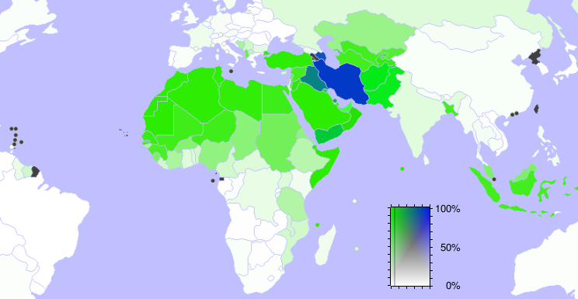
Sunni and Shia Muslims
Blue: Shia
Green: Sunni
Notes:
Instructional Approach(s): The teacher should present the information on the slide

Slide 33
Complete the “Corrections or New Information” section of your Religions of the Middle East Chart.
Pair and Share when instructed
Notes:
Instructional Approach(s): The students should use the information in the chart to identify any corrections or new information based on their previous “What I Think I Know” section at the beginning of the lesson. Partners can be determined by the students or the teacher can provide more specific directions such as turn to the person directly in front/behind you or to the right/left of you, etc. It may be necessary to have a group of three if you have an uneven number of students. Do not allow more than 1-2 minutes of discussion time. The teacher should be walking around listening and redirecting discussions as needed. The teacher can briefly discuss student responses with the class.

Slide 34
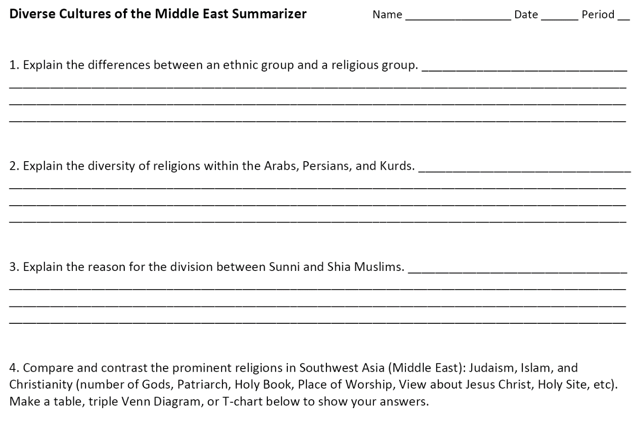
Diverse Cultures of the Middle East Summarizer
Notes:
Instructional Approach(s): Each student should complete the summarizer. The teacher should use the summarizer to determine the level of student mastery and if differentiation is needed.

