Slide 1
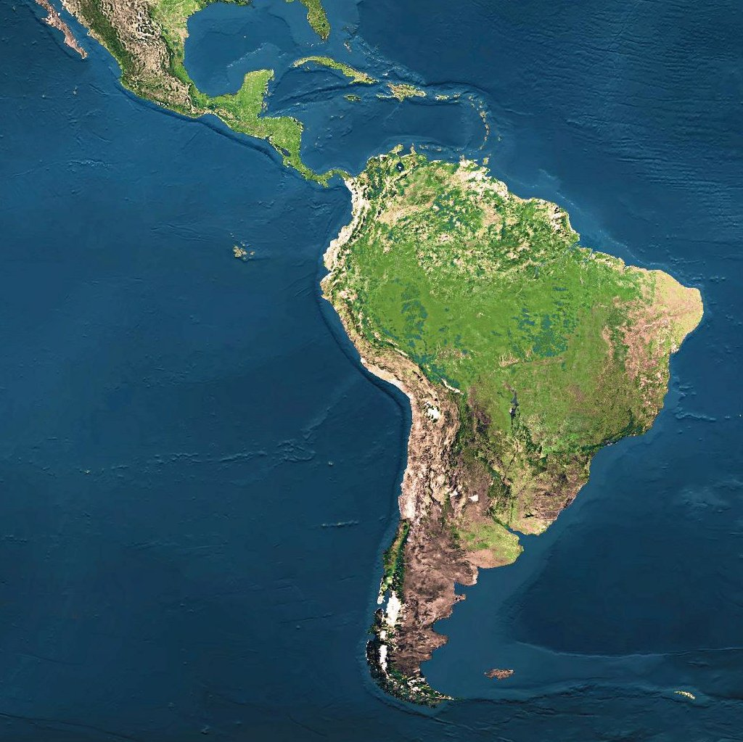
Geography of
Latin America

Slide 2
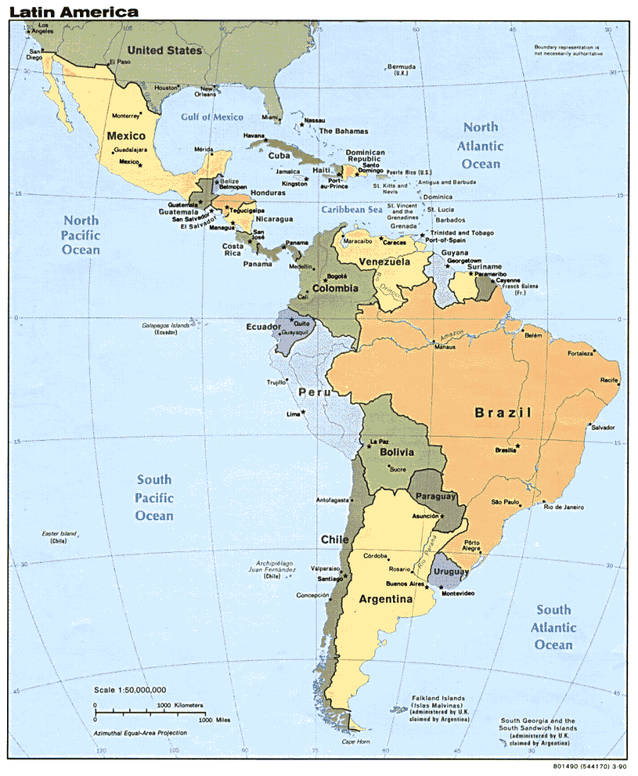
Geography
Latin America is divided into three regions:
Mexico and Central America
The Caribbean
3. South America

Slide 3
Mexico & Central America
2,500 miles (about as wide as the US)
Mountains dominate the region
Part of a huge system that extends from Canada, through the US, and all the way to the tip of South America
Central plateau in Mexico
Lies between Sierra Madre mountains and makes up more than half the country’s area
Central America is an Isthmus
Isthmus = a narrow strip of land that has water on both sides and joins 2 larger bodies of water
Many volcanoes in Central America, as a result, their soil is arable (fertile) and many people farm lands

Slide 4
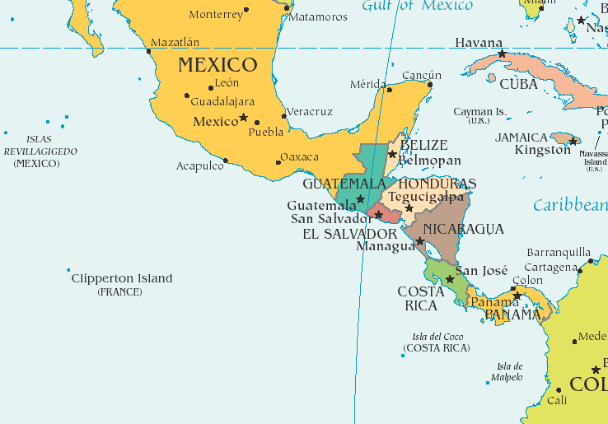

Slide 5
Gulf of Mexico
The Gulf of Mexico is a body of water.
It is bordered by:
United States to the north,
5 Mexican states to the south, &
and Cuba to the east.

Slide 6
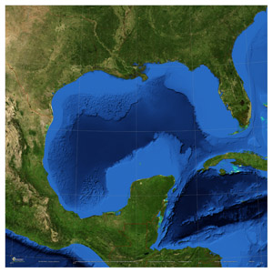

Slide 7
Sierra Madre Mountains
A mountain system in Mexico
Three major chains: the Sierra Madre Occidental in the west, the Sierra Madre Oriental in the east, and the Sierra Madre del Sur, which extends along the southern coast.
The Sierra Madre range contains some of the highest mountains and volcanoes in Latin America.

Slide 8
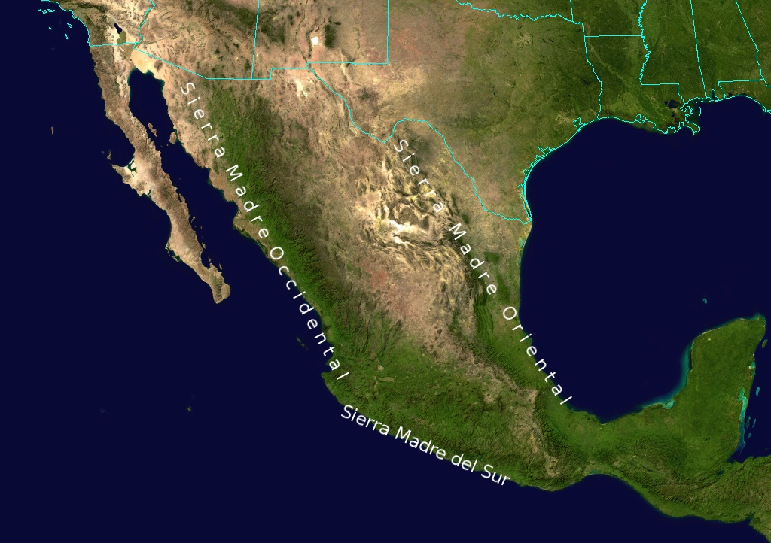

Slide 9
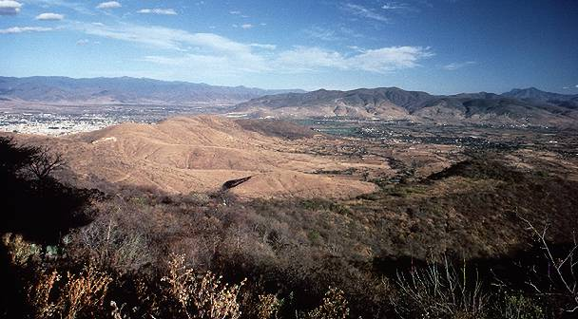

Slide 10
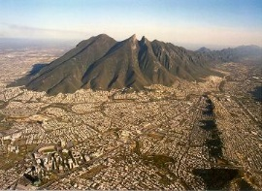
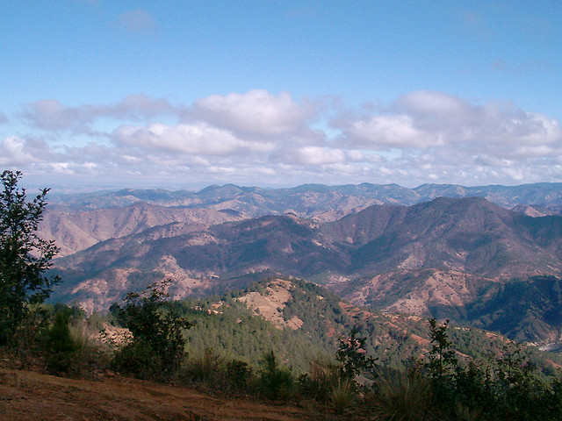

Slide 11
Panama Canal
A canal across the isthmus of Panama in Central America
A major “shortcut” that allows ships to travel between the Pacific and Atlantic oceans.
It handles a large volume of world shipping and enables vessels to avoid traveling around South America, reducing their voyages by thousands of miles and many days.
It consists of artificially created lakes, channels, and a series of locks, or water-filled chambers, that raise and lower ships through the mountainous terrain of central Panama.

Slide 12
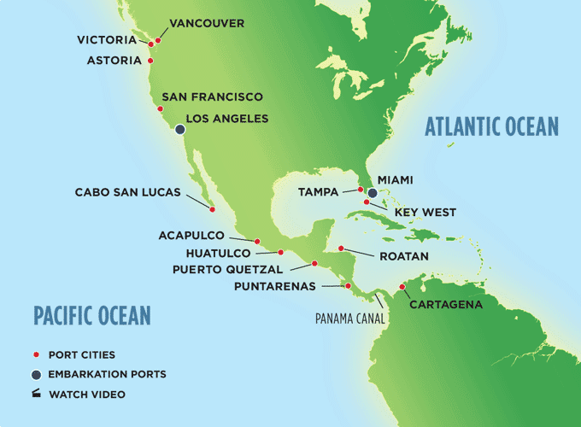

Slide 13
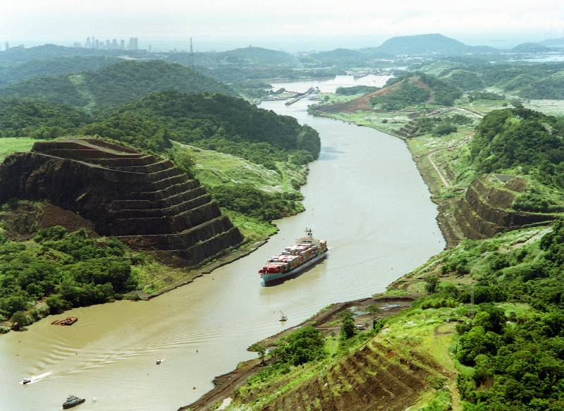

Slide 14
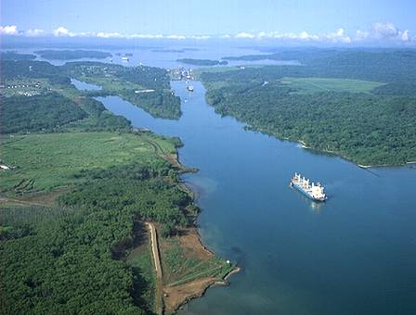

Slide 15
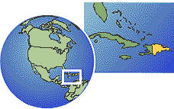
Caribbean Islands
The smaller islands are made of coral.
(Skeletons of tiny sea animals, rock-like substance)
The larger islands are tops of underwater mountains.
Examples: Cuba, Jamaica

Slide 16
Caribbean Sea
It surrounds the islands of the West Indies.
It’s east of Central America.
It’s a major trade route for Latin American countries.
A popular tourist area—noted for its mild tropical climate and beautiful waters

Slide 17
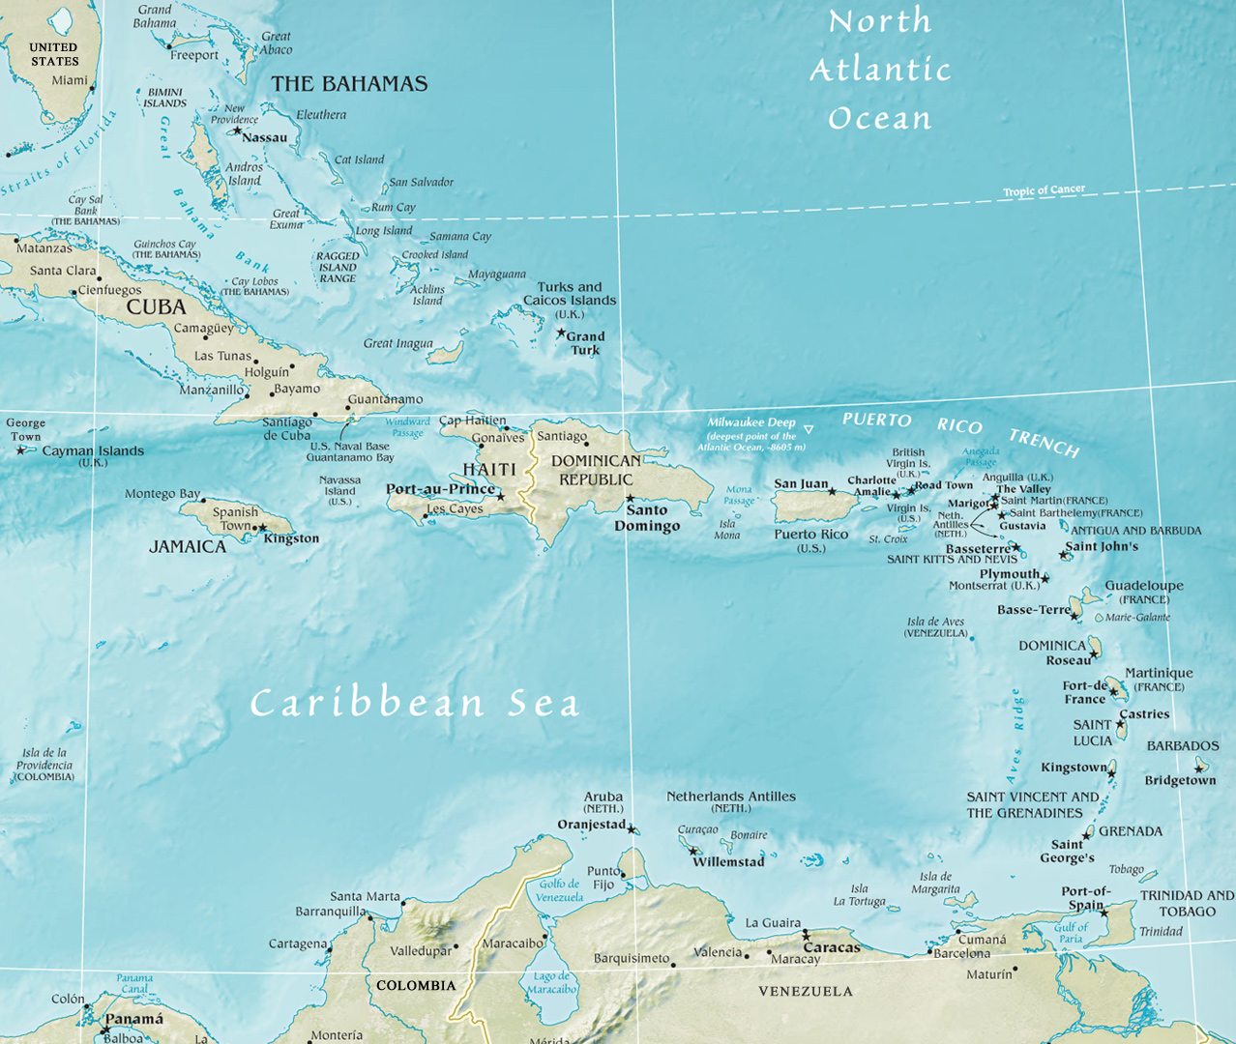

Slide 18
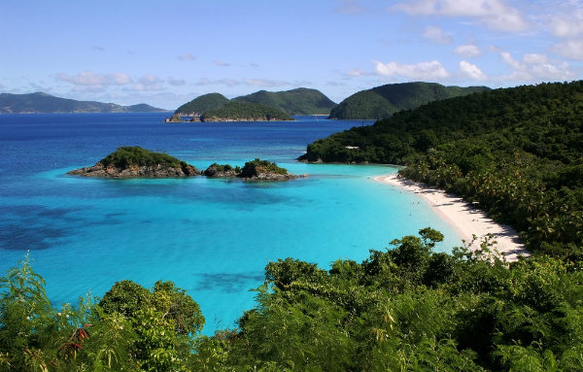

Slide 19
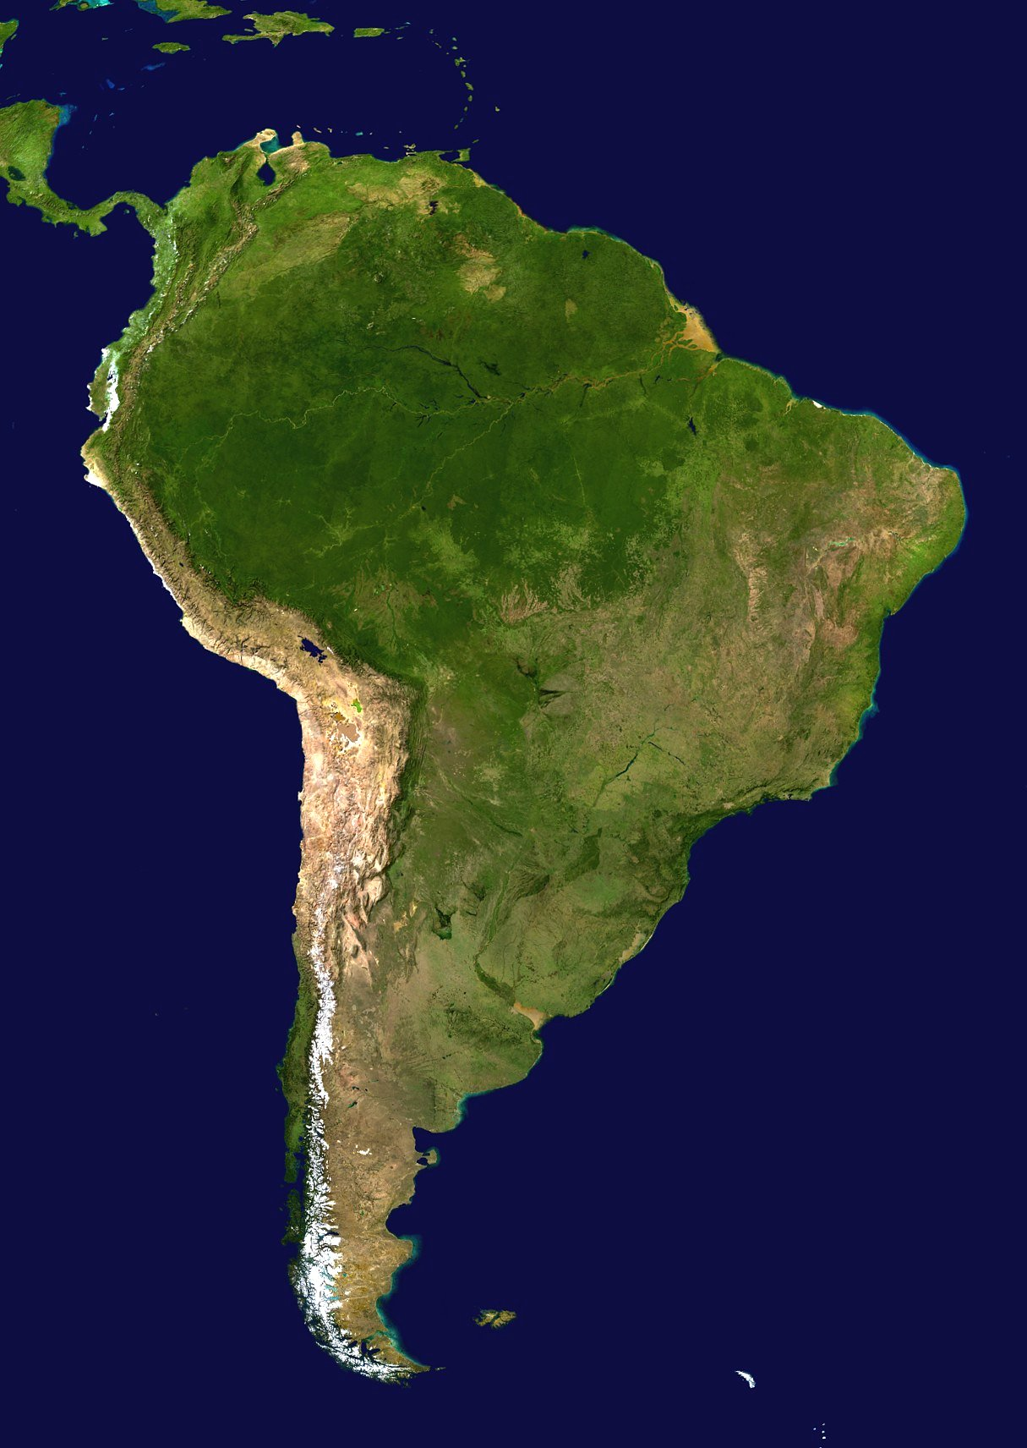
South America

Slide 20
Andes Mountains
4,500 miles along west coast of South America
They rise at some points to 20,000 feet—same height as twenty 100 story buildings stacked on top of each other!
2nd largest mountains in the world--Himalayas are the 1st.

Slide 21
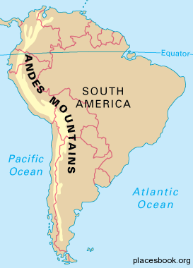

Slide 22
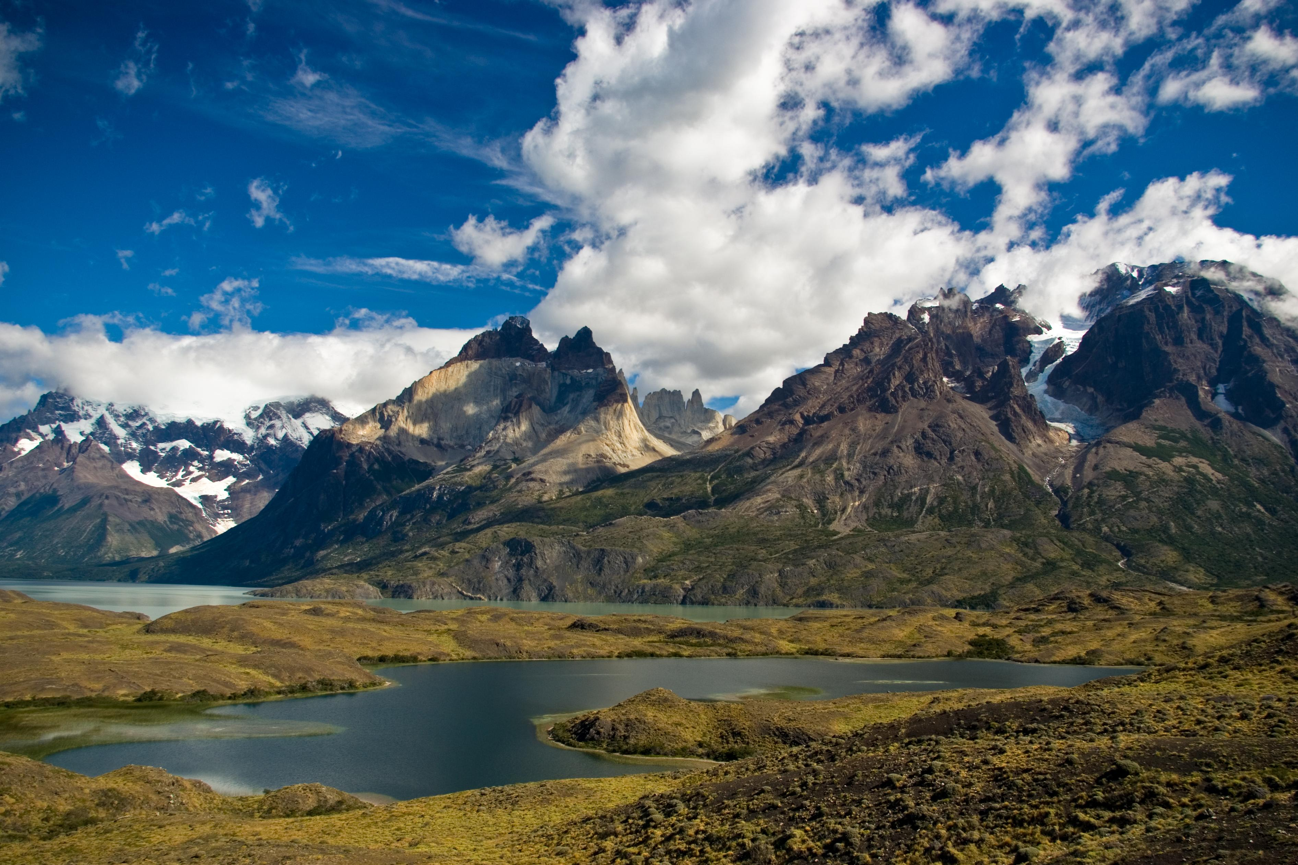

Slide 23
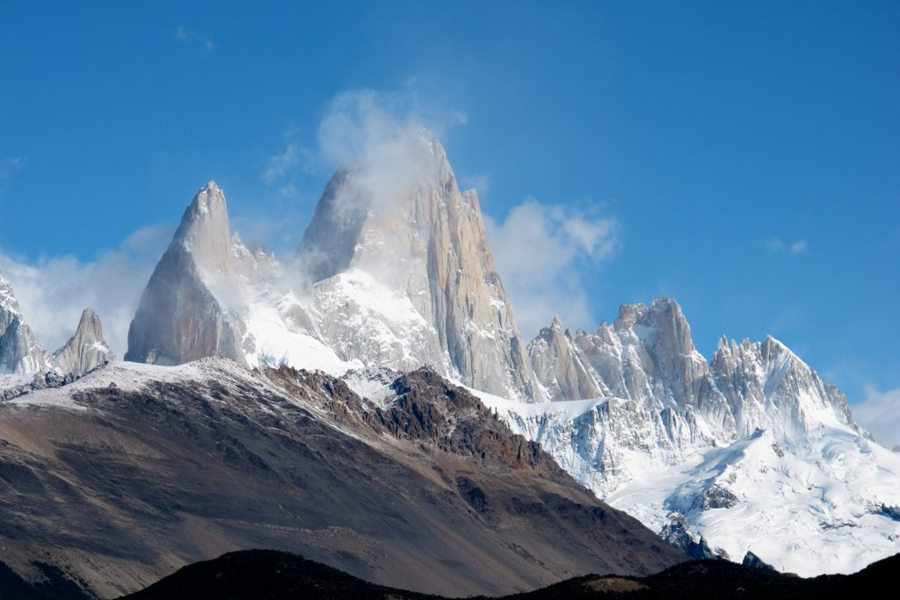

Slide 24
Amazon Rain Forest
Located in Brazil, in the Amazon River Basin
It is the largest tropical rain forest in the world.
It covers 1/3 of the continent of South America.

Slide 25
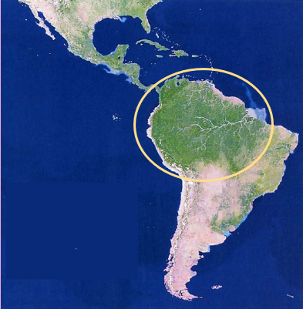

Slide 26
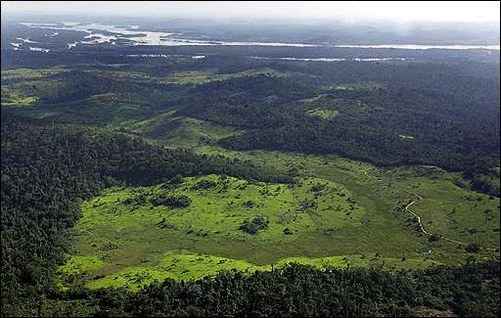
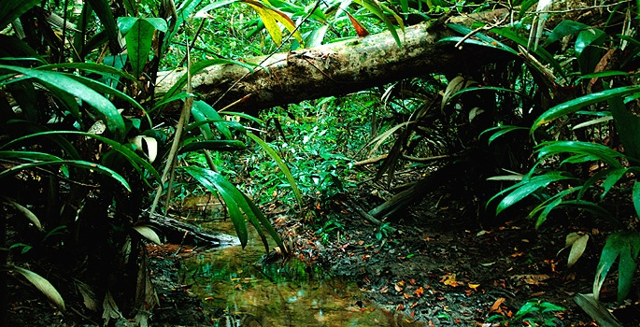

Slide 27
Atacama Desert
It is located in Chile.
Between the Pacific Ocean and the Andes Mountains
It’s one of the driest places on earth; very little rainfall year round.

Slide 28
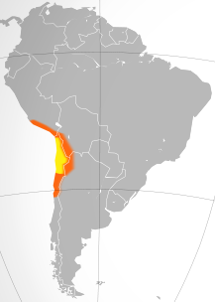

Slide 29
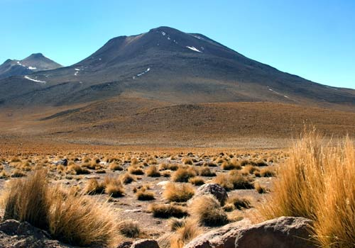

Slide 30
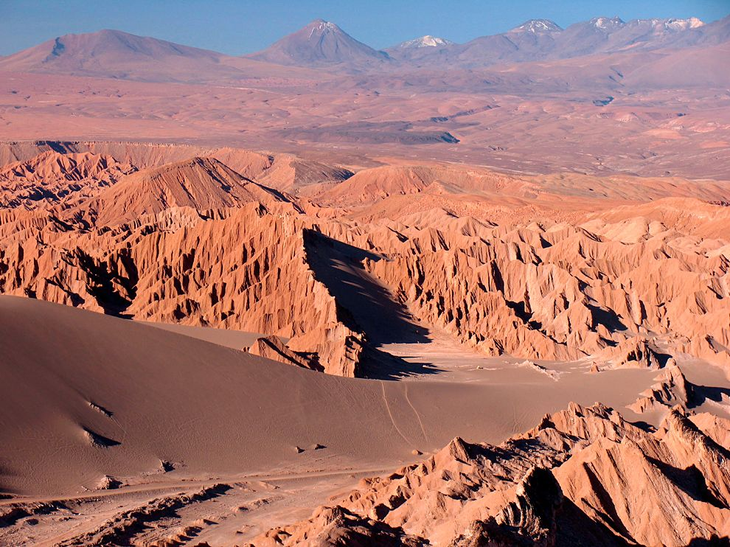

Slide 31
Amazon River
It’s the 2nd largest river in the world (1st is the Nile River).
It stretches 4,000 miles from Peru across to Atlantic Ocean.
The river contains 20% of all fresh water in the world!
It serves as a natural highway where it’s hard to build roads.
It provides food and hydroelectric power.

Slide 32
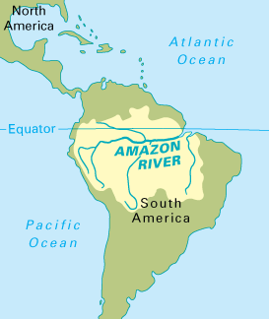

Slide 33
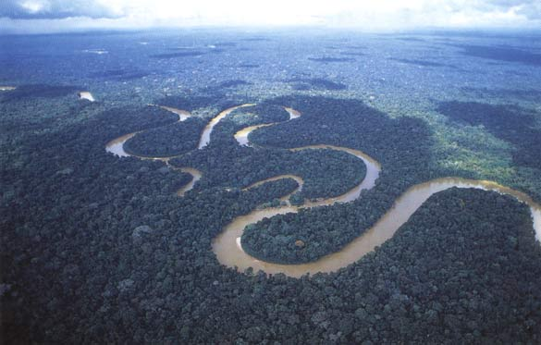

Slide 34
Pacific Ocean
World’s largest ocean
Covers the western coast of South America

Slide 35
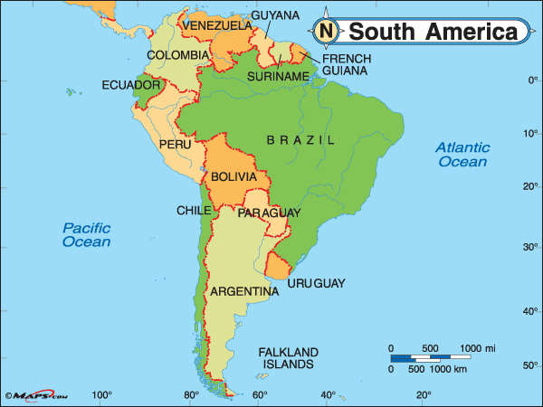

Slide 36
