Slide 1
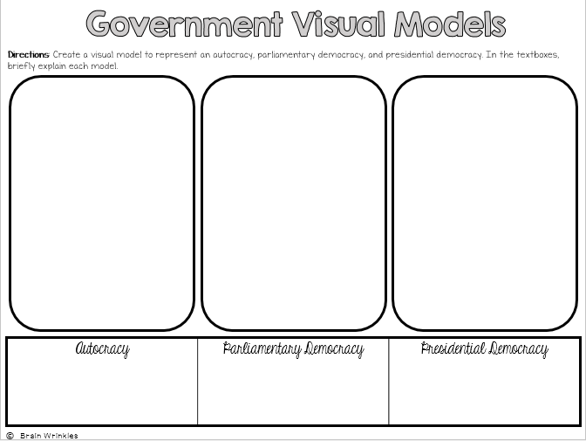
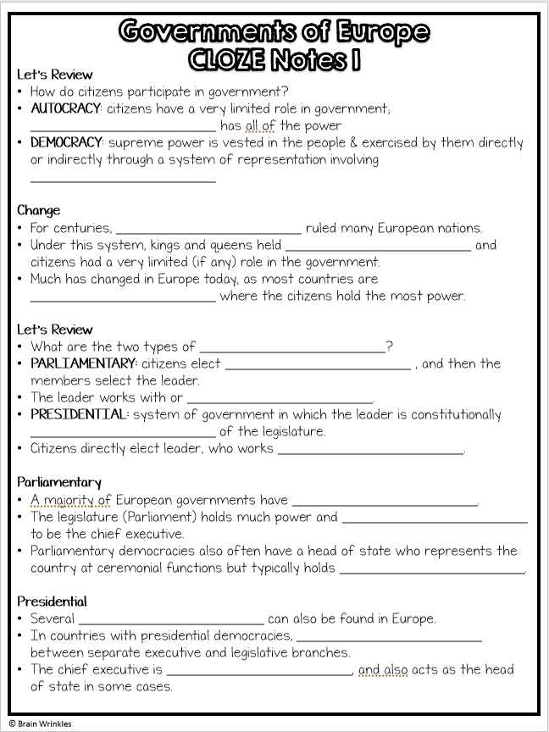
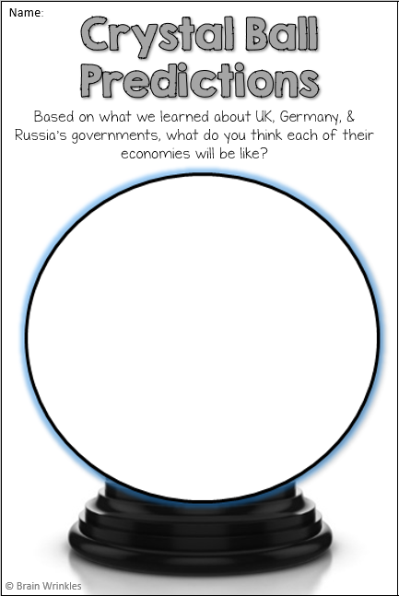
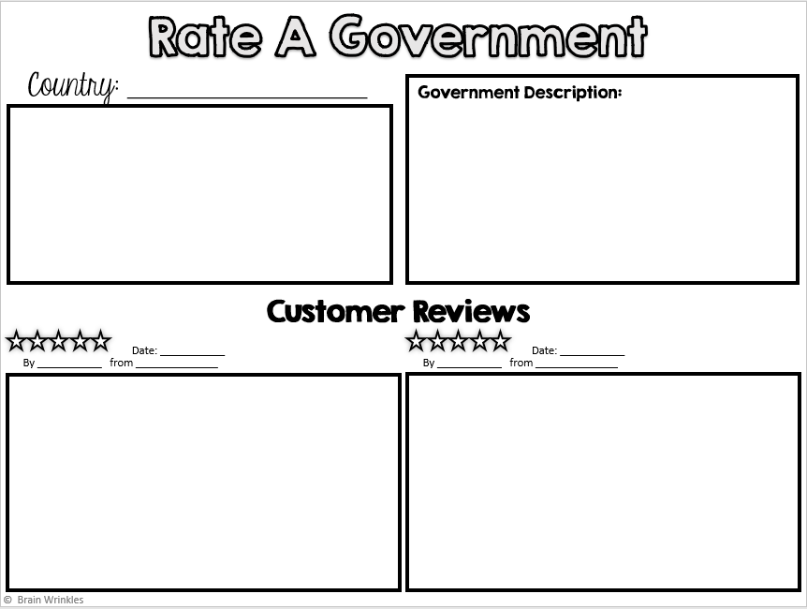
Europe’s
GOVERNMENTS
GOVERNMENTS
UK, Germany, & Russia
Presentation, Graphic Organizers, & Activities

Slide 2
STANDARDS:
SS6CG3 Compare and contrast various forms of government.
Explain citizen participation in autocratic and democratic governments. [i.e., role of citizens in choosing the leaders of the United Kingdom (parliamentary democracy), Germany (parliamentary democracy), and Russia (presidential democracy)].
Describe the two predominant forms of democratic governments: parliamentary and presidential.
© Brain Wrinkles

Slide 3
TEACHER INFO: Visual Models
Print off the Visual Models handout for each student.
BEFORE the presentation, have the students create models to represent an autocracy, parliamentary democracy, & presidential democracy. They will explain the models in the textboxes.
AFTER the presentation, give the students a few minutes to add to/change their models. When complete, have students share & discuss in small groups.
© Brain Wrinkles

Slide 4
Government Visual Models
Directions: Create a visual model to represent an autocracy, parliamentary democracy, and presidential democracy. In the textboxes, briefly explain each model.
Autocracy | Parliamentary Democracy | Presidential Democracy
© Brain Wrinkles

Slide 5
TEACHER INFO: Anticipation Guide
Print off the Anticipation Guide for each student (two-per-page).
The students will complete the guide BEFORE the presentation. Afterwards, give the students a few minutes to look back over their answers and make any corrections.
Check the answers as a class AFTER the presentation.
KEY
B
F
C
I
G
E
D
H
A
© Brain Wrinkles

Slide 6
Name:
Name:
European Governments
Anticipation Guide
European Governments
Anticipation Guide
Directions: You will make predictions about the answers to the following questions BEFORE learning about this unit. Write the letter of the vocabulary term that matches the definitions below.
Directions: You will make predictions about the answers to the following questions BEFORE learning about this unit. Write the letter of the vocabulary term that matches the definitions below.
A. State | B. Presidential | C. Democracy
D. Germany | E Russia | F. Legislature
G. Autocracy | H. Parliamentary | I. Chancellor
A. State | B. Presidential | C. Democracy
D. Germany | E Russia | F. Legislature
G. Autocracy | H. Parliamentary | I. Chancellor
_______ In this type of democracy, the leader works independently of the legislature.
_______ This branch of government makes the country’s laws.
_______ In this type of government, citizens play an important role because they are able to vote for leaders and laws.
_______ Who is Germany’s head of government?
_______ In this type of government, citizens have virtually no role because all the decisions are made by a single leader.
_______ This country was previously part of an autocratic system.
_______ The head of government is part of the legislature in which country?
_______ What type of democracy is found in the United Kingdom?
_______ The head of _____ is a ceremonial position with very little real power.
.
_______ In this type of democracy, the leader works independently of the legislature.
_______ This branch of government makes the country’s laws.
_______ In this type of government, citizens play an important role because they are able to vote for leaders and laws.
_______ Who is Germany’s head of government?
_______ In this type of government, citizens have virtually no role because all the decisions are made by a single leader.
_______ This country was previously part of an autocratic system.
_______ The head of government is part of the legislature in which country?
_______ What type of democracy is found in the United Kingdom?
_______ The head of _____ is a ceremonial position with very little real power.
.
© Brain Wrinkles
© Brain Wrinkles

Slide 7
TEACHER INFO: CLOZE Notes
The next pages are handouts for the students to use for note-taking during the presentation. (Print front to back to save paper and ink.)
Check the answers as a class after the presentation.
© Brain Wrinkles

Slide 8
Let’s Review
How do citizens participate in government?
AUTOCRACY: citizens have a very limited role in government; ________________________ has all of the power
DEMOCRACY: supreme power is vested in the people & exercised by them directly or indirectly through a system of representation involving ________________________
Change
For centuries, ________________________ ruled many European nations.
Under this system, kings and queens held ________________________ and citizens had a very limited (if any) role in the government.
Much has changed in Europe today, as most countries are ________________________ where the citizens hold the most power.
Let’s Review
What are the two types of ________________________?
PARLIAMENTARY: citizens elect ________________________ , and then the members select the leader.
The leader works with or ________________________.
PRESIDENTIAL: system of government in which the leader is constitutionally ________________________ of the legislature.
Citizens directly elect leader, who works ________________________.
Parliamentary
A majority of European governments have ________________________.
The legislature (Parliament) holds much power and ________________________ to be the chief executive.
Parliamentary democracies also often have a head of state who represents the country at ceremonial functions but typically holds ________________________.
Presidential
Several ________________________ can also be found in Europe.
In countries with presidential democracies, ________________________ between separate executive and legislative branches.
The chief executive is ________________________, and also acts as the head of state in some cases.
Governments of Europe
CLOZE Notes 1

Slide 9
Let’s Review
Know the difference when it comes to ________________________ :
Chief Executive: is the Head of Government; this is a country’s ________________________ who manages the day-to-day activities of the government.
Head of State: is a leader who officially represents the nation during ceremonial events, but in reality holds very ________________________.
UNITED KINGDOM
Background
In the past, the United Kingdom was a ________________________.
The reigning king or queen had the ________________________ and British citizens had little to no right to participate in government.
Today, the monarch still reigns, but has ________________________ in the country’s government.
Leadership
The ________________________ is the chief executive of the national government that holds the most political power.
He or she ________________________ in making and enforcing laws in the UK.
The ________________________ is the head of state who performs mostly ceremonial duties and holds little political power.
This role is restricted by the constitution of the United Kingdom (________________________).
How Leaders Are Chosen
The prime minister is ________________________ in parliament from the majority party.
Citizens elect members of parliament, and then the members ________________________.
The British monarch is a position ________________________ through the family line.
Legislature
United Kingdom’s ________________________ is called Parliament.
The ________________________ are called the House of Lords and the House of Commons.
Members of the House of Lords are ________________________ to the position.
Members in the House of Commons are ________________________ by Britain’s citizens.
House of Commons
UK’s citizens ________________________.
646 members total: ________________________, 40 from Wales, 59 from Scotland, and 18 from Northern Ireland
This branch controls the ________________________(has lots of power).
Governments of Europe
CLOZE Notes 2

Slide 10
Parliamentary Democracy
The ________________________ with the most members in the House of Commons is asked by the queen to become prime minister.
The prime minister is the chief executive (head of the government) and runs the ________________________ of the government.
Role of Citizens
Much like in the US, citizens have ________________________ like freedom of speech, press, religion, and assembly.
Citizens also have the ________________________.
Men and women who are ________________________ of age may choose to vote in national elections.
Citizens can choose representatives from ________________________.
Citizens do ________________________ the leader (chief executive), only members of the House of Commons.
GERMANY Leadership
Germany’s ________________________ is the powerful chief executive and head of the military.
He or she ________________________(Bundestag) in making and enforcing Germany’s laws.
The ________________________ is the official head of state and has very little power.
The duties are ________________________ and is a symbol for the country.
How Leaders Are Chosen
The chancellor is the leader of the ________________________ in Germany’s legislature (indirectly elected by the German people).
A special committee of representatives from the legislature ________________________.
Legislature
Germany’s ________________________ is called Parliament.
The ________________________ are called the Bundestag and the Bundesrat.
German citizens age ________________________ elect members of both houses.
Bundestag
The Bundestag is the lower house and has the ________________________.
Citizens of each German state ________________________.
Members of this house ________________________(chief executive of Germany).
Governments of Europe
CLOZE Notes 3

Slide 11
Parliamentary Democracy
Germany’s parliamentary democracy is structured very much like that ________________________.
German citizens ________________________ of the Bundestag.
Several political parties are represented in the Bundestag, and the ________________________ party becomes the chief executive (chancellor).
Role of Citizens
In Germany, citizens age ________________________ can vote in elections.
Germany’s constitution called the ________________________ established rights and personal freedoms for German citizens, including freedom of speech and religion, equal rights for women, and equal education for all.
UK & Germany
UK and Germany are both very ________________________.
Both are ________________________ democracies.
Citizens have ________________________ and freedoms.
People can participate in government by running for office, voting, and ________________________ on important issues.
RUSSIA
Background
Russia’s government has gone through ________________________ over the past several decades. During the Cold War era, Russia was part of the ________________________ Soviet Union.
As more and more personal and economic freedoms began opening up in the country during the 1990s, Russia shifted from a communist country to a ________________________.
Today, Russia’s government is based on the presidential democracy of the ________________________.
Leadership
The ________________________ is the chief executive with the most political power.
Can issue orders ________________________ of the legislature
Appoints many ________________________, including the prime minister
The ________________________ serves more of an administrative role and helps with the day-to-day running of the government.
How Leaders Are Chosen
Russians ________________________ a president to serve as the chief executive for a six-year term.
The president then ________________________ to help with running the government.
Governments of Europe
CLOZE Notes 4

Slide 12
Legislature
Russia’s bicameral legislature is called the ________________________.
It consists of ________________________ called the Federation Council and the State Duma.
Citizens vote to ________________________ to the State Duma, while members of the Federation Council are appointed by Russia’s many lower district governments.
Presidential Democracy
Russia has a ________________________ democracy.
Citizens directly ________________________ every six years.
The executive branch (president) ________________________ of the legislative branch (Federal Assembly.
Role of Citizens
Citizens age ________________________ are free to vote or run for office.
Russians have a lot ________________________ over the government today than they did a couple decades ago.
Russia adopted a new constitution in 1993 that guarantees ________________________ of speech, religion, the press, assembly, etc.
Other important rights granted, which were denied during Communist rule, include freedom of movement, mail correspondence, and right to ________________________.
Struggles
Unfortunately, freedoms for Russia’s citizens are ________________________.
Even though Russia is a democracy, the Russian government is often accused of ________________________ of speech.
The government often uses ________________________ with the press and media so that information is manipulated.
Russians who criticize the government often ________________________, such as jail time.
Governments of Europe
CLOZE Notes 5

Slide 13
Let’s Review
How do citizens participate in government?
AUTOCRACY: citizens have a very limited role in government; one person has all of the power
DEMOCRACY: supreme power is vested in the people & exercised by them directly or indirectly through a system of representation involving free elections
Change
For centuries, absolute monarchs ruled many European nations.
Under this system, kings and queens held most of the power and citizens had a very limited (if any) role in the government.
Much has changed in Europe today, as most countries are democracies where the citizens hold the most power.
Let’s Review
What are the two types of democratic governments?
PARLIAMENTARY: citizens elect members of Parliament, and then the members select the leader.
The leader works with or through the legislature.
PRESIDENTIAL: system of government in which the leader is constitutionally independent of the legislature.
Citizens directly elect leader, who works separately from legislature.
Parliamentary
A majority of European governments have parliamentary democracies.
The legislature (Parliament) holds much power and elects a prime minister to be the chief executive.
Parliamentary democracies also often have a head of state who represents the country at ceremonial functions but typically holds very little real power.
Presidential
Several presidential democracies can also be found in Europe.
In countries with presidential democracies, power is divided between separate executive and legislative branches.
The chief executive is elected by the people, and also acts as the head of state in some cases.
© Brain Wrinkles
Governments of Europe
CLOZE Notes 1

Slide 14
Let’s Review
Know the difference when it comes to leadership:
Chief Executive: is the Head of Government; this is a country’s top powerful official who manages the day-to-day activities of the government.
Head of State: is a leader who officially represents the nation during ceremonial events, but in reality holds very little political power.
UNITED KINGDOM
Background
In the past, the United Kingdom was a powerful monarchy.
The reigning king or queen had the ultimate power and British citizens had little to no right to participate in government.
Today, the monarch still reigns, but has very little influence in the country’s government.
Leadership
The prime minister is the chief executive of the national government that holds the most political power.
He or she leads Parliament in making and enforcing laws in the UK.
The monarch is the head of state who performs mostly ceremonial duties and holds little political power.
This role is restricted by the constitution of the United Kingdom (constitutional monarchy).
How Leaders Are Chosen
The prime minister is elected by members in parliament from the majority party.
Citizens elect members of parliament, and then the members vote for prime minister.
The British monarch is a position inherited through the family line.
Legislature
United Kingdom’s bicameral legislature is called Parliament.
The two houses are called the House of Lords and the House of Commons.
Members of the House of Lords are appointed to the position.
Members in the House of Commons are elected by Britain’s citizens.
House of Commons
UK’s citizens elect these members.
646 members total: 529 from England, 40 from Wales, 59 from Scotland, and 18 from Northern Ireland
This branch controls the country’s budget (has lots of power).
© Brain Wrinkles
Governments of Europe
CLOZE Notes 2

Slide 15
Parliamentary Democracy
The leader of the political party with the most members in the House of Commons is asked by the queen to become prime minister.
The prime minister is the chief executive (head of the government) and runs the day-to-day activities of the government.
Role of Citizens
Much like in the US, citizens have many personal freedoms like freedom of speech, press, religion, and assembly.
Citizens also have the right to vote.
Men and women who are 18 years of age may choose to vote in national elections.
Citizens can choose representatives from many political parties.
Citizens do NOT directly elect the leader (chief executive), only members of the House of Commons.
GERMANY Leadership
Germany’s chancellor is the powerful chief executive and head of the military.
He or she leads the parliament (Bundestag) in making and enforcing Germany’s laws.
The president is the official head of state and has very little power.
The duties are mostly ceremonial and is a symbol for the country.
How Leaders Are Chosen
The chancellor is the leader of the majority party in Germany’s legislature (indirectly elected by the German people).
A special committee of representatives from the legislature appoint the president.
Legislature
Germany’s bicameral legislature is called Parliament.
The two houses are called the Bundestag and the Bundesrat.
German citizens age 18 and older elect members of both houses.
Bundestag
The Bundestag is the lower house and has the most power.
Citizens of each German state elect its members.
Members of this house elect the chancellor (chief executive of Germany).
© Brain Wrinkles
Governments of Europe
CLOZE Notes 3

Slide 16
Parliamentary Democracy
Germany’s parliamentary democracy is structured very much like that in the UK.
German citizens elect members of the Bundestag.
Several political parties are represented in the Bundestag, and the leader of the majority party becomes the chief executive (chancellor).
Role of Citizens
In Germany, citizens age 18 and older can vote in elections.
Germany’s constitution called the Basic Law established rights and personal freedoms for German citizens, including freedom of speech and religion, equal rights for women, and equal education for all.
UK & Germany
UK and Germany are both very democratic countries.
Both are parliamentary democracies.
Citizens have many rights and freedoms.
People can participate in government by running for office, voting, and expressing opinions on important issues.
RUSSIA
Background
Russia’s government has gone through drastic changes over the past several decades. During the Cold War era, Russia was part of the Communist Soviet Union.
As more and more personal and economic freedoms began opening up in the country during the 1990s, Russia shifted from a communist country to a democratic one.
Today, Russia’s government is based on the presidential democracy of the United States.
Leadership
The president is the chief executive with the most political power.
Can issue orders without approval of the legislature
Appoints many government officials, including the prime minister
The prime minister serves more of an administrative role and helps with the day-to-day running of the government.
How Leaders Are Chosen
Russians directly elect a president to serve as the chief executive for a six-year term.
The president then appoints a prime minister to help with running the government.
© Brain Wrinkles
Governments of Europe
CLOZE Notes 4

Slide 17
Legislature
Russia’s bicameral legislature is called the Federal Assembly.
It consists of two houses called the Federation Council and the State Duma.
Citizens vote to elect representatives to the State Duma, while members of the Federation Council are appointed by Russia’s many lower district governments.
Presidential Democracy
Russia has a presidential democracy.
Citizens directly elect the president every six years.
The executive branch (president) works independently of the legislative branch (Federal Assembly.
Role of Citizens
Citizens age 18 and older are free to vote or run for office.
Russians have a lot more influence over the government today than they did a couple decades ago.
Russia adopted a new constitution in 1993 that guarantees basic freedoms of speech, religion, the press, assembly, etc.
Other important rights granted, which were denied during Communist rule, include freedom of movement, mail correspondence, and right to private telephone calls.
Struggles
Unfortunately, freedoms for Russia’s citizens are not absolute.
Even though Russia is a democracy, the Russian government is often accused of violating citizens’ freedom of speech.
The government often uses censorship with the press and media so that information is manipulated.
Russians who criticize the government often face consequences, such as jail time.
© Brain Wrinkles
Governments of Europe
CLOZE Notes 5

Slide 18
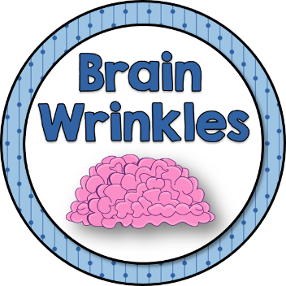
Europe’s
GOVERNMENTS
UK, Germany,
& Russia
© Brain Wrinkles

Slide 19
Let’s Review
How do citizens participate in government?
AUTOCRACY: citizens have a very limited role in government; one person has all of the power
DEMOCRACY: supreme power is vested in the people & exercised by them directly or indirectly through a system of representation involving free elections
© Brain Wrinkles

Slide 20
Change
For centuries, absolute monarchs ruled many European nations.
Under this system, kings and queens held most of the power and citizens had a very limited (if any) role in the government.
Much has changed in Europe today, as most countries are democracies where the citizens hold the most power.
© Brain Wrinkles

Slide 21
Let’s Review
What are the two types of democratic governments?
PARLIAMENTARY: citizens elect members of Parliament, and then the members select the leader.
The leader works with or through the legislature.
PRESIDENTIAL: system of government in which the leader is constitutionally independent of the legislature.
Citizens directly elect leader, who works separately from legislature.
© Brain Wrinkles

Slide 22
Parliamentary
A majority of European governments have parliamentary democracies.
The legislature (Parliament) holds much power and elects a prime minister to be the chief executive.
Parliamentary democracies also often have a head of state who represents the country at ceremonial functions but typically holds very little real power.
© Brain Wrinkles

Slide 23
Presidential
Several presidential democracies can also be found in Europe.
In countries with presidential democracies, power is divided between separate executive and legislative branches.
The chief executive is elected by the people, and also acts as the head of state in some cases.
© Brain Wrinkles

Slide 24
Let’s Review
Know the difference when it comes to leadership:
Chief Executive: is the Head of Government; this is a country’s top powerful official who manages the day-to-day activities of the government.
Head of State: is a leader who officially represents the nation during ceremonial events, but in reality holds very little political power.
© Brain Wrinkles

Slide 25
UNITED
KINGDOM
Parliamentary Democracy
© Brain Wrinkles

Slide 26
Background
In the past, the United Kingdom was a powerful monarchy.
The reigning king or queen had the ultimate power and British citizens had little to no right to participate in government.
Today, the monarch still reigns, but has very little influence in the country’s government.
© Brain Wrinkles

Slide 27
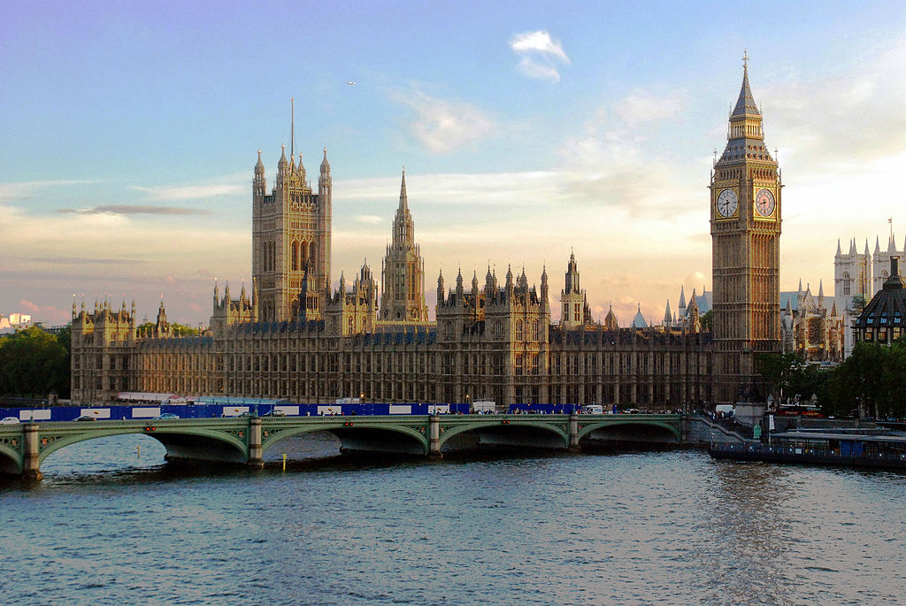
Palace of Westminster
(House of UK’s Parliament)
© Brain Wrinkles

Slide 28
Leadership
The prime minister is the chief executive of the national government that holds the most political power.
He or she leads Parliament in making and enforcing laws in the UK.
The monarch is the head of state who performs mostly ceremonial duties and holds little political power.
This role is restricted by the constitution of the United Kingdom (constitutional monarchy).
© Brain Wrinkles

Slide 29
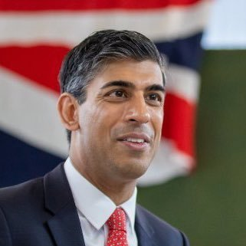
Rishi Sunak
UK’s Prime Minister

Slide 30
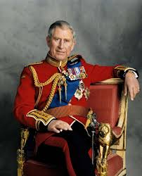
King Charles III
His Royal Highness

Slide 31
How Leaders
Are Chosen
The prime minister is elected by members in parliament from the majority party.
Citizens elect members of parliament, and then the members vote for prime minister.
The British monarch is a position inherited through the family line.
© Brain Wrinkles

Slide 32
Legislature
United Kingdom’s bicameral legislature is called Parliament.
The two houses are called the House of Lords and the House of Commons.
Members of the House of Lords are appointed to the position.
Members in the House of Commons are elected by Britain’s citizens.
© Brain Wrinkles

Slide 33
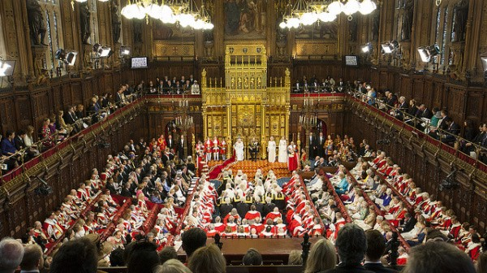
House of Lords
© Brain Wrinkles

Slide 34
House of
Commons
UK’s citizens elect these members.
646 members total: 529 from England, 40 from Wales, 59 from Scotland, and 18 from Northern Ireland
This branch controls the country’s budget (has lots of power).
© Brain Wrinkles

Slide 35
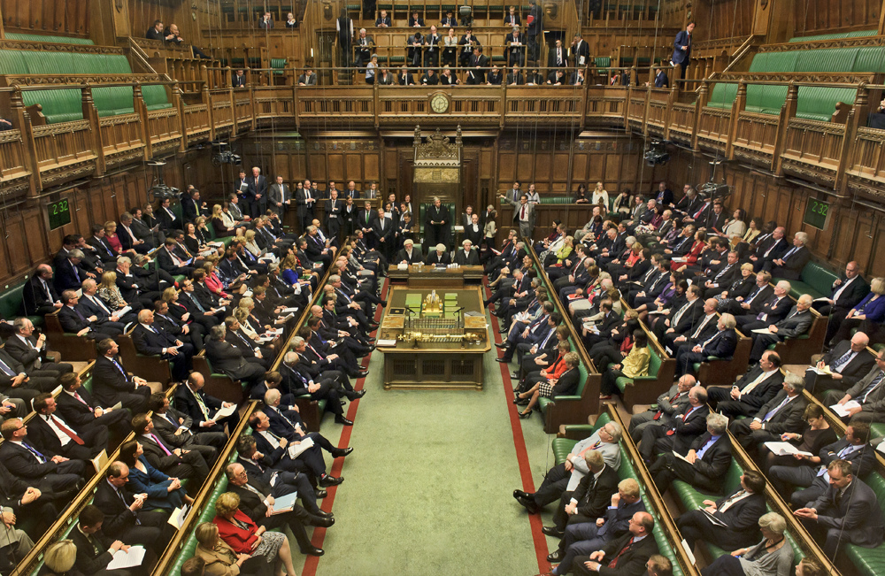
House of Commons
© Brain Wrinkles

Slide 36
Parliamentary
Democracy
The leader of the political party with the most members in the House of Commons is asked by the queen to become prime minister.
The prime minister is the chief executive (head of the government) and runs the day-to-day activities of the government.
© Brain Wrinkles

Slide 37
Role of
Citizens
Much like in the US, citizens have many personal freedoms like freedom of speech, press, religion, and assembly.
Citizens also have the right to vote.
Men and women who are 18 years of age may choose to vote in national elections.
© Brain Wrinkles

Slide 38
Role of
Citizens
Citizens can choose representatives from many political parties.
Citizens do NOT directly elect the leader (chief executive), only members of the House of Commons.
© Brain Wrinkles

Slide 39
GERMANY
Parliamentary Democracy
© Brain Wrinkles

Slide 40
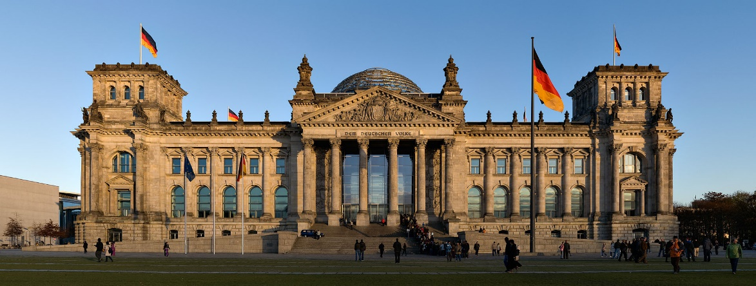
Germany’s Reichstag Building
© Brain Wrinkles

Slide 41
Leadership
Germany’s chancellor is the powerful chief executive and head of the military.
He or she leads the parliament (Bundestag) in making and enforcing Germany’s laws.
The president is the official head of state and has very little power.
The duties are mostly ceremonial and is a symbol for the country.
© Brain Wrinkles

Slide 42
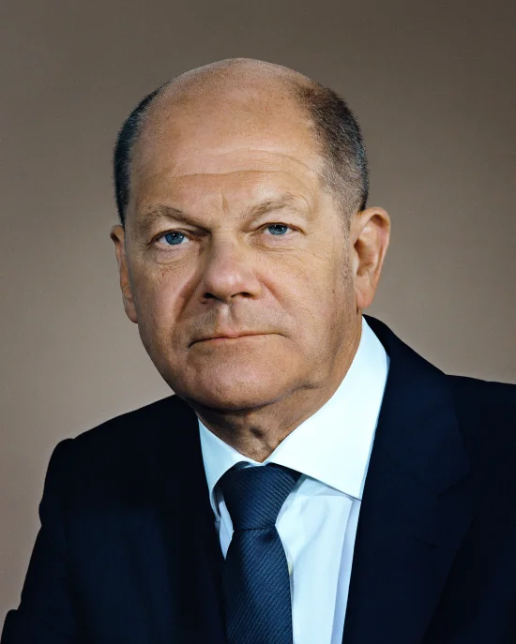
Olaf Scholz
Germany’s Chancellor

Slide 43
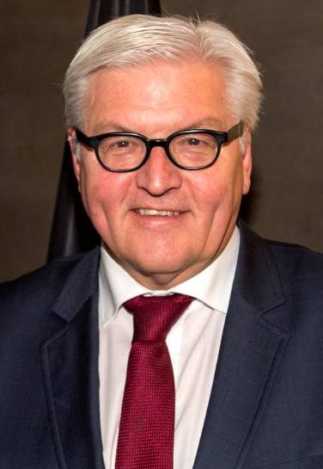
Frank-Walter Steinmeier
Germany’s President

Slide 44
How Leaders
Are Chosen
The chancellor is the leader of the majority party in Germany’s legislature (indirectly elected by the German people).
A special committee of representatives from the legislature appoint the president.
© Brain Wrinkles

Slide 45
Legislature
Germany’s bicameral legislature is called Parliament.
The two houses are called the Bundestag and the Bundesrat.
German citizens age 18 and older elect members of both houses.
© Brain Wrinkles

Slide 46
Bundestag
The Bundestag is the lower house and has the most power.
Citizens of each German state elect its members.
Members of this house elect the chancellor (chief executive of Germany).
© Brain Wrinkles

Slide 47
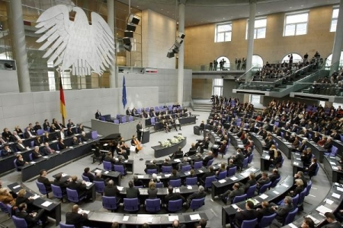
© Brain Wrinkles

Slide 48
Parliamentary
Democracy
Germany’s parliamentary democracy is structured very much like that in the UK.
German citizens elect members of the Bundestag.
Several political parties are represented in the Bundestag, and the leader of the majority party becomes the chief executive (chancellor).
© Brain Wrinkles

Slide 49
Role of
Citizens
In Germany, citizens age 18 and older can vote in elections.
Germany’s constitution called the Basic Law established rights and personal freedoms for German citizens, including freedom of speech and religion, equal rights for women, and equal education for all.
© Brain Wrinkles

Slide 50
UK & Germany
UK and Germany are both very democratic countries.
Both are parliamentary democracies.
Citizens have many rights and freedoms.
People can participate in government by running for office, voting, and expressing opinions on important issues.
© Brain Wrinkles

Slide 51
RUSSIA
Presidential Democracy
© Brain Wrinkles

Slide 52
Background
Russia’s government has gone through drastic changes over the past several decades.
During the Cold War era, Russia was part of the Communist Soviet Union.
As more and more personal and economic freedoms began opening up in the country during the 1990s, Russia shifted from a communist country to a democratic one.
Today, Russia’s government is based on the presidential democracy of the United States.
© Brain Wrinkles

Slide 53
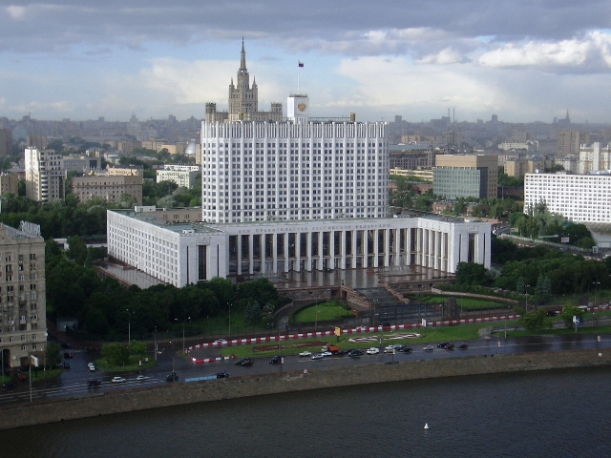
Russia’s White House
© Brain Wrinkles

Slide 54
Leadership
The president is the chief executive with the most political power.
Can issue orders without approval of the legislature
Appoints many government officials, including the prime minister
The prime minister serves more of an administrative role and helps with the day-to-day running of the government.
© Brain Wrinkles

Slide 55
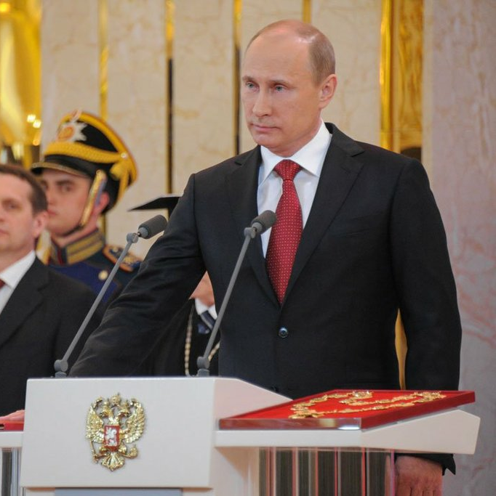
Vladimir Putin
Russia’s President

Slide 56
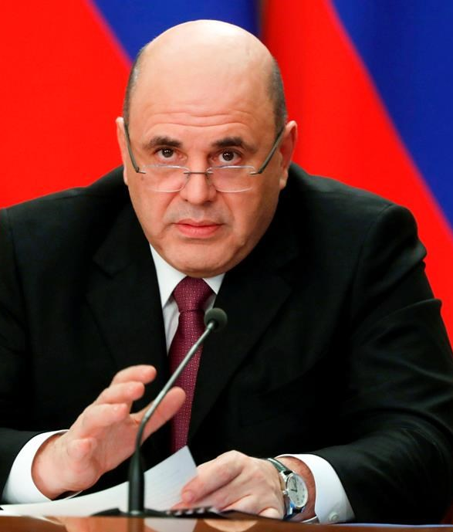
Mikhail Mishustin
Russia’s Prime Minister

Slide 57
How Leaders
Are Chosen
Russians directly elect a president to serve as the chief executive for a six-year term.
The president then appoints a prime minister to help with running the government.
© Brain Wrinkles

Slide 58
Legislature
Russia’s bicameral legislature is called the Federal Assembly.
It consists of two houses called the Federation Council and the State Duma.
Citizens vote to elect representatives to the State Duma, while members of the Federation Council are appointed by Russia’s many lower district governments.
© Brain Wrinkles

Slide 59
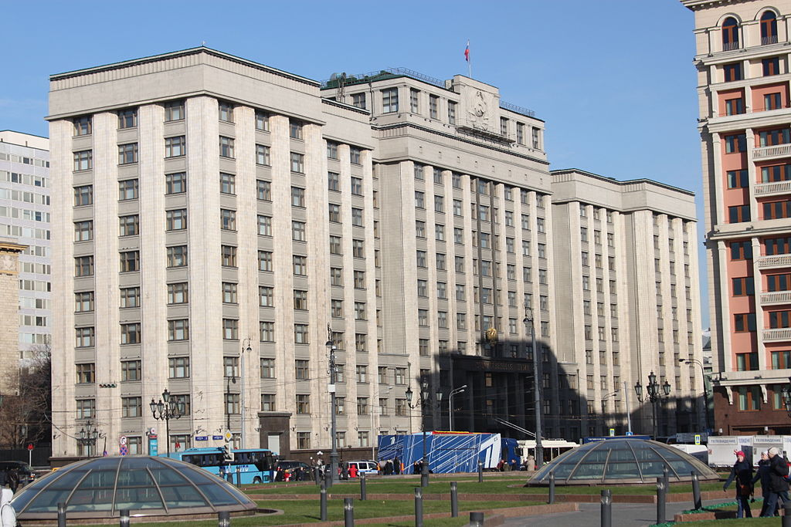
State Duma Building in Moscow
© Brain Wrinkles

Slide 60
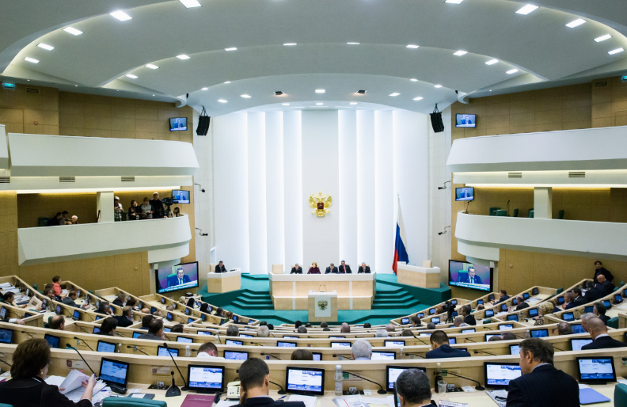
Federal Assembly in Session
© Brain Wrinkles

Slide 61
Presidential
Democracy
Russia has a presidential democracy.
Citizens directly elect the president every six years.
The executive branch (president) works independently of the legislative branch (Federal Assembly.
© Brain Wrinkles

Slide 62
Role of
Citizens
Citizens age 18 and older are free to vote or run for office.
Russians have a lot more influence over the government today than they did a couple decades ago.
© Brain Wrinkles

Slide 63
Role of
Citizens
Russia adopted a new constitution in 1993 that guarantees basic freedoms of speech, religion, the press, assembly, etc.
Other important rights granted, which were denied during Communist rule, include freedom of movement, mail correspondence, and right to private telephone calls.
© Brain Wrinkles

Slide 64
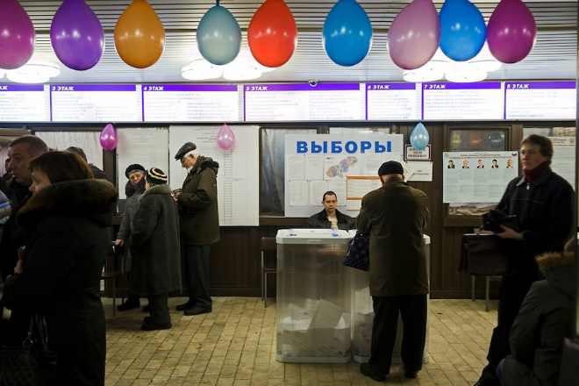
Voting in Russia
© Brain Wrinkles

Slide 65
Struggles
Unfortunately, freedoms for Russia’s citizens are not absolute.
Even though Russia is a democracy, the Russian government is often accused of violating citizens’ freedom of speech.
The government often uses censorship with the press and media so that information is manipulated.
Russians who criticize the government often face consequences, such as jail time.
© Brain Wrinkles

Slide 66
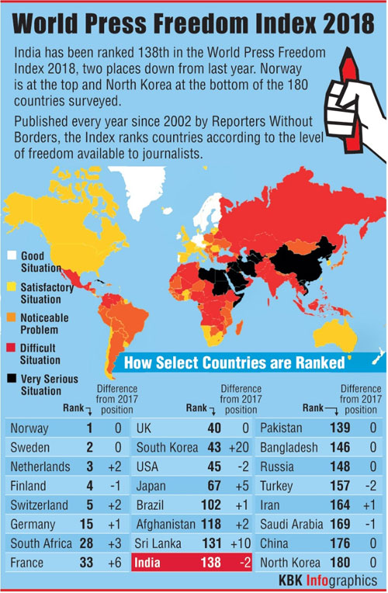
© Brain Wrinkles

Slide 67
TEACHER INFO: Government Charts
Print off the Government charts for each student. (Print front-to-back to save paper.)
The students will complete the charts after discussing the presentation.
Check the answers as a class to be sure that all charts are completed correctly.
© Brain Wrinkles

Slide 68
Comparing European Governments
Directions: Complete the chart below while discussing the presentation.
Country | Government System | Leadership | How is Head of Government Chosen? | Legislature | Role of Citizen & Freedoms
United Kingdom
Federal Republic of Germany
Russian Federation
© Brain Wrinkles

Slide 69
Comparing European Governments
Directions: Complete the chart below while discussing the presentation.
Country | Government System | Leadership | How is Head of Gov. Chosen? | Legislature | Role of Citizen & Freedoms
United Kingdom | Parliamentary Democracy | 1. Prime Minister 2. Monarch | 1. Leader of the political party in the House of Commons with the most members 2. hereditary | Parliament | Many freedoms, can vote but not directly for chief executive
Federal Republic of Germany | Parliamentary Democracy | Chancellor President | Both are selected by members of the legislature | Parliament | Many freedoms, can vote but not directly for chief executive
Russian Federation | Presidential Democracy | President Prime Minister | 1. Elected by popular vote 2. Appointed by president | Federal Assembly | citizens vote directly for leader More freedoms since moving away from communism, however government still censors a lot
© Brain Wrinkles

Slide 70
TEACHER INFO: Insta-Snaps
Print off the following slide & make a copy for each student.
In each “snap box” the students will draw a picture to represent a part of each country’s government. (It could be a leader, legislature, citizens’ rights, building, etc.)
In the text box, they should describe what the picture is and why/how it is important to the country’s government.
© Brain Wrinkles

Slide 71
Insta-Snaps
Directions: In the “snap box”, draw a picture to represent one important aspect of each country’s government. (It could be the government type, citizens’ rights, how leaders are elected, legislature’s role, etc.) In each caption box, describe what the picture is and how it is important to the country’s government. Don’t forget to include a hashtag for the most important part!
Insta-Snaps
Insta-Snaps
Insta-Snaps
© Brain Wrinkles

Slide 72
TEACHER INFO: Rate A Government
Print out the Rate a Government handout for each student.
The students will choose one of the 3 country’s governments and give it a review (similar to a book review on Amazon).
They will include a symbol, description, and two review from people who agree/disagree with the country’s government.
Project the directions slide on the next screen so that students know what goes in each section.
© Brain Wrinkles

Slide 73
Rate A Government
Country: __________________________
Government Description:
Describe the key components of the country’s government.
Symbol
Customer Reviews
Date: ___________
Date: ___________
By ___________ from ______________
By ___________ from ______________
What would someone who agrees with the country’s government say about it? How many stars would he give?
What would someone who disagrees with the country’s government say about it? How many stars would he give?
© Brain Wrinkles

Slide 74
Rate A Government
Country: __________________________
Government Description:
Customer Reviews
Date: ___________
Date: ___________
By ___________ from ______________
By ___________ from ______________
© Brain Wrinkles

Slide 75
TEACHER INFO: Head’s Up Review Game
Print off the Head’s Up review cards, cut them up, and place each set in a baggie.
Print off the Direction sheet for each partner set.
Divide students into partners or small groups (print enough cards accordingly).
Each group will need a timer set to one minute (use cell phone).
Student draws a card from the deck and without looking at it, places the word card face up on his/her forehead for partner or group to see.
Partner or group gives clues (definitions, examples, etc.) in order to get the person holding the card to guess what the card is.
Student has one minute to see how many he or she can guess correctly.
If the partner/group can’t give enough clues, they can say “pass”, but those cards should be placed in a separate discard pile.
Keep score by counting all cards that were guessed correctly in the minute time span.
The next student reshuffles the deck and starts the game over.
© Brain Wrinkles

Slide 76
3 | 2 | 1 | Game
 |  |  | Student A Score
 |  |  | Student B Score
© Brain Wrinkles
Correct Card Pile
Student A draws a card from the deck and without looking at it, places the word card face up on his/her forehead for Student B to see.
Student B gives clues (definitions, examples, etc.) in order to get Student A to guess the word on the card.
Student A has one minute to see how many he or she can guess correctly.
If Student B can’t give enough clues, they can say “pass”, but those cards should be placed in the discard pile.
Keep score by counting all cards that were guessed correctly in the minute time span.
Student B reshuffles the deck and starts the game over.
HEAD’S UP: A Review Game
Discard Pile

Slide 77
Chief Executive | Prime Minister | Head of State | Parliamentary Democracy | Absolute Monarchy
Bicameral legislature | Chancellor | Constitutional Monarchy | Democracy | Presidential Democracy
© Brain Wrinkles

Slide 78
Legislature | Russia | Hereditary | Constitution | The Basic Law
Communist | Germany | United Kingdom | Role of the Citizen | Majority Party
© Brain Wrinkles

Slide 79
Emperor | Bundestag | Parliament | Monarch | Basic Freedoms
 | Federal Assembly | House of Commons | President | Autocracy
© Brain Wrinkles

Slide 80
TEACHER INFO: Comprehension Check
Print off the Comprehension Check for each student.
The students will complete this handout at the end of the lesson. You can count this as a quiz!
© Brain Wrinkles

Slide 81
UNITED KINGDOM
1. What is the United Kingdom’s system of government?
2. Which part of government is responsible for making the laws for the United Kingdom?
3. Which house of the UK’s parliament has the most power?
4. How is the Prime Minister elected in the United Kingdom?
5. Describe the monarch’s role in the UK’s government:
6. What type of freedoms do British citizens enjoy?
GERMANY
7. What is Germany’s system of government?
8. What is Germany’s head of government called?
9. What role do German citizens play in choosing the government leaders?
10. Why is Germany considered a parliamentary democracy?
© Brain Wrinkles
Governments of Europe
Comprehension Check

Slide 82
RUSSIA
11. What type of democracy does Russia have?
12. What country was a major influence on Russia’s government structure?
13. What is the name for Russia’s chief executive?
14. What role to Russian citizens play in selecting the country’s leader?
15. In Russia, what office do the people elect—the president or prime minister?
16. How has the role of the citizens in Russia changed since the fall of Communism & the Soviet Union?
17. In what ways does Russia’s government restrict the freedoms of its citizens today?
© Brain Wrinkles
Governments of Europe
Comprehension Check

Slide 83
UNITED KINGDOM
1. What is the United Kingdom’s system of government?
Parliamentary Democracy
2. Which part of government is responsible for making the laws for the United Kingdom?
Parliament
3. Which house of the UK’s parliament has the most power?
House of Commons
4. How is the Prime Minister elected in the United Kingdom?
The leader of the political party in the House of Commons with the most members
5. Describe the monarch’s role in the UK’s government:
Mostly ceremonial, power is limited by constitution
6. What type of freedoms do British citizens enjoy?
Constitution guarantees similar freedoms to those in US (speech, press, assembly, religion, etc.)
GERMANY
7. What is Germany’s system of government?
Parliamentary Democracy
8. What is Germany’s head of government called?
Chancellor
9. What role do German citizens play in choosing the government leaders?
Citizens elect members of one house of parliament; leader of majority party becomes the chancellor
10. Why is Germany considered a parliamentary democracy?
Chancellor is elected by members of legislature
© Brain Wrinkles
Governments of Europe
Comprehension Check

Slide 84
RUSSIA
11. What type of democracy does Russia have?
presidential
12. What country was a major influence on Russia’s government structure?
United States
13. What is the name for Russia’s chief executive?
President
14. What role to Russian citizens play in selecting the country’s leader?
Citizens directly elect the president
15. In Russia, what office do the people elect—the president or prime minister?
President
16. How has the role of the citizens in Russia changed since the fall of Communism & the Soviet Union?
Can vote on leader, more personal freedoms, less censorship (mail, telephone, etc.)
17. In what ways does Russia’s government restrict the freedoms of its citizens today?
Often uses censorship with the press and media so that information is manipulated; Russians who criticize the government often face consequences, such as jail time.
© Brain Wrinkles
Governments of Europe
Comprehension Check

Slide 85
TEACHER INFO: TICKET OUT THE DOOR
Print off the Crystal Ball handout for each student (two-per-page).
Have the students make predictions about each country’s economy based on what they learned about the country’s government.
Collect & read their responses and begin the next day’s lesson by sharing a few outloud.
© Brain Wrinkles

Slide 86
Name:
Name:
Crystal Ball
Predictions
Crystal Ball
Predictions
Based on what we learned about UK, Germany, & Russia’s governments, what do you think each of their economies will be like?
Based on what we learned about UK, Germany, & Russia’s governments, what do you think each of their economies will be like?
© Brain Wrinkles
© Brain Wrinkles

Slide 87
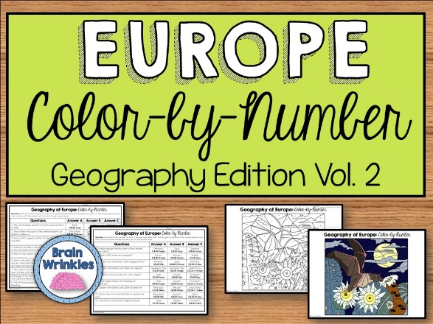
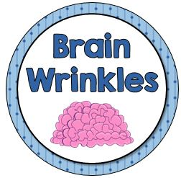
Thank You!
Thank you so much for downloading this file. I sincerely hope you find it helpful and that your students learn a lot from it! I look forward to reading your feedback in my store.
If you like this file, you might want to check out some of my other products that teach social studies topics in creative, engaging, and hands-on ways.
Best wishes,
Ansley at Brain Wrinkles

Slide 88
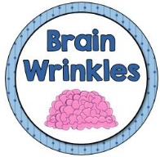
© Brain Wrinkles. Your download includes a limited use license from Brain Wrinkles. The purchaser may use the resource for personal classroom use only. The license is not transferable to another person. Other teachers should purchase their own license through my store.
This resource is not to be used:
By an entire grade level, school, or district without purchasing the proper number of licenses. For school/district licenses at a discount, please contact me.
As part of a product listed for sale or for free by another individual.
On shared databases.
Online in any way other than on password-protected website for student use only.
© Copyright Brain Wrinkles. All rights reserved. Permission is granted to copy pages specifically designed for student or teacher use by the original purchaser or licensee. The reproduction of any other part of this product is strictly prohibited. Copying any part of this product and placing it on the Internet in any form (even a personal/classroom website) is strictly forbidden. Doing so makes it possible for an Internet search to make the document available on the Internet, free of charge, and is a violation of the Digital Millennium Copyright Act (DMCA).
Thank you,
Ansley at Brain Wrinkles
Terms of Use
Clipart, fonts, & digital papers for this product were purchased from:

