Slide 1
Comparing
Economies:
Israel, Iran, Turkey,
& Saudi Arabia

Slide 2
Standards
SS7E5 The student will analyze different economic systems.
a. Compare how traditional, command, and market economies answer the economic questions of (1) what to produce, (2) how to produce, and (3) for whom to produce.
b. Explain how most countries have a mixed economy located on a continuum between pure market and pure command.
c. Compare and contrast the economic systems in Israel, Saudi Arabia, and Turkey.
SS7E7 The student will describe factors that influence economic growth and examine their presence or absence in Israel, Saudi Arabia, and Iran.
a. Explain the relationship between investment in human capital (education and training) and gross domestic product (GDP).
b. Explain the relationship between investment in capital (factories, machinery, and technology) and gross domestic product (GDP).
c. Explain the role of oil in these countries’ economies.
d. Describe the role of entrepreneurship.

Slide 3
Comparing
Economies:
Israel, Iran, Turkey,
& Saudi Arabia

Slide 4
Let’s Review
Economic Systems
Do you remember the three questions that every country must answer when developing its economic plan?
What goods/services will be produced?
How will goods/services be produced?
Who will consume the goods/services?
The way a country answers these questions determines what kind of economic system it will have:
Traditional Command Market

Slide 5
Traditional Economy
All economic decisions are based on customs, traditions, & beliefs of the past.
People will make what they always made & do the same things their parents did.
The exchange of goods is done through bartering.
Bartering = trading without using money
Some examples: villages in Africa & South America, the Inuit in Canada, Aborigines in Australia

Slide 6
Command Economy
All economic decisions are made by the Government.
The government owns most of the property, sets the prices of goods, determines the wages of workers, plans what will be made…everything.
This system has not been very successful. More and more countries are abandoning it.
This system is very harsh to live under; because of this, there are no PURE command countries in the world today.
Some countries are close: Cuba, former Soviet Union, North Korea, former East Germany, etc.
All of these countries have the same type of government: Communist! The government is in control of everything.

Slide 7
Market Economy
Economic decisions are made based on the changes in prices that occur as buyers & sellers interact in the market place.
The government has no control over the economy; private citizens answer all economic questions.
In a truly free market economy, the government would not be involved at all. Scary…
There would be no laws to make sure goods/services were safe. *Food! Medicine!
There would be no laws to protect workers from unfair bosses.
Because of this, there are no PURE market economies, but some countries are closer than others.
Some Examples: US, UK, Australia, etc.

Slide 8
Hmmm…
Since there are no countries that are purely command or purely market, what does that make them?
Most democratic countries have some characteristics of both systems, so we keep it simple and call them: MIXED
Of course, most countries’ economies are closer to one type of system than another.

Slide 9
Let’s Review
Factors of Production
There are 4 factors of production that influence economic growth within a country:
Natural Resources available
Investment in Human Capital
Investment in Capital Goods
Entrepreneurship
The presence or absence of these 4 factors determine the country’s Gross Domestic Product (GDP) for the year.

Slide 10
GDP
GDP is the total value of all the goods and services produced in that country in one year.
It measures how rich or poor a country is.
It shows if the country’s economy is getting better or worse.
Raising the GDP of a country can improve the country’s standard of living.

Slide 11
Natural Resources
“Gifts of Nature”
Natural resources are important to countries because without them, countries must import the resources they need (can be costly).
A country is better off if it can use its own resources to supply the needs of its people.
If a country has many natural resources, it can trade/sell them with other countries.

Slide 12
Capital Goods
To increase GDP, countries must invest in capital goods:
All of the factories, machines, technologies, buildings, and property needed by businesses to operate
If a business is to be successful, it cannot let its equipment break down or have its buildings fall apart.
New technology can help a business produce more goods for a cheaper price.

Slide 13
Human Capital
To increase GDP, countries must invest in human capital.
Human capital includes education, training, skills, and healthcare of the workers in a business or country.

Slide 14
Entrepreneurship
People who provide the money to start and operate a business are called entrepreneurs.
These people risk their own money and time because they believe their business ideas will make a profit.
Entrepreneurs must organize their businesses well for them to be successful .
They bring together natural, human, and capital resources to produce foods or services to be provided by their businesses.

Slide 15
Specialization
Not every country can produce all of the goods and services it needs.
Countries specialize in producing those goods and services they can provide best and most efficiently.
They look for others who may need these goods and services so they can sell their products.
The money earned by such sales then allows the purchase of goods and services the first county is unable to produce.
In international trade, no country can be completely self-sufficient (produce all the goods and services it needs).
Specialization creates a way to build a profitable economy and to earn money to buy items that cannot be made locally.

Slide 16
Israel’s
Economy

Slide 17
Economic System
Israel has a mixed economy that is also technologically advanced.
This has allowed Israel to make up for much of what the country lacks in farmland and natural resources.
The Israeli government and private Israeli companies own and control the economy.
Because of high-tech manufacturing and financial services, Israel’s economy is the most developed in Southwest Asia.
Israel has extremely low oil production, therefore oil has very little impact on its economy.

Slide 18
Natural Resources
Israel does not have many natural resources.
What are the major natural resources?
timber, potash, copper ore, natural gas, phosphate rock, magnesium bromide, clays, sand

Slide 19
Land Use
What percentage of the land is arable?
13.7% (But remember, Israel is not very big.)
What are the major agricultural products?
citrus, vegetables, cotton, beef, poultry, dairy products
Israel’s limited arable land and natural freshwater resources make it hard for agriculture.

Slide 20
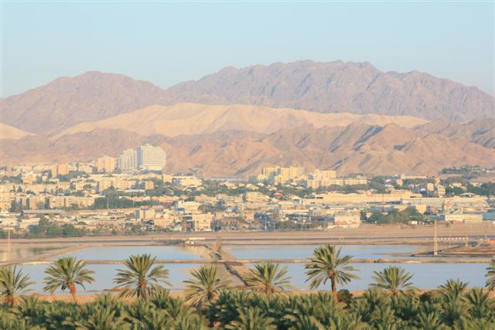

Slide 21
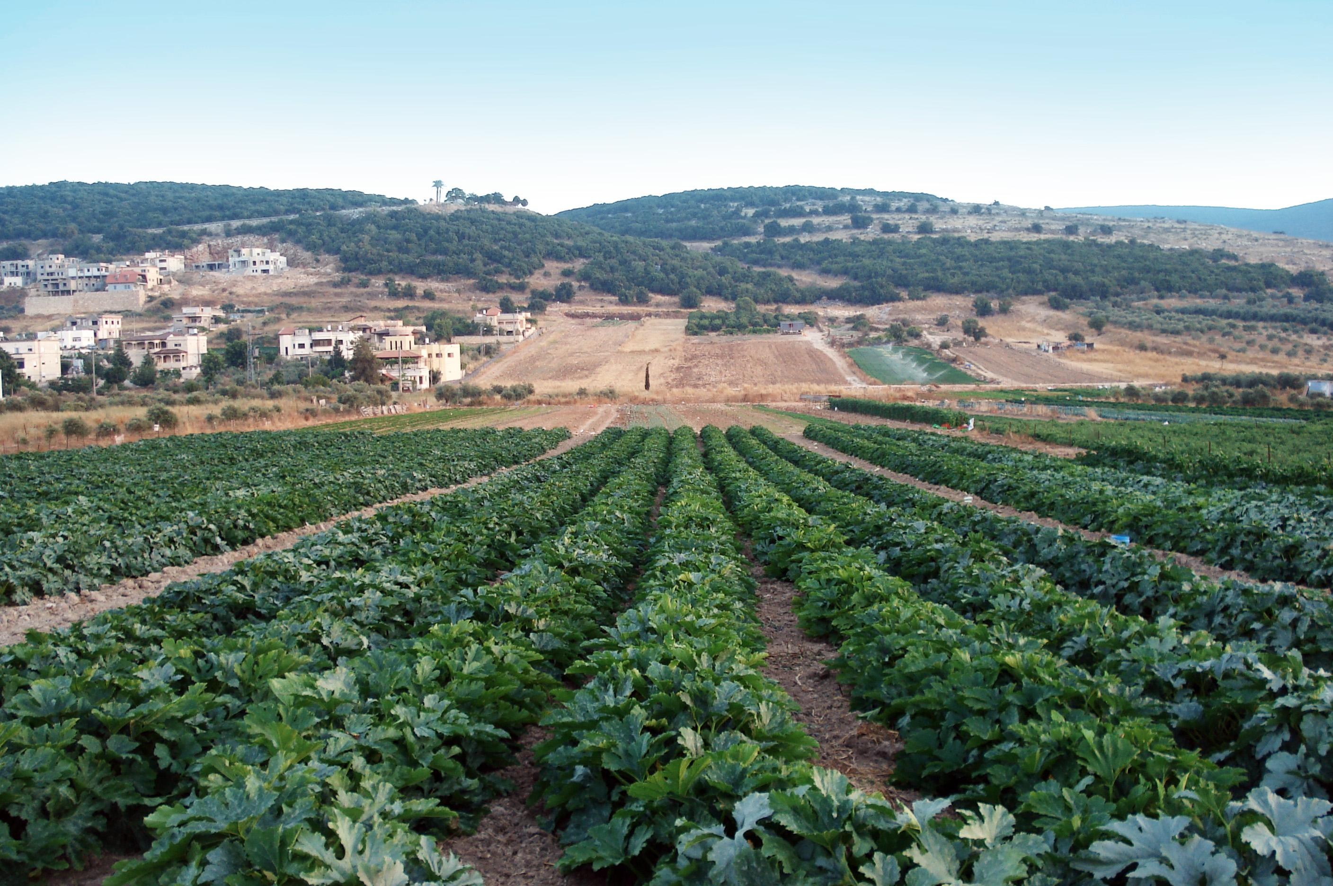

Slide 22
Industries
What’s produced in Israel’s factories?
high-technology products, wood and paper products, potash and phosphates, food, beverages, tobacco, cement, construction, metal products, chemical products, plastics, diamond cutting, textiles, footwear
The service industry (helping someone) accounts for much of Israel’s economy – areas such as insurance, banking, retail, and tourism.

Slide 23
Specialization
Israel’s chief exports include:
machinery and equipment, software, cut diamonds, and agricultural products.
Israel has become a leader in agricultural technology, even though it has a limited supply of land suitable for farming.
The country can sell this technology to earn the money to supplement their limited production of food.

Slide 24
Literacy Rate
What percentage of people over the age of 15 can read and write?
97.1%
How long are students expected to stay in school?
16 years old (females)
15 years old (males)

Slide 26
Unemployment Rate
What percentage of people do not have jobs?
6.9%
What percentage of people live in poverty?
23.6%

Slide 27
GDP
$300 billion
37th in the world
GDP Per Capita--What is the value of goods and services produced per person?
$32,800

Slide 28
Economic Struggles
Israel does not have many natural resources.
Israel depends heavily on imports of grain, oil, military technologies, and many other goods.
War is a major threat to Israel.
A large number of immigrants also present challenges to Israel’s economy.
The Israeli government has taken control of certain economic activities in order to address the warfare and immigrant problems.
The Israeli government controls most activities related to agriculture.

Slide 29
Turkey’s
Economy

Slide 30
Economic System
In the past century, Turkey’s government has really helped its economy to grow.
After World War I, the government invested heavily in Turkey’s weapons and steel industries.
Industries such as airlines, railroads, telephone, and television have been controlled by the government in the past.
By the 1980s, many people objected to the government having so much control over the economy.
The government has begun to allow private businesses more control.
Today, more private ownership has been allowed, and more laws have been passed to protect business owners.
Turkey has a mixed economy.

Slide 31
Economic System
Turkey is moving towards fewer government-run businesses and more privately-owned businesses. (Mixed)
It’s economy is diversified with large service, manufacturing, and agricultural industries.
Most of these products are sold and used within Turkey, but a significant portion are exported to other countries.
Turkey produces little oil, there oil has a small impact on its economy.

Slide 32
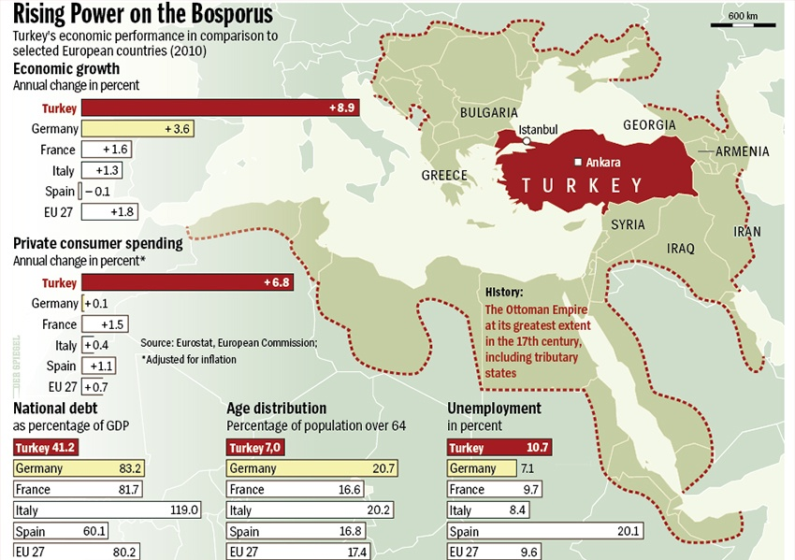

Slide 33
Natural Resources
What are Turkey’s major natural resources?
coal, iron ore, copper, chromium, antimony, mercury, gold, barite, borate, celestite, emery, feldspar, limestone, magnesite, marble, perlite, pumice, pyrites (sulfur), clay, arable land, hydropower

Slide 34
Land Use
What percentage of the land is arable?
26.2%
What are the major agricultural products?
tobacco, cotton, grain, olives, sugar beets, hazelnuts, citrus, livestock, hazelnuts, figs, pomegranates, watermelons, and cucumbers
A large part of the Turkey’s economy is based on agriculture.
Turkey consistently ranks among the world’s top ten nations for agricultural output.
As Turkey continues to modernize, its agriculture continues to decline.

Slide 35
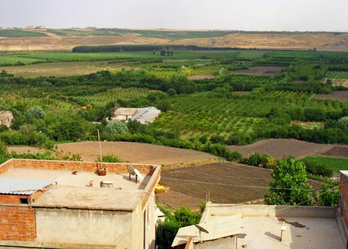

Slide 36
Industries
What’s produced in Turkey’s factories?
textiles, food processing, autos, electronics, mining (coal, chromate, copper, boron), steel, petroleum, construction, lumber, paper
The service industry makes up about half of Turkey’s economy, just as it does in Israel.

Slide 37
Specialization
Turkey’s chief exports include:
apparel, foodstuffs, textiles, metal manufactures, transport equipment

Slide 38
Literacy Rate
What percentage of people over the age of 15 can read and write?
94.1%
How long are students expected to stay in school?
Males: 14 years old
Females: 13 years old

Slide 39
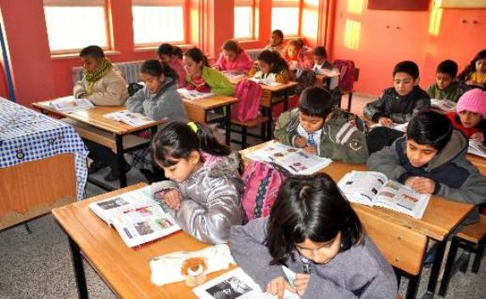

Slide 40
Unemployment Rate
What percentage of people do not have jobs?
9.2%
What percentage of people live in poverty?
16.9%

Slide 41
GDP
$1.142 trillion
17th in the world
GDP Per Capita--What is the value of goods and services produced per person?
$15,200

Slide 42
Saudi
Arabia’s
Economy

Slide 43
Economic System
Saudi Arabia has an oil-based economy with strong government controls over major economic activities.
Even though Saudi Arabia is considered to have a mixed economy, the Saudi king and his advisors still make quite a lot of the country’s economic decisions, especially those related to oil.
Saudi Arabia’s economy depends predominantly on oil, its main export.
Oil funds the country’s education, defense, transportation, health, and housing.

Slide 44
Economic System
Over half of Saudi Arabia’s GDP comes from oil production.
The government owns the oil and other major industries; however, private ownership of small businesses is increasing.
Saudi Arabia is trying to encourage more private businesses to boost the economy and decrease the country’s dependence on oil.
It also has commercial manufacturing and financial industries.

Slide 45
Natural Resources
What are Saudi Arabia’s major natural resources?
petroleum, natural gas, iron ore, gold, copper

Slide 46
Land Use
What percentage of the land is arable?
1.5%
What are the major agricultural products?
wheat, barley, tomatoes, melons, dates, citrus; mutton, chickens, eggs, milk

Slide 47
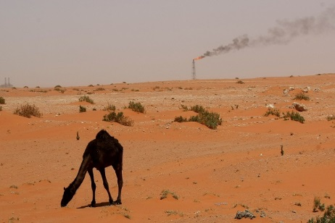

Slide 48
Industries
What’s produced in Saudi Arabia’s factories?
crude oil production, petroleum refining, basic petrochemicals, ammonia, industrial gases, sodium hydroxide (caustic soda), cement, fertilizer, plastics, metals, commercial ship repair, commercial aircraft repair, construction

Slide 49
Specialization
Saudi Arabia’s chief exports include petroleum and petroleum products (90%).
Saudi Arabia is able to specialize in the production of oil and natural gas and sell these products for a great profit in the world market.
The money earned in this trade can then be used to purchase food and the technology needed to make their agriculture system more efficient.

Slide 50
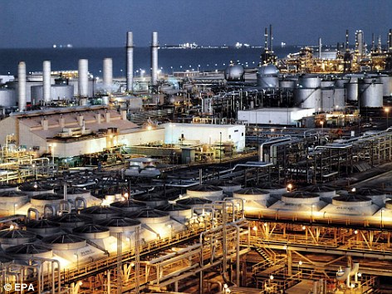
Saudi Oil Refinery

Slide 51
Literacy Rate
What percentage of people over the age of 15 can read and write?
87.2%
How long are students expected to stay in school?
15 years old

Slide 52
Unemployment Rate
What percentage of people do not have jobs?
10.6%
What percentage of people live in poverty?
Not available (government does not release this information)

Slide 53
GDP
$1.6 trillion
14th in the world
GDP Per Capita--What is the value of goods and services produced per person?
$52,200

Slide 54
Iran’s
Economy

Slide 55
Economic System
Iran has great oil wealth, like Saudi Arabia.
Iran also has a mixed economy that has grown in spite of government attempts to keep tighter control.
Iran’s mixed-command economy has not been very efficient in recent years.
Even though there is oil wealth, many Iranians do not share in the money.
Much of it goes toward the military.

Slide 56
Natural Resources
What are Iran’s major natural resources?
petroleum, natural gas, coal, chromium, copper, iron ore, lead, manganese, zinc, sulfur

Slide 57
Land Use
What percentage of the land is arable?
10.5%
What are the major agricultural products?
wheat, rice, other grains, sugar beets, sugarcane, fruits, nuts, cotton, dairy products, wool, caviar

Slide 58
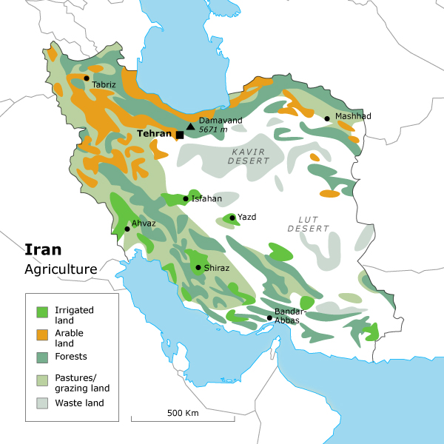

Slide 59
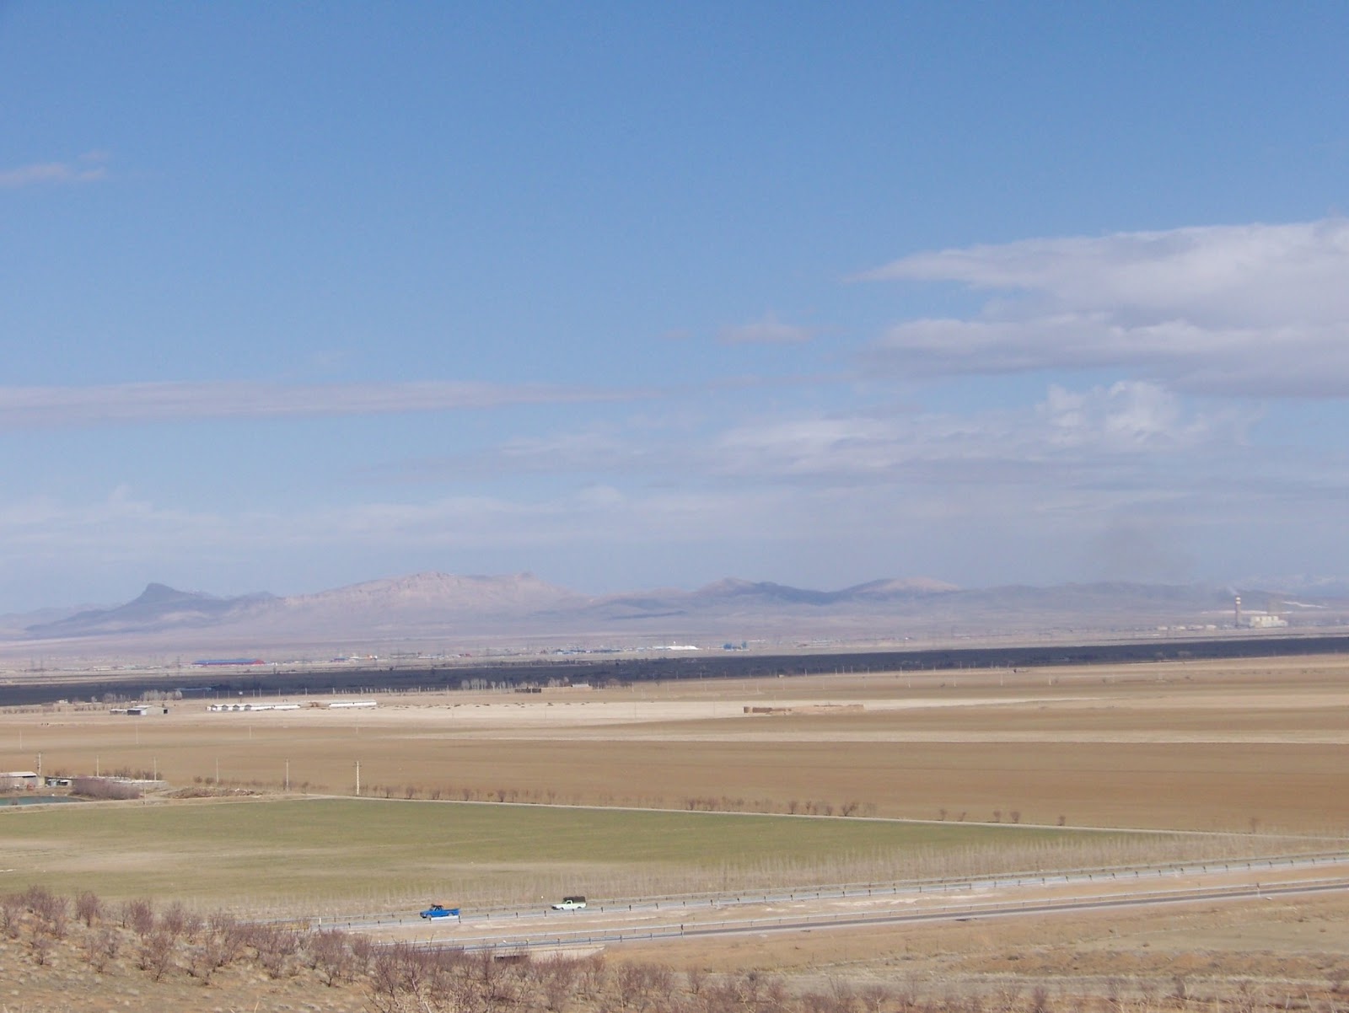

Slide 60
Industries
What’s produced in Iran’s factories?
petroleum, petrochemicals, fertilizers, caustic soda, textiles, cement and other construction materials, food processing (particularly sugar refining and vegetable oil production), metal fabrication, armaments
The service industry makes up roughly 51% of Iran’s economy.

Slide 61
Specialization
Iran’s chief exports include:
petroleum (80%), chemical and petrochemical products, fruits and nuts, carpets

Slide 62
Literacy Rate
What percentage of people over the age of 15 can read and write?
85%
How long are students expected to stay in school?
14 years old

Slide 63
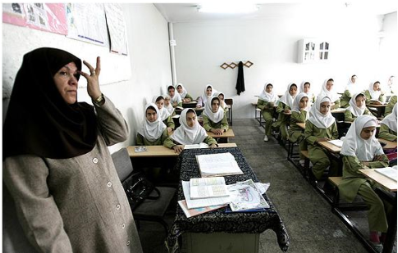

Slide 64
Unemployment Rate
What percentage of people do not have jobs?
15.5%
What percentage of people live in poverty?
18.7%

Slide 65
GDP
$1.2 trillion
18th in the world
GDP Per Capita--What is the value of goods and services produced per person?
$16,463

