Slide 1
Southwest Asian
Governments
State of Israel, Kingdom of Saudi Arabia, & Islamic Republic of Iran

Slide 2
Standards
SS7CG4 The student will compare and contrast various forms of government.
a. Describe the ways government systems distribute power: unitary, confederation, and federal.
b. Explain how governments determine citizen participation: autocratic, oligarchic, and democratic.
c. Describe the two predominant forms of democratic governments: parliamentary and presidential.
SS7CG5 The student will explain the structures of the national governments of Southwest Asia (Middle East).
a. Compare the parliamentary democracy of the State of Israel, the monarchy of the Kingdom of Saudi Arabia, and the theocracy of the Islamic Republic of Iran, distinguishing the form of leadership and the role of the citizen in terms of voting rights and personal freedoms.

Slide 3
Southwest Asian
Governments
State of Israel, Kingdom of Saudi Arabia, & Islamic Republic of Iran

Slide 4
Let’s Review
Government Systems – Who has the power?
Unitary--power is held by one central authority
Confederation--association of independent states that agree to certain limitations on their freedoms by joining together
Federal--power is divided between central authority & several regional authorities

Slide 5
Let’s Review
Government Types – how do citizens participate?
Autocracy-- 1 person possesses unlimited power & citizens have limited role in government
Oligarchy-- small group exercises control & citizens have limited role in government
Democracy--supreme power is vested in the people & exercised by them directly or indirectly through a system of representation involving free elections
Theocracy--form of government in which a god is recognized as the supreme civil ruler. Religious institutional representatives often replace or mix into the civilian government.

Slide 6
Let’s Review
Two Types of Democratic Governments:
Parliamentary– citizens elect members of Parliament, and then the members select the leader
Leader works with or through the legislature
Presidential--system of government in which the leader is constitutionally independent of the legislature; citizens directly elect leader
Leader works separate from legislature

Slide 7
State
of Israel
Federal Parliamentary Democracy

Slide 8
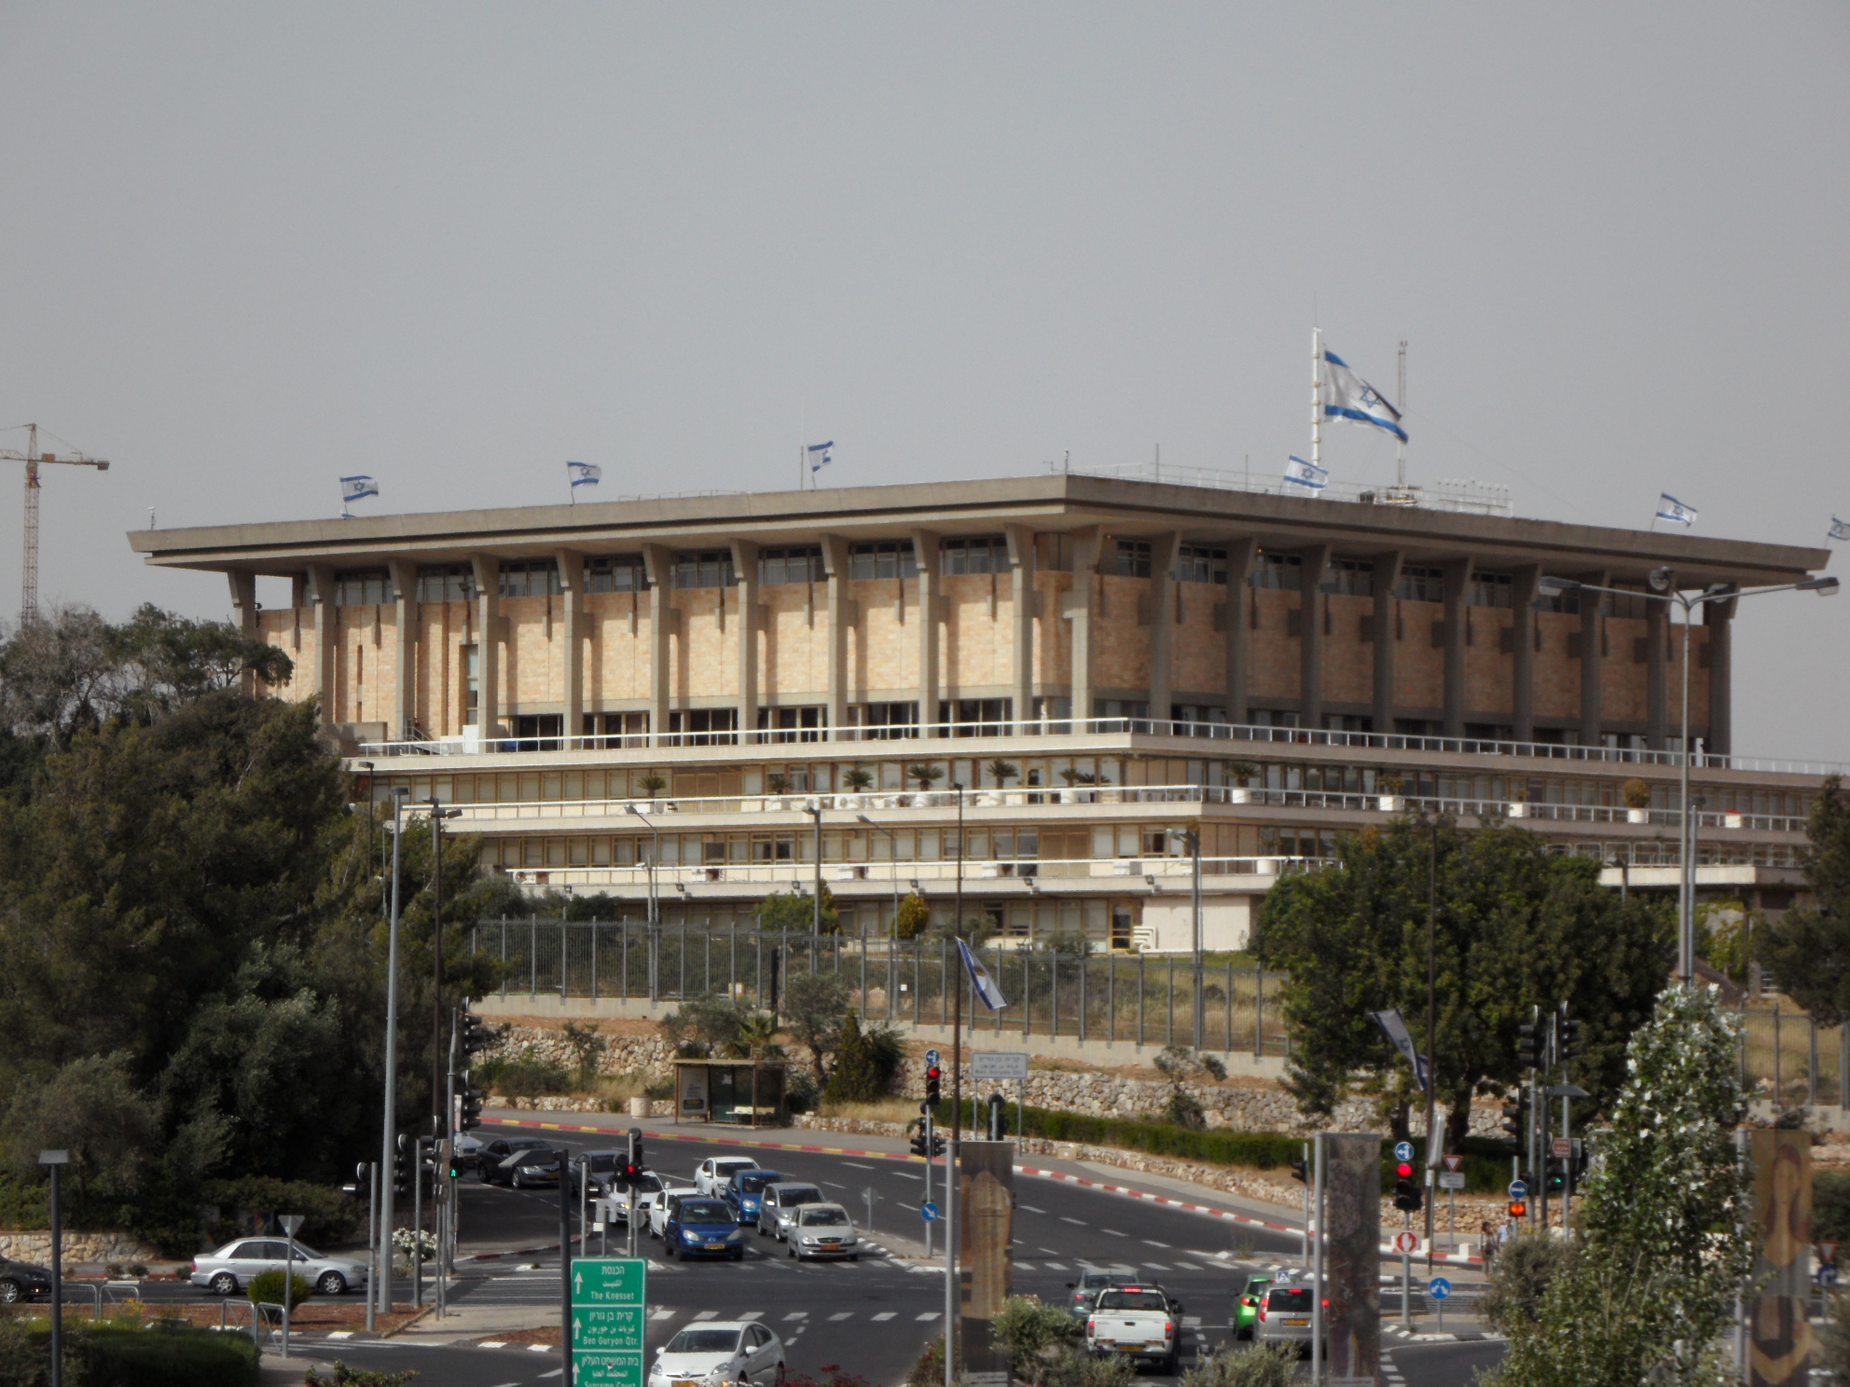
The Knesset Building, in Tel Aviv, is home to Israel’s government.

Slide 9
Background Info.
In 1948, the United Nations voted to divide the former British colony of Palestine into two parts.
One part became the nation of Israel, a homeland for the Jewish people.
The other part was for the Palestinian Arabs.
The governments of the countries in Southwest Asia often reflect Islamic beliefs, and Arabic people are often Islamic by faith.
The emergence of Israel as a Jewish nation became and still is a major political issue in the Middle East.

Slide 10
Unitary System
Israel has a unitary system, which means that the national (central) government has all of the power.
The districts (states) are under central government control.
Israel has 6 districts -- Central, Haifa, Jerusalem, Northern, Southern, & Tel Aviv

Slide 11
Leadership
1. Prime Minister: holds the most political power; works closely with the legislature (the Knesset)
2. Chief of State: President; has little political power, mostly a ceremonial role

Slide 12
His Excellency
Benjamin Netanyahu
Prime Minister

Slide 13
His Honour
Reuven Rivlin
President

Slide 14
How Leaders Are Chosen
President: largely a ceremonial role and is elected by the Knesset for a seven-year term (one-term limit).
Prime Minister: serves a 5-year term; the President nominates a member of the Knesset and the other members vote on him/her. (Generally, the prime minister is usually the leader of the largest political party in the Knesset.)

Slide 15
Legislature
Israel’s parliament is called the Knesset.
It is a unicameral governing body.
The Knesset passes all laws, elects the president & prime minister, and supervises the work of the government through its committees.
Israel does not have a formal constitution in place, but members of the Knesset have been working on one since 2003.

Slide 16
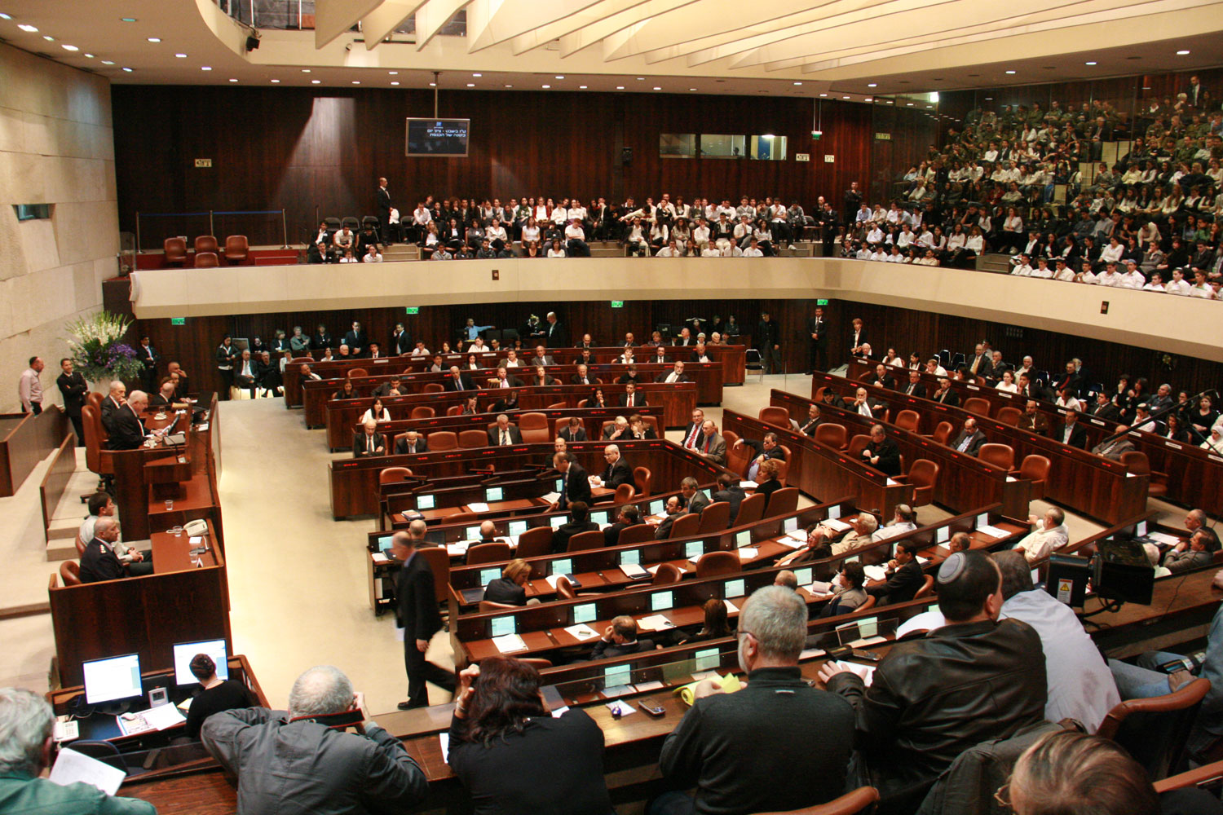
Knesset Chamber

Slide 17
Parliamentary
Democracy
Generally, whichever political party has the most members in the legislature selects the Prime Minister.
This is the major difference between a Presidential Democracy and a Parliamentary Democracy!
Parliamentary Democracy – legislature chooses the executive leader
In Israel, citizens vote for members of Knesset (parliament), then the elected members choose the Prime Minister.

Slide 18
Role of the Citizen
Citizens must be 18 to vote, but voting is not required by law.
As a democracy, its citizens must participate in voting and elections:
They elect members of Knesset.
Elections are held in Israel every four years.

Slide 19
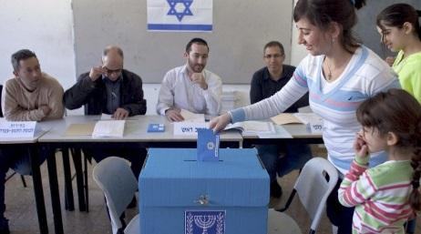
Voting in Israel

Slide 20
Kingdom of
Saudi Arabia
Unitary System – Absolute Monarchy

Slide 21
Background Info.
Saudi Arabia is the largest country on the Arabian Peninsula and it has the most influence in the region.
It is one of the few absolute monarchies left in the world today.
Members of the al-Saud family have ruled Saudi Arabia since 1932.
Most government officials are relatives of the king.
The king may ask members of his family, Islamic scholars, and tribal leaders for advice on decisions.

Slide 22
Unitary System
Saudi Arabia has a unitary system, which means that the national (central) government has all of the power.
The provinces are under central government control.
There are thirteen provinces in Saudi Arabia: Al Bahah, Al Hudud ash Shamaliyah (Northern Border), Al Jawf, Al Madinah (Medina), Al Qasim, Ar Riyad (Riyadh), Ash Sharqiyah 'Asir, Ha'il, Jizan, Makkah (Mecca), Najran, & Tabuk.

Slide 23
Oligarchy
Saudi Arabia is one of the few absolute monarchies left in the world today.
The king and his advisors, many of whom are his family members or influential business and religious leaders in the country, make all the laws.
Conservative religious leaders also have a great deal of influence in decisions made by the monarchy.
There is no written constitution; however, the Qur’an acts as the constitution.
Saudi Arabia is governed on the basis of Islamic law (Shari’a).

Slide 24
Leadership
Saudi Arabia is ruled by a hereditary monarchy, which means the government is led by a king who comes from a family that has ruled the country for several generations.
The King of Saudi Arabia has been a member of the al-Saud family since the 1930s.
The people of Saudi Arabia do not choose the king.
When a king dies, the Saudi family announces who the next king will be from among their male family members.

Slide 25
Abdullah bin Abdulaziz Al Saud
Former King of Saudi Arabia, died January 23, 2015

Slide 26
Salman bin Abdulaziz al-Salud
King of Saudi Arabia

Slide 27
Legislature
Saudi Arabia’s legislature is called the Consultative Council.
It can propose legislation to the king, but has no legal powers itself.
There are 150 members and a chairman that is chosen by the king to serve 4-year terms.
The king chooses two-thirds of the members of the Council, while men in the country vote for the remaining one-third of the members.
The Council mostly consists of members of the royal family.

Slide 28
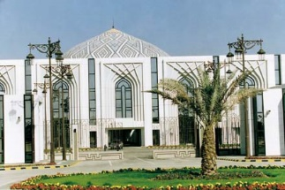
Consultative Assembly of Saudi Arabia in Riyadh

Slide 29
Role of the Citizen
In 2004, the Saudi government began allowing men who are 21 and older to vote for half of their local officials.
Men also vote for one-third of the members of the legislature.
There are no political parties in Saudi Arabia.
What about the women??

Slide 30
Islamic Republic
of Iran
Theocratic Republic

Slide 31
Background Info.
In 1979, the Islamic (or Iranian) Revolution, overthrew the monarchy that had ruled Iran for centuries.
The Shah (king), who had been the monarch, had made Iran into a modern, less religious society.
Ayatollah Khomeini, who became Iran’s new leader, set up a religious dictatorship based on Islamic principles.

Slide 32
Unitary System
Iran has a unitary system, which means that the national (central) government has all of the power.
The provinces are under central government control.
There are thirty-one provinces in Saudi Arabia.

Slide 33
Theocratic Republic
Iran has a unique political system that combines elements of a parliamentary democracy with a theocracy.
The people vote for members of a group called the General Assembly, who then elects the head of state of Iran, the Supreme Leader.
The Supreme Leader is always an ayatollah, or recognized religious authority, who follows the Islamic principles of Shari’ a law.

Slide 34
Leadership
Supreme Leader (Ayatollah): head of state and highest ranking political and religious authority in Iran; appointed for life
President: the highest authority after the Supreme Leader (his/her power is limited by the Supreme Leader)

Slide 35
His Eminence Ayatollah
Ali Khamenei
Supreme Leader

Slide 36
Hassan Rouhani
President

Slide 37
How Leaders Are Chosen
Supreme Leader: elected by the Assembly of Experts (88 elected people who are also charged with supervising the leader’s activities)
President: elected by the Iranian people and serves a 4-year term

Slide 38
Legislature
Iran’s legislature is unicameral and is called the Islamic Consultative Assembly of Iran (Parliament).
There are 290 members and they are elected by the people for 4-year terms.
Parliament drafts legislation, ratifies treaties, and approves the national budget.

Slide 39
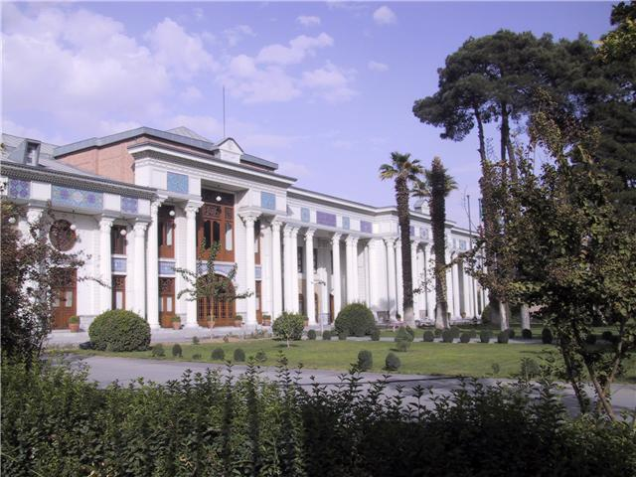
Islamic Consultative Assembly in Tehran, Iran

Slide 40
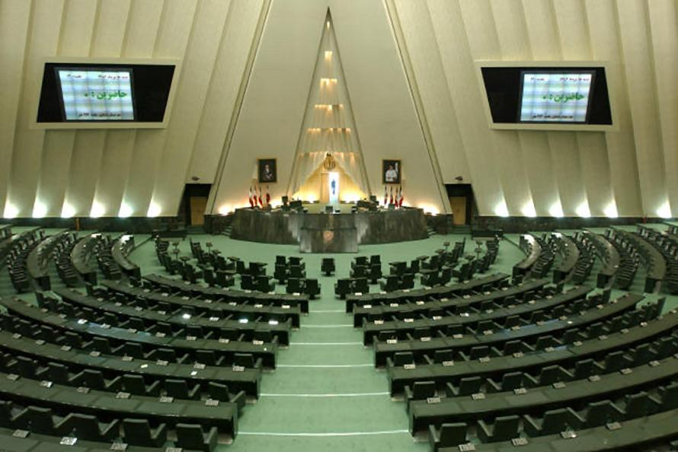
Islamic Consultative Assembly in Tehran, Iran

Slide 41
Role of the Citizen
Citizens must be 18 to vote, but voting is not required by law.
As a democracy, its citizens must participate in voting and elections:
They elect the 290 members of the Consultative Assembly.
Elections for the president are held every four years.
Election for the Assembly of Experts are held every six years.

Slide 42
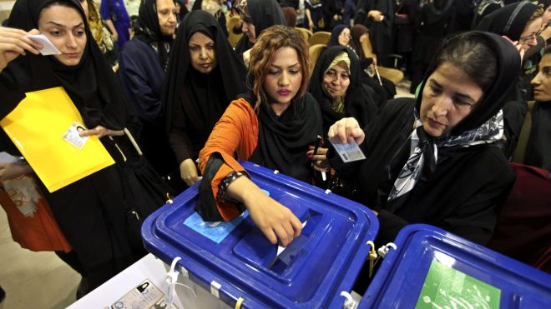
Voting in Iran

