Slide 1
Amazon Rainforest Amazon River
Located in Brazil
Largest river in the world

Slide 2
Amazon Rainforest/Amazon River

Slide 3
Amazon Rainforest/Amazon River

Slide 4
Andes Mountains
Located in South America
Runs down the west coast from Colombia to Argentina

Slide 5
Andes Mountains

Slide 6
Andes Mountains

Slide 7
Andes Mountains

Slide 8
Andes Mountains

Slide 9
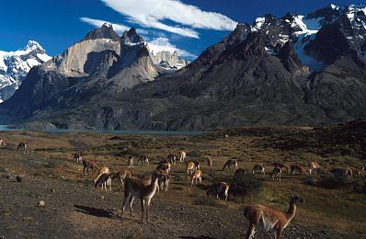
Andes Mountains

Slide 10
Panama Canal
Located in Panama
Was dug out by humans
Connects the Atlantic and Pacific Oceans

Slide 11
Panama Canal

Slide 12
Panama Canal

Slide 13
Panama Canal

Slide 14
Sierra Madre Mountains
Located in Mexico
Located on both sides of Mexico creating a valley in the middle

Slide 15
Sierra Madre Mountains

Slide 16
Sierra Madre Mountains

Slide 17
Sierra Madre Mountains

Slide 18
Sierra Madre Mountains

Slide 19
Atacama Desert
Located in Chile
Near the Andes Mountains

Slide 20
Atacama Desert

Slide 21
Atacama Desert

Slide 22
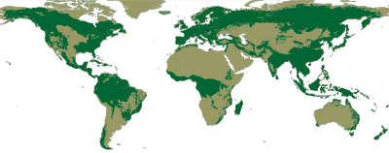
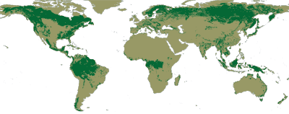
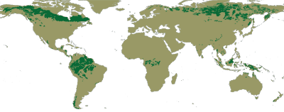
Original Forest Cover
Current Forest Cover
DEFORESTATION
Future Forest Cover

