Slide 1
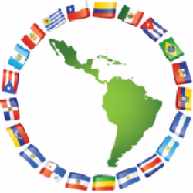
Latin America History: Encyclopedia
Made By: Teresa Lopez

Slide 2
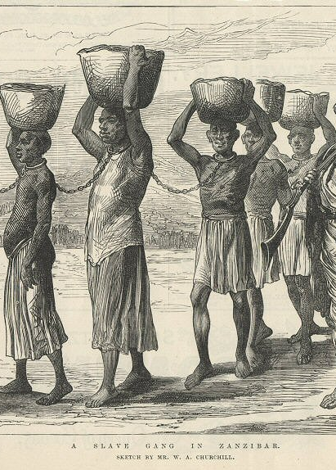
African Slave Trade
The slave trade began in the 15th century, after the Portuguese started exploring the coast of West Africa.
In about 1650, however, with the development of plantations on the newly colonized Caribbean islands and American mainland, the trade grew.
The first enslaved Africans arrived in Hispaniola in 1501, after the Papal Bull of 1493 gave almost all of the New World to Spain.
Colombia was a major destination for slave ships, with the town of Cartagena de Indias one of the most important ports through, which enslaved Africans entered Nueva Granada
Europeans in Latin America used African labor in every conceivable form in every place they decided to settle during the colonial period and beyond.

Slide 3
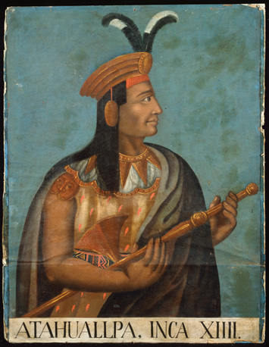
Atahualpa
Atahualpa was born 1502, Quito, Ecuador.
Atahualpa died July 26, 1533, Cajamarca, Perú.
When the old Inca chief died, the kingdom was divided between Atahualpa, who ruled the northern part of the empire from Quito, and Huáscar, the legitimate heir, who ruled from Cuzco, the traditional Inca capital.
After traveling through the desert and snow-capped mountains, arrived at Cajamarca in this year, where "the Inca", Atahualpa, the 13th and last emperor of the Incas, awaited him. Atahualpa accepted an invitation to visit the Spanish commander and arrived attended by crowds of unarmed Incas.
He founded Ciudad de los Reyes (City of the Kings), which is now Lima. The city was the seat of his new government.

Slide 4
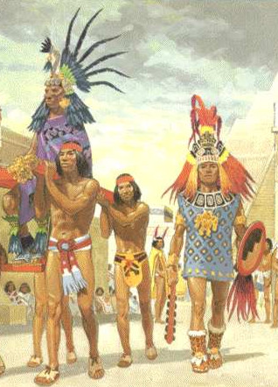
Aztecs
From their magnificent capital city, Tenochtitlan, the Aztecs emerged as the dominant force in central Mexico, developing a social, political, religious and commercial organization that brought many of the region’s city-states under their control by the 15th century.
The Aztecs, who originated as a nomadic tribe in northern Mexico, arrived in Mesoamerica around the beginning of the 13th century.
The exact origins of the Aztec people are uncertain, but they are believed to have begun as a northern tribe of hunter-gatherers whose name came from that of their homeland, Aztlan.
When the Aztecs saw an eagle perched on a cactus on the marshy land near the southwest border of Lake Texcoco, they took it as a sign to build their settlement there.
Their relatively sophisticated system of agriculture (including intensive cultivation of land and irrigation methods) and a powerful military tradition would enable the Aztecs to build a successful state, and later an empire.

Slide 5
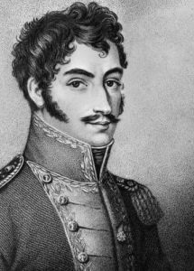
Simon Bolivar
Simón Bolívar was a South American soldier who was instrumental in the continent's revolutions against the Spanish empire.
Simón Bolívar was a South American soldier who was instrumental in the continent's revolutions against the Spanish empire
Simon Bolivar was born on July 24, 1783 in Caracas, New Granada (which is now Venezuela).
Young Bolívar moved to Spain in 1799 after the deaths of his parents. In Spain, he continued his education, begun in Venezuela with tutors, and married María Teresa Rodríguez del Toro y Alaysa in 1802.
Simon Bolivar on December 17, 1830, however, Simón Bolívar died in Santa Marta, Colombia.

Slide 6
Columbian Exchange
The Columbian Exchange impacted the social and cultural makeup of both sides of the Atlantic.
Advancements in agricultural production, evolution of warfare, increased mortality rates and education are a few examples of the effect of the Columbian Exchange on both Europeans and Native Americans.
The Columbian Exchange refers to a period of cultural and biological exchanges between the New and Old Worlds.
The creation of colonies in the Americas that led to the exchange of new types of food, plants, and animals.
During the Columbian Exchange, what were some impacts on Native Americans were forced labor, dieases, and did not build up their a natural immunity.

Slide 7
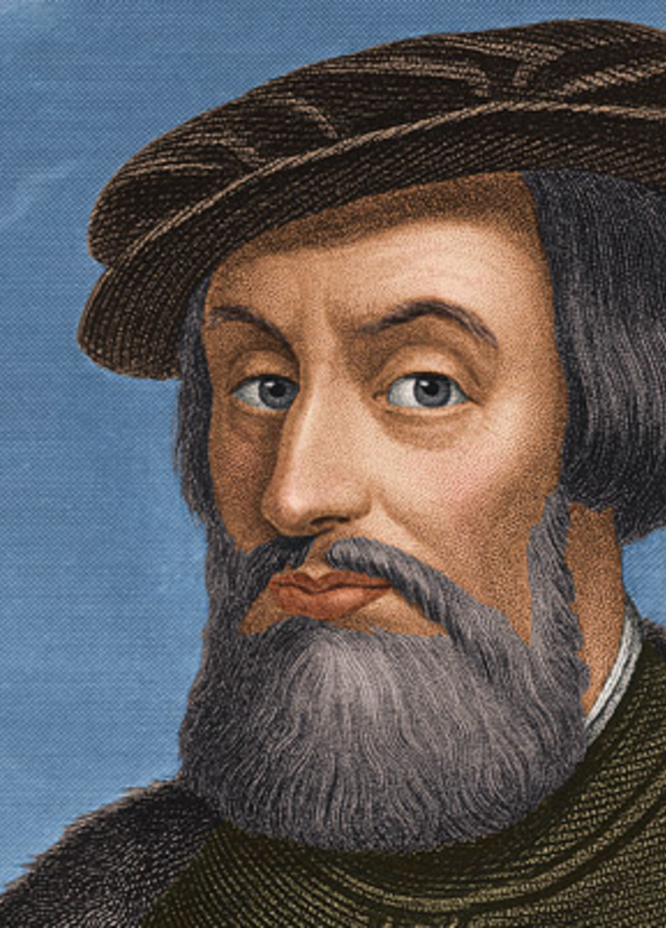
Hernando Cortes
Hernando Cortes was born in Medellin, Spain, conquistador Hernán Cortés, he first served as a soldier in an expedition of Cuba led by Diego Velázquez in 1511.
He ignored orders and traveled to Mexico with about 500 men and 11 ships in 1519, setting his sights on overthrowing ruler Montezuma II in the Aztec capital of Tenochtitlan.
Cortés became allies with some of the native peoples he encountered, but with others he used deadly force to conquer Mexico.
Hernando Cortes returned to Tenochtitlan to find a rebellion in progress. The Aztecs eventually drove the Spanish from the city, but Cortés returned again to defeat them and take the city in 1521.
Hernando Cortes died December 2, 1547, Castilleja de la Cuesta, Spain.

Slide 8
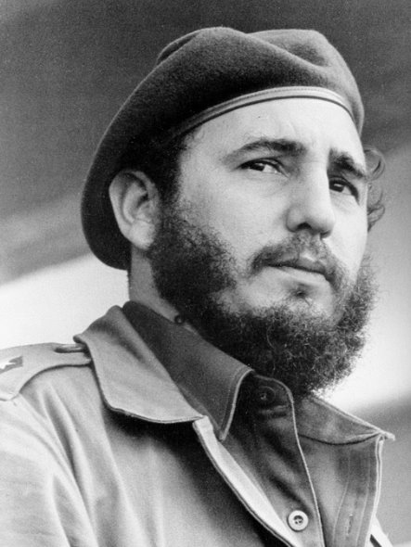
Fidel Castro
Cuban leader Fidel Castro established the first communist state in the Western Hemisphere after leading an overthrow of the military dictatorship of Fulgencio Batista in 1959.
He ruled over Cuba for nearly five decades, until handing off power to his younger brother Raúl in 2008.
Castro was born on August 13, 1926, in Birán, a small town in eastern Cuba.
In 1950, Castro graduated from the University of Havana and opened a law office.
Fidel Castro died on November 25, 2016, at the age of 90.

Slide 9
Cuban Revolution
Batista originally been elected as president, but made himself dictator. Many people were unhappy with his rule for example poverty, education was poor, healthcare was limited, and Batista also cancelled all free elections.
Over the following years much of Latin America saw an upsurge of rural guerrilla conflict and urban terrorism, in response to the persistence of stark social inequality and political repression.
The Cuban Revolution was an armed revolt conducted by Fidel Castro's 26th of July Movement and its allies against the authoritarian government of Cuban President Fulgencio Batista.
The regime progressively dissolved the capitalist system in Cuba, by establishing a Centrally entry, collectivizing agricultural production (except for a small percentage of farmland), forming close economic ties with the Soviet Union, and developing a range of social services, particularly in rural areas.
In 1958 the United States isolated Batista’s government with an arms embargo, and several Cuban military commanders sympathized with the rebellion or joined it.

Slide 10
Bay of Pigs
The Bay of Pigs Invasion was a failed military invasion of Cuba by the US
The CIA trained and equipped a guerilla army of Cuban exiles

Slide 11
Cuban Missile Crisis
A confrontation between the United States and the Soviet Union in 1962
It was over the presence of missile sites in Cuba; one of the “hottest” periods of the cold war
The leaders of the U.S. and the Soviet Union engaged in a tense, 13-day political and military standoff
A confrontation between the United States and the Soviet Union concerning American ballistic missile deployment in Italy and Turkey

Slide 12
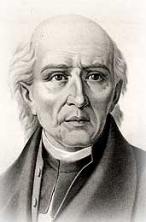
Miguel Hidalgo
Miguel Hidalgo was a Mexican Catholic priest.
Miguel Hidalgo was the one who called for revolution against the Spanish on September 16, 1810.
Miguel Hidalgo was born on May 8, 1753, in Pénjamo, México.
Miguel Hidalgo died on July 30, 1811, in Chihuahua, Mexico.
Miguel Hidalgo began in San Miguel as a movement for independence became a social and economic war of the masses against the upper classes. Joined by thousands of Indians and mestizos, Hidalgo marched forth from Dolores under the banner of Our Lady of Guadalupe.

Slide 13
Incas
The Inca Emperor Pachacuti rises to power and transforms his kingdom into the largest empire in South America.
The Incas at the time of the Spanish conquest in 1532, ruled an empire that extended along the Pacific coast and Andean highlands from the northern border of modern Ecuador to the Maule River in central Chile.
The Incas established their capital at Cuzco (Peru) in the 12th century. They began their conquests in the early 15th century and within 100 years had gained control of an Andean population of about 12 million people.
The Incas state spanned the distance of northern Ecuador to central Chile and consisted of 12 million inhabitants from more than 100 different ethnic groups at its peak.
The Incas first appeared in what is today southeastern Peru during the 12th century A.D. According to some versions of their origin myths, they were created by the sun god, Inti, who sent his son Manco Capac to Earth through the middle of three caves in the village of Paccari Tampa.

Slide 14
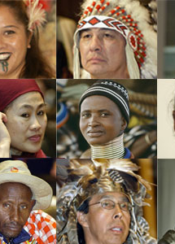
Indigenous Populations
Indigenous populations are communities that live within, or are attached to, geographically distinct traditional habitats or ancestral territories.
They identify themselves as being part of a distinct cultural group.
They generally maintain cultural and social identities, and social, economic, cultural and political institutions, separate from the mainstream or dominant society or culture.
They are descended from groups present in the area before modern states were created and current borders defined.
The Indigenous Population includes Inuit people, Yupik peoples, Aleut people, Alaskan Natives, Native Americans, First Nations, Métis, Indigenous Mexicans, the Caribbean, Central America, and South America.

Slide 15
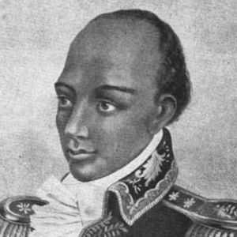
Toussaint L’ Ouverture
Toussaint L'Ouverture was a leader of the Haitian independence movement during the French Revolution.
Toussaint L’Ouverture was a former Haitian slave who led the only successful slave revolt in modern history.
Though he didn’t live to see it, Francois Toussaint’s actions set in motion a series of global events that changed the geography of the western hemisphere and spelled the beginning of the end for European colonial domination in the Americas.
Toussaint L’Ouverture was born on 1743 in Haiti.
Toussaint L’Ouverture died on April 7, 1803 in Fort-de-Joux, France.

Slide 16
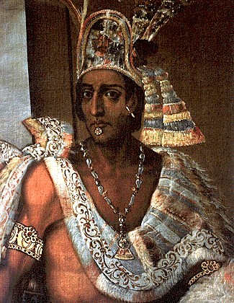
Montezuma
Montezuma was born in 1466.
Montezuma died in June 30, 1520 Tenochtitlán, México.
Montezuma, Cortés realized it was a trap and, instead, made the emperor his prisoner, believing that the Aztecs would not attack as long as he held Montezuma captive.
In 1502 Montezuma succeeded his uncle Ahuitzotl as the leader of an empire that had reached its greatest extent, stretching to what is now Honduras and Nicaragua, but that was weakened by the resentment of the subject tribes to the increasing demands for tribute and victims for the religious sacrifices
Montezuma was commander of the army and organized extensive expeditions of conquest in deference to Huitzilopochtli, the god of war and of the sun.

Slide 17
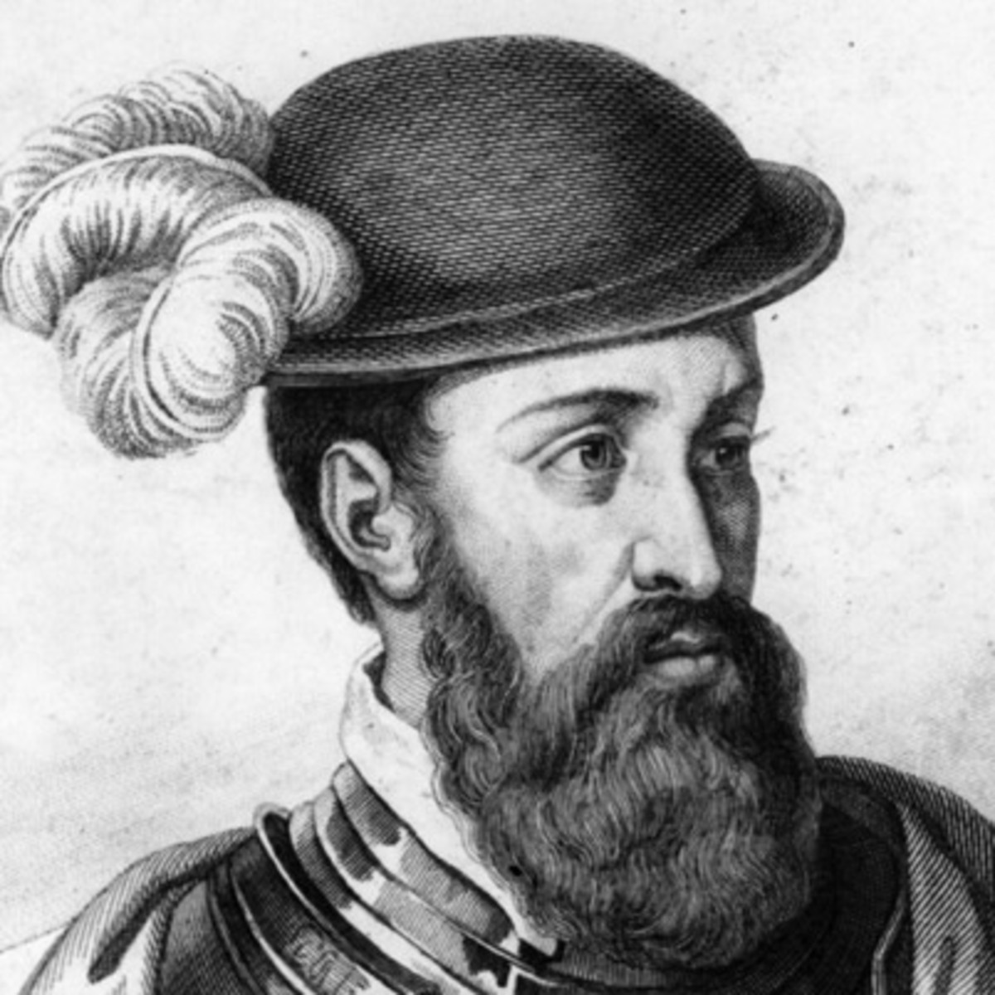
Francisco Pizarro
Francisco Pizarro was an explorer, soldier and conquistador.
Francisco Pizarro was Born around 1474 in Trujillo, Spain.
As young man, Pizarro heard tales of the New World and was seized by a lust for fortune and adventure. In 1510, he accompanied Spanish explorer Alonzo de Ojeda on a voyage to Urabá, Colombia.
As a soldier, he served on the 1513 expedition of Vasco Nunez de Balboa, during which he discovered the Pacific Ocean.
Almagro had taken over Cuzco after one of Pizarro’s half-brothers, Juan Pizarro, was killed during a revolt. Pizarro did not want Almagro to have the city, but was too old to fight himself so he sent his brothers to Cuzco to fight.

Slide 18
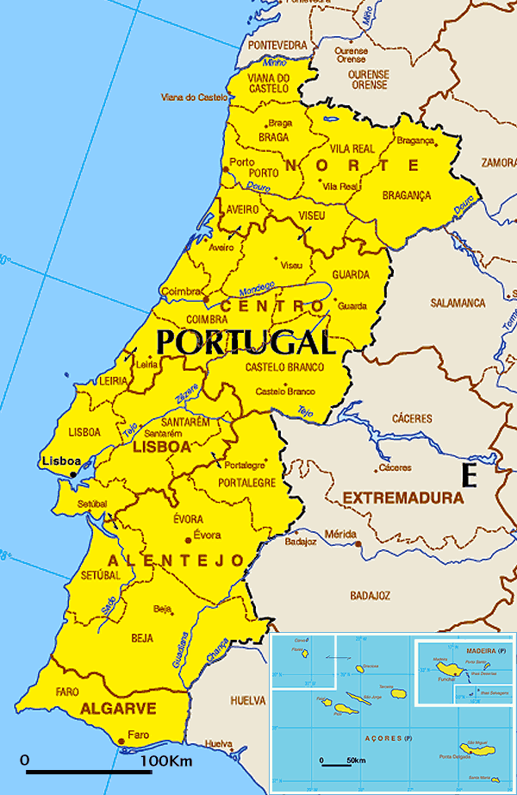
Portugal
Portugal is a southern European country on the Iberian Peninsula, bordering Spain.
Portugal is a country lying along the Atlantic coast of the Iberian Peninsula in southwestern Europe.
Portugal was once continental Europe’s greatest power, Portugal shares commonalities, geographic and cultural with the countries of both northern Europe and the Mediterranean.
Lisbon is Portugal’s capital and economic and cultural centre. The city clings to low but steep hills situated on the right bank of the Tagus and is a popular tourist destination.
Lisbon is rather more tranquil and reserved than Madrid in neighboring Spain, but it shares with it a reputation for great food, melancholy and romantic music, dance, and sport.

Slide 19
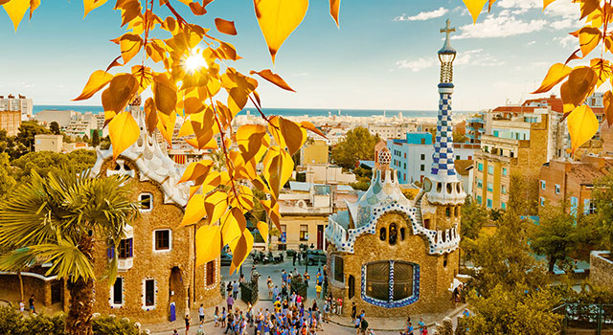
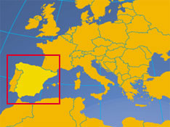
Spain
A village in Andalusia, Spain, showing housing typical of the region.© David Warren/SuperStock
Spain is a country located in extreme southwestern Europe. It occupies about 85 percent of the Iberian Peninsula, which it shares with its smaller neighbor Portugal.
Spain’s countryside is quaint, speckled with castles, aqueducts, and ancient ruins, but its cities are resoundingly modern.
The southern portion of the country is desert, an extension of the Sahara made familiar to Americans through the “spaghetti western” films of the 1960s and early ’70s.
The southeastern Mediterranean coast and the Balearic Islands enjoy a gentle climate, drawing millions of visitors and retirees, especially from northern Europe.
Madrid is Spain’s largest city and is also its financial and cultural centre, as it has been for hundreds of years.

Slide 20
Spanish Conquistadors
The Spanish conquistadors are the leaders in the Spanish conquest of America, especially of Mexico and Peru, in the 16th century.
Spanish dominion was extended by a number of expeditions from Peru, including one by Sebastián de Benalcázar to the present Colombia, whose rule he had to share with Gonzalo Jiménez de Quesada, who had marched inland from the Caribbean coast.
Cortés marched inland with about 400 men and secured an alliance with the independent city of Tlaxcala, with whose aid he conquered the Aztec capital of Tenochtitlan (now Mexico City). Between 1522 and 1524, Michoacán and the Pacific coastal regions were conquered, and in 1524, expeditions led by Pedro de Alvarado and Cristóbal de Olid, respectively, were sent to Mayan Guatemala and the Gulf of Honduras.
Pedrarias sent a kinsman, Gil González Davila, to explore northward, and he found civilization on the shores of Lake Nicaragua. The jealous Pedrarias forced him to flee to Santo Domingo before a Spanish colony could be planted
Francisco Hernández de Córdoba in 1524, who established Granada on Lake Nicaragua and León not far from Lake Managua

Slide 21
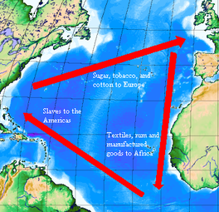
Triangular Trade
The Triangular trade is the Atlantic trade routes between three different destinations, or countries, in Colonial Times.
The Triangular Trade routes, cover England, Europe, Africa, the Americas and the West Indies.
The West Indies supplied slaves, sugar, molasses and fruits to the American colonies.
The Triangular Trade involved three journeys each with the promise of a large profit and a full cargo. The journey was more complicated with ships travelling from all over Europe carrying manufactured goods to different ports along the African coast to trade for slaves.
The ships from Africa, then sailed across the Atlantic to the Caribbean and Americas to trade the slaves for raw materials.

Slide 22
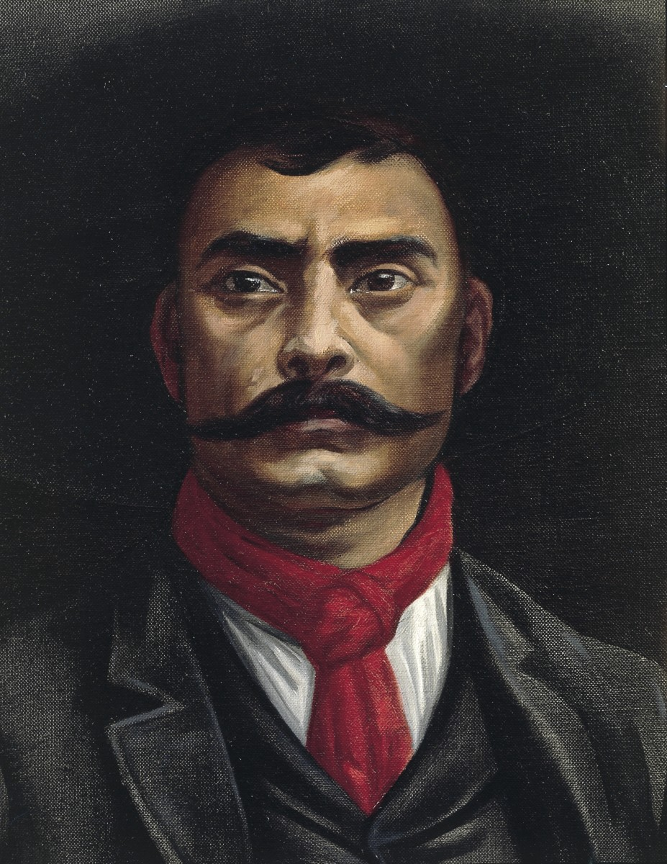
Emiliano Zapata
Emiliano Zapata was born on August 8, 1879 in Anenecuilco, Mexico.
Emiliano Zapata was the son of a mestizo peasant, who trained and sold horses. He was orphaned at the age of 17 and had to look after his brothers and sisters.
In 1909 Emiliano’s neighbors elected him president of the board of defense for their village.
Emiliano Zapata was a men of the people, he became a leading figure in Anenecuilco, where his family had lived for many generations, and he became involved in the struggles of the local people.
Born a peasant, he was forced to join the Mexican army in 1908, following his attempt to recover village lands taken over by a rancher. After the revolution began in 1910, he raised an army of peasants in the southern state of Morelos under the slogan “Land and Liberty.”

Slide 23
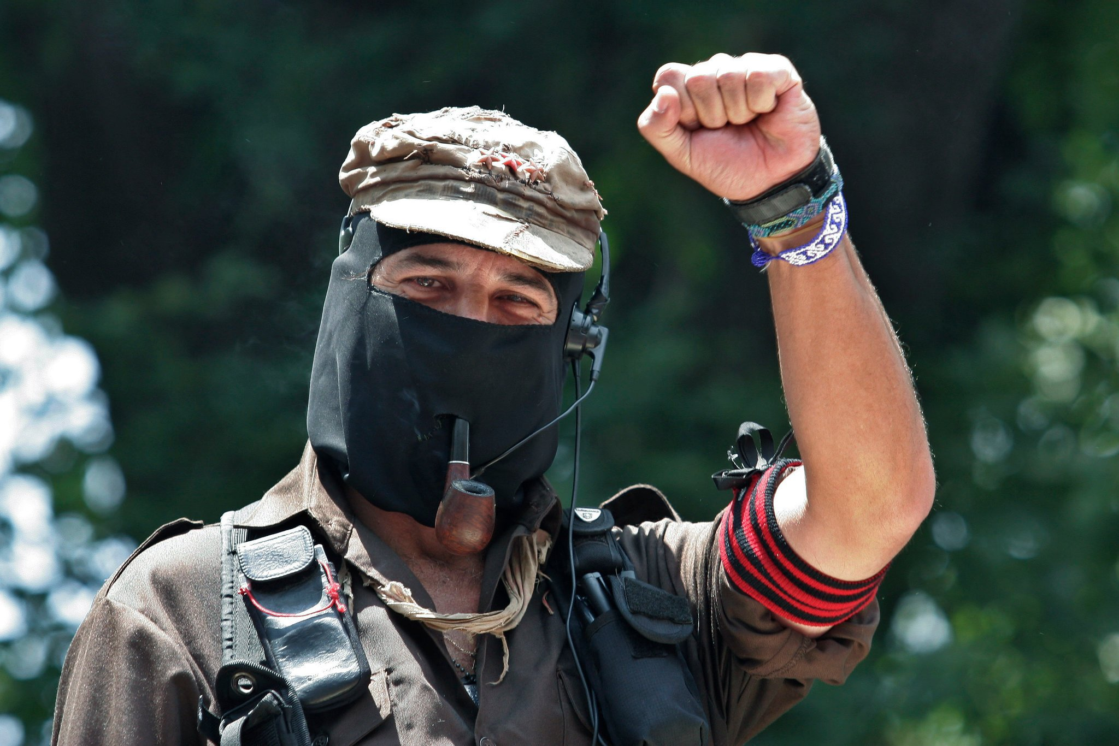
Zapatista Guerilla Movement
Some people involved in the movement was Zapatista Army of National Liberation, Ejercito Zapatista de Liberacion Nacional (ELN), Natives that were coffee growers, and Poor people of the Chiapas.
It started because Zapatista Army declared war on the Mexican state of Chiapas. They got the world’s attention by taken over several Mexican cities and attacking their military posts.
It happened on January 1, 1994 in Chiapas, Mexico
Zapatista Army wanted more land, and thought NAFTA was going to increase poverty.
The outcome to this was the indigenous (natives) and peasants of Chiapas have started their own health and education programs and the uprising was a reminder of what can happen if people are ignored.

Slide 24
Bibliography
Realhistories.org
Britannica.com/biography
www.S9.com/biography
History.com
callowayk.weebly.com
www.Int/topics.com

