Slide 1
LATIN AMERICAN INDEPENDENCE MOVEMENT
BY:AJA BANKS, GISELLE DELGADO

Slide 2
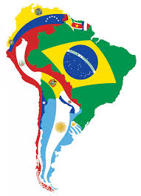
Why Latin America wanted independence?
Spanish law allowed wealthy people of mix heritage to “buy” whiteness and thus rise in a society which did not want to see their status change. This caused resentment with the privileged classes: the “Dark Side” of the revolutions was that they were fought, in part, to maintain a racist status quo in the colonies free of Spanish laborism.

Slide 3
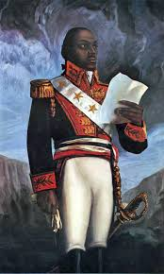
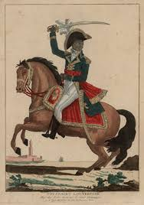
Toussaint L’Ouverture
Born: May 20, 1743
Nationality: French
Allegiance: France/Haiti
Was the leader of the nation revolution
He switched allegiance to the French when they abolished slavery
In 1801 he promulgated an autonomist constitution for the colony, with himself as governor for life

Slide 4
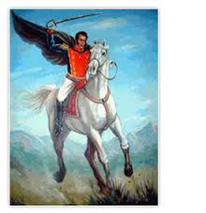
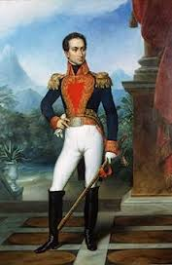
Simon Bolivar
Born: July 24, 1783
Nationality: Venezuelan
Following his triumph over the Spanish monarchy, Bolivar participated in the foundation of the first union of independent nations in Latin America, gran Columbia, of which he was president from 1819 to 1830.
Modern-day historians have considered Bolivar to be a heavily polarized individual, with criticism especially aimed at his somewhat dubious belief that a strong presidency, maintained for life, is essential to a state’s survival.

Slide 5
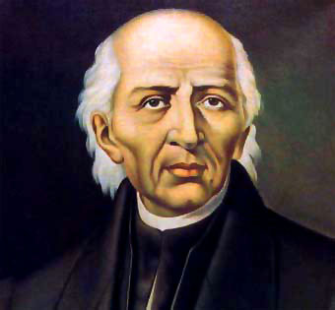
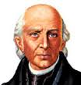
Miguel Hidalgo
Born: May 18, 1753
Allegiance: Mexico
As a priest he served in a church
He marched across Mexico and gathered an army of nearly 90,000 poor farmers and Mexican civilians who attacked and killed both Spanish Peninsulares and Crillo elites, even though, Hidalgos troops lacked training and were poorly armed.
In 1810 he gave the famous speech, “The Cry of Dolores”, calling upon the people to protect the interest of their king Fernando VII by revolting against the European - born Spaniards who had over thrown the Spanish Viceroy.

