Slide 1
Location, Climate,
& Natural Resources:
Mexico,
Venezuela,
Cuba, & Brazil
Where People Live
& How They Trade

Slide 2
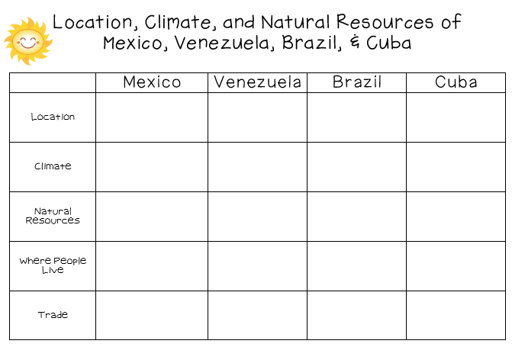

Slide 3
Location, Climate,
& Natural Resources:
Mexico,
Venezuela,
Cuba, & Brazil
Where People Live
& How They Trade

Slide 4
Mexico

Slide 5
Location
It’s south of the US, east of the Pacific Ocean, and west of the Gulf of Mexico & Caribbean Sea.
It’s great that it’s located between major bodies of water because:
great opportunities for trading
can easily ship goods around the world
Another advantage: close to US, so trade between two countries is convenient.

Slide 7
Climate
In Mexico, the climate varies according to location:
The northern part is mostly desert (hot).
The beaches have a tropical climate.
Mountains and plains have a more mild climate.

Slide 8
Chihuahua (Mexican state)

Slide 9
Sierra Madre Occidental

Slide 10
Chiapas (Mexican state)

Slide 11
Natural Resources
Oil is one of the top exports:
Exports 1.7 million barrels/day.
Money from oil sales provides 1/3 of government’s budget.
Mexico is one of the world’s top producers of silver.
Other exports include fruits, vegetables, coffee, & cotton.
Tourism is also a major industry.

Slide 12
Where People Live
Most people live in central Mexico:
arable farmland with enough rain to grow crops
many manufacturing centers are located here (provide jobs to 75% of the country’s population)
urban: 77%
rural: 23%

Slide 13
Mexico City

Slide 14
Mexico City

Slide 15
How They Trade
Mexico has a mix of new and old industries.
recently expanded railroads, airports, and electric generating plants
7 major seaports
exports: oil, manufactured goods, silver, fruits, vegetables, coffee, & cotton
tourism

Slide 16
Venezuela

Slide 17
Location
Venezuela is in the northeast part of South America, just north of equator.
It has coasts on Caribbean Sea and Atlantic Ocean.
This gives it easy access to trade with other countries.
The nearby Panama Canal provides a shortcut to the Pacific to trade with Asian countries.
There are mountains in the north and south, so only about 3% of the land is arable.

Slide 18
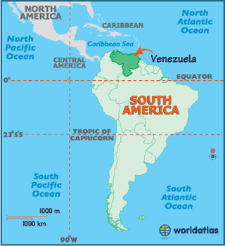

Slide 20
Climate
Venezuela has a hot, tropical climate.
It’s cooler in the mountains.
Rain varies by region (16 inches on the coast; over 100 inches in the mountains).

Slide 21
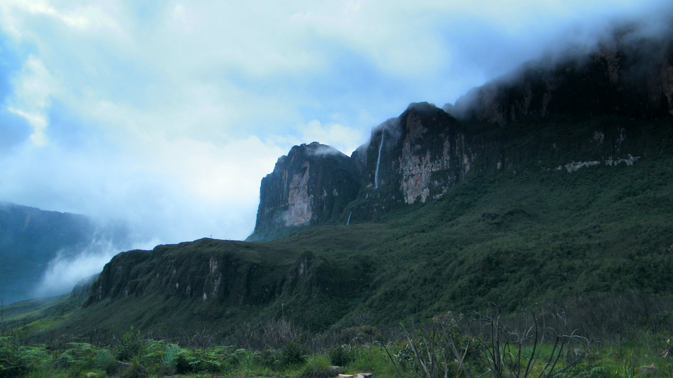

Slide 23
Natural Resources
Venezuela is the sixth-largest oil exporter in the world.
It produces 2.8 million barrels/day.
90% of the money the government makes on trade comes from oil exports.
Farming provides jobs for 10% of the population.

Slide 25
Where People Live
urban: 88%
rural: 12%
Caracas is the largest city.
Most people live in the northern highlands, along the coast.

Slide 26
Caracas

Slide 27
Caracas

Slide 28
How They Trade
90% of money made on exports comes from oil.
4 major seaports
Other exports: bauxite and aluminum, steel, chemicals, agricultural products, basic manufactures
Tourism

Slide 29
Cuba

Slide 30
Location
Cuba is an island 90 miles south of Florida, in the Caribbean Sea.
It’s only 700 miles long.
It’ the largest island in the West Indies.
It’s location on ocean trading routes has been an important influence on its history and economy.

Slide 31
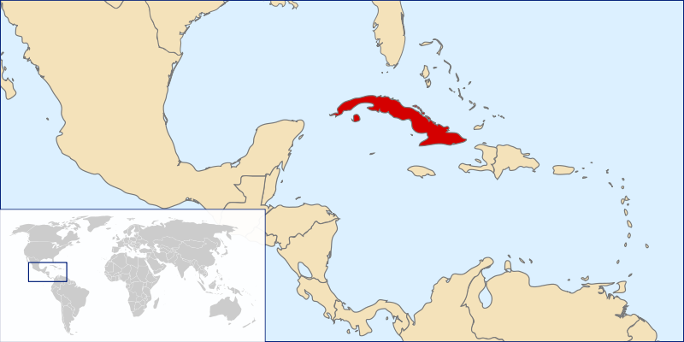

Slide 32
Climate
The climate is tropical but moderated by trade winds.
(It’s warm-to-hot all year long, but the winds provide relief from the heat.)
There’s a rainy season from May to October and a dry season from November to April.
Cuba is a target for hurricanes.
Hurricane season runs from June to November.

Slide 33
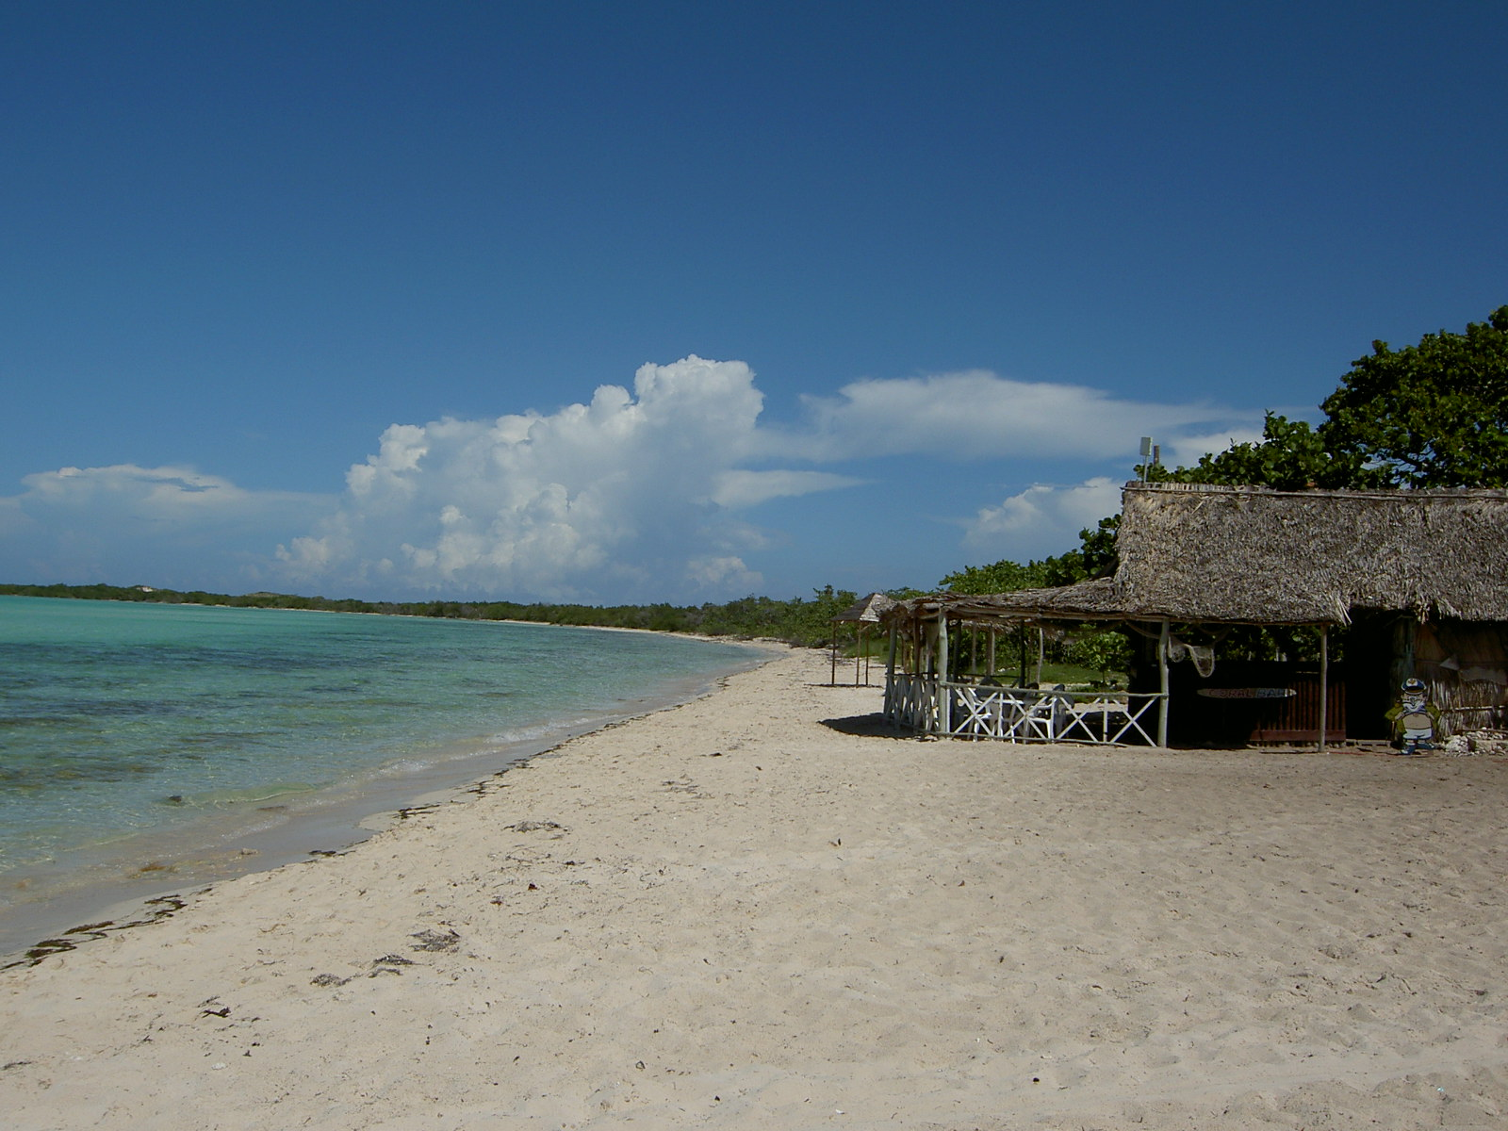

Slide 34
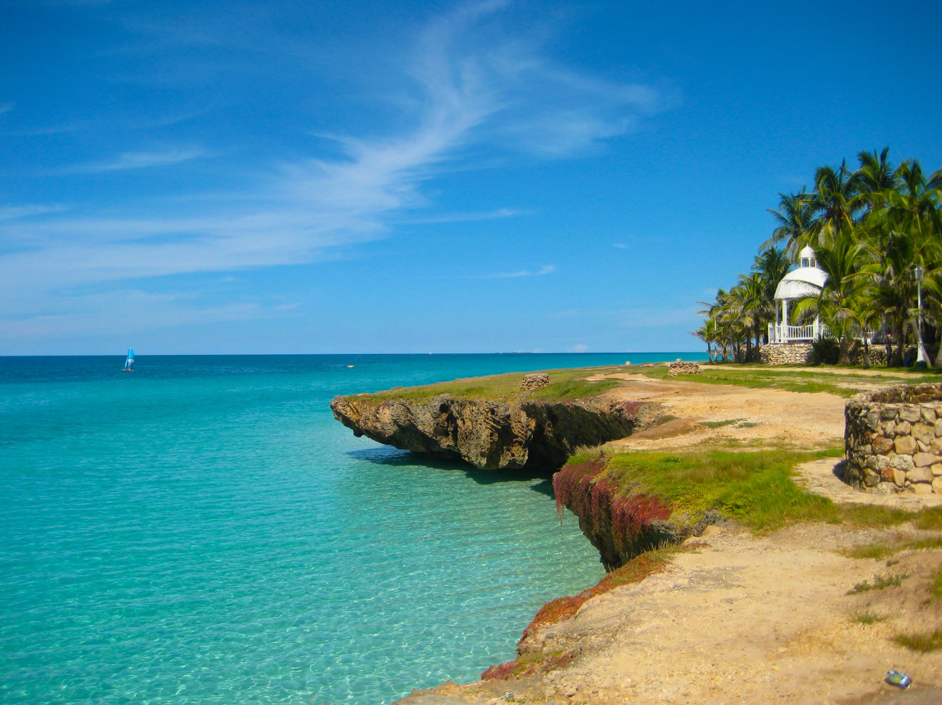

Slide 35
Natural Resources
28% of Cuba’s land is arable.
It’s most important export is sugar cane.
Other exports include: coffee, fish, fruits, & tobacco.
Tourism is a fast-growing industry.

Slide 36
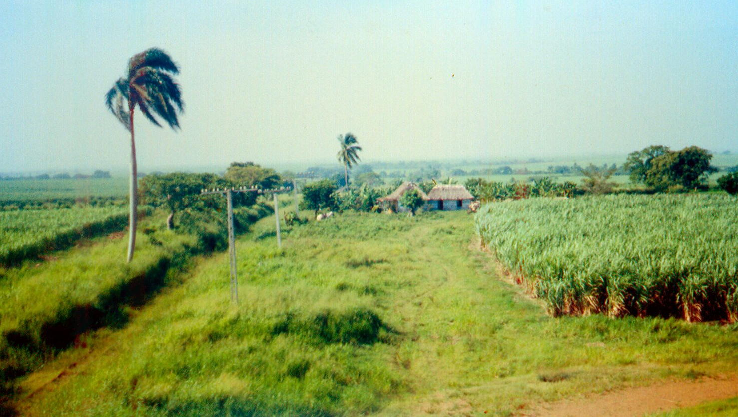
Sugar cane Farm

Slide 37
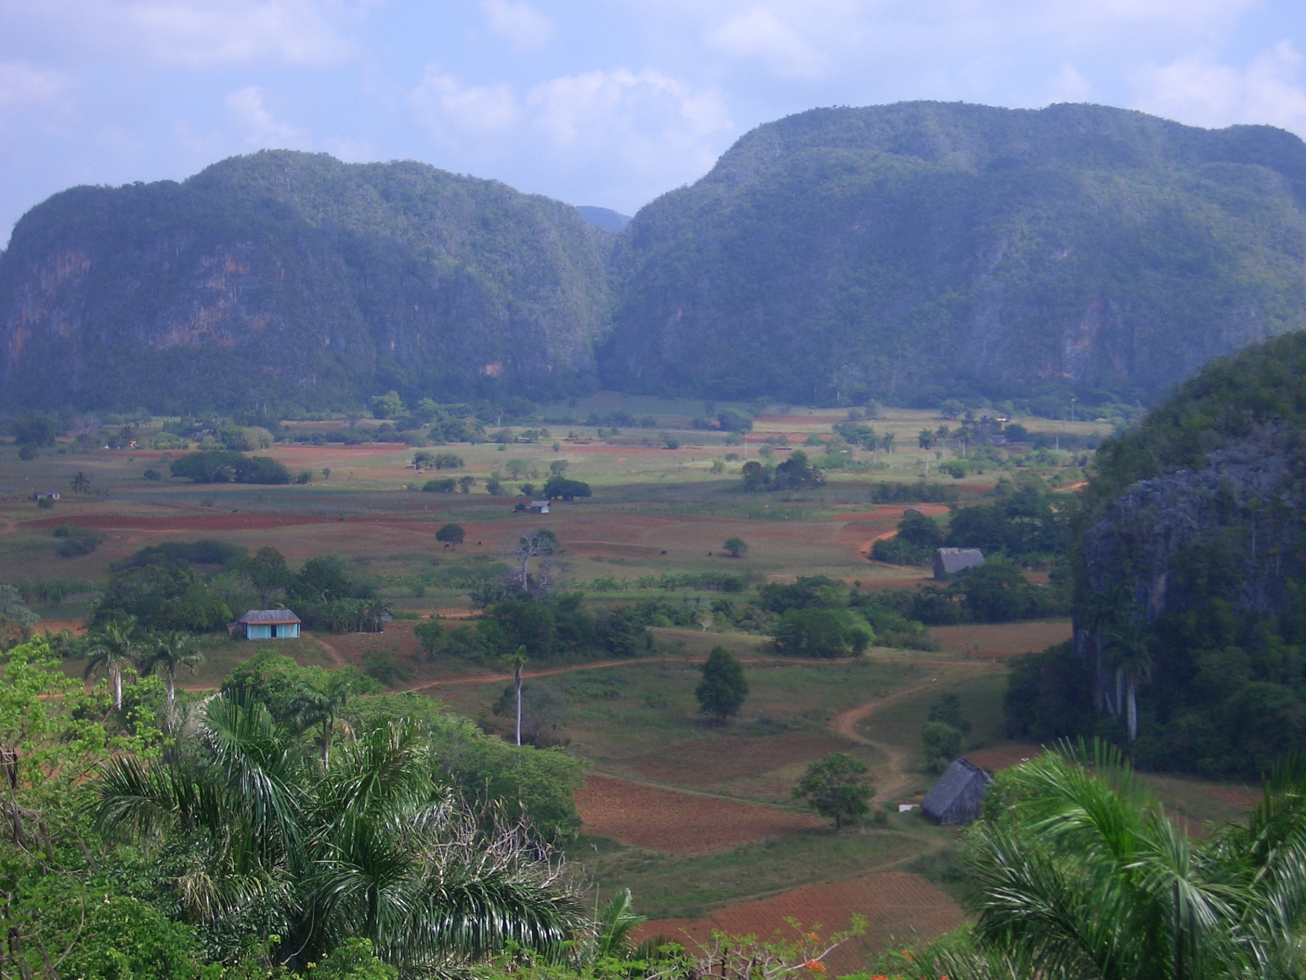

Slide 38
Where People Live
urban: 76%
rural: 24%
Havana is the largest city.
20% of Cubans live in Havana.

Slide 39
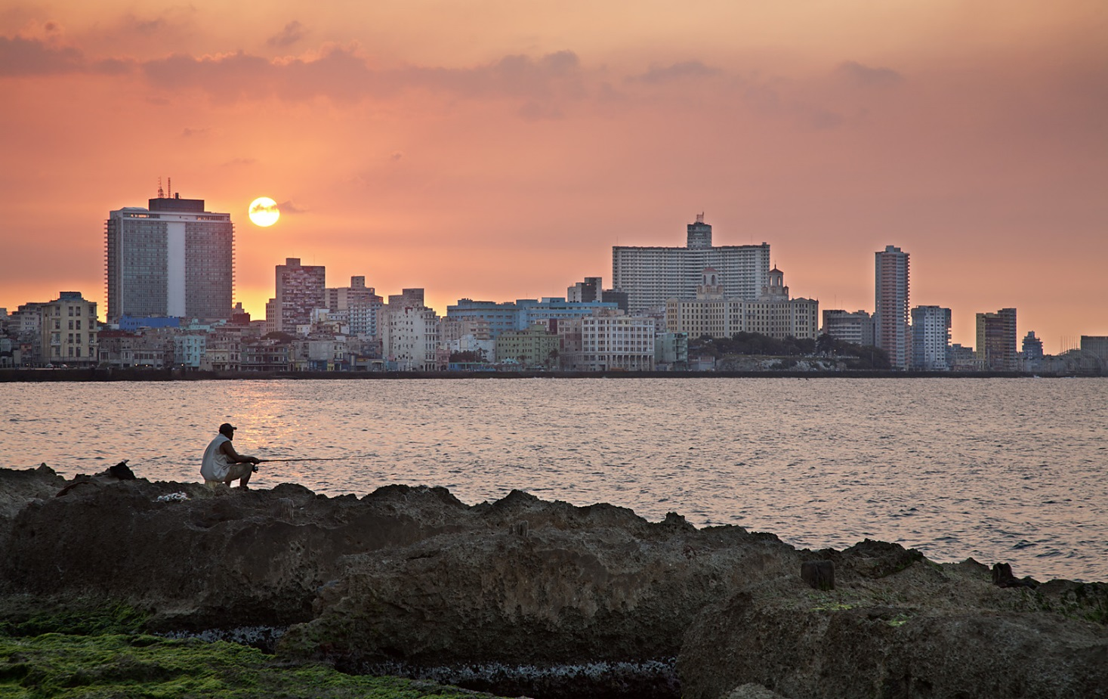
Havana

Slide 40
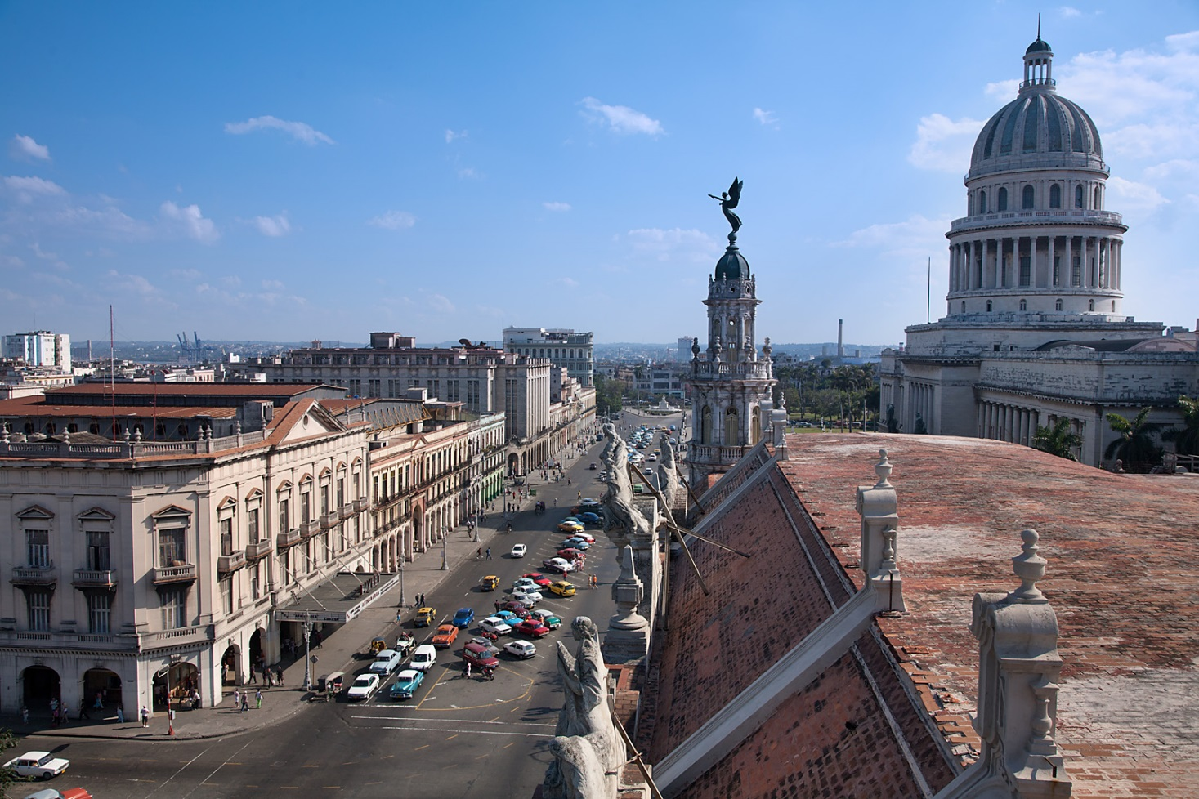
Havana

Slide 41
How They Trade
3 major seaports
Exports: sugar, nickel, tobacco, fish, medical products, citrus, coffee
Tourism
Venezuela is Cuba’s largest trading partner; it sells oil to Cuba at a reduced price.

Slide 42
How They Trade
The Communist government of the Soviet Union helped support Cuba for many years.
When it collapsed in 1991, Cuba faced difficult times.
Trade from other countries does not bring in enough money to meet needs of Cuba’s people.
Government sometimes orders businesses & factories to close.
Also orders blackouts—times when all electricity is cut off in order to save electricity.

Slide 43
Brazil

Slide 44
Location
Brazil is on the eastern side of South America, along the coast of the Atlantic Ocean.
It shares a border with nearly every country in South America!
Amazon River and other large rivers stretch across Brazil.

Slide 45
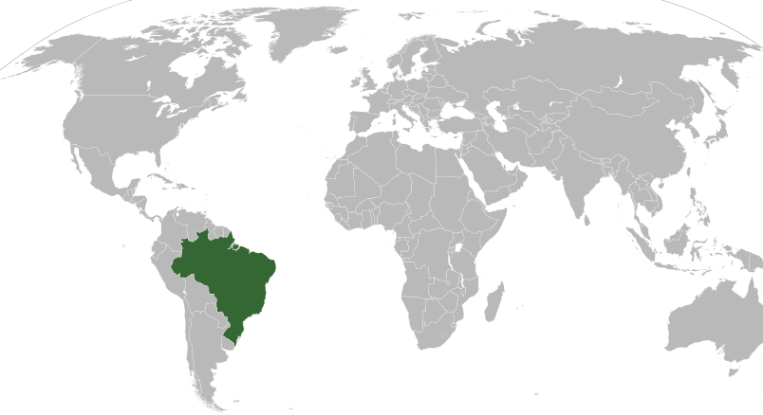

Slide 46
Climate
Brazil’s location on the equator gives it the climate needed to support one of the world’s largest rain forests.
Its climate is mostly hot and tropical.
In the south, the climate is temperate (mild).

Slide 47
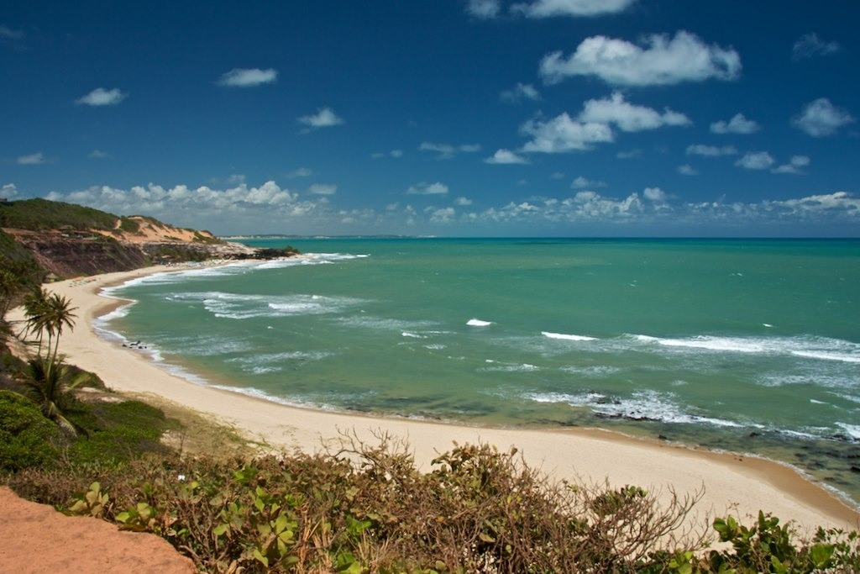

Slide 48
Natural Resources
Only 7% of land is arable, but Brazil makes the most of this resource.
Farmers grow 1/3rd of the world’s coffee, and lead the world in production of oranges, papayas, sugar cane, and soybeans.
Only the US exports more farm products than Brazil.

Slide 49
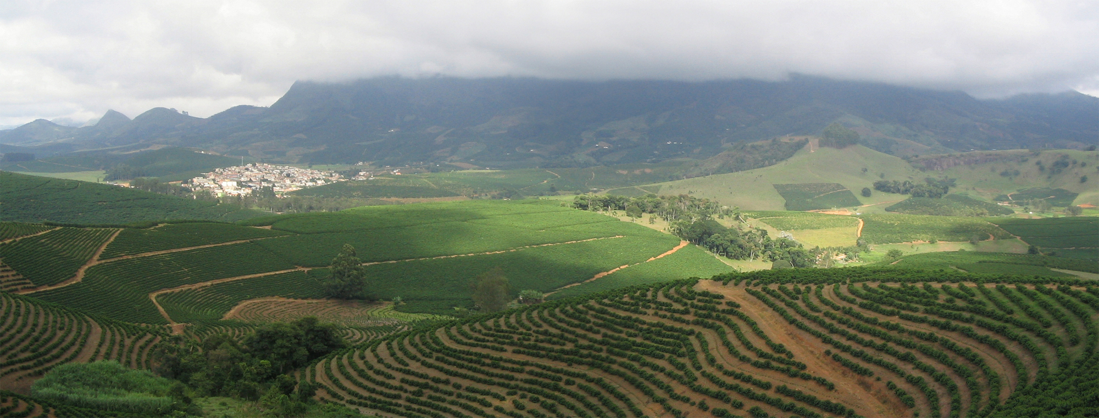
Coffee Plantation

Slide 50
Where People Live
urban: 84%
rural: 16%
It’s the most populated country in Latin America.
It’s the largest Portuguese-speaking country in the world.
Most Brazilians live along the coasts; 80% live within 200 miles of the ocean.

Slide 51
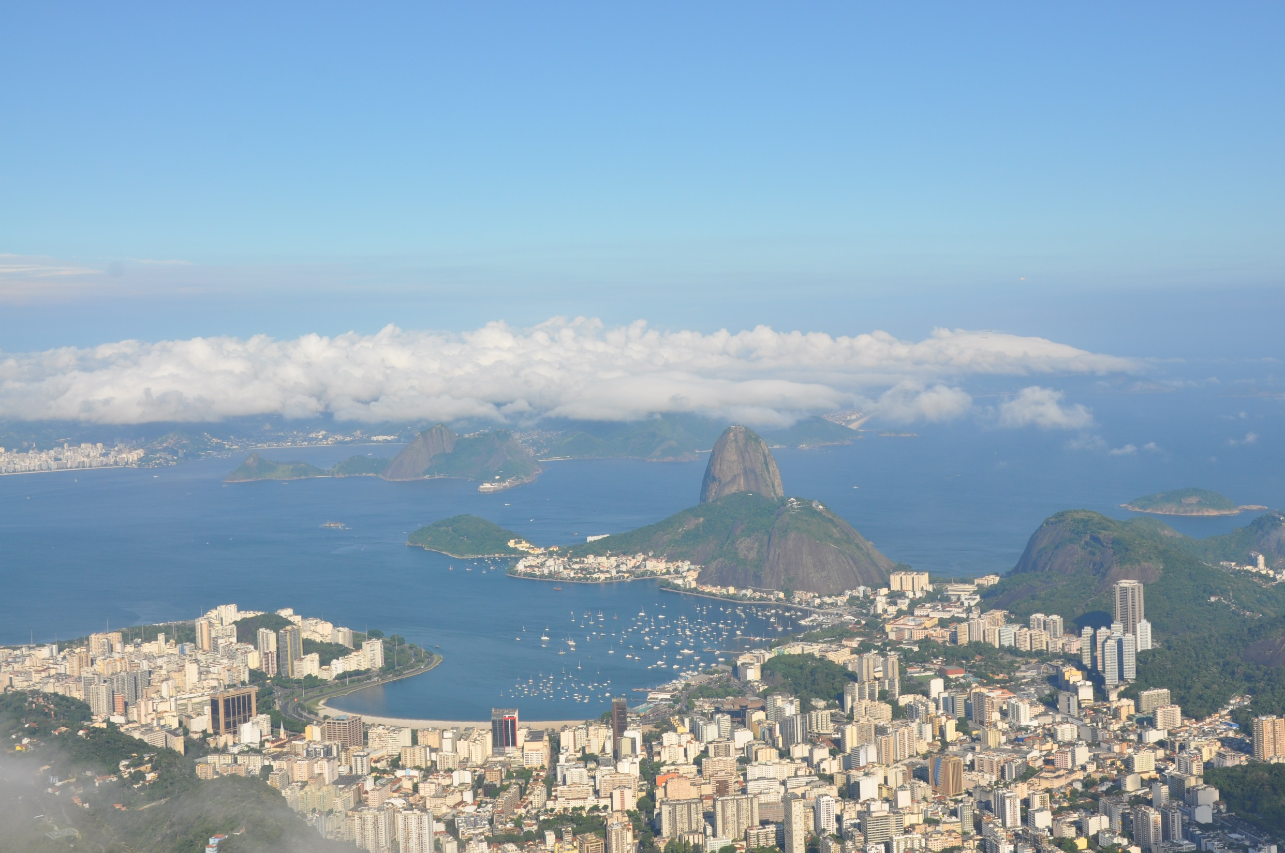
Havana

Slide 52
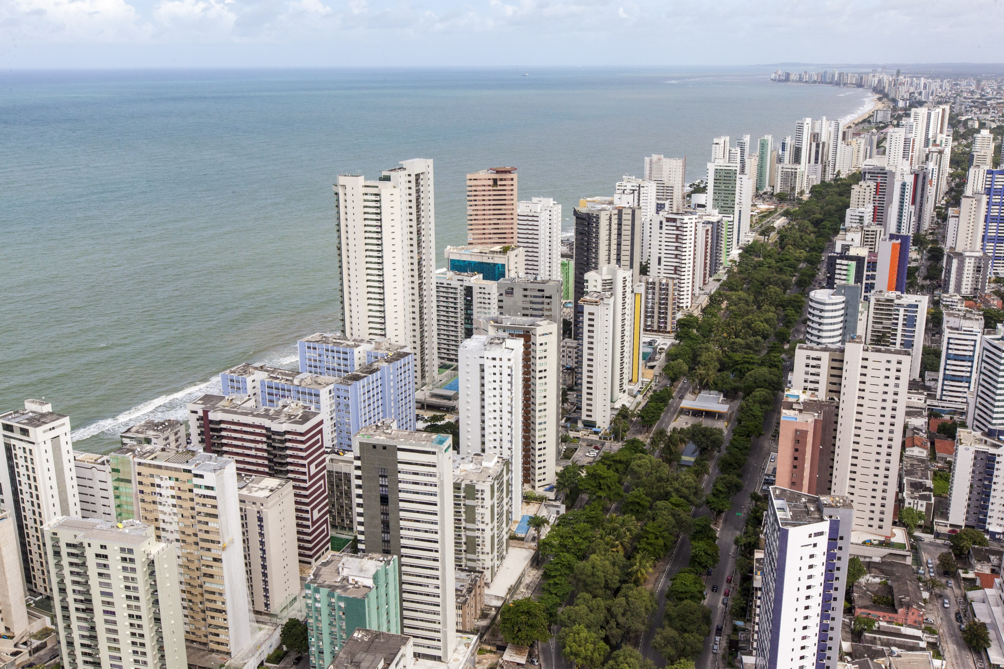
Havana

Slide 53
How They Trade
7 major seaports
Exports: transportation equipment, iron ore, soybeans, footwear, coffee, autos, sugar, fruits
tourism
Amazon Rainforest attracts many visitors.
Beaches are another attraction.
USA is Brazil’s largest trading partner.

Slide 54
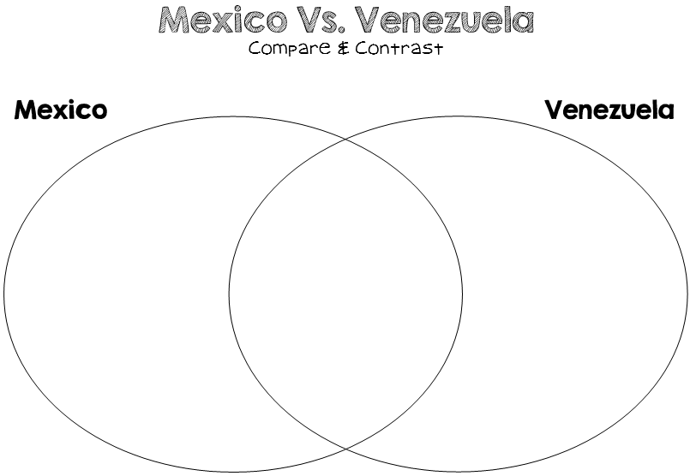

Slide 55
