Slide 1
Location, Climate,
& Natural Resources:
Mexico,
Venezuela,
Cuba, & Brazil
Where People Live
& How They Trade

Slide 2
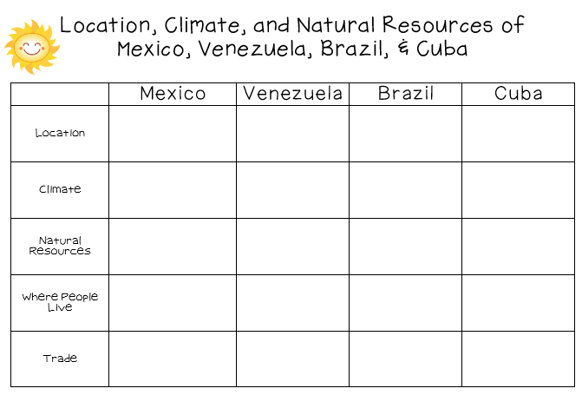

Slide 3
Mexico

Slide 4
Location
It’s south of the US, east of the Pacific Ocean, and west of the Gulf of Mexico & Caribbean Sea.
It’s great that it’s located between major bodies of water because:
great opportunities for trading
can easily ship goods around the world
Another advantage: close to US, so trade between two countries is convenient.

Slide 6
Climate
In Mexico, the climate varies according to location:
The northern part is mostly desert (hot).
The beaches have a tropical climate.
Mountains and plains have a more mild climate.

Slide 7
Chihuahua (Mexican state)

Slide 8
Sierra Madre Occidental

Slide 9
Chiapas (Mexican state)

Slide 10
Natural Resources
Oil is one of the top exports:
Exports 1.7 million barrels/day.
Money from oil sales provides 1/3 of government’s budget.
Mexico is one of the world’s top producers of silver.
Other exports include fruits, vegetables, coffee, & cotton.
Tourism is also a major industry.

Slide 11
Where People Live
Most people live in central Mexico:
arable farmland with enough rain to grow crops
many manufacturing centers are located here (provide jobs to 75% of the country’s population)
urban: 77%
rural: 23%

Slide 12
Mexico City

Slide 13
Mexico City

Slide 14
How They Trade
Mexico has a mix of new and old industries.
recently expanded railroads, airports, and electric generating plants
7 major seaports
exports: oil, manufactured goods, silver, fruits, vegetables, coffee, & cotton
tourism

Slide 15
Venezuela

Slide 16
Location
Venezuela is in the northeast part of South America, just north of equator.
It has coasts on Caribbean Sea and Atlantic Ocean.
This gives it easy access to trade with other countries.
The nearby Panama Canal provides a shortcut to the Pacific to trade with Asian countries.
There are mountains in the north and south, so only about 3% of the land is arable.

Slide 17
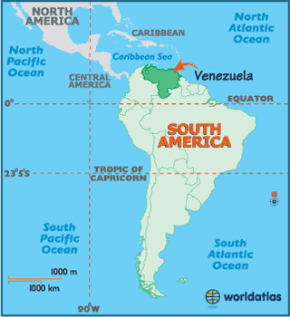

Slide 19
Climate
Venezuela has a hot, tropical climate.
It’s cooler in the mountains.
Rain varies by region (16 inches on the coast; over 100 inches in the mountains).

Slide 21
Natural Resources
Venezuela is the sixth-largest oil exporter in the world.
It produces 2.8 million barrels/day.
90% of the money the government makes on trade comes from oil exports.
Farming provides jobs for 10% of the population.

Slide 23
Where People Live
urban: 88%
rural: 12%
Caracas is the largest city.
Most people live in the northern highlands, along the coast.

Slide 24
Caracas

Slide 25
How They Trade
90% of money made on exports comes from oil.
4 major seaports
Other exports: bauxite and aluminum, steel, chemicals, agricultural products, basic manufactures
Tourism

Slide 26
Cuba

Slide 27
Location
Cuba is an island 90 miles south of Florida, in the Caribbean Sea.
It’s only 700 miles long.
It’ the largest island in the West Indies.
It’s location on ocean trading routes has been an important influence on its history and economy.

Slide 28
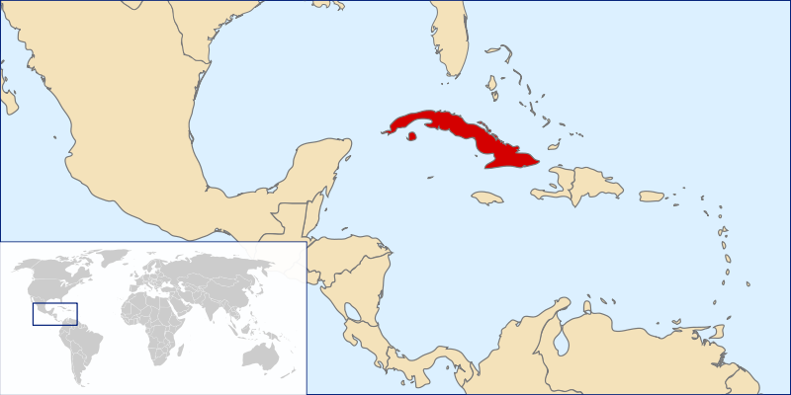

Slide 29
Climate
The climate is tropical but moderated by trade winds.
(It’s warm-to-hot all year long, but the winds provide relief from the heat.)
There’s a rainy season from May to October and a dry season from November to April.
Cuba is a target for hurricanes.
Hurricane season runs from June to November.

Slide 30
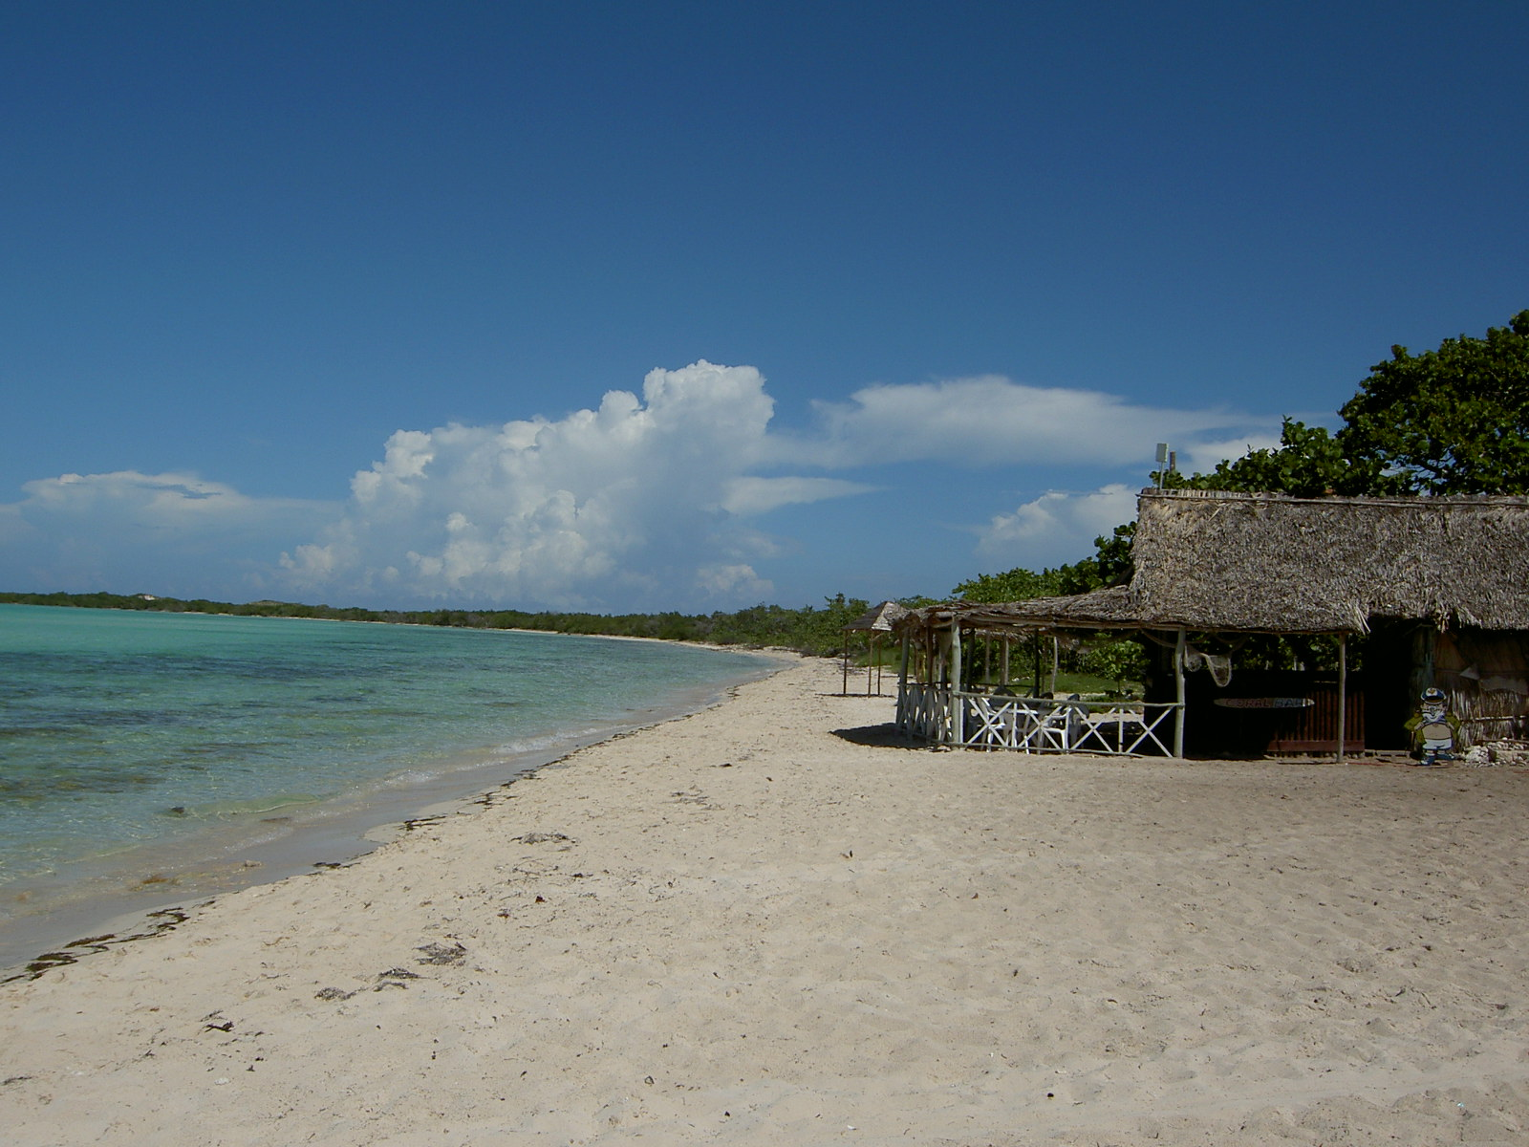

Slide 31
Natural Resources
28% of Cuba’s land is arable.
It’s most important export is sugar cane.
Other exports include: coffee, fish, fruits, & tobacco.
Tourism is a fast-growing industry.

Slide 32
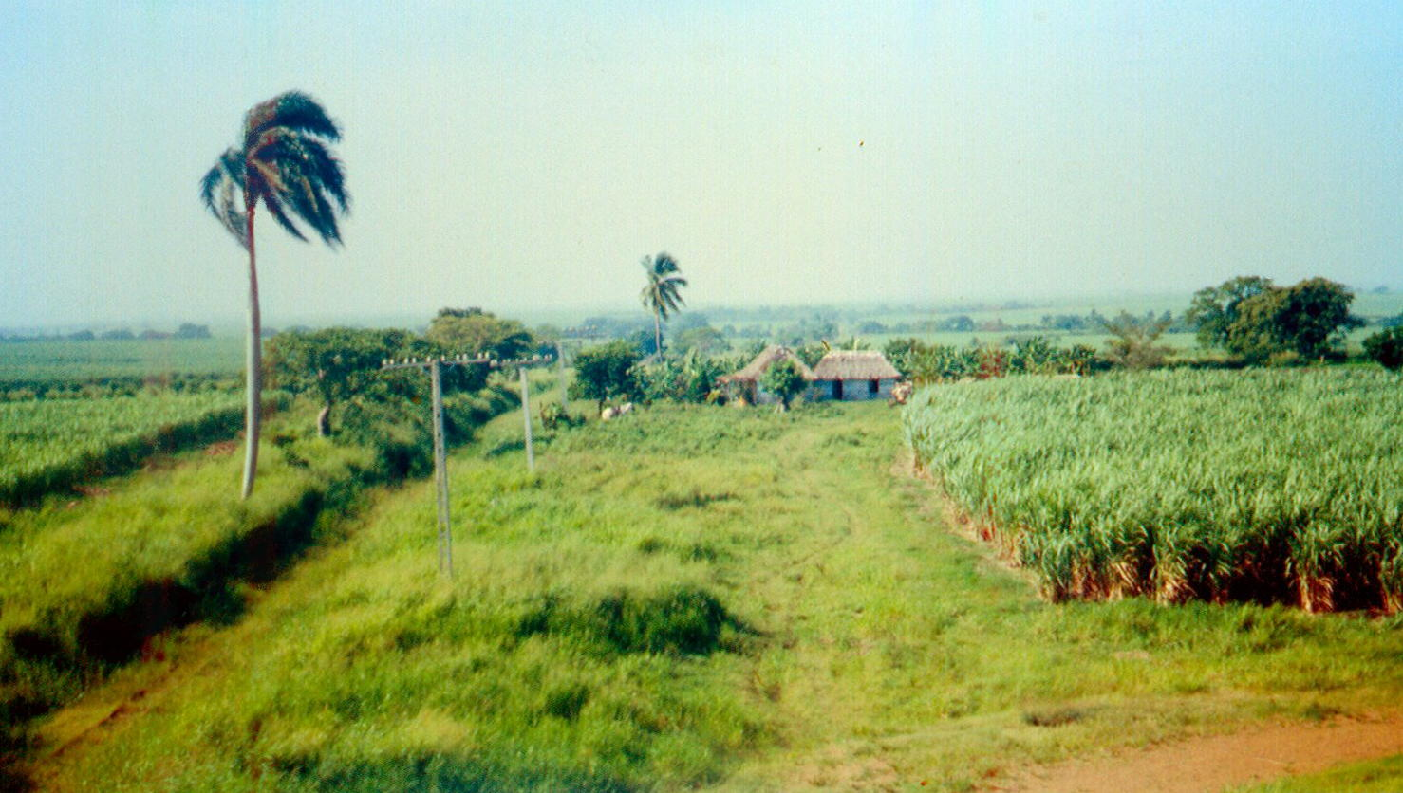
Sugar cane Farm

Slide 33
Where People Live
urban: 76%
rural: 24%
Havana is the largest city.
20% of Cubans live in Havana.

Slide 34
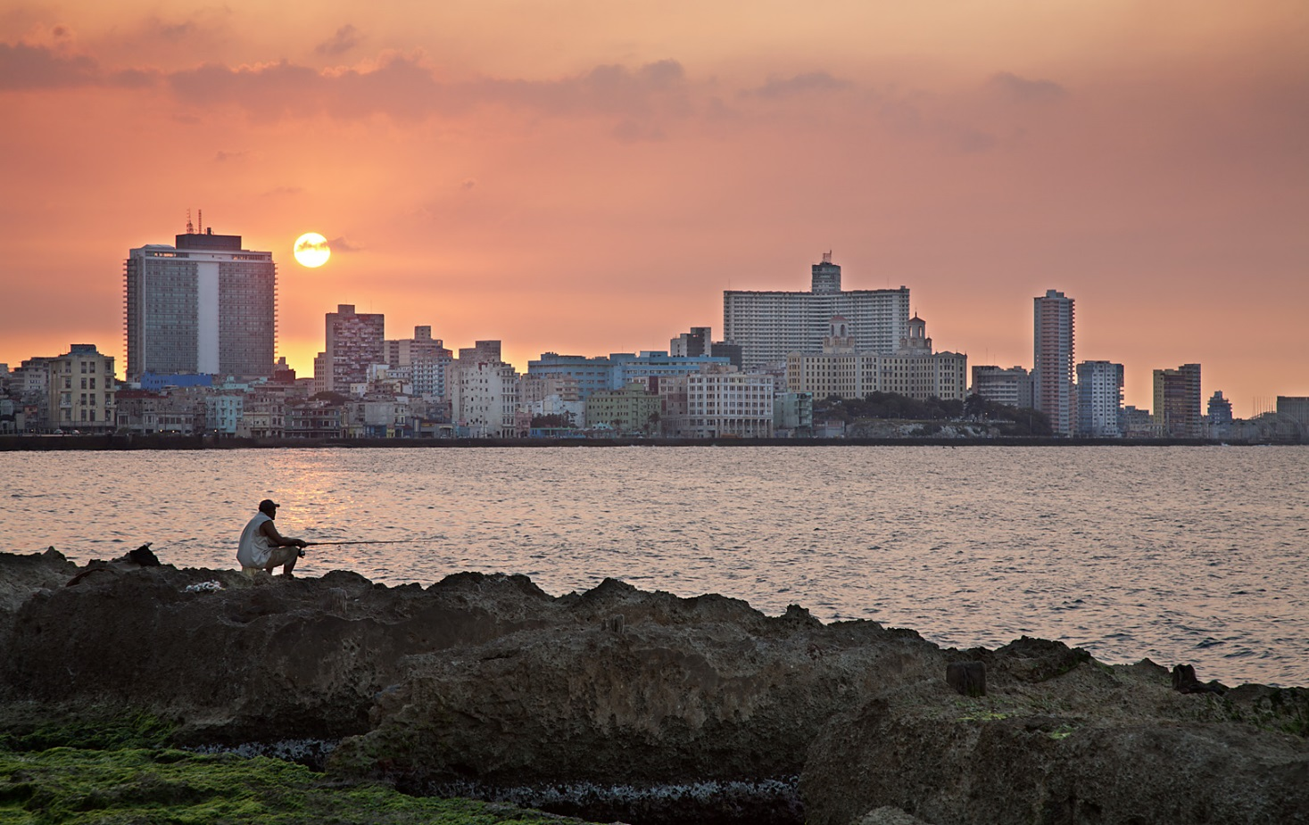
Havana

Slide 35
How They Trade
3 major seaports
Exports: sugar, nickel, tobacco, fish, medical products, citrus, coffee
Tourism
Venezuela is Cuba’s largest trading partner; it sells oil to Cuba at a reduced price.

Slide 36
How They Trade
The Communist government of the Soviet Union helped support Cuba for many years.
When it collapsed in 1991, Cuba faced difficult times.
Trade from other countries does not bring in enough money to meet needs of Cuba’s people.
Government sometimes orders businesses & factories to close.
Also orders blackouts—times when all electricity is cut off in order to save electricity.

Slide 37
Brazil

Slide 38
Location
Brazil is on the eastern side of South America, along the coast of the Atlantic Ocean.
It shares a border with nearly every country in South America!
Amazon River and other large rivers stretch across Brazil.

Slide 39
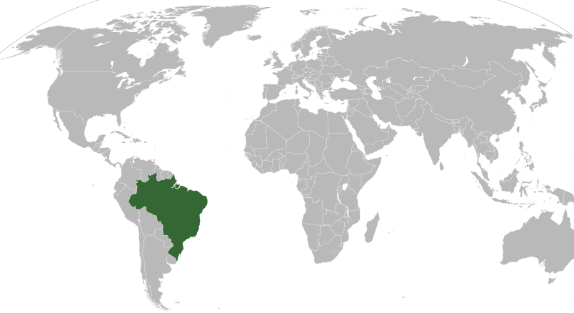

Slide 40
Climate
Brazil’s location on the equator gives it the climate needed to support one of the world’s largest rain forests.
Its climate is mostly hot and tropical.
In the south, the climate is temperate (mild).

Slide 41
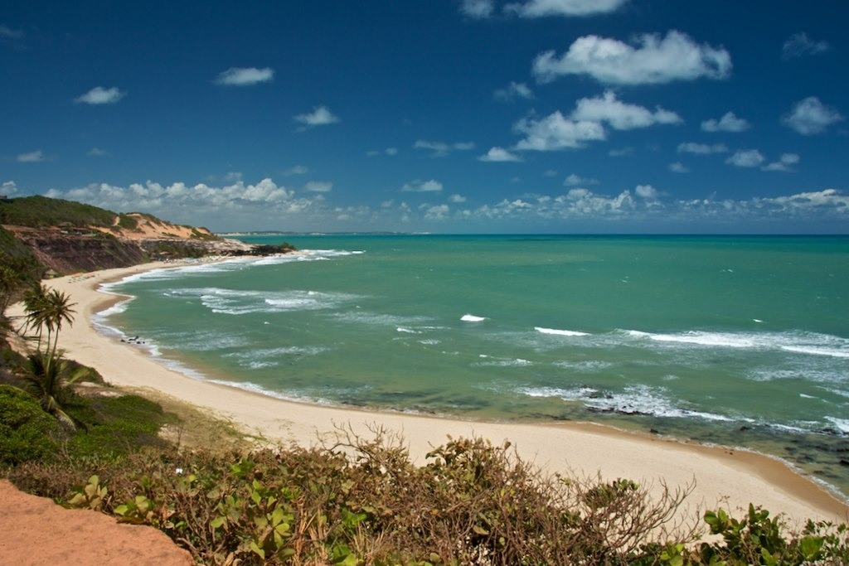

Slide 42
Natural Resources
Only 7% of land is arable, but Brazil makes the most of this resource.
Farmers grow 1/3rd of the world’s coffee, and lead the world in production of oranges, papayas, sugar cane, and soybeans.
Only the US exports more farm products than Brazil.

Slide 43
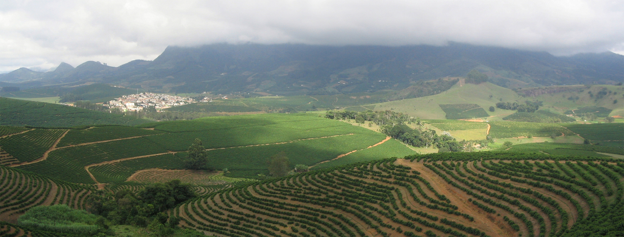
Coffee Plantation

Slide 44
Where People Live
urban: 84%
rural: 16%
It’s the most populated country in Latin America.
It’s the largest Portuguese-speaking country in the world.
Most Brazilians live along the coasts; 80% live within 200 miles of the ocean.

Slide 45
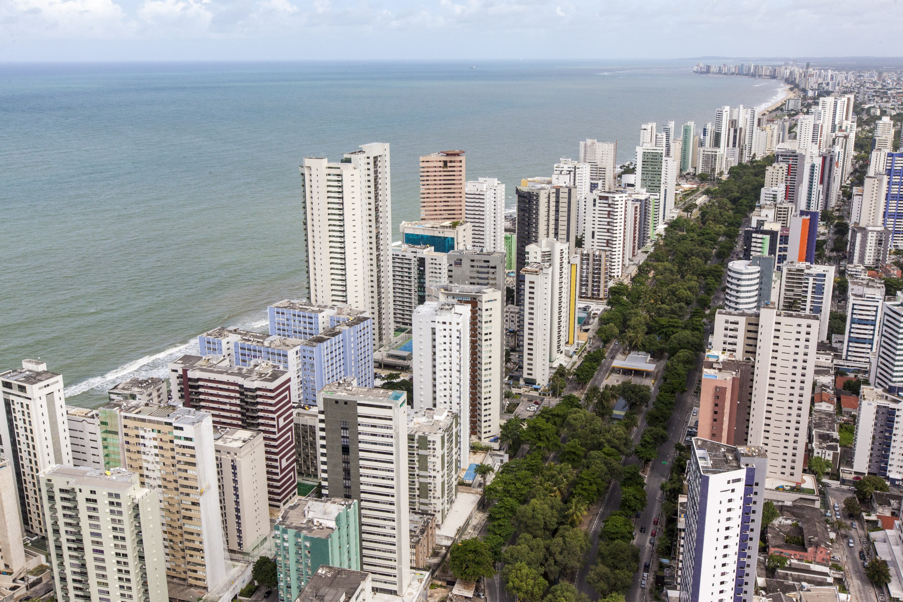
Havana

Slide 46
How They Trade
7 major seaports
Exports: transportation equipment, iron ore, soybeans, footwear, coffee, autos, sugar, fruits
tourism
Amazon Rainforest attracts many visitors.
Beaches are another attraction.
USA is Brazil’s largest trading partner.

Slide 47
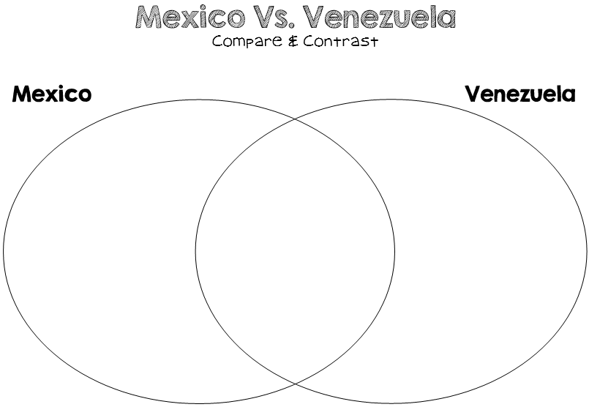

Slide 48
