Slide 1
Essential Question: How do the countries of Israel, Saudi Arabia, and Turkey answer basic economic questions?
Standard:
SS7Ec. Compare and contrast the economic systems in Israel, Saudi Arabia, and Turkey
SS7E5a. Compare how traditional, command, and market economies answer the economic questions of (1) What to produce (2) how to produce (3) for whom to produce
SS7E5b. Explain how most countries have a mixed economy located on a continuum between pure market and pure command.
Notes:
Instructional Approach(s): The teacher should introduce the essential question and the standards that align to the essential question.

Slide 2
Southwest Asia (Middle East) Economic Systems Continuum Activity
Notes:
Instructional Approach(s): Have students complete the economic continuum activity in which they use information about countries to determine where the country falls on the economic continuum. The students then guess which Middle East country the information describes. Discuss the activity with the students. After giving students a chance to predict the information, give them the graphic organizer to complete using the information from the activity or use the following slides to ensure students get the correct information from the activity. The continuum activity can be done individually or in small groups.

Slide 3
Use the Southwest Asia (Middle East) Economic Systems Graphic Organizer to record your information
Notes:
Instructional Approach(s): The teacher should give each student a copy of the Southwest Asia (Middle East) Economic Systems Graphic Organizer [linked on the curriculum map] to record important information during the lesson. The students can also use the Economics Systems Continuum Activity to record the information on their graphic organizer or continue to the next few slides to present the information.

Slide 4
Israel’s Economic System
Israel has a Mixed Market economy because…
The private division of the country produces goods and services for national and international markets based on the market price system
Israel has a significant amount of government ownership of business, but it gradually privatizing companies
In short, Israel has a mixed market economy because some of its economy is driven by producers, consumers, and markets while other aspects of its economy are controlled by the government
Notes:
Instructional Approach(s): The teacher should present the information on the slide while the students record the information on their graphic organizer (if needed)

Slide 5
Saudi Arabia’s Economic System
Saudi Arabia has a Command economy moving towards a mixed economy because…
Over 95% of the oil industry in the country is operated by the government. Most other major industries have significant government involvement.
Since the 1980s, the Saudi government has been trying to increase private ownership of business and encourage projects with foreign companies.
In short, Saudi Arabia has a command economy moving towards a mixed economy because a significant amount of Saudi Arabia’s economy is controlled by the government, but they are trying to increase private ownership of businesses.
Notes:
Instructional Approach(s): The teacher should present the information on the slide while the students record the information on their graphic organizer (if needed)

Slide 6
Turkey’s Economic System
Turkey has a Mixed Market economy because…
The government of Turkey has a major role in industry, banking, transportation, and communication.
There is growing private business in agriculture, textiles, and manufacturing.
In short, Turkey has a Mixed Market economy because some of its economy is driven by private business while other aspects of its economy are controlled by the government
Notes:
Instructional Approach(s): The teacher should present the information on the slide while the students record the information on their graphic organizer (if needed)

Slide 7
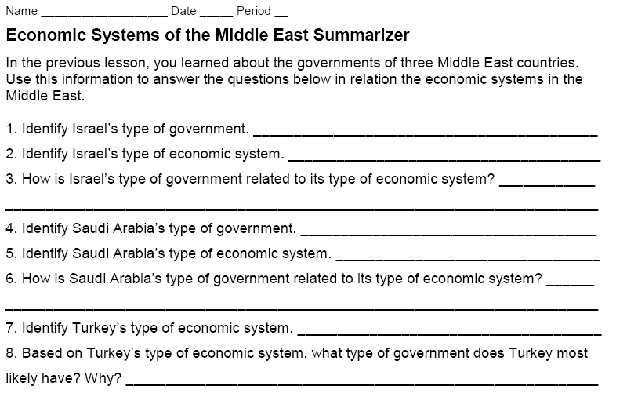
Middle East Economic Systems Summarizer
Notes:
Instructional Approach(s): Each student should complete the summarizer. The teacher should use the summarizer to determine the level of student mastery and if differentiation is needed.

