Slide 1
Fall of the Ottoman Empire and Conflict in SW Asia

Slide 2
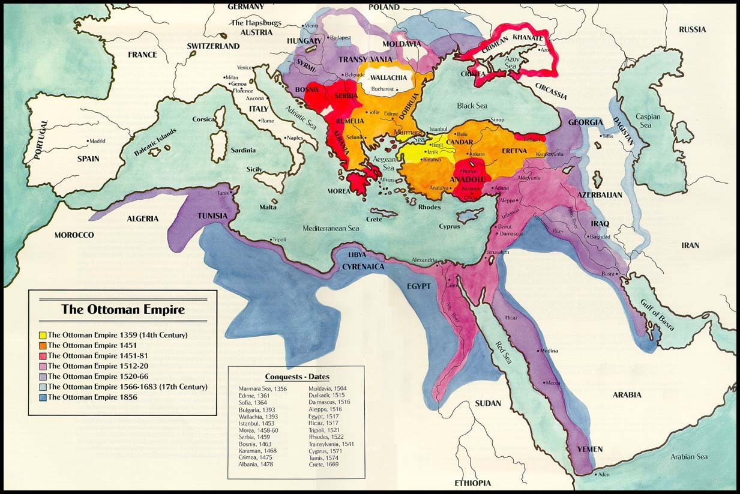
Ottoman Empire’s Lands

Slide 3
Reasons for the Decline of an Empire
Ottomans’ technology begin to fall behind
Europe
When the Ottoman Empire reached it’s height, other empires attack the Ottomans and/or conflict arises within the Empire
Fighting causes the Empire to lose land

Slide 4
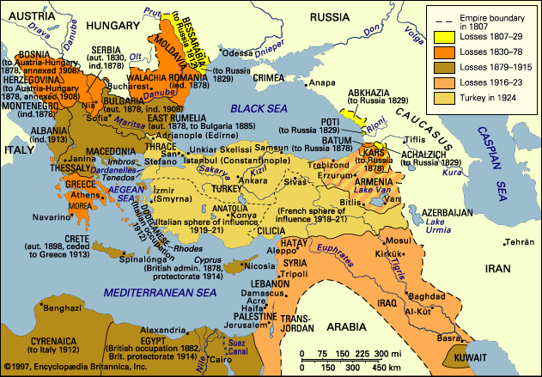
Map of Lost Ottoman Land

Slide 5
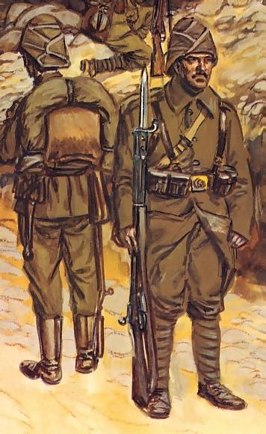
Ottoman Empire & WWI
Ottoman Empire enters WWI hoping to regain some of their lost empire.
Unfortunately, the Ottomans picked the losing side of the war.
In 1917, when the war was over, France and Britain (who won the war) agreed on how to divide up the Ottoman Empire.

Slide 6
Results of WWI & Partitioning
When the Ottomans and the rest of the Central Powers lost…
The government of the Ottoman Empire was ended
Turkey was created out of the (previously) Ottoman Empire
All the land that was under the control of the Ottomans was given to France and Britain
British and French partitioned (divided) the Middle East into countries:
THIS CREATES ARTIFICIAL POLITICAL BORDERS
DID NOT NECESSARILY REFLECT THE NATURAL DIVISIONS IN THE REGION – BLENDED ETHNIC & RELIGIOUS GROUPS
New countries created include: Iran, Iraq, & Turkey

