Slide 1
Asia’s
Population
Distribution
The Impact of Climate, Location,
Physical Characteristics, & Natural Resources

Slide 2
Standards
SS7G11 The student will explain the impact of location, climate, physical characteristics, distribution of natural resources, and population distribution on Southern and Eastern Asia.
a. Describe the impact climate and location has on population distribution in Southern and Eastern Asia.
b. Describe how the mountain, desert, and water features of Southern and Eastern Asia have affected the population in terms of where people live, the types of work they do, and how they travel.

Slide 3
China
Population: 1,349,585,838

Slide 4
Location
Two great deserts are located in Northern China.
Few people live here besides nomads and animal herders.
Other parts of northern and western China have more moderate climates so farming is possible.
About 90% of China’s people are concentrated in the plateaus, plains, and river valleys of the eastern third of the country.
The northeast, around the Huang He River, is China’s most populated region.
Here, in Chinese cities like Beijing and Shanghai, the population can exceed almost 6,000 people per square mile.

Slide 5
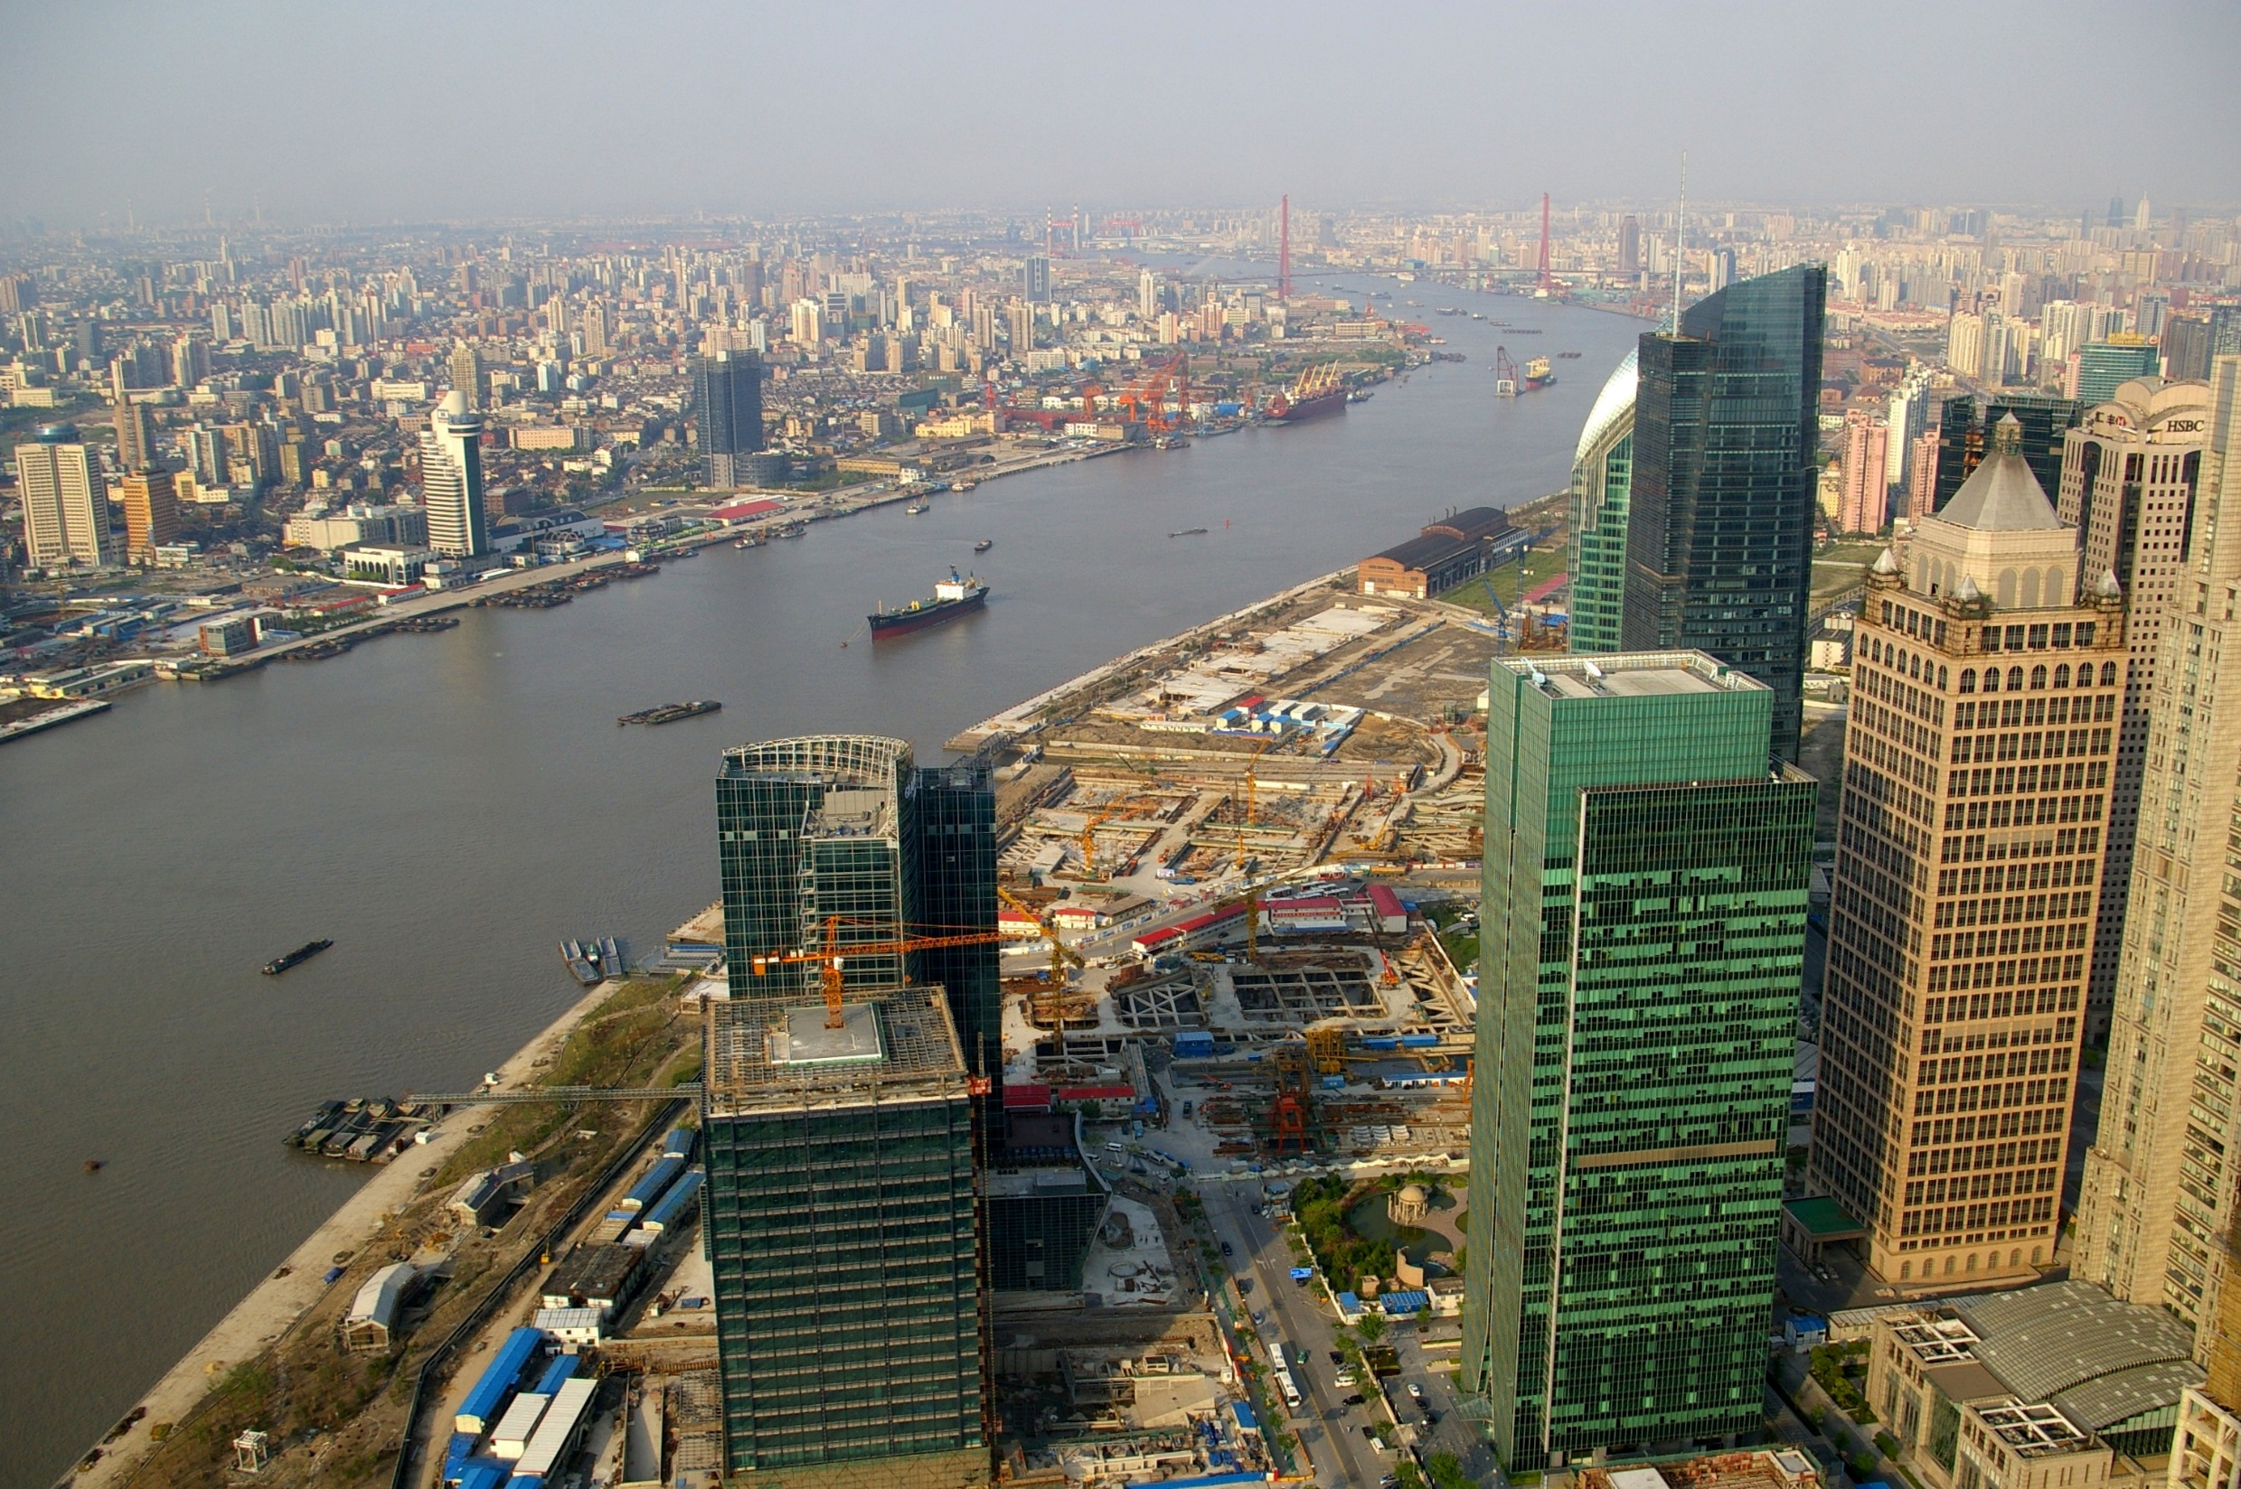
Shanghai

Slide 6
Climate
Because of China’s great size, it has a variety of climates.
High mountain ranges to the south cut off moisture from the Indian ocean, making the Gobi and Taklimakan desert regions in the country’s center harsh and dry.
Northern China is semi-arid, while areas to the east and south are humid and tropical.
Most of China’s one billion people live where there are milder climates (northeast).

Slide 7
Natural Resources
The massive country of China has an abundance of natural resources.
What are China’s major natural resources?
coal, iron ore, petroleum, natural gas, mercury, tin, tungsten, antimony, manganese, molybdenum, vanadium, magnetite, aluminum, lead, zinc, rare earth elements, uranium, hydropower potential (world's largest)
Even though much of China’s land is not arable (good for farming), the country’s land and rivers provide a good foundation for China’s industry and economic growth.

Slide 8
India
Population: 1,220,800,359

Slide 9
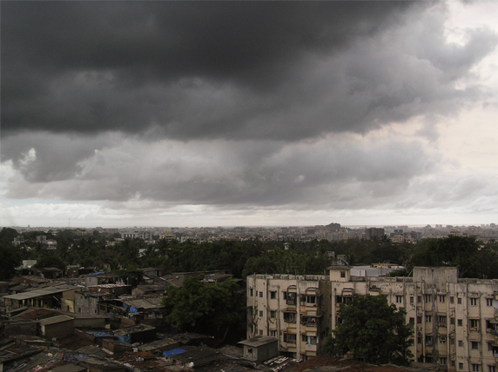
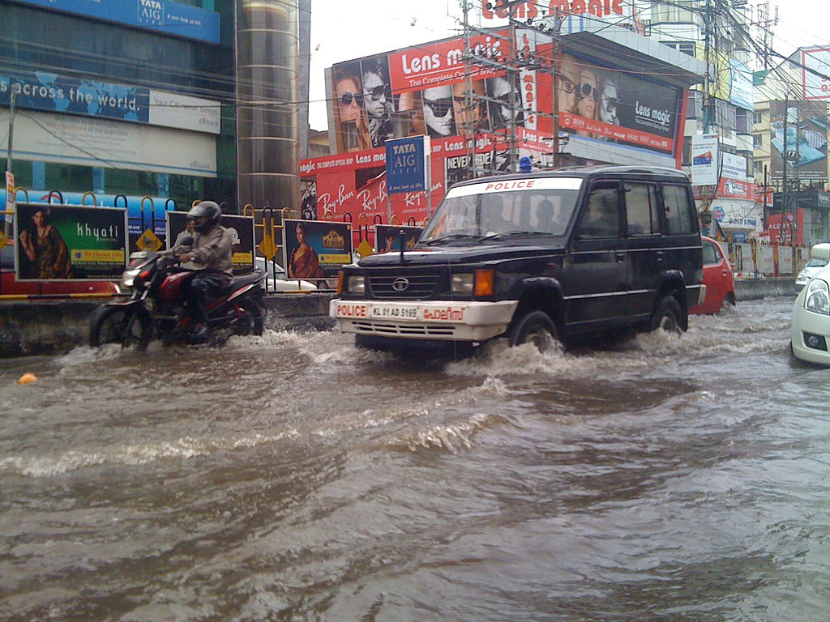
Monsoon - Mumbai

Slide 10
Climate
India has many types of climates.
Snow and ice cover the mountains in the north.
A large desert area borders Pakistan.
The Ganges Plain is humid and almost tropical.
The Deccan Plateau in the higher center of the country is more moderate.
There is a subtropical coastal plain along the Indian Ocean.
India’s climate is shaped by unpredictable monsoons that blow hot, dry air across the continent during the winter.
During spring and summer, the winds bring heavy rains from the ocean.

Slide 11
Location
India is separated from the rest of Asia by three mountain ranges.
South of the mountains, most of India is a broad plain between the Indus and Ganges rivers.
The land here is very fertile, which is good because most of India’s people rely on farming and other agricultural work.
Most of India’s large cities are located along the Ganges River or near the coast.
Fewer people live in the high center of the country on the Deccan plateau.

Slide 12
Natural Resources
About half of India’s land is arable, and most Indians work in agriculture.
India’s fertile land and ample water supply are its most valuable resources.
India has the fourth-largest coal reserves in the world.

Slide 13
Japan
Population: 127,253,075

Slide 14
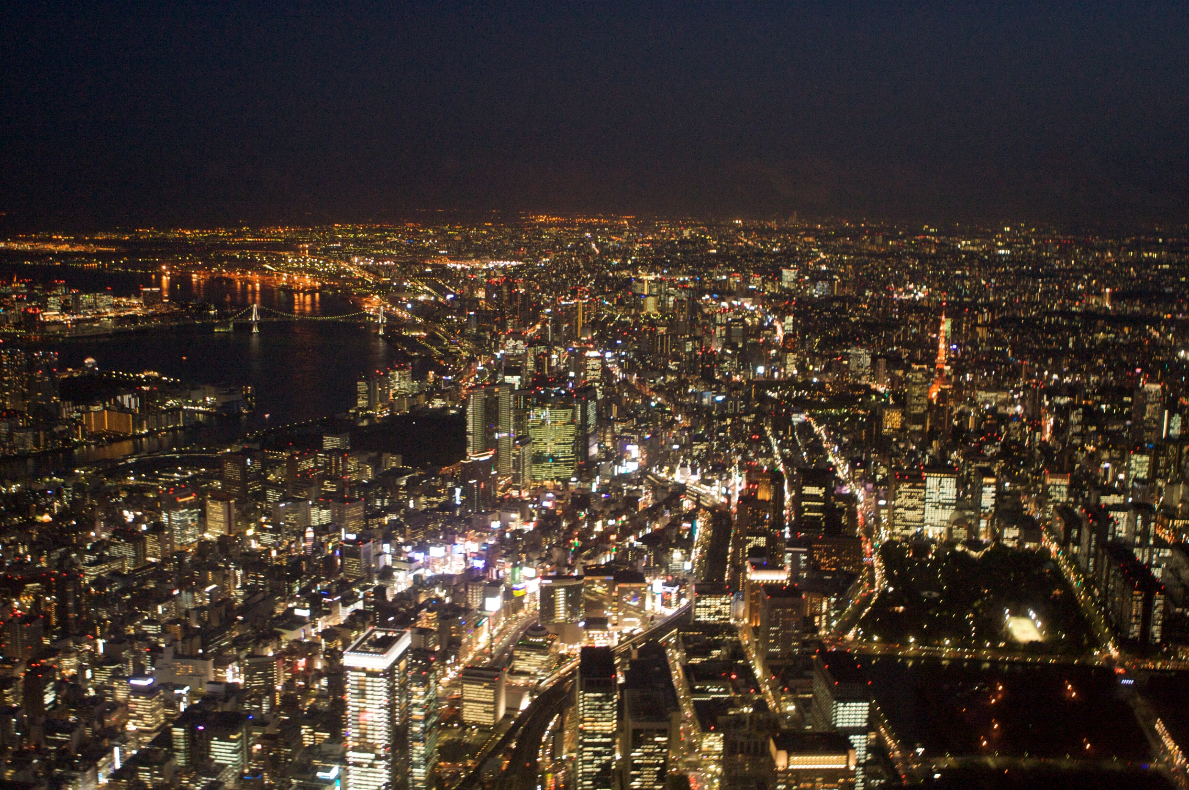
Tokyo – World’s Largest Megacity

Slide 15
Climate
Japan is an island country on the far eastern edge of Asia whose climate is affected by ocean currents.
The Japan Current brings warm water to the southern and eastern coasts, while the Oyashio Current cools the northern coast.
The warmer parts of Japan have longer growing seasons for farming, and the cooler north is good for fishing.
Japan experiences monsoons and typhoons.

Slide 16
Location
Almost 80% of Japan is covered with mountains, which leaves a very small percentage of land available for farming.
There are many volcanoes in Japan, which often cause earthquakes.
Some parts of the country have developed hot springs around the volcanic areas, and others use the heat to warm water for people to use.
Much of Japan’s population is crowded into cities.
Tokyo is the most crowded urban area in the world.

Slide 17
Natural Resources
Japan has practically no natural resources.
Much of the land is not arable, so the majority of Japan’s food must be imported.
The country must depend on industry and trade to supply its population with the goods they need.
Japan does, however, have a strong fishing industry.
It is actually the world’s top fishing country, with China in second.

Slide 18
North
Korea
Population: 24,720,407

Slide 19
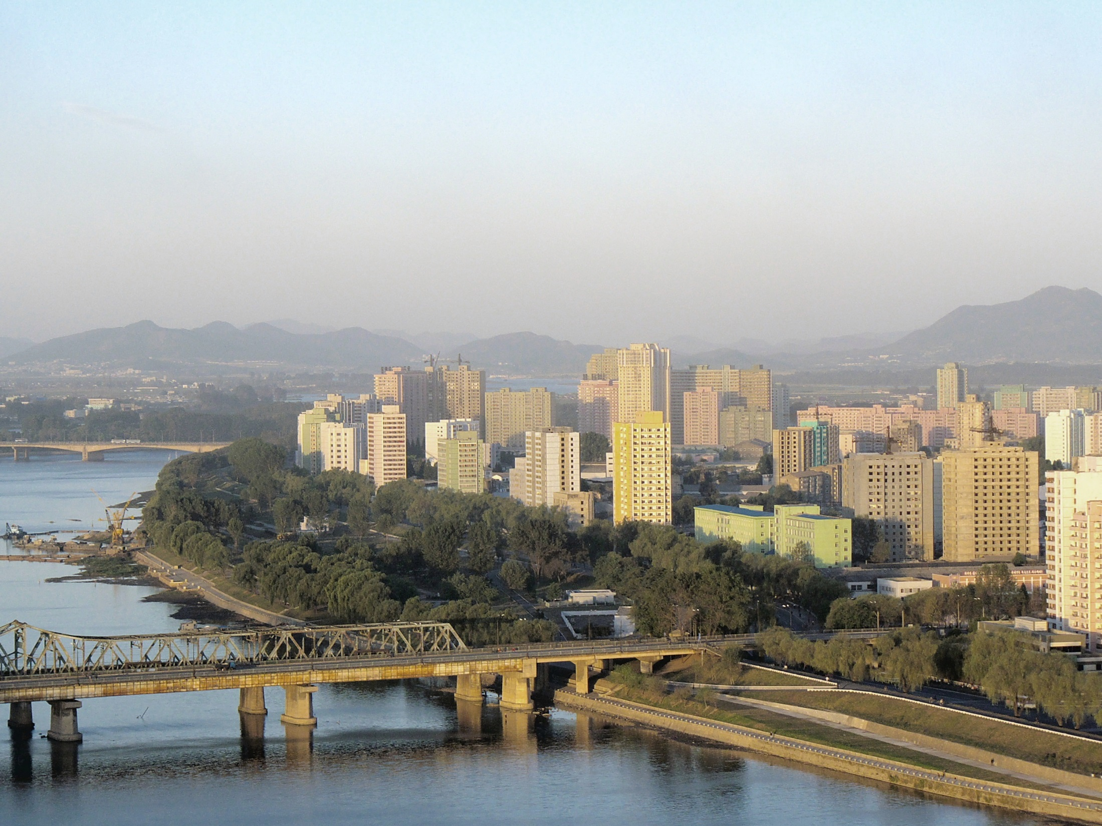
Pyongyang, North Korea’s Capital

Slide 20
Climate & Location
North Korea has short summers and long, cold winters.
The land is mountainous and is not as heavily populated as South Korea.
The mountains of North Korea have caused it to have less success with agriculture than others in the region.
Most of the people live along the western half of the country where farming is more successful.

Slide 21
Natural Resources
There are fast-flowing rivers in the mountains where North Koreans have developed hydroelectric power plants.
The country earns a profit from mining coal and other minerals like iron and copper.

Slide 22
South
Korea
Population: 48,955,203

Slide 23
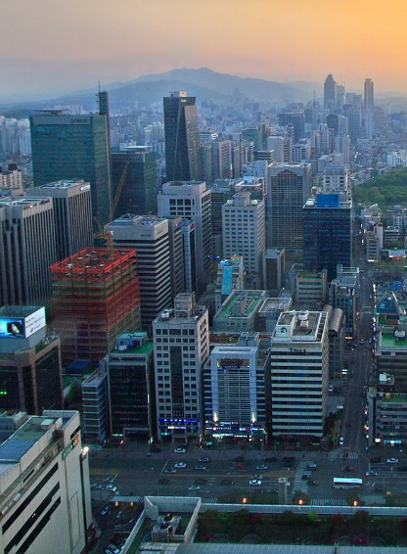
Gangnam District Seoul,
South Korea

Slide 24
Climate & Location
Due to the warm winds that come from the ocean, South Korea has a milder climate than North Korea.
South Korea has a larger population than North Korea, with about 25% of the people living in the capital city, Seoul.
There are less mountains than in the north, so farming is more widely practiced here.

Slide 25
Natural Resources
Both North and South Korea have a number of mineral deposits, including lead and zinc.

Slide 26
Other
Countries

Slide 27
Climate & Location
Countries farther to the southeast like Vietnam are warmer and tropical.
Some of the world’s oldest rainforests are found in the Asian countries of Indonesia, Malaysia, Thailand, Cambodia, and Laos.
Few people live in the rainforests, but they are rapidly disappearing because of deforestation.

Slide 28
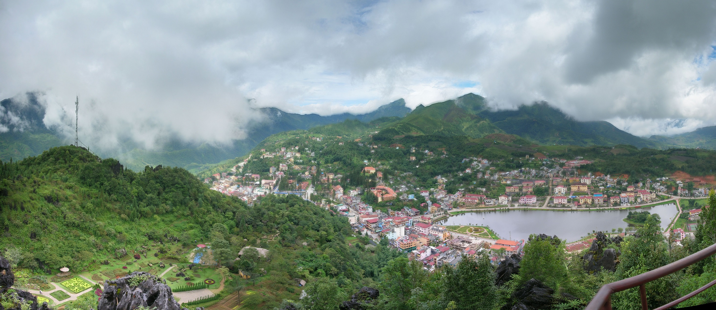
Rainforest – Sa Pa, Vietnam

Slide 29
Natural Resources
There are rich farmlands in southeast Asian countries where 90% of the world’s rice is grown.
About half of Vietnam’s people are farmers, living in the fertile deltas of the Mekong and Red rivers.
In Thailand, people also live in fertile river areas where they grow rice and other crops.
Vietnam is also able to mine phosphates for export, as well as drill for oil.

Slide 30
Transportation

Slide 31
Transportation
Most transportation systems across Asia are underdeveloped. Road systems are not well developed and borders are often close because of disagreements.
Most of Asian travel (between countries) happens by sea or air.
However Japan has a high speed Rail system that goes 199 mph!
Walking is common for transportation in rural areas throughout Asia but buses and train systems are available.
Roads are highly congested in China and India.

Slide 32
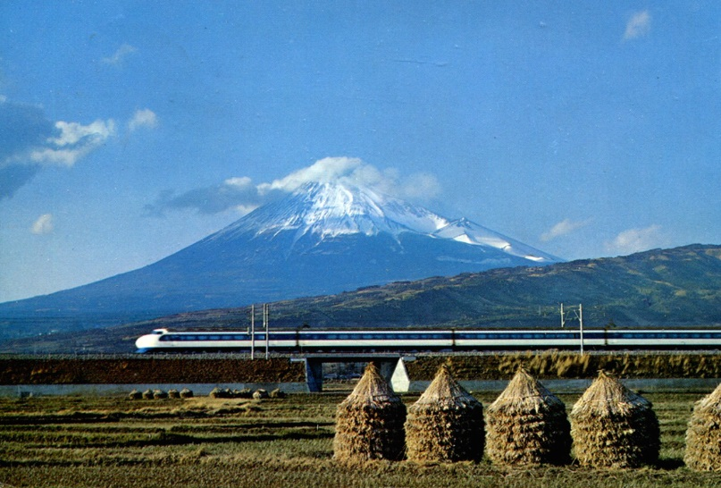
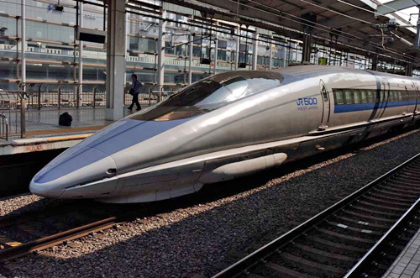
Japanese Bullet Train

