Slide 1
Warm-up #39 10/20/11
*Remember to:
Identify any Parts of Speech
Type of sentence
Summarize the meaning
Mentor Sentences:
Europeans require school children to learn one or two other languages besides their native language. They face challenges when communicating with one another because most Europeans do not want to learn another language. Out of the European languages, French and Italian are examples of the Romantic Languages.

Slide 2
Europe Unit 1 Review: *Get one piece of paper out for your group.
Scribe-Write down your group’s answers.
-AND-
Reporter- Report your answer to the class, Remember to RAISE your hand when your pencil is DOWN!!!
Time Keeper- 1 minute for each question from the teacher saying “GO”!!!
Leader-Keep everyone on TASK.

Slide 3
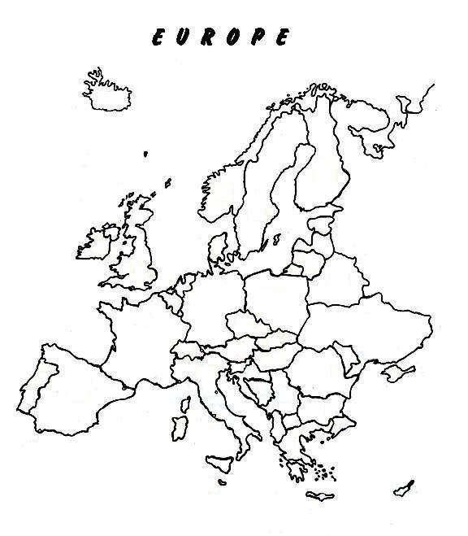
1. Which number on the map marks the Scandinavian Peninsula?
3
5
8
2
7
1
6
4

Slide 4
#3

Slide 5
2. Which number on the map marks the Mediterranean Sea?
3
5
8
2
7
1
6
4

Slide 6
#4

Slide 7
3. Which country is located at the “2” on the map?
3
5
8
2
7
1
6
4

Slide 8
3. France

Slide 9
4. The English Channel lies between what two countries?

Slide 10
4. United Kingdom and France/Belgium

Slide 11
5. What mountain range forms the boundary between Europe and Asia?

Slide 12
5. Ural Mountains

Slide 13
6. Lines of ____________ measure distances North or South of the equator.

Slide 14
LATITUDE
Latitude lines run East and West, but measure distances North and South of the equator.

Slide 15
7. North –south lines on the globe measure _____________, the distance east and west of the Prime Meridian.

Slide 16
LONGITUDE
Longitude lines run north and south, but measure distances east and west of the Prime Meridian.

Slide 17
8. Name the country.

Slide 18
8. Ukraine

Slide 19
9. Which of the following is an example of a peninsula?
a. the Alps b. Russia c. the Great European Plain d. Scandinavia

Slide 20
9. D

Slide 21
10. What condition helped United Kingdom become a leader in World Trade?
A. It is an island with a mild climate located near many other countries.
B. Two percent of the people are farmers, and their is a lot of arable land.
C. It is home to world’s busiest airport and has seven other large airports.
D. Urban area is populated, and most jobs are found in urban areas.

Slide 22
10. D

Slide 23
11. Which area has the greatest population?
A. Siberia
B. Asian Russia
C. St. Petersburg
D. European Russia

Slide 24
11. D

Slide 25
12. Which describes the climate of most of Germany?
A. Very cold winters with hot and dry summers
B. Cool summers with land deep in snow most of the winter
C. Cool winters and mild summers with good precipitation of crops.
D. Hot summers and cold winters with little precipitation.

Slide 26
12. A

Slide 27
13. What has helped Italian Merchants become successful traders?
A. The location of the Alps, which are a defense against other countries.
B. The location of the Mediterranean Sea with access to Africa, Asia, and Europe.
C. The islands of Sicily and Sardinia, which are not far form the coast of Western Italy.
D. the warm air from the Sahara Desert, which creates a warm, dry summer for most of Italy.

Slide 28
13. B

Slide 29
14. Which statement best describes the natural resources of the united Kingdom and Russia?
A. The United Kingdom and Russia both have gold, a valuable natural resource.
B. The United Kingdom’s coal resources are used as fuel for manufacturing, but Russia’s are not.
C. The United Kingdom and Russia both have large amounts of land and climates suitable for farming.
D. The United Kingdom’s fossil fuels resources are being used up, but not much of Russia’s are unused due to Russia's climate and Geography.

Slide 30
14. D

Slide 31
15.How do the ports of the United Kingdom and Russia differ?
A. The ports of the United Kingdom are open all year round, and Russia’s are not.
B. Russia has no port cities, while the United Kingdom is an island with many.
C. There is no difference in the year-round use of the ports in the United Kingdom.
D. The ports of the United Kingdom are influenced by a mild climate, but Russia’s ports are all subtropical.

Slide 32
15. A

Slide 33
16. Even though Italy has a strategic geographic location, Germany is a more successful trading nation because
A. Is has more valuable natural resources
B. Is has a warmer climate
C. It has a larger total area and more major cities.
D. Its total population is higher

Slide 34
16. A

Slide 35
Chernobyl Disaster
17. Where did this nuclear Fallout happen?
Jamaica
Ukraine
London
Africa

Slide 36
17.B

Slide 37
Chernobyl was abandoned.
18. What caused the people to abandoned this city?
A. nuclear power plant exploded and radiation levels were unsafe.
B. the people were being persecuted by soldiers of the Soviet Union.
C. the Chernobyl river was diverted so there was no drinking water.
D. the area was under water because of the construction of a dam.

Slide 38
18. A

Slide 39
19. Why were other countries concerned about the Chernobyl Disaster?
A. Chernobyl was immediately closed.
B. the cost of nuclear power increased.
C. radioactive material fell on other countries.
D. they did not have room for the sick people in their hospitals.

Slide 40
19. c

Slide 41
Acid Rain
20. What are the main causes of acid rain?
A. farms and forests
B. water power and electricity
C. coal burning factories and automobile emissions
D. solar power and wind turbines blowing poisonous gases.

Slide 42
20. c

Slide 43
21. How does nature play a role in Germany’s acid rain problem?
A. the poisonous emissions from cars cause acid rain
B. air currents carry toxic smoke from other countries’ factories to Germany
C. the rivers of southwestern Germany are used to make electricity for other countries.
D. Germany has many buildings that are being destroyed by the chemicals in the acid rain.

Slide 44
21. b

Slide 45
22. Which is one of the United Kingdom’s solutions to the air pollution problem?
A. using cleaner fuels.
B. restricting driving miles
C. allowing factories to pollute without monitoring
D. keeping drivers from using gasoline in their cars

Slide 46
22. a

Slide 47
23. What is the main cause of air pollution in the United Kingdom today?
A. factory smoke
B. London smog
C. use of fossil fuels
D. automobile exhaust emissions

Slide 48
23. c

Slide 49
24. What have Europeans done to try to solve the problem of so many languages?
A. Outlawed the use of languages spoken by only a few people
B. Decided not to trade with people who do not speak the same languages
C. Made laws ensuring that English is the only official language of the European Union.
D. Required school children to learn one or two other languages besides their native tongue.

Slide 50
24. D

Slide 51
25. Besides difference in word, what other challenge do Europeans face in communicating with each other?
A they use two different alphabets
B. People in the United States mostly speak English.
C. Europe’s population is double the size of the uNited States
D. Most of the people in Europe do not want to lean another language.

Slide 52
25. d

Slide 53
26. French and Italian are examples of which language family?
A. Germanic
B. Romance
C. Slavic
D. Urgic

Slide 54
26. B

Slide 55
27. Which is the oldest of the three main religions?
A. Chrisitianity
B. Islam
C. Judiasm
D. Roman Catholic

Slide 56
27. A

Slide 57
28. How are the three religions alike?
A. They worship serveral gods
B. They each worship pnly one god (monotheistic)
C. Each of the three religions is getting smaller
D. They each use a sacred tect know as the books of Moses.

Slide 58
28. B

Slide 59
29. Which pairing of the sacred text and religion is correct?
A. Protestant-Bible
B. Christianity-Talmud
C. Shiite Muslim-Torah
D. Orthodox Judaism-Koran

Slide 60
29. a

Slide 61
30. Which of the following statements about literacy is true?
A. Countries with higher literacy are richer
B. Countries with higher literacy are poorer
C. Countries with high literacy have high population
D. Countries with high literacy have low population

Slide 62
30. a

Slide 63
Let’s see who won!!!!!
STUDY
STUDY
STUDY!!!!!!!!!!!!!!!!!!!

