Slide 1
SS7G7b
Southwest
Asia
Where People Live,
Work, & Travel
© 2014 Brain Wrinkles

Slide 2
Standards
SS7G7 The student will explain the impact of location, climate, physical characteristics,
Distribution of natural resources and population distribution on Southwest Asia (Middle East).
b. Describe how the deserts and rivers of Southwest Asia (Middle East) have affected the population in terms of where people live, the type of work they do, and how they travel.
© 2014 Brain Wrinkles

Slide 3
Deserts
© 2014 Brain Wrinkles

Slide 4
SW Asia’s Deserts
There are 2.8 million miles of land in the Middle East, and a large number of it is covered by large desert areas.
The Rub al-Khali (or “empty quarter”) is in southern Saudi Arabia.
The Great Syrian Desert is located between Syria and Iraq.
© 2014 Brain Wrinkles

Slide 5
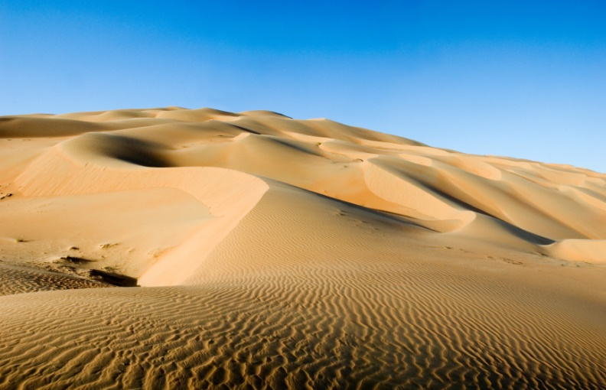
© 2014 Brain Wrinkles

Slide 6
Where People Live
The desert areas are not a favorable place to live due to the extremely hot and arid climate.
Food and water is difficult to find; however, oases provide a temporary water source.
Bedouins (desert nomads) have called the desert home for thousands of years.
They live in tent camps and in huts.
© 2014 Brain Wrinkles

Slide 7
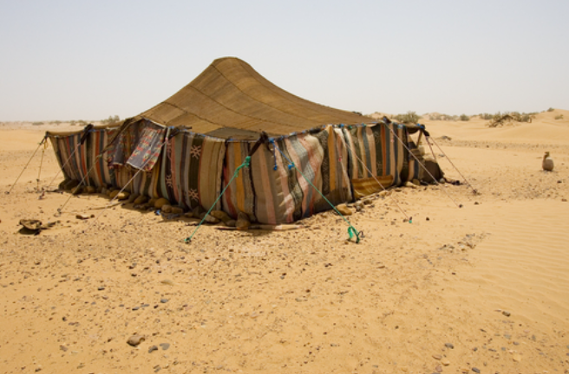
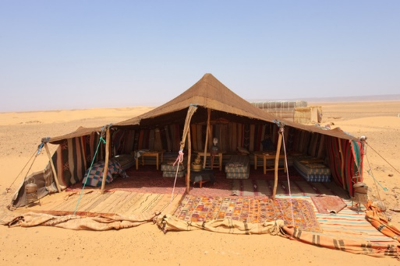
© 2014 Brain Wrinkles

Slide 8
Where People Live
Since the discovery of oil, most people have moved away from the desert areas.
Over the last 50 years, residents have been exchanging the harsh nomadic life for work in the cities.
In Saudi Arabia, only about 1% of the population remains as nomadic herders.
© 2014 Brain Wrinkles

Slide 9
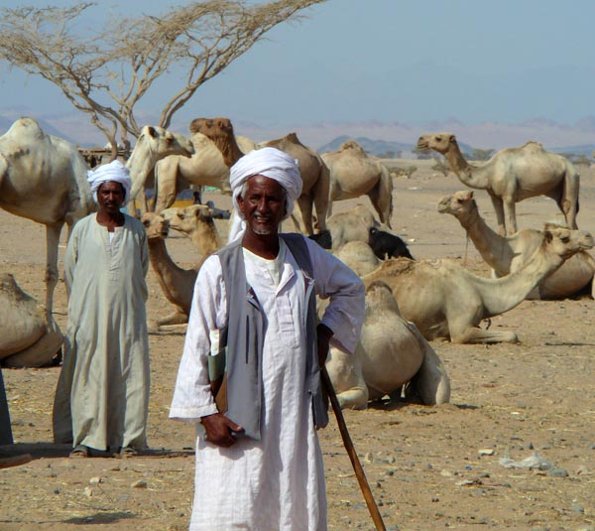
© 2014 Brain Wrinkles

Slide 10
Where People Work
Many Bedouins are sheep, camel, and goat herders.
They trade animals and hand-made goods with people who live in towns along the desert’s edge.
Most people have left the desert behind and have moved to cities to find work.
© 2014 Brain Wrinkles

Slide 11
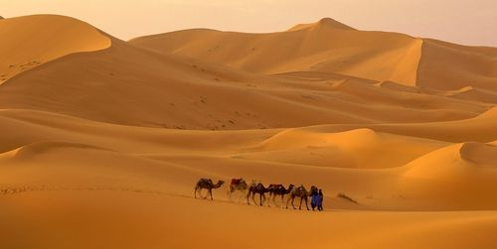
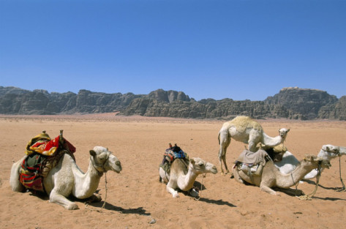
© 2014 Brain Wrinkles

Slide 12
How People Travel
People travel across the desert in camel caravans.
Some even use All Terrain Vehicles (ATVs) to maneuver across the sand.
© 2014 Brain Wrinkles

Slide 13
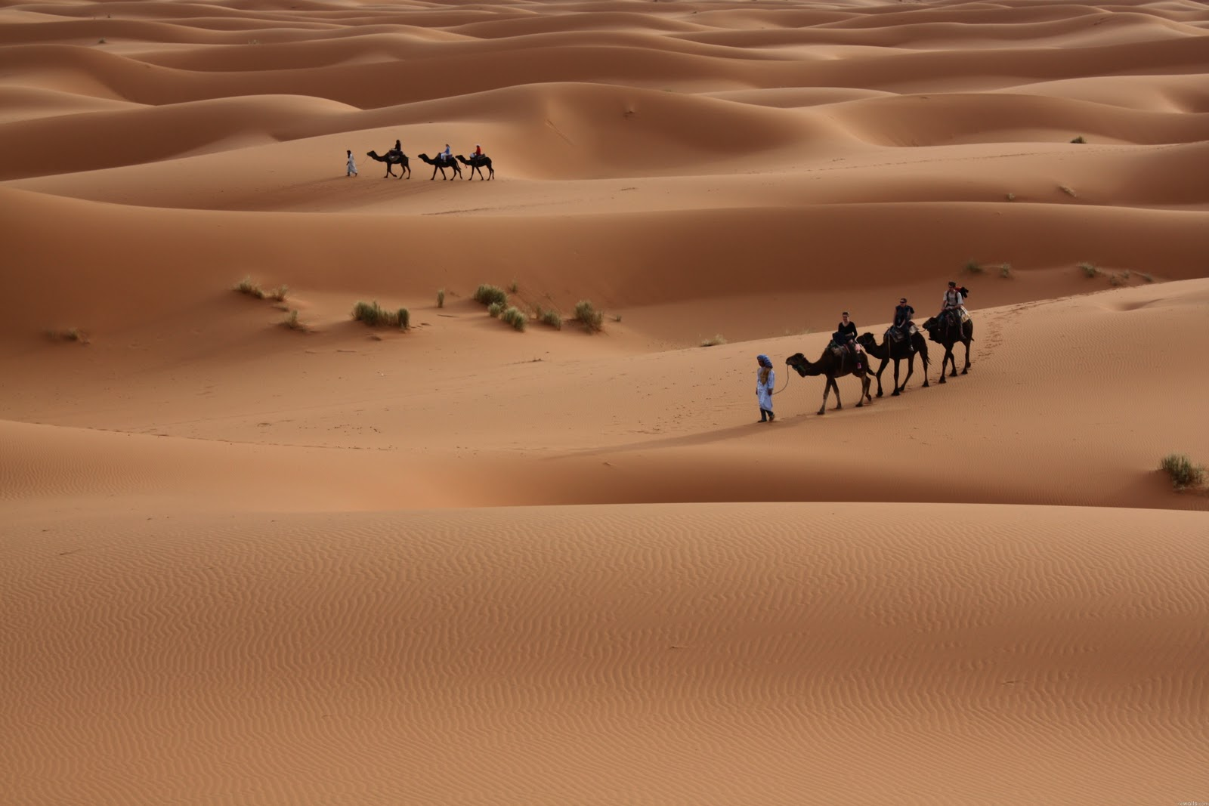
© 2014 Brain Wrinkles

Slide 14
Rivers
© 2014 Brain Wrinkles

Slide 15
SW Asia’s Rivers
The Tigris River runs through Turkey and Iraq and joins with the Euphrates to become the Shatt al Arab, which empties into the Persian Gulf.
The Euphrates River runs through Turkey, Syria, and Iraq.
The Jordan River forms part of the border for Syria, Jordan, and Israel.
© 2014 Brain Wrinkles

Slide 16
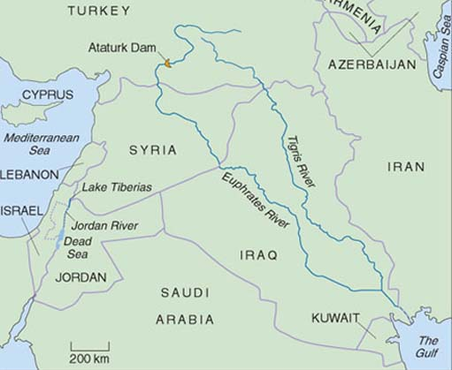
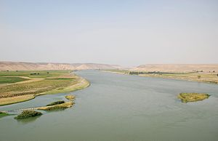
© 2014 Brain Wrinkles

Slide 17
Where People Live
Cities are built near rivers to take advantage of the scarce water sources in Southwest Asia.
Access to water for bathing and drinking make the area much easier to live in.
Farmers grow crops by rivers and in river valleys because they provide a source of irrigation.
Rivers also provide a good source of food (fish).
© 2014 Brain Wrinkles

Slide 18
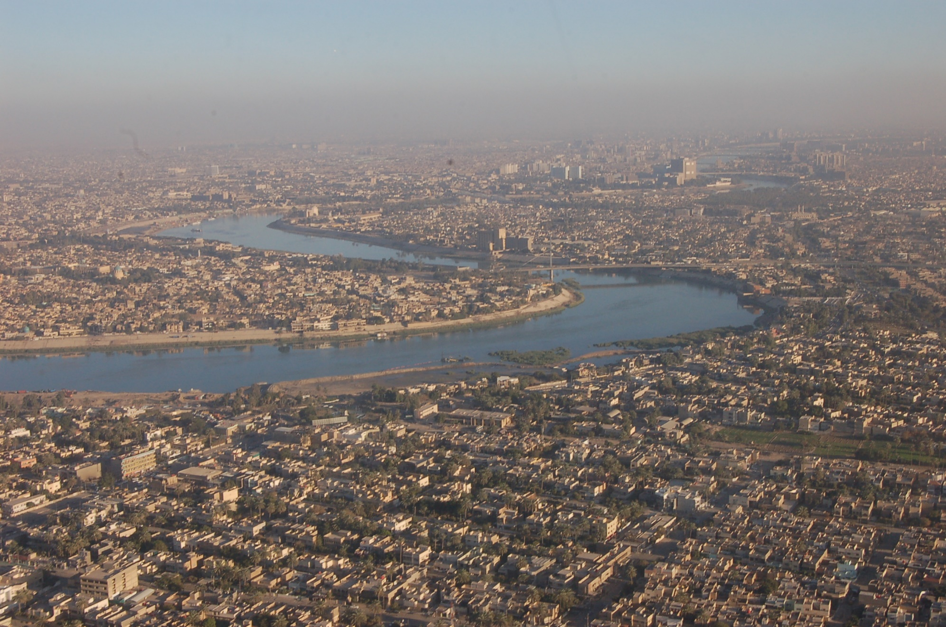
Baghdad, Iraq & the Tigris River
© 2014 Brain Wrinkles

Slide 19
Where People Work
Cities and towns on rivers have become major hubs of industry.
Most people in these cities make a living working in industrial factories.
Rivers are also important trade routes for people in cities to use to ship goods to other merchants.
Farming and fishing are also important areas of income for people who live near rivers.
© 2014 Brain Wrinkles

Slide 20
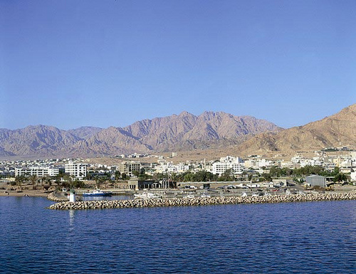
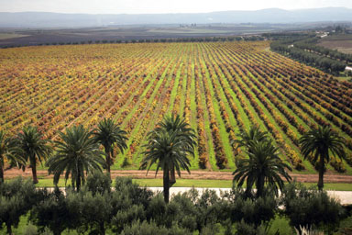
Al Aqaba, Jordan & the Jordan River
© 2014 Brain Wrinkles

Slide 21
How People Travel
Rivers have always provided important routes for transportation.
People use boats for travel and trade along rivers.
© 2014 Brain Wrinkles

Slide 22
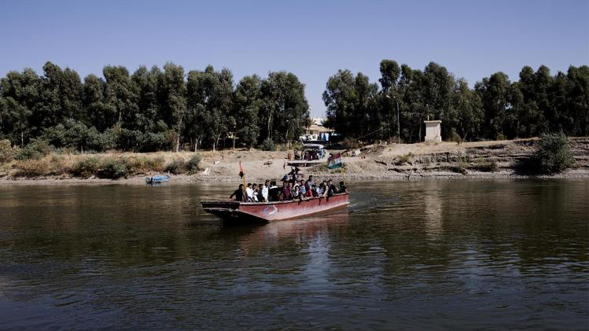
© 2014 Brain Wrinkles

