Slide 1
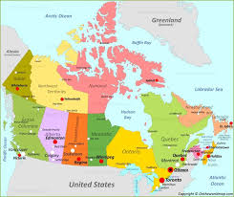
Canada’s
GEOGRAPHY

Slide 2
STANDARDS:
SS6G4 Locate selected features of Canada.
Locate on a world and regional political-physical map: the St. Lawrence River, Hudson Bay, Atlantic Ocean, Pacific Ocean, the Great Lakes, Canadian Shield, and Rocky Mountains.
Locate on a world and regional political-physical map Canada and the province of Quebec
© Brain Wrinkles

Slide 3
TEACHER INFO:
Print off the following 2 pages for each student. (Print front-to-back to save paper.)
Students should use an atlas to label the map and answer the questions before the presentation. This will help familiarize them with the different features.
© Brain Wrinkles

Slide 4
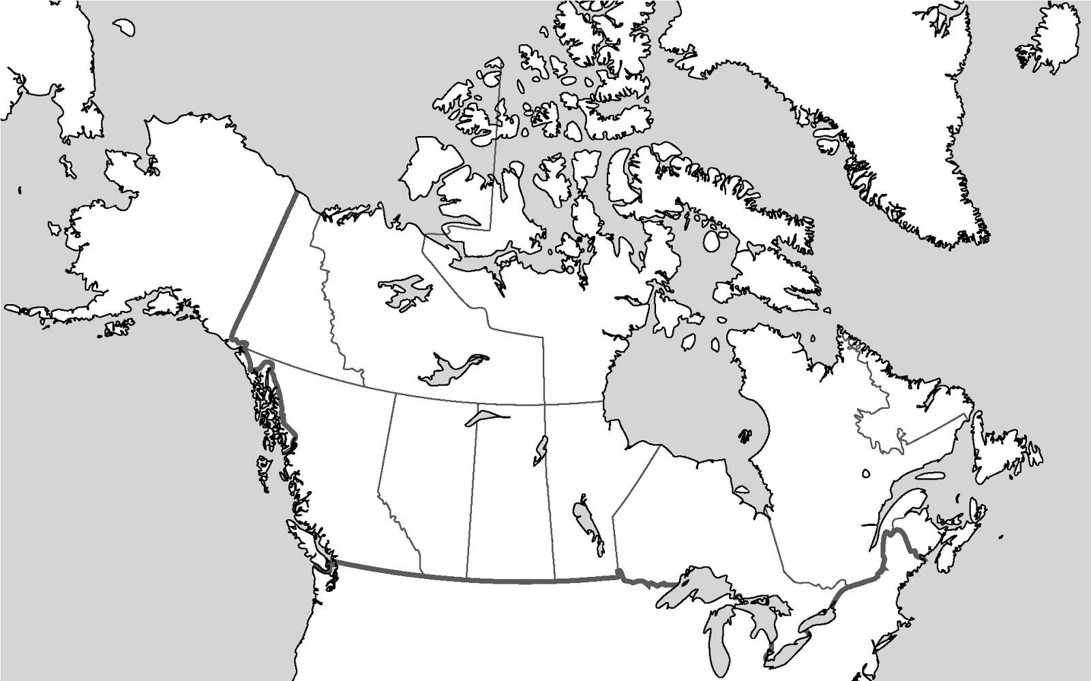
CANADA
Directions:
1. Label the following physical features:
Pacific Ocean
Atlantic Ocean
Canadian Shield
Hudson bay
Great Lakes
Rocky Mountains
St. Lawrence River
2. Create a map key that includes symbols for:
Oceans
St. Lawrence River
Rocky Mountains
Hudson Bay
Great Lakes
Canadian Shield
3. Draw the symbol for each feature next to the correct label on the map. Color all symbols!
4. Label the province of Quebec.
Map Key:
© Brain Wrinkles

Slide 5
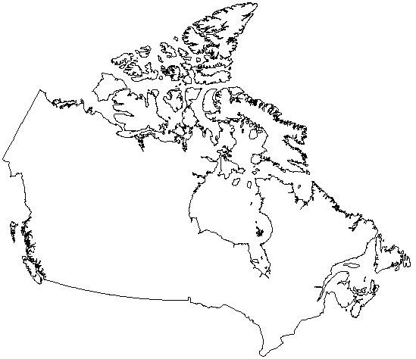
Canada’s Features
Quick Check
Directions: Use an atlas to help you answer the following questions about different features of Canada.
1. What major landform covers most of eastern and southern Canada?
2. What country forms Canada southern border?
3. What body of water dominates central-eastern Canada?
4. What body of water forms Canada’s eastern coast?
5. What mountain range runs from western Canada down to New Mexico?
6. What is Canada’s largest province?
7. Which waterway consists of five large freshwater lakes?
8. Which body of water forms Canada’s western coast?
9. What river connects the Great Lakes to the Atlantic Ocean?
© Brain Wrinkles

Slide 6
CANADA’S
GEOGRAPHY
© Brain Wrinkles

Slide 7
Canada
Canada lies on the North American continent, in the northern and western hemispheres.
It is the second largest country in the world—only Russia is bigger.
Its land stretches over 3,000 miles from one side to the other.
The United States forms Canada’s southern border.
© Brain Wrinkles

Slide 8
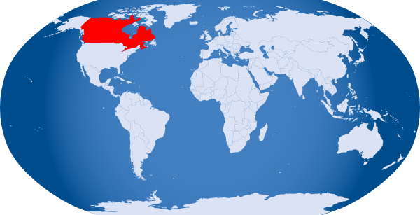
© Brain Wrinkles

Slide 9
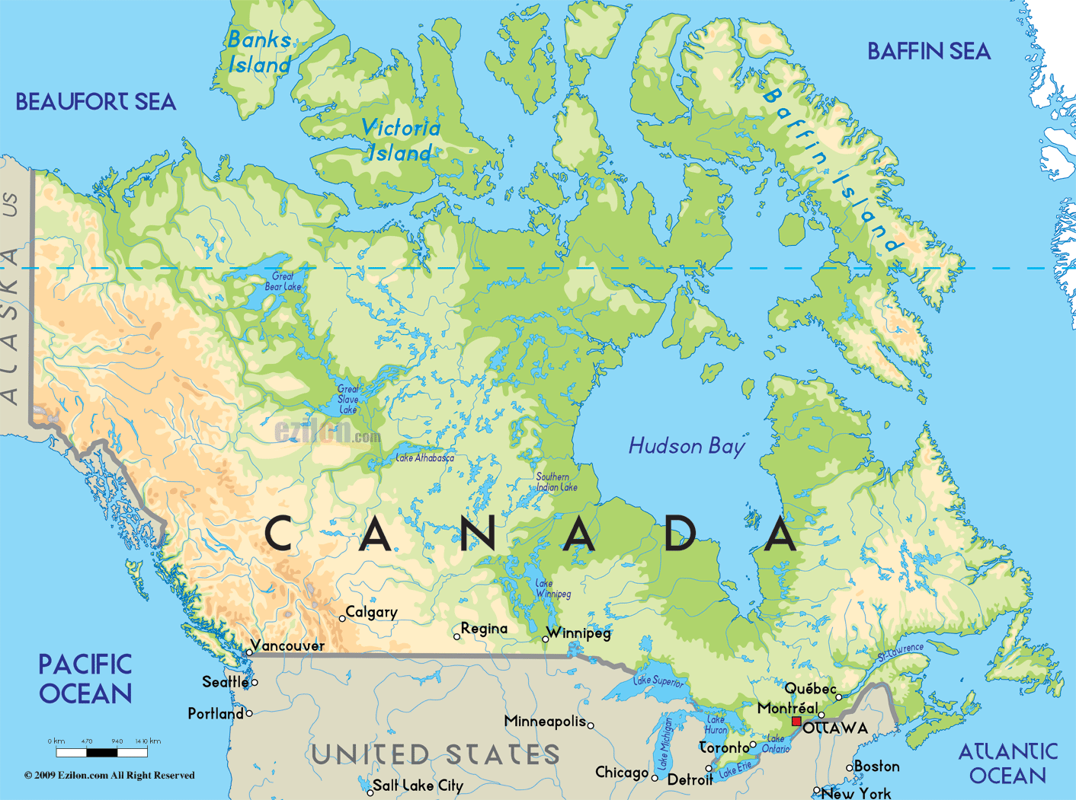
© Brain Wrinkles

Slide 10
Canada
Canada is made up of ten provinces (like states) and three territories.
Ottawa is the capital of Canada and it is in the province of Ontario.
Quebec is in eastern Canada and is the country’s largest province.
© Brain Wrinkles

Slide 11
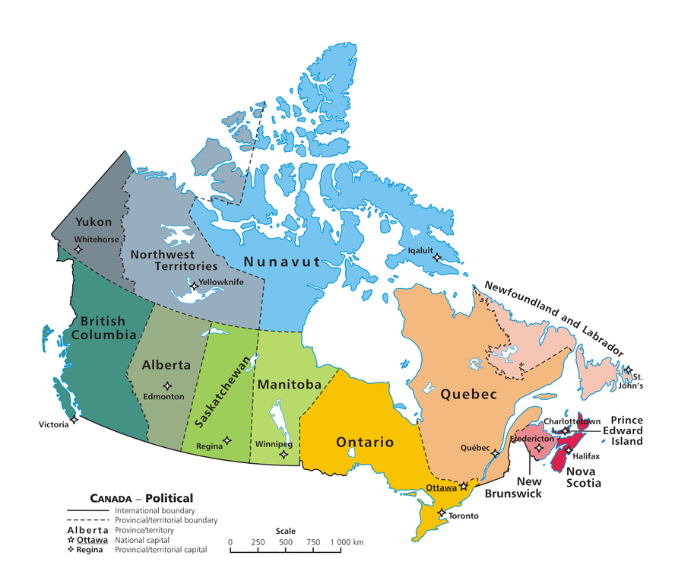
© Brain Wrinkles

Slide 12
Pacific Ocean
The Pacific Ocean is the largest and deepest of the world’s five oceans.
It covers 1/3rd of the earth’s surface.
The Pacific Ocean borders Canada to the west.
It is a major shipping route from Canada to Asia.
© Brain Wrinkles

Slide 13
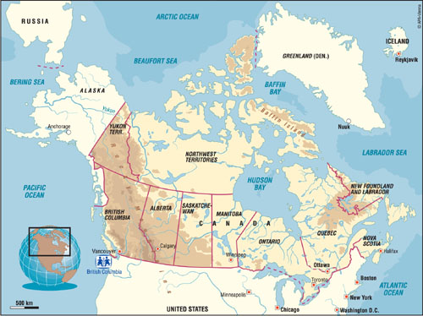
© Brain Wrinkles

Slide 14
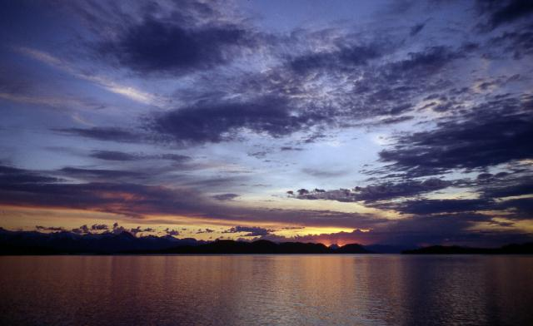
© Brain Wrinkles

Slide 15
Atlantic Ocean
The Atlantic Ocean is the second largest of the world’s five oceans.
It is the world’s most heavily traveled ocean.
The Atlantic Ocean borders Canada to the east.
It is a major shipping route from Canada to Europe and Africa.
© Brain Wrinkles

Slide 16
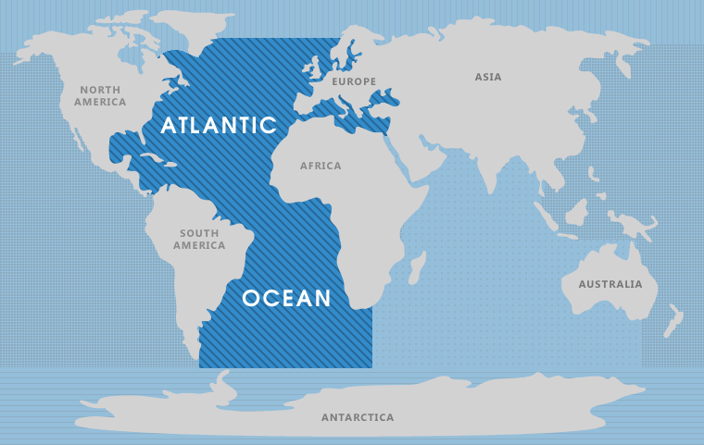
Canada
© Brain Wrinkles

Slide 17
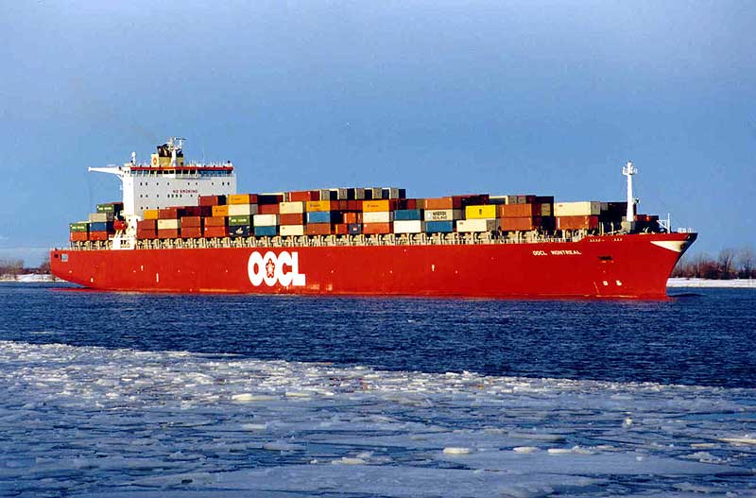
© Brain Wrinkles

Slide 18
Canadian Shield
The Canadian Shield is a huge physical region that covers most of eastern and southern Canada.
It covers nearly half of Canada’s land area.
The shield forms a horseshoe-shaped curve around Hudson Bay and stretches from the Great Lakes to the Arctic Ocean.
© Brain Wrinkles

Slide 19
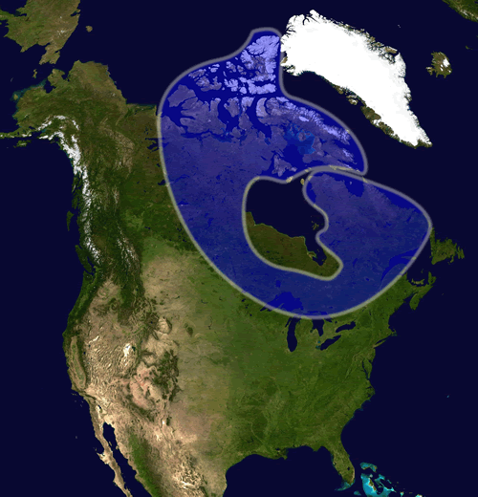
© Brain Wrinkles

Slide 20
Canadian Shield
The Canadian Shield is not good for farming because it is covered in mostly thin soil on top of layers of rock.
However, it is rich in natural resources, such as trees, minerals, and water.
It also contains thousands of lakes made by glaciers.
The region is sparsely populated.
© Brain Wrinkles

Slide 21
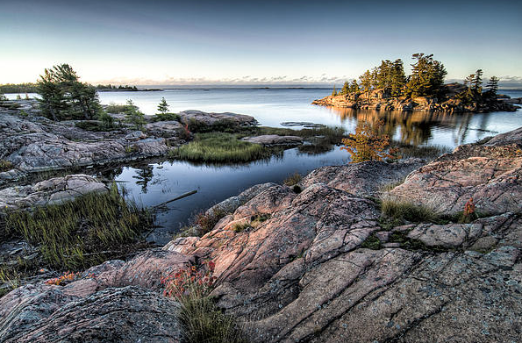
© Brain Wrinkles

Slide 22
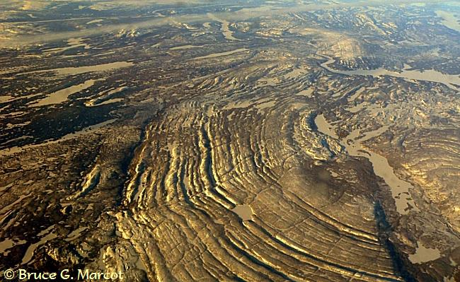
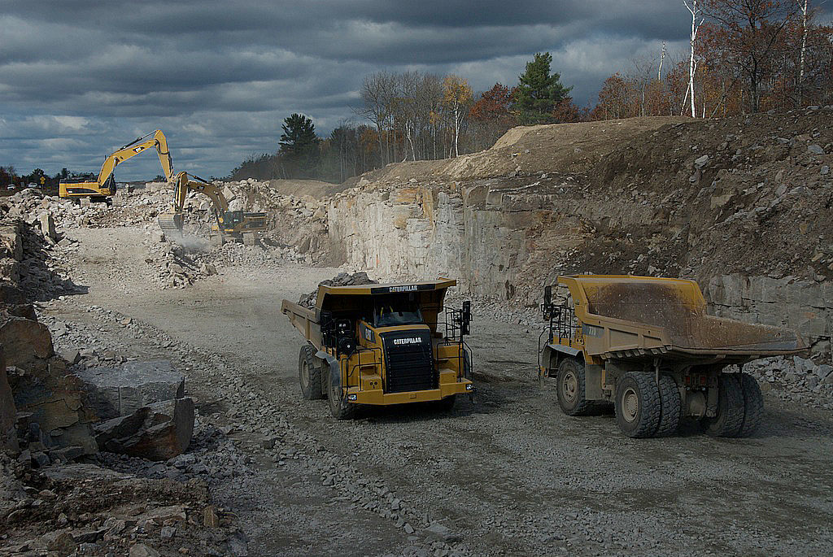
© Brain Wrinkles

Slide 23
Hudson Bay
Hudson Bay is a massive gulf located in east-central Canada.
(A gulf is an arm of a sea or ocean partly enclosed by land.)
It is connected to both the Atlantic and Arctic Oceans.
It is named after the English explorer Henry Hudson.
© Brain Wrinkles

Slide 24
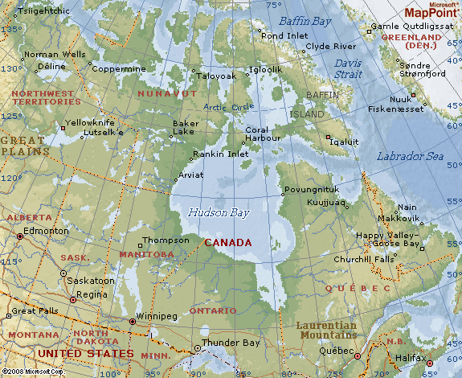
© Brain Wrinkles

Slide 25
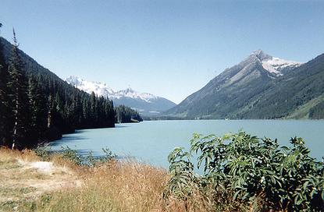
© Brain Wrinkles

Slide 26
Hudson Bay
Grain from Alberta and Saskatchewan is shipped from Hudson Bay out to the Atlantic Ocean and on to other countries around the world.
Because of the harsh climate, Hudson Bay is only navigable from July to October.
© Brain Wrinkles

Slide 27
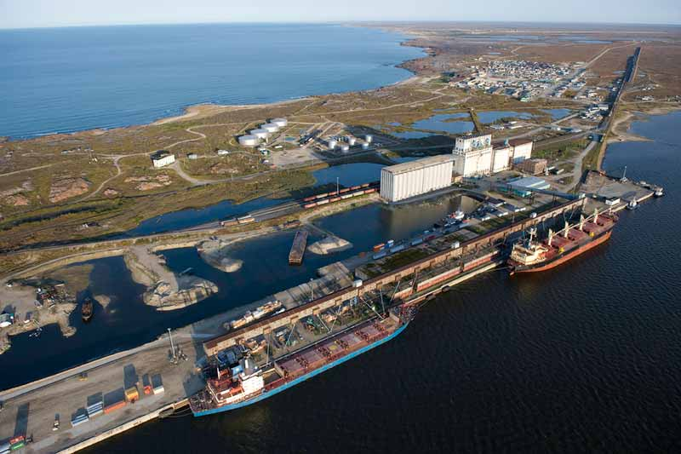
© Brain Wrinkles

Slide 28
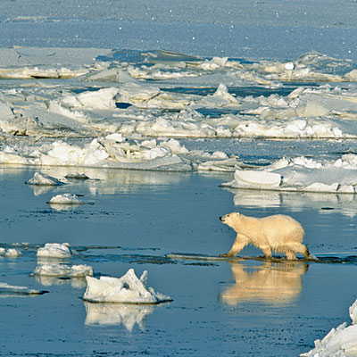
© Brain Wrinkles

Slide 29
Great Lakes
The Great Lakes are five freshwater lakes in central North America.
They are located along the border between the United States and Canada.
From east to west, the Great Lakes are Lake Ontario, Lake Erie, Lake Huron, Lake Michigan, and Lake Superior (HOMES).
© Brain Wrinkles

Slide 30
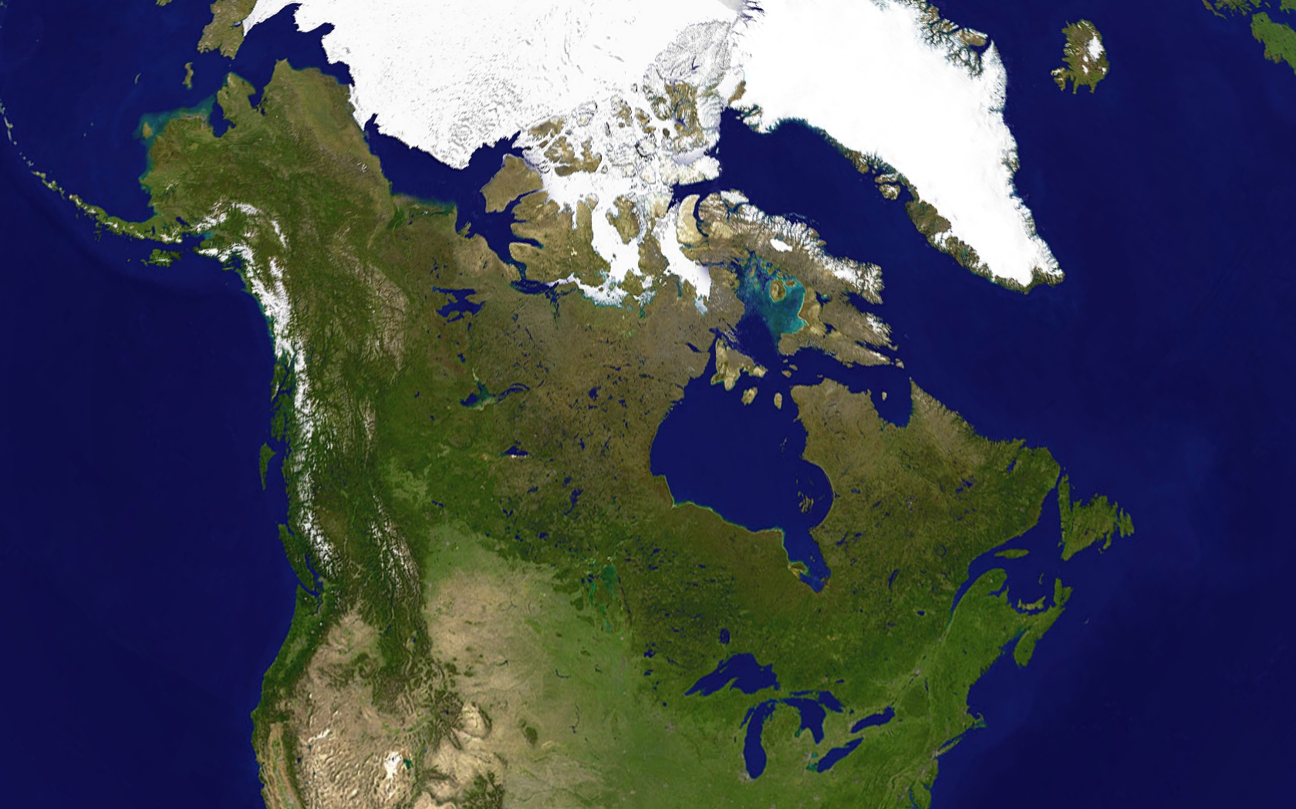
© Brain Wrinkles

Slide 31
© Brain Wrinkles

Slide 32
Great Lakes
The Great Lakes form a valuable transportation network for many products shipped to and from the US.
The region is one of the world’s busiest shipping areas.
Much of Canada’s population lives around the Great Lakes region.
© Brain Wrinkles

Slide 33
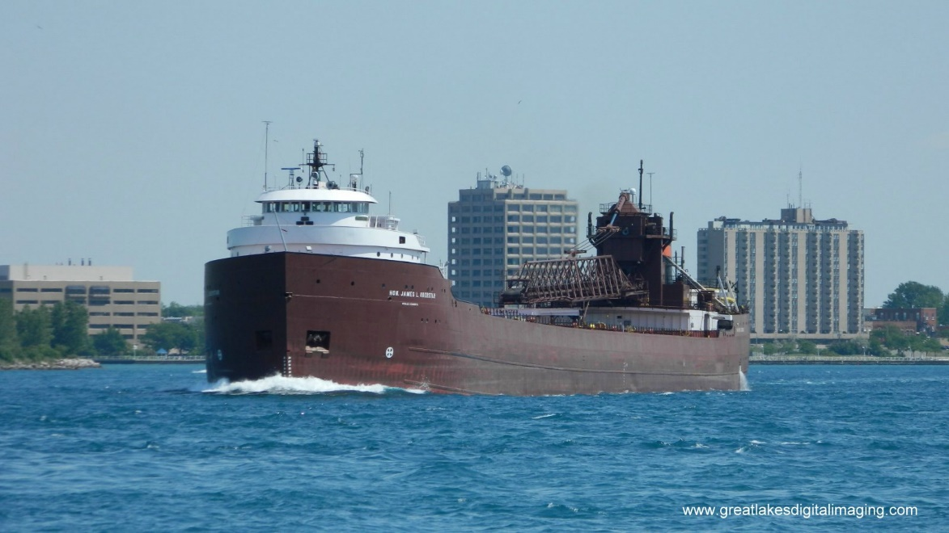
© Brain Wrinkles

Slide 34
Rocky Mountains
The Rocky Mountains are a mountain range located in western Canada and the United States.
They extend over 2000 miles from New Mexico to northern British Columbia.
Because of the terrain, the Rocky Mountains are sparsely populated and contain few cities.
© Brain Wrinkles

Slide 35
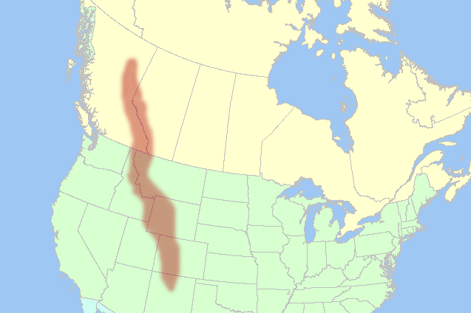
© Brain Wrinkles

Slide 36
Rocky Mountains
There are numerous glaciers within the Canadian Rockies.
Mining is the biggest industry in the region, followed closely by logging.
Major minerals found here include iron ore, copper, coal, and gold.
The Rockies are also a popular tourist destination, and most of the Canadian Rockies are now protected as national parks.
© Brain Wrinkles

Slide 37
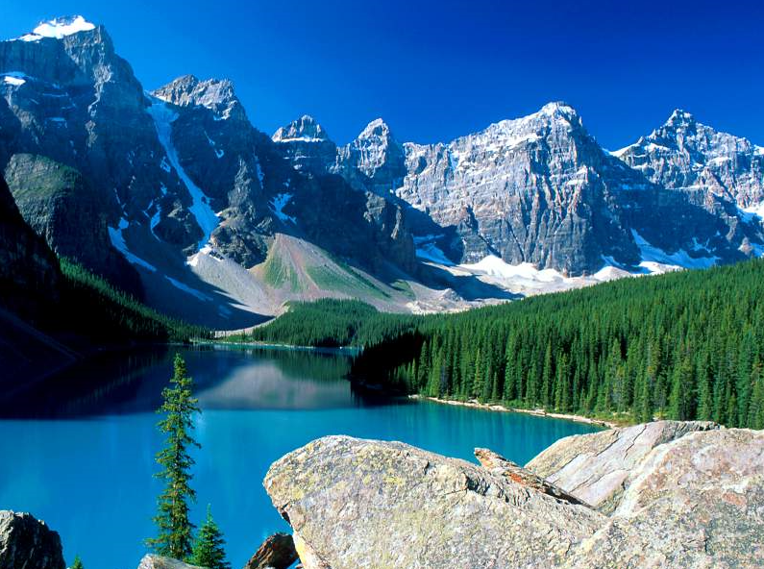
© Brain Wrinkles

Slide 38
St. Lawrence River
The St. Lawrence River connects the Great Lakes with the Atlantic Ocean.
The St. Lawrence River is a huge producer of hydroelectricity.
It is also a major source of overseas and US-Canada shipping and trading.
© Brain Wrinkles

Slide 39
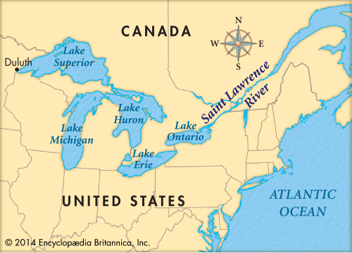
© Brain Wrinkles

Slide 40
St. Lawrence River
In 1959, the United States and Canada completed the St. Lawrence Seaway, which is a series of locks, canals, and dams that allow huge cargo ships to travel from the Atlantic Ocean to the Great Lakes.
The seaway has made cities in eastern Canada home to many successful manufacturing companies.
Because of the climate, the St. Lawrence Seaway is closed from November to April.
© Brain Wrinkles

Slide 41
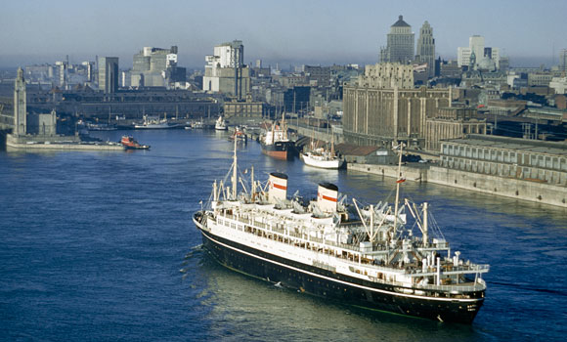
© Brain Wrinkles

Slide 42
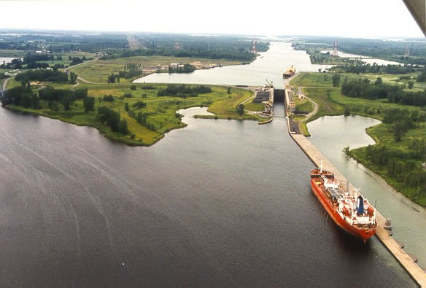
© Brain Wrinkles

Slide 43
Quebec
Quebec is Canada’s largest province and second-most populated province.
It is in eastern Canada and is home to a major shipping route (St. Lawrence River).
French fur traders settled the region in the 1600s.
Quebec is French-speaking while the rest of Canada is predominately English-speaking.
© Brain Wrinkles

Slide 44
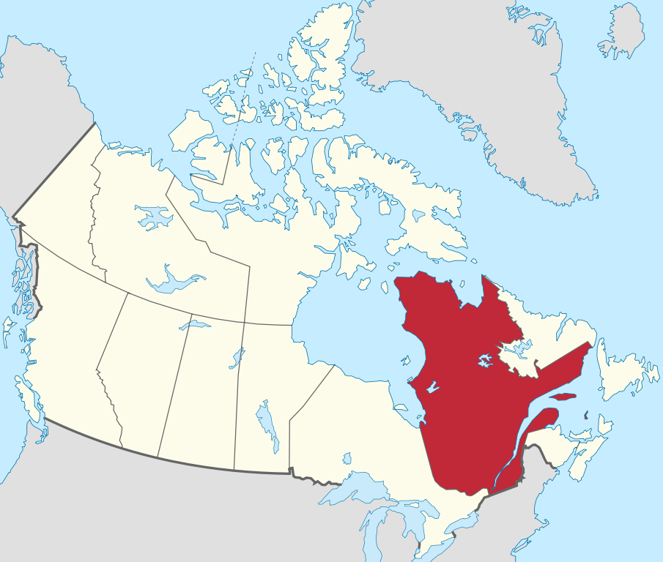
Quebec
© Brain Wrinkles

Slide 45
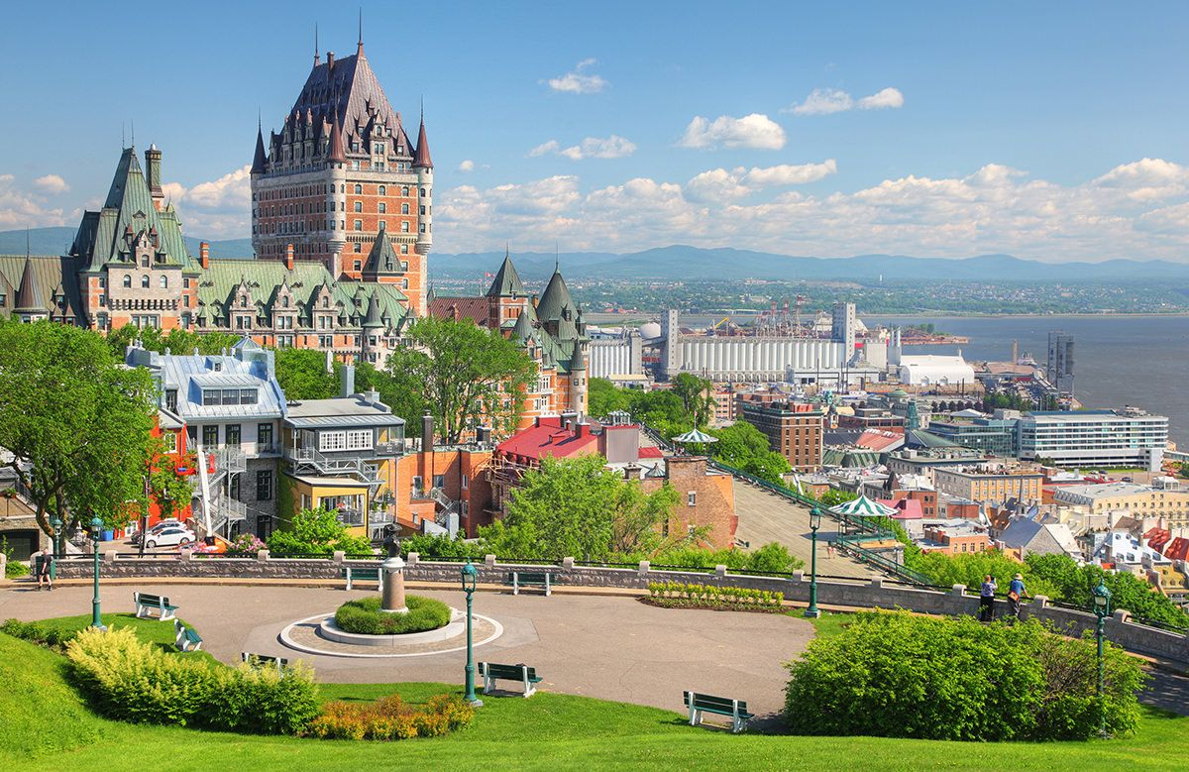
© Brain Wrinkles

Slide 46
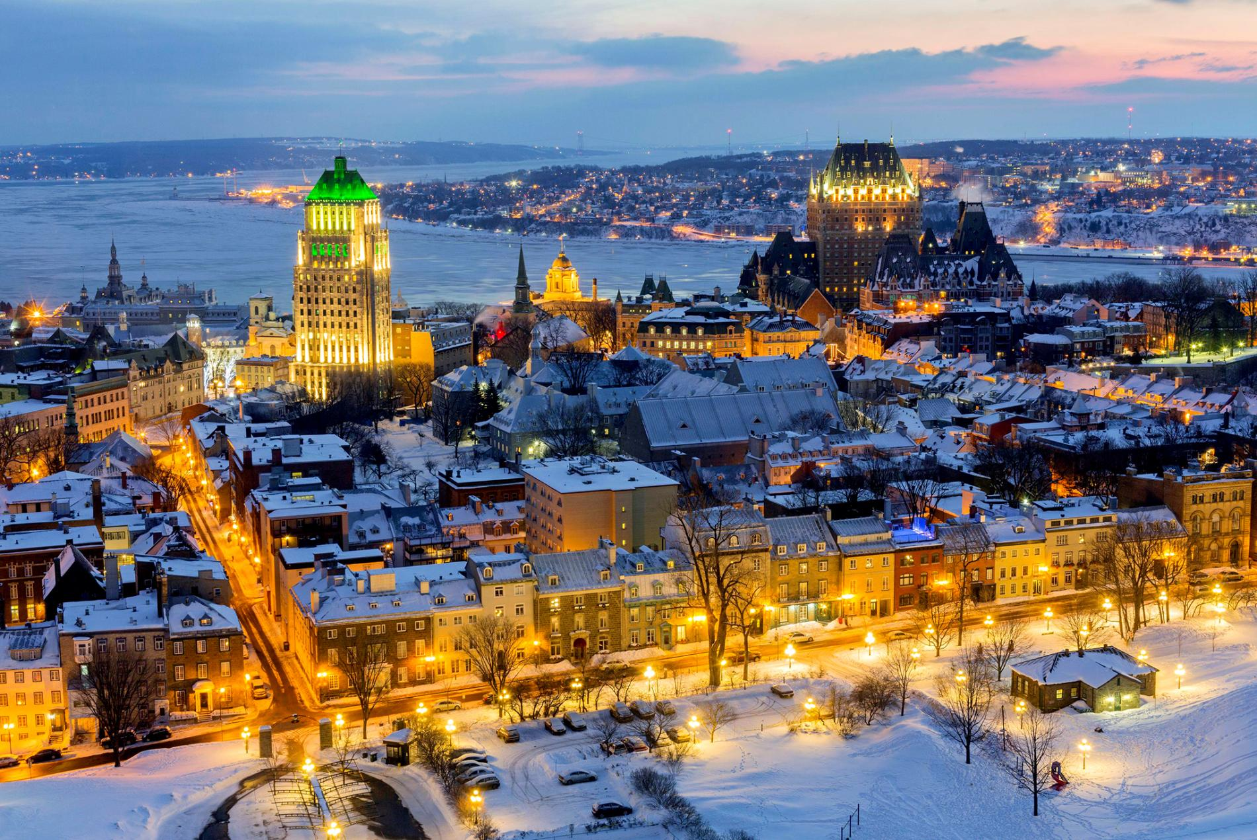
© Brain Wrinkles

Slide 47
What:
Where:
Illustration:
What:
Where:
Illustration:
What:
Where:
Illustration:
What:
Where:
Illustration:
© Brain Wrinkles
Hudson Bay
Canadian Shield
Atlantic Ocean
Pacific Ocean
Directions: Complete the chart below with information that you learned during the presentation. If time allows, color your illustrations.
Canada’s Features
What:
Where:
Illustration:
What:
Where:
Illustration:
What:
Where:
Illustration:
What:
Where:
Illustration:
Quebec
St. Lawrence River
Rocky Mountains
Great Lakes

Slide 48
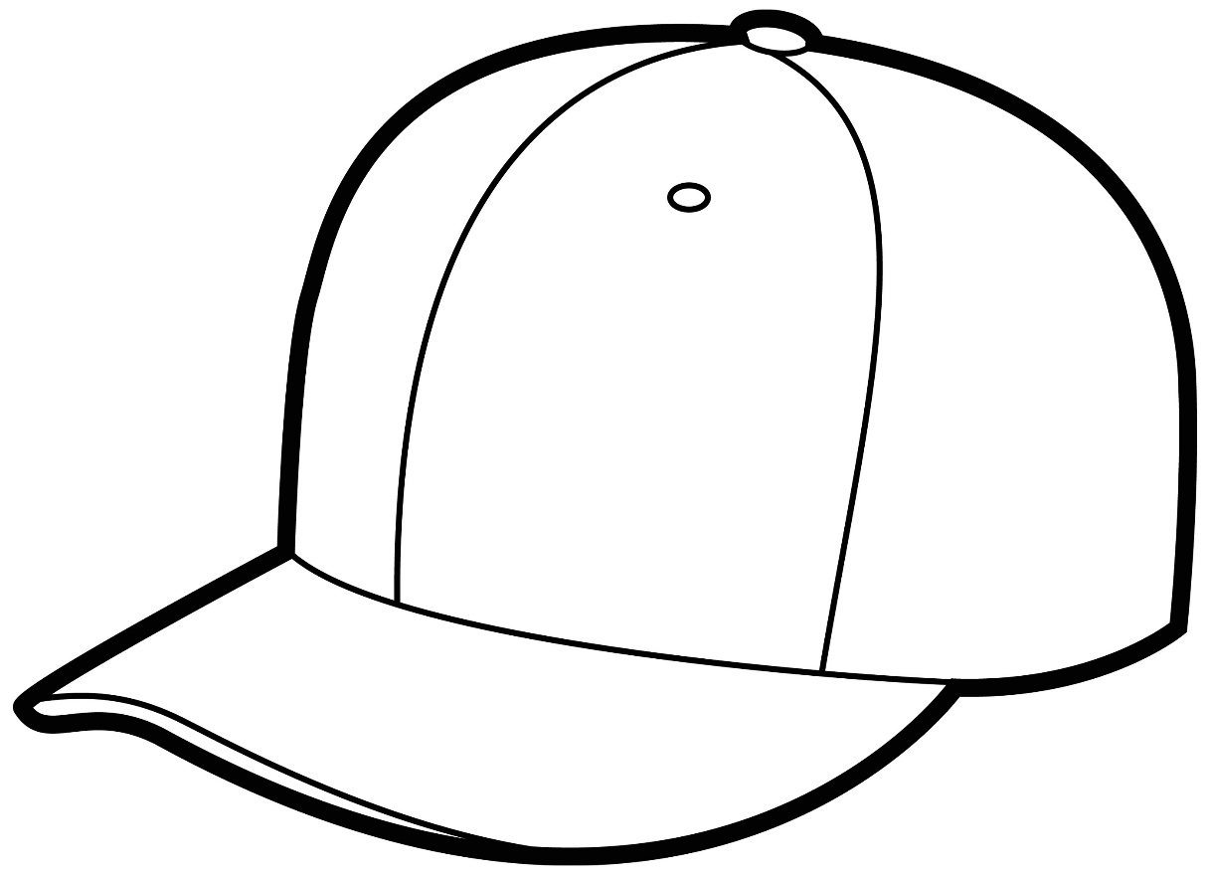
Canada’s Souvenir Hats
Directions: Imagine that you own a touristy gift shop in Canada. Design fun & creative hats to sell that showcase a few of the country’s features. Include a brief description of each feature in the textbox.
Canadian Shield
Hudson Bay
© Brain Wrinkles

Slide 49
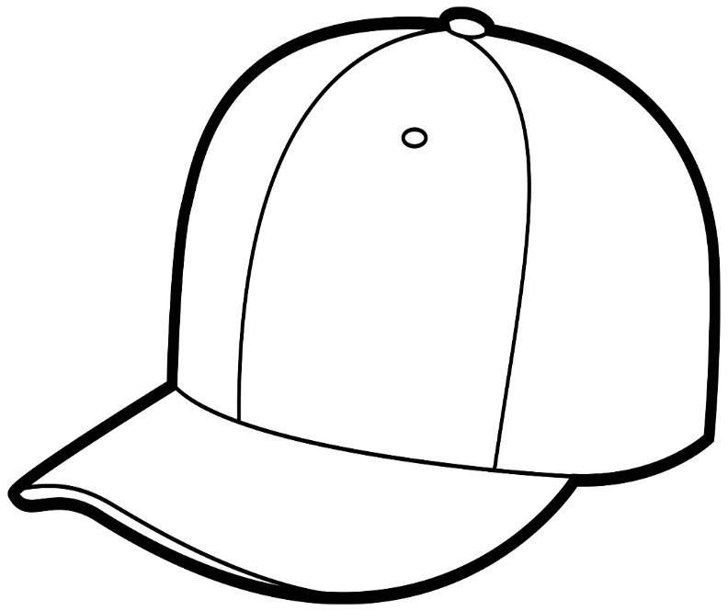
St. Lawrence River
Rocky Mountains
Great Lakes
© Brain Wrinkles

Slide 50
You Are Now Entering…
Directions: Choose one of Canada’s physical features and create a “welcome sign” that visitors will see as they enter the feature’s region. The sign should include key facts about the feature, as well as significant illustrations.
© Brain Wrinkles

Slide 51
TEACHER INFO: Flyswatter Review
Project the blank map of Canada on the whiteboard.
Put the students into groups and have one member from each group come to the board.
Call out different features in Canada and have the students use flyswatters to hit the location.
The first person to hit it correctly wins!
© Brain Wrinkles

Slide 52
FLYSWATTER REVIEW
One member from each team will come to the board.
I will call out different political and physical features of Canada.
If you know where the feature or country is located, you should hit the location on the map.
The first person to correctly hit the location wins a point!
© Brain Wrinkles

Slide 53
© Brain Wrinkles

Slide 54
1. Canada is located on which continent?
2. Canada is in which two hemispheres?
3. Which nation forms Canada southern border?
4. Which landform in Canada, located along the Hudson Bay, is rich in minerals?
5. Why are the Great Lakes valuable to the United States and Canada?
6. Which ocean forms Canada’s western border?
7. What body of water connects the Great Lakes with the Atlantic Ocean?
8. What body of water is in east-central Canada?
9. What mountain range do the United States and Canada share along the western coast?
10. What did Canada and the United States build in 1959 to open the Great Lakes up to shipping in the Atlantic Ocean?
11. Which ocean forms Canada’s eastern border?
12. Name three natural resources found in the Canadian Shield:
13. While most of Canada is English-speaking, what province in eastern Canada is French-speaking?
© Brain Wrinkles
Canada’s Geography
Comprehension Check

