Slide 1
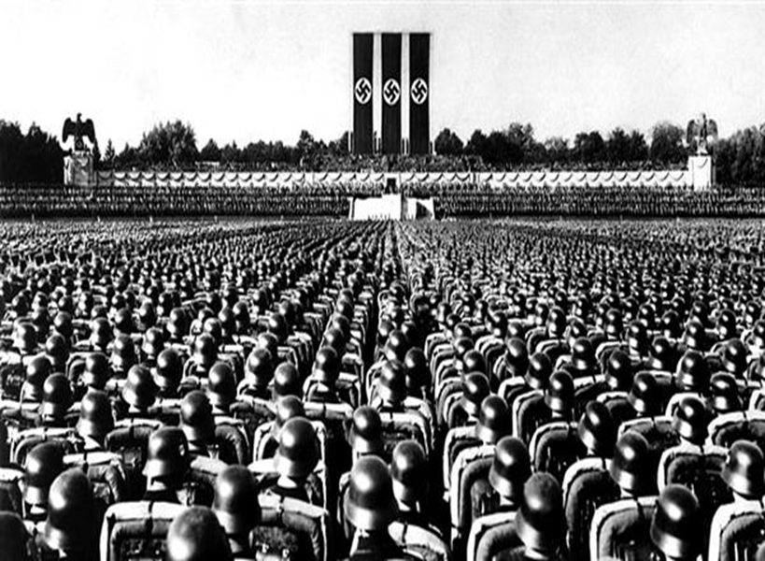
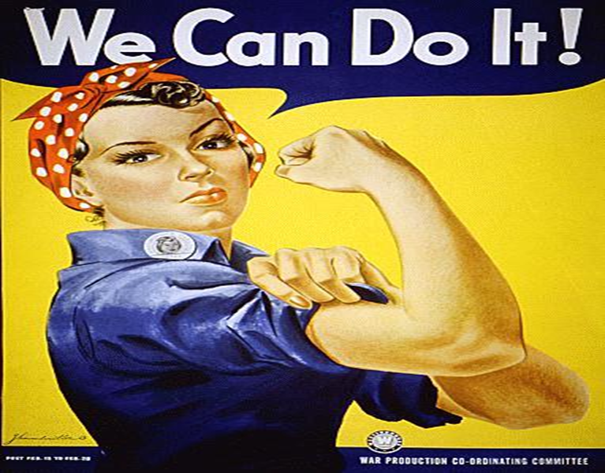
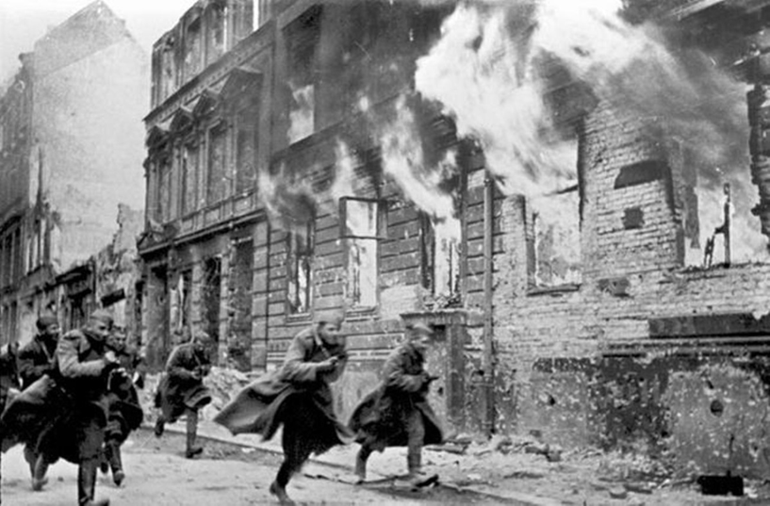
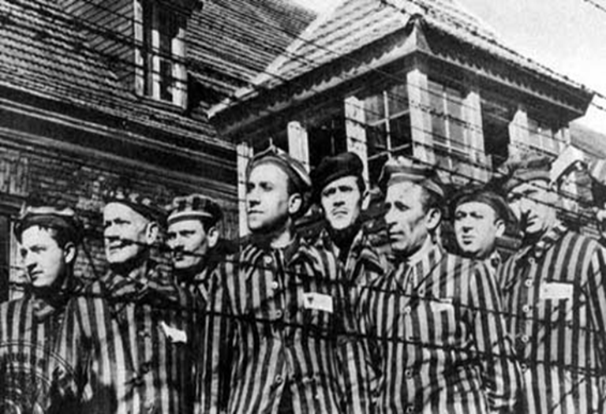
Rise of Nazism

Slide 2
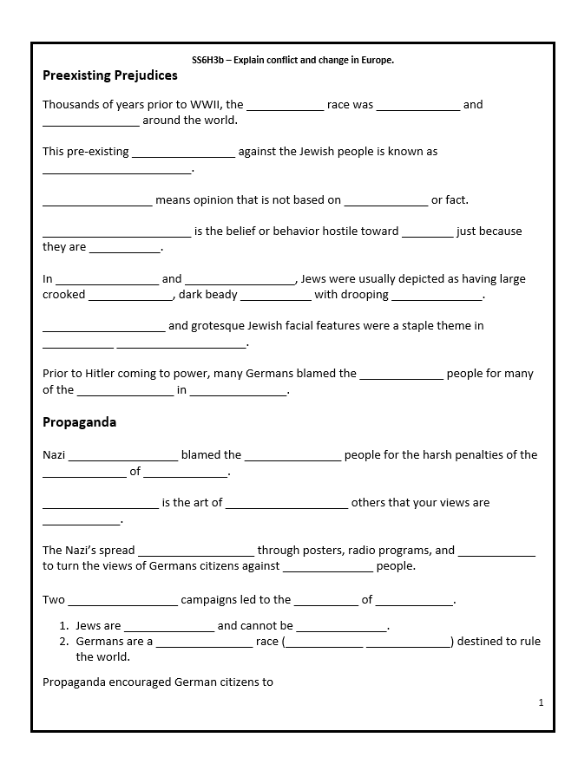
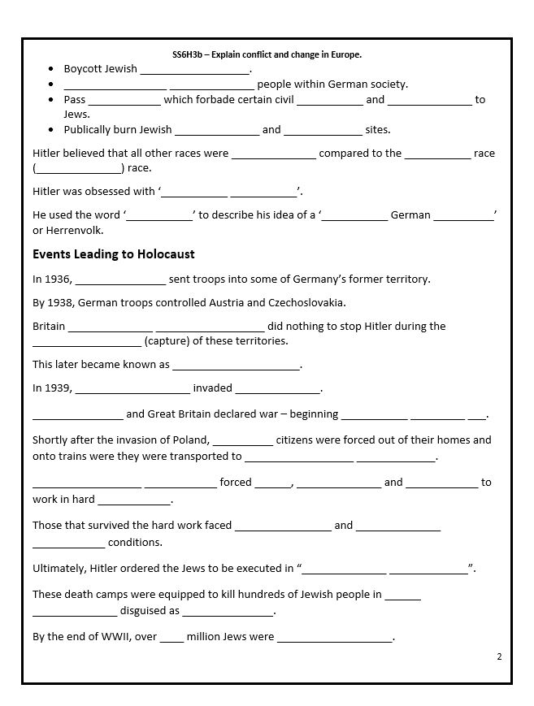
Pre Existing Prejudices

Slide 3
Standard: SS6H3 Explain conflict and change in Europe.
Element: b. Explain the rise of Nazism including pre existing prejudices, the use of propaganda, and events which resulted in the Holocaust.

Slide 4
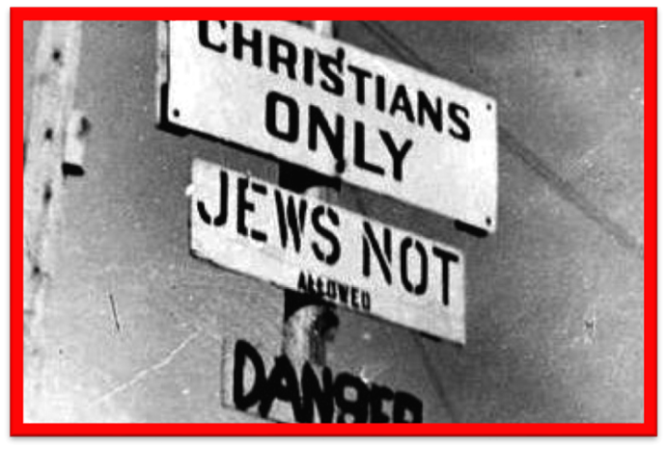
Pre Existing Prejudices
Thousands of years prior to WWII, the Jewish race was disliked and persecuted around the world.
This pre-existing prejudice against the Jewish people is known as anti-Semitism.
Prejudice means opinion that is not based on reason or fact.
Anti-Semitism is the belief or behavior hostile toward Jews just because they are Jewish.
From the days of the Bible until the Roman Empire, Jews were criticized and sometimes punished for their efforts to remain a separate social and religious group. The rise in Christianity greatly influenced hatred of the Jews. Many Christians believed that the Jews rejected Jesus and crucified him.

Slide 5
Anti-Semitism
Wordle
In caricatures and cartoons, Jews were usually depicted as having large crooked noses, dark beady eyes with drooping eyelids.
Exaggerated and grotesque Jewish facial features were a staple theme in Nazi Propaganda.
Prior to Hitler coming to power, many Germans blamed the Jewish people for many of the problems in society.
Many people believe that Hitler created the prejudice views against the Jewish people, when in reality, this view had been going on for thousands of years in the Middle East.

Slide 6
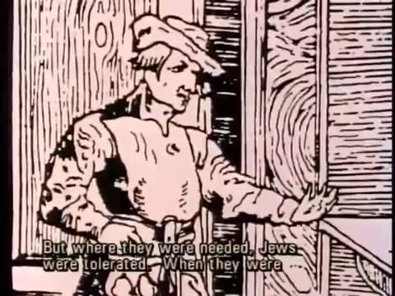
History of Anti-Semitism

Slide 7
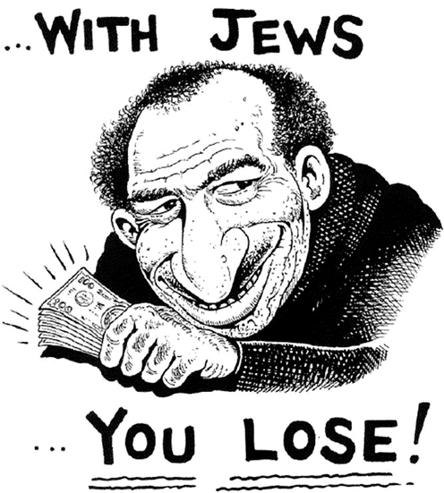
Propaganda
Nazi propaganda blamed the Jewish people for the harsh penalties of the Treaty of Versailles.
Propaganda is the art of persuading others that your views are correct.
The Nazi’s spread propaganda through posters, radio programs, and movies to turn the views of Germans citizens against Jewish people.
The Treaty of Versailles altered the way Germans once lived. What money Germany had was sent to pay for war reparations. This impacted all of Germany in a negative way.

Slide 8
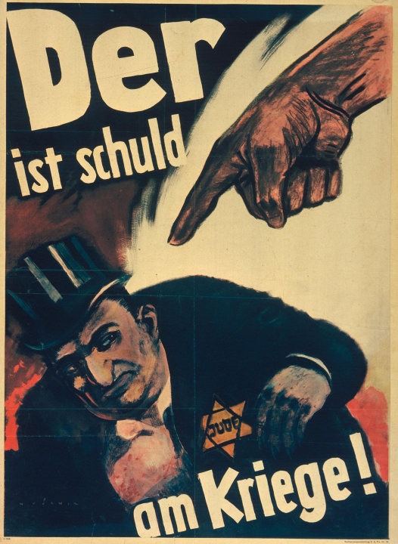
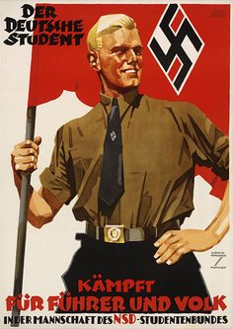
Two propaganda campaigns led to the rise of Nazism.
Jews are inferior and cannot be trusted.
Germans are a superior race (Aryan race) destined to rule the world.

Slide 9
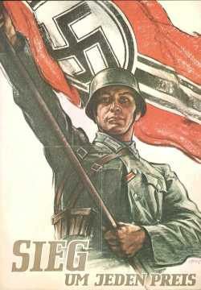
Propaganda might take the form of persuading others that your military might is too great to be challenged or your political might within a nation is too great or popular to challenge etc.

Slide 10
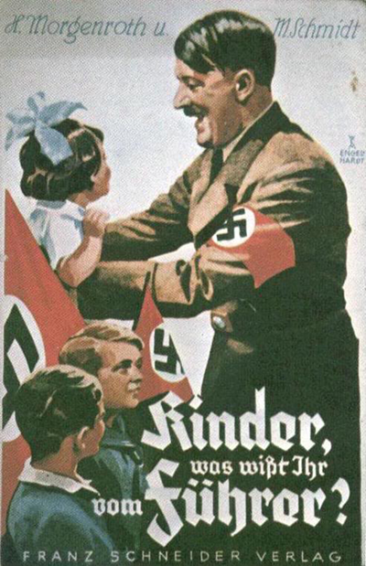
Propaganda encouraged German citizens to
Boycott Jewish businesses.
Segregate Jewish people within German society.
Pass laws which forbade certain civil rights and privileges to Jews.
Publically burn Jewish literature and religious sites.

Slide 11
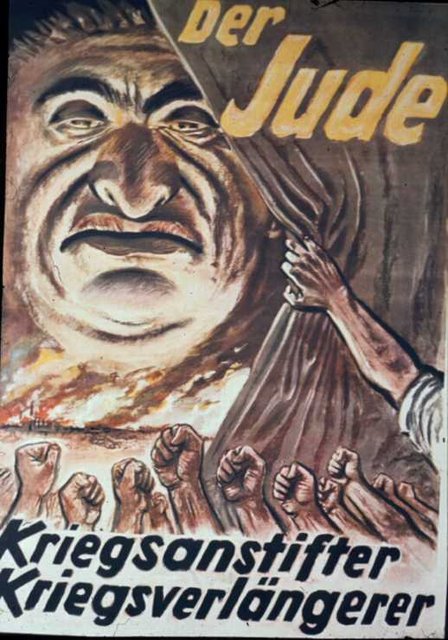
By giving the Jews the blame for Germany's financial problems, Hitler created an enemy for Germans to conquer.
Hitler said that all Germany's problems had been caused by the Jews.

Slide 12
Hitler believed that all other races were inferior compared to the master race (German) race.
Hitler was obsessed with 'racial purity'.
He used the word 'Aryan' to describe his idea of a 'pure German race' or Herrenvolk.
Hitler believed the 'Aryan race' had a duty to control the world. According to the Hitler, the Aryans had the most "pure blood" of all the people on earth.

Slide 13
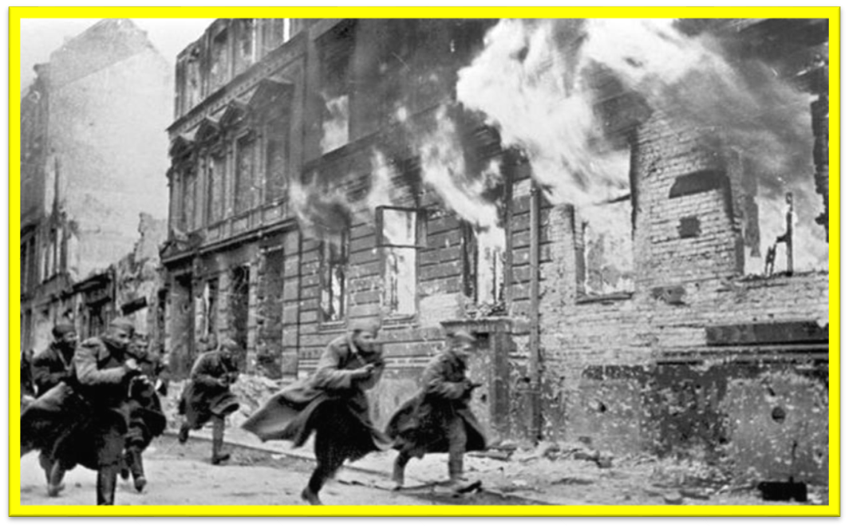
Propaganda
Listening to the propaganda, many Jewish houses and apartments were set on fire.

Slide 14
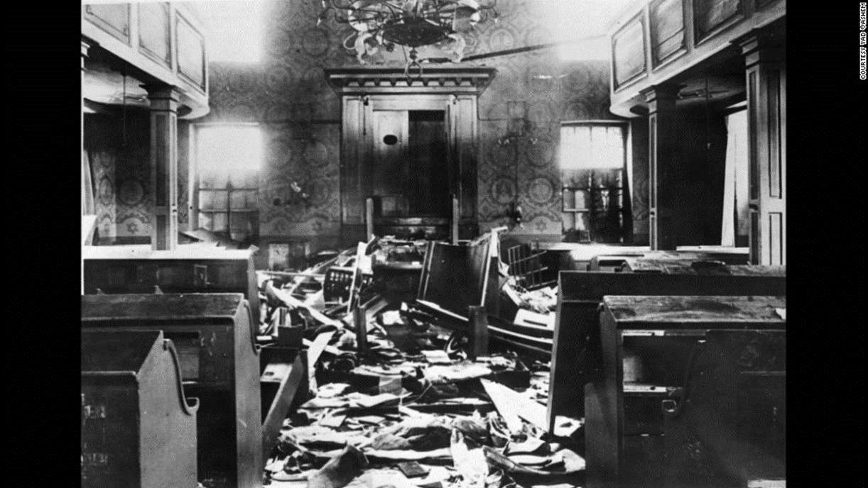
Propaganda
Holy Places of worship for the Jews were destroyed.

Slide 15
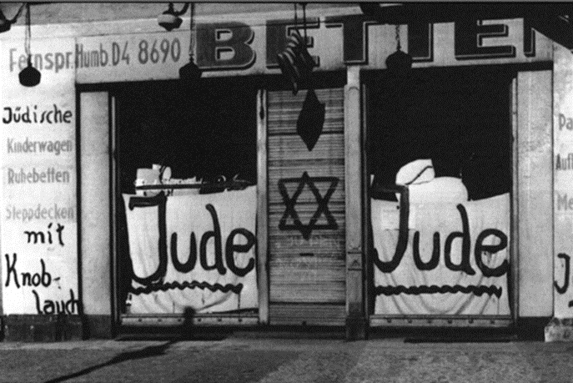
Propaganda
Jewish businesses were vandalized and looted.

Slide 16
Anti-Semitism Out the Door
What is Anti-Semitism?
How was it used in propaganda by Nazi’s?

Slide 17
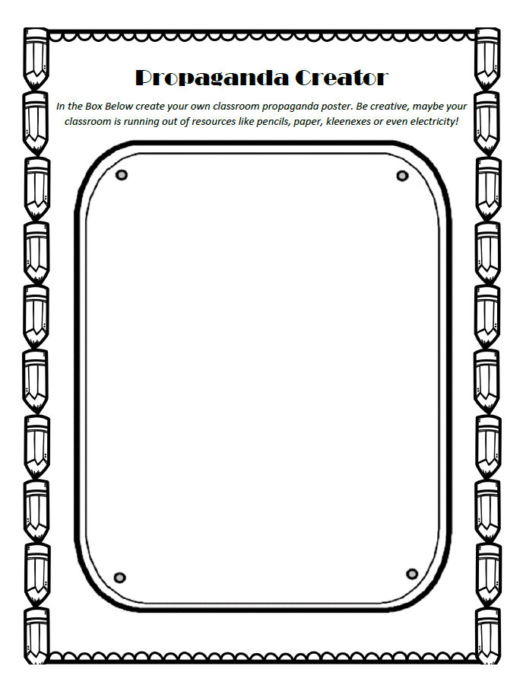
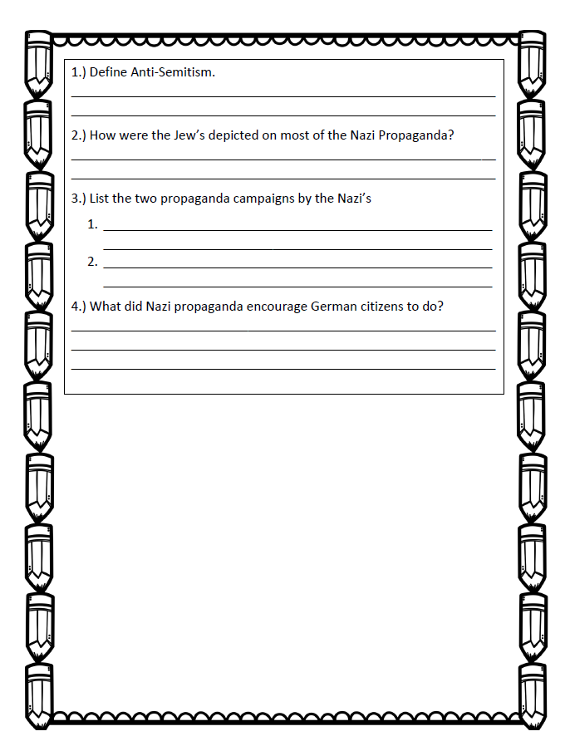
Propaganda Creator

Slide 18
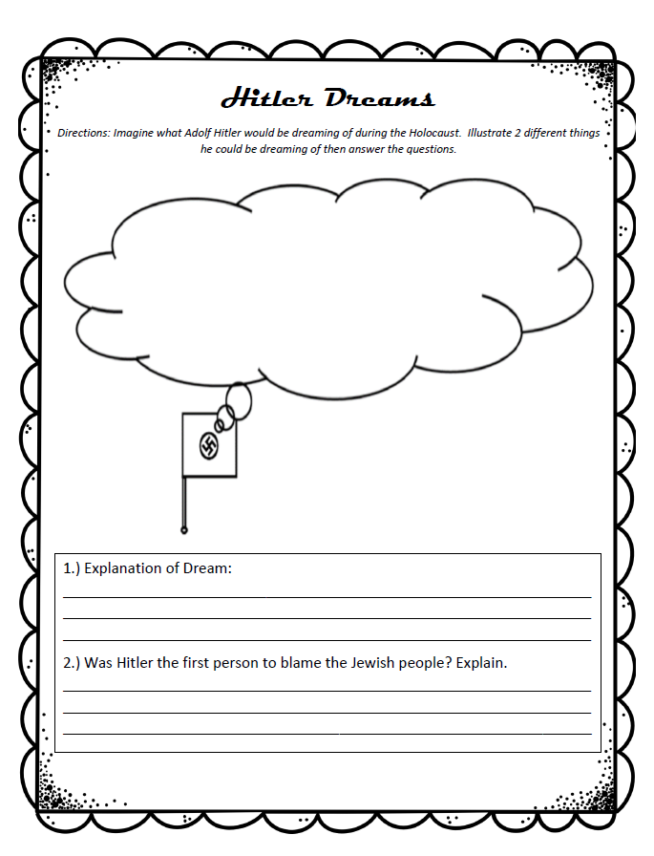
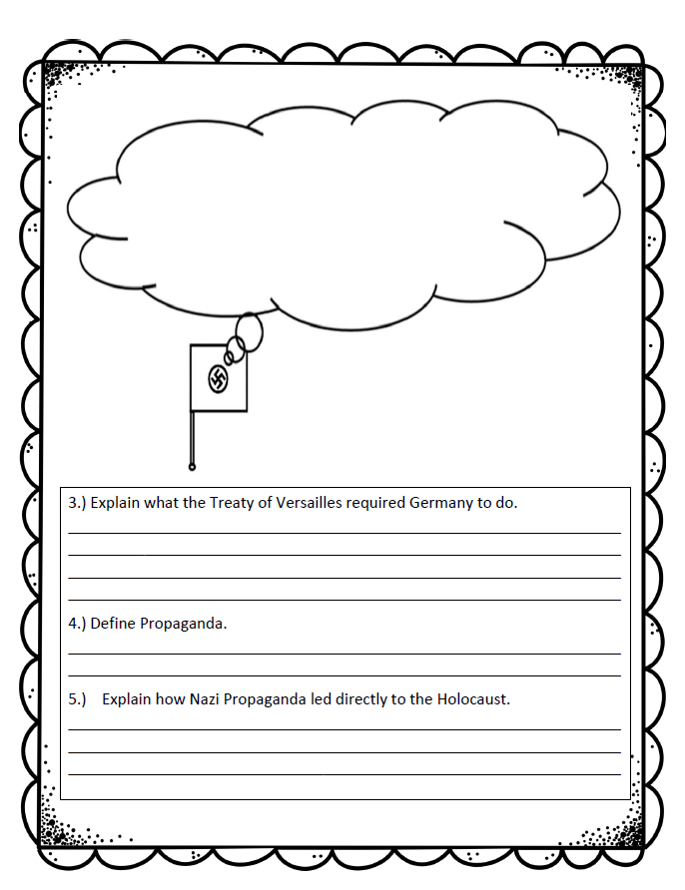
Hitler Dreams

Slide 19
Events leading to Holocaust
In 1936, Hitler sent troops into some of Germany’s former territory.
By 1938, German troops controlled Austria and Czechoslovakia.
Britain Prime Minister did nothing to stop Hitler during the annexation (capture) of these territories.
This later became known as appeasement.

Slide 20
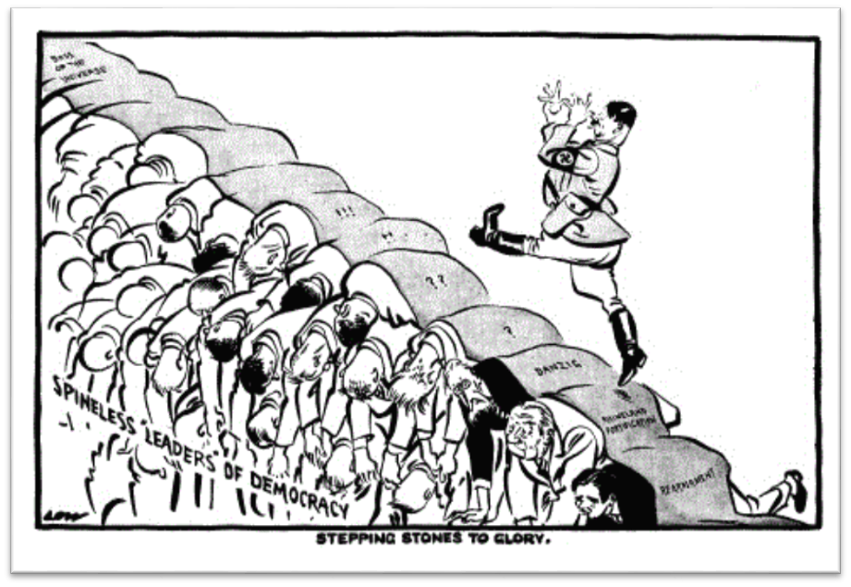
Events leading to Holocaust
Most Europeans believed that Germany was rightfully reclaiming land it lost during the previous war plus no one wanted another war.

Slide 21
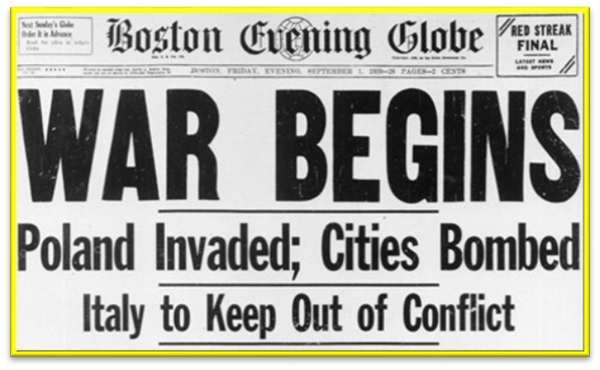
Events leading to Holocaust
In 1939, Germany invaded Poland.
France and Great Britain declared war – beginning World War II.

Slide 22
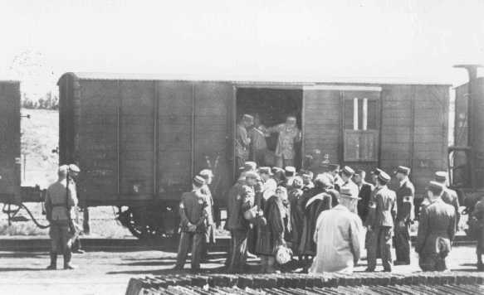
Holocaust
Shortly after the invasion of Poland, Jewish citizens were forced out of their homes and onto trains were they were transported to concentration camps.
Concentration camps forced men, women and children to work in hard labor.
No families were allowed to go on trains together. At the train station, the Jewish people were separated by men, women and children on separate trains going to different locations.

Slide 23
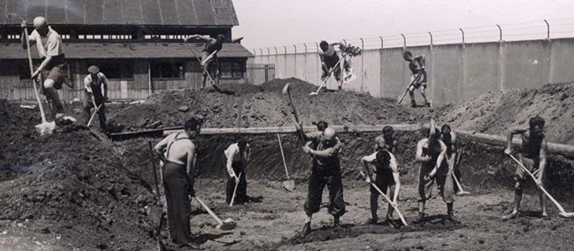
Holocaust
Healthy Jewish men were forced into rebuilding roads, buildings, and railroads destroyed by the Allies. Healthy Jewish women were forced into working in factories creating weapons of war. Both worked long, strenuous hours with little or no food nor breaks. When workers would die from the strenuous work, Nazi officials replaced them with a seemly endless supply of Jewish workers.

Slide 24
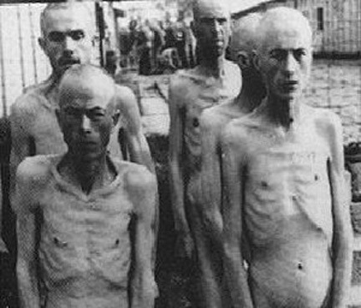
Holocaust
Those that survived the hard work faced starvation and unsanitary living conditions.
In concentration camps, Jewish prisoners were given very little if any rations. Survivors say up to 100 people would share a bowl of potato soup. The soup would contain “one” potato cut up into small pieces. Leather from shoes were thrown in as well to give the prisoners something to chew on.

Slide 25
Holocaust
Ultimately, Hitler ordered the Jews to be executed in “death camps”.
These death camps were equipped to kill hundreds of Jewish people in gas chambers disguised as showers.
By the end of WWII, over 6 million Jews were murdered.

Slide 26
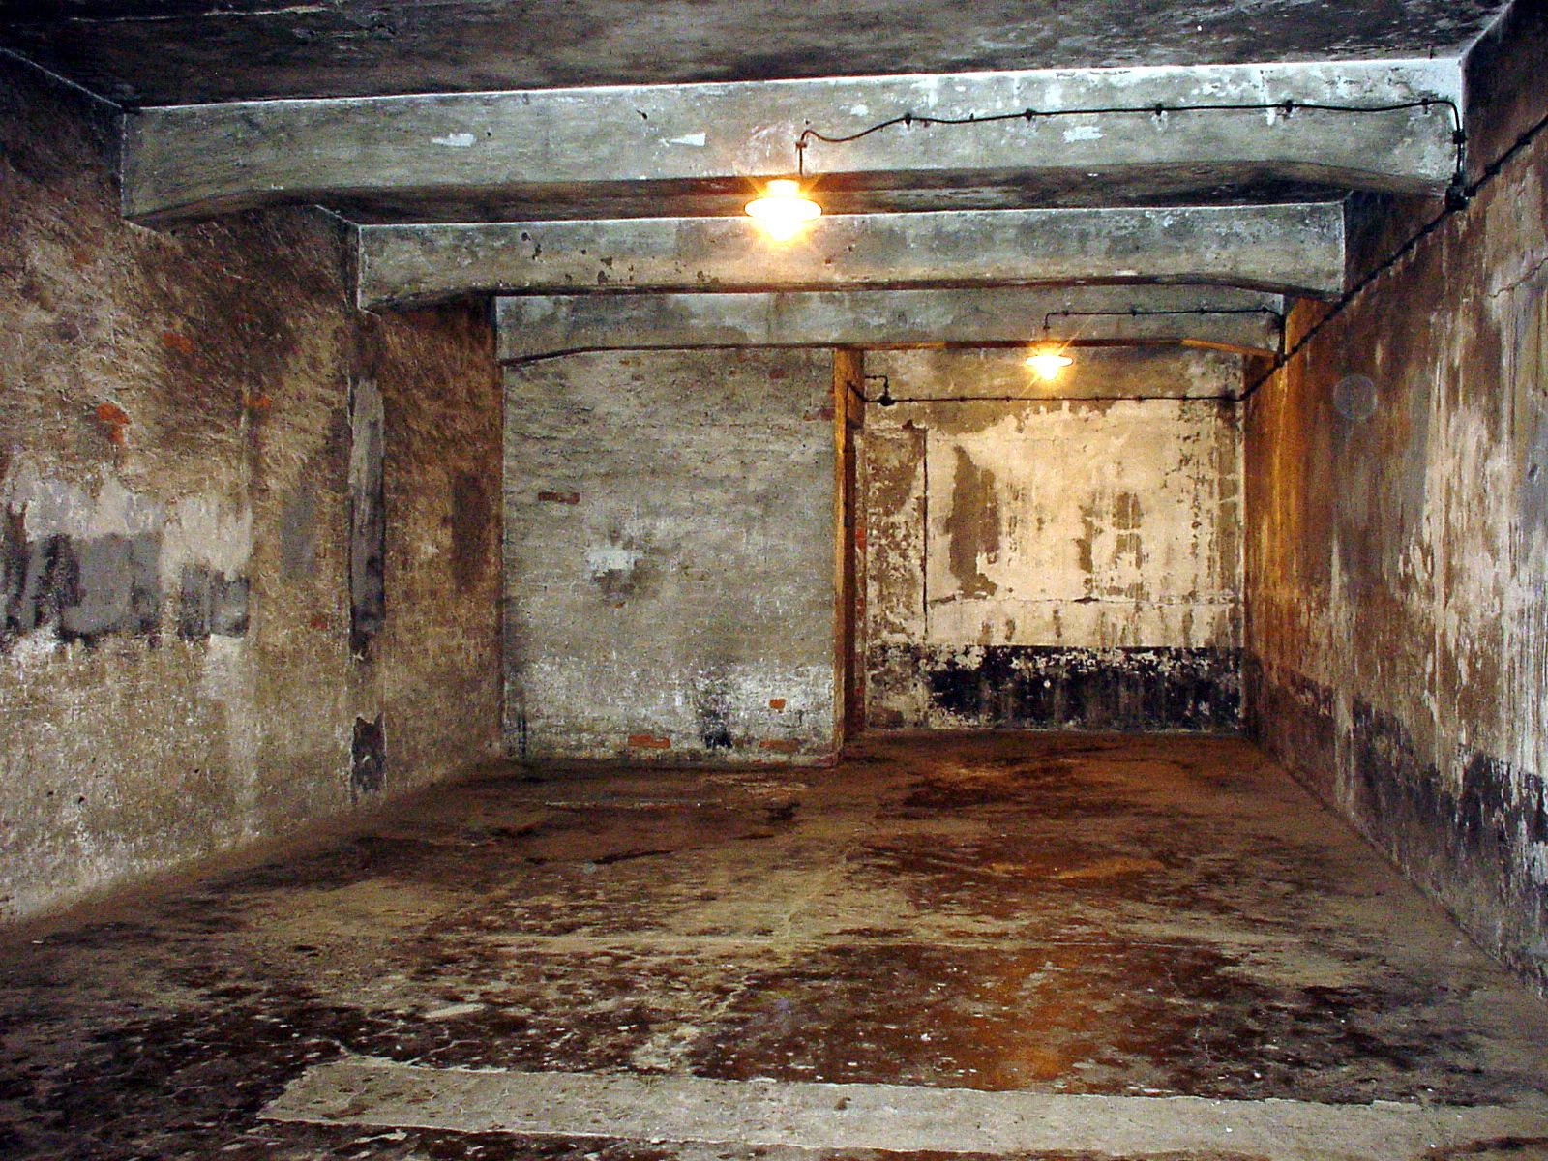
Holocaust
The picture above is an actual gas chamber used in the death camps.

Slide 27
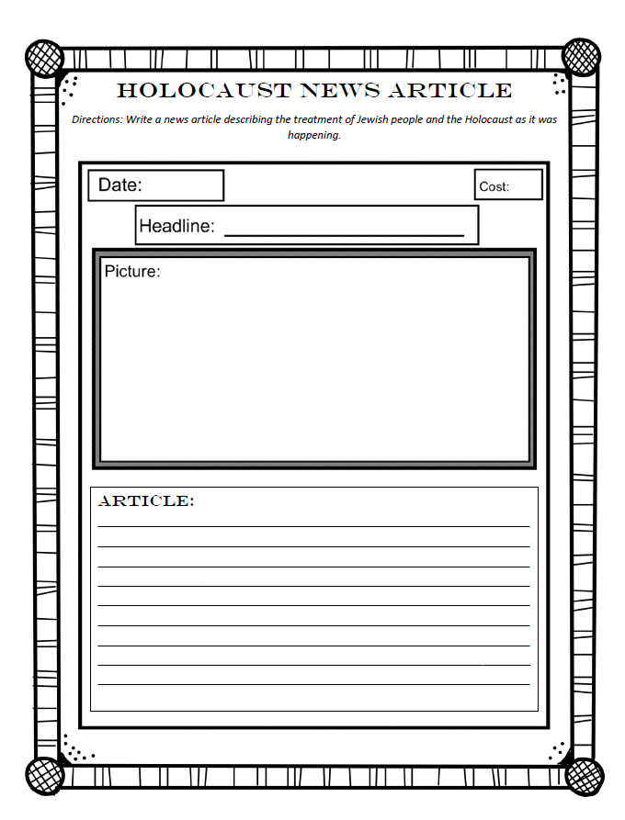
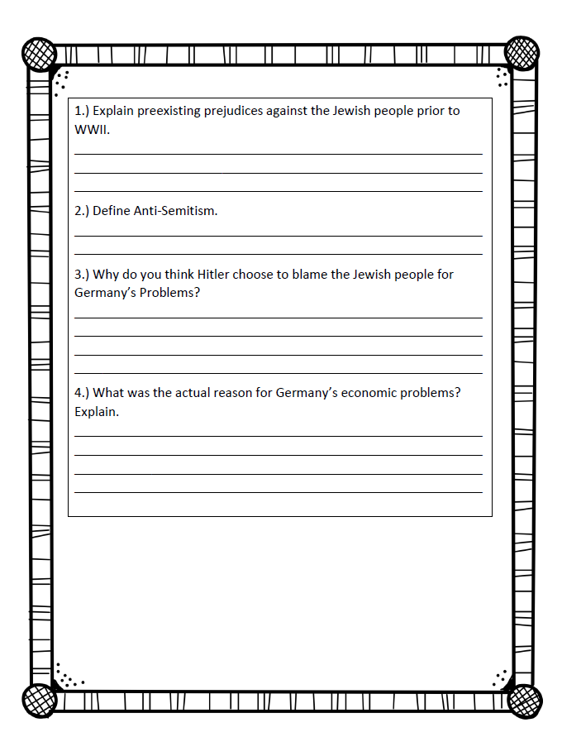
Holocaust News Article

Slide 28
Terms of Use
© Brainy Yak. Your download includes a limited use license from Brainy Yak. The purchaser may use the resource for personal classroom use only. The license is not transferable to another person. Other teachers should purchase their own license through my store.
This resource is not to be used:
By an entire grade level, school, or district without purchasing the proper number of licenses. For school/district licenses at a discount, please contact me.
As part of a product listed for sale or for free by another individual.
On shared databases.
Online in any way other than on password-protected website for student use only.
© Copyright Brainy Yak. All rights reserved. Permission is granted to copy pages specifically designed for student or teacher use by the original purchaser or licensee. The reproduction of any other part of this product is strictly prohibited. Copying any part of this product and placing it on the Internet in any form (even a personal/classroom website) is strictly forbidden. Doing so makes it possible for an Internet search to make the document available on the Internet, free of charge, and is a violation of the Digital Millennium Copyright Act (DMCA).
Thank you,
James at Brainy Yak

Slide 29
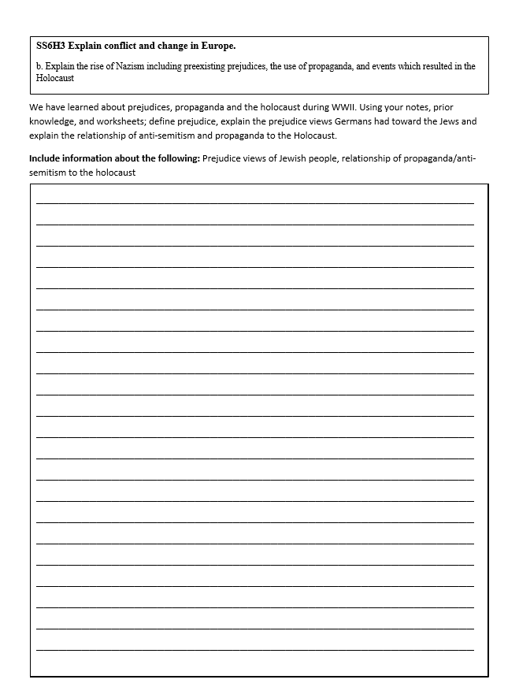
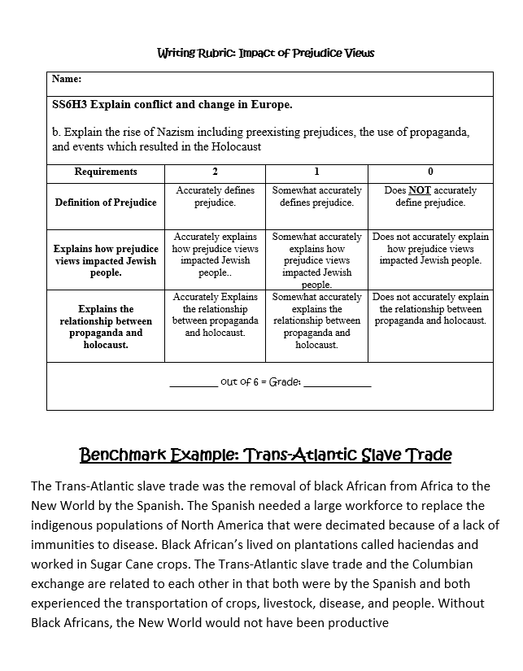
Impact of Prejudice Views Writing Prompt

