Slide 1
The Impact of Water in the Middle East

Slide 2
Essential Question: How do water pollution and the unequal distribution of water impact the Middle East (Southwest Asia)?
Standard: SS7G6a. Explain how water pollution and the unequal distribution of water impacts irrigation and drinking water.
Notes:
Instructional Approach(s): The teacher should present the essential question for the lesson and the standard that aligns to the essential question.

Slide 3
Activating Strategy: Scarcity of Water
What does scarcity mean? With a seat partner, discuss another word for scarcity.
https://www.youtube.com/watch?v=GlWVDcdRVUA [watch first 3 minutes]
Notes:
Instructional Approach(s): The teacher should show the video [first 3 minutes only] and have students pair up to discuss the meaning of scarcity. Partners can be determined by the students or the teacher can provide more specific directions such as turn to the person directly in front/behind you or to the right/left of you, etc. It may be necessary to have a group of three if you have an uneven number of students. Do not allow more than 30 seconds to 1 minute of discussion time. The teacher should be walking around listening and redirecting discussions as needed. The teacher can briefly discuss student responses.

Slide 4
Physical Water Scarcity Activity [optional]
Notes:
Instructional Approach(s): This is an optional teacher demonstration or small group demonstration that shows the relationship between populations resources (specifically water). The directions and questions are linked on the resource page.

Slide 5
Interview: Water Crisis in the Middle East Task [see resources]
Notes:
Instructional Approach(s): Students read either an excerpt of an interview with a water expert or read the entire interview [linked on the resource page] and answer questions. The teacher should be walking around an facilitating the process. Students can work individually or with a partner. The teacher should review the answers to the questions briefly with the class.

Slide 6
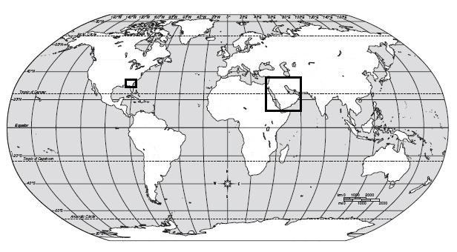
Where is the Middle East?
We are here
Middle East
Let’s examine a few maps of the Middle East in relation to water supplies.
Notes:
Instructional Approach(s): The teacher should present the animated slide

Slide 7
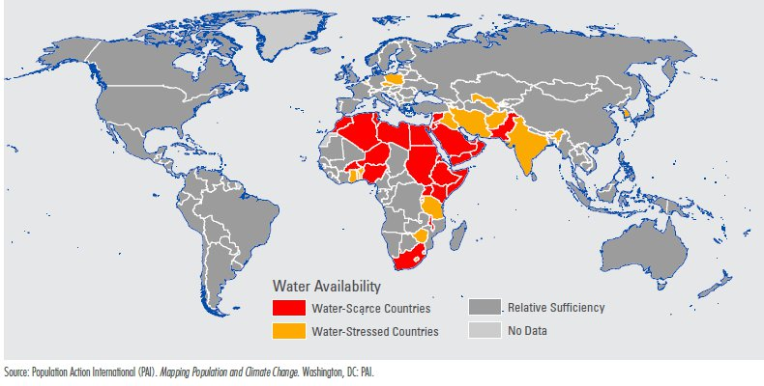
What is the difference between a Water-Scarce Country and a Water-Stressed Country?
Notes:
Instructional Approach(s): The teacher should present the information on the slide. The teacher can ask for student volunteers or call on specific students to answer the question. The teacher may also opt for students to discuss the question with an elbow partner and then lead a brief classroom discussion of the difference between water-scarce and water-stressed.

Slide 8
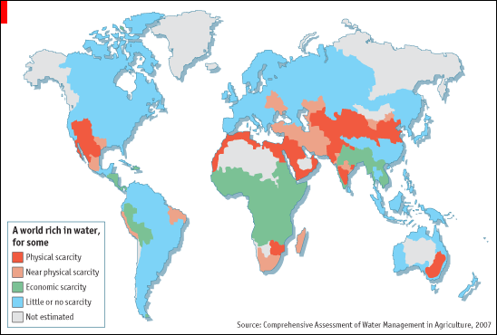
What is the difference between Physical Scarcity and Economic Scarcity?
Notes:
Instructional Approach(s): The teacher should present the information on the slide. The teacher can ask for student volunteers or call on specific students to answer the question. The teacher may also opt for students to discuss the question with an elbow partner and then lead a brief classroom discussion of the difference between physical scarcity and economic scarcity.

Slide 9
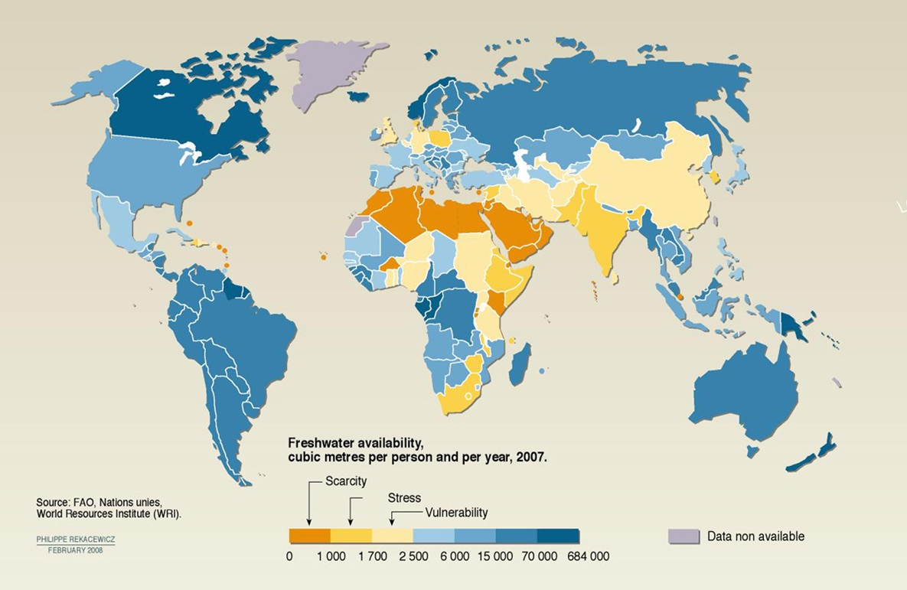
Notes:
Instructional Approach(s): The teacher should use the diagram on the slide to reinforce the scarcity of water in the Middle East.

Slide 10
After looking at the maps, turn to a partner and come up with a sentence to describe water in the Middle East. Write your sentence on your notes handout.
Notes:
Instructional Approach(s): Have students turn to a partner and discuss the question on the slide. Partners can be determined by the students or the teacher can provide more specific directions such as turn to the person directly in front/behind you or to the right/left of you, etc. It may be necessary to have a group of three if you have an uneven number of students. Do not allow more than 30 seconds to 1 minute of discussion time. The teacher should be walking around listening and redirecting discussions as needed. The teacher can briefly discuss student responses. Be sure that students have recorded their sentence on their notes handout.

Slide 11
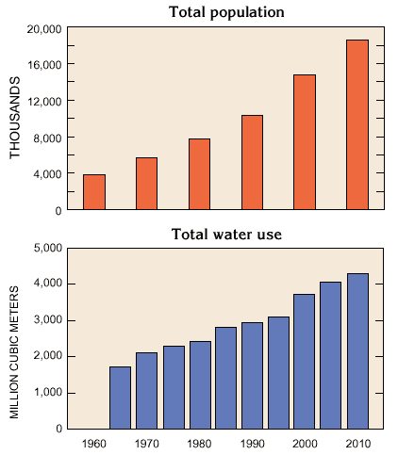
What do these graphs show?
Is this going to cause problems? Why?
Notes:
Instructional Approach(s): The teacher should present the information on the slide. The teacher can ask for student volunteers or call on specific students to answer the questions. The teacher may also opt for students to discuss the questions with an elbow partner and then lead a brief classroom discussion of the relationship between population and water use.

Slide 12
The Middle East contains 5% of the world’s population, but it has less than 1% of the world’s freshwater resources.
Notes:
Instructional Approach(s): The teacher should present the information on the slide while the students record the important information on their notes.

Slide 13
The Middle East is an arid (dry) region where little rain falls
Rivers are the main source of water for drinking and for power in many countries in the Middle East
Notes:
Instructional Approach(s): The teacher should present the information on the slide while the students record the important information on their notes.

Slide 14
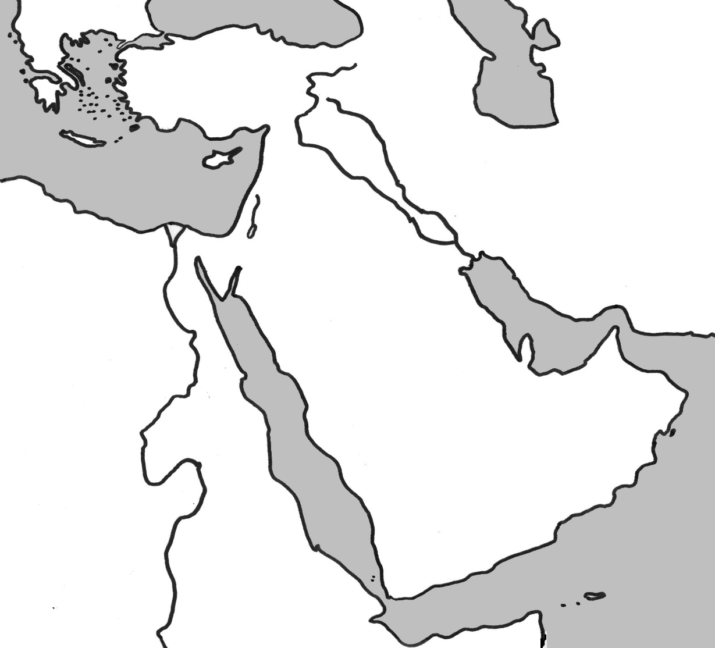
Think of your physical features map, how many rivers do you recall being in the Middle East region we labeled?
If rivers are the main source of water, what is part of the problem?
Notes:
Instructional Approach(s): The teacher should pose the question on the slide to the class and ask for student responses.

Slide 15
Turkey, Iraq, Syria, Israel, Jordan and other Middle East countries all depend on many of the same water resources
The existing ground and surface water resources are not enough to meet the needs of everyone [drinking water, irrigation of crops, domestic uses, etc.]
Notes:
Instructional Approach(s): The teacher should present the information on the slide while the students record the important information on their notes.

Slide 16
How is the scarcity of water related to the unequal distribution of water?
In which countries do you think water is unevenly distributed? Why?
Notes:
Instructional Approach(s): The teacher should pose the questions on the slide to the class. Ask for student responses or call on students. Mention here how Israel and Jordan have conflicts over the use of the Jordan River that borders both countries. Students will need to be familiar with this example for the unit test.

Slide 17
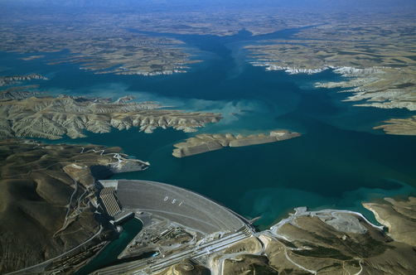
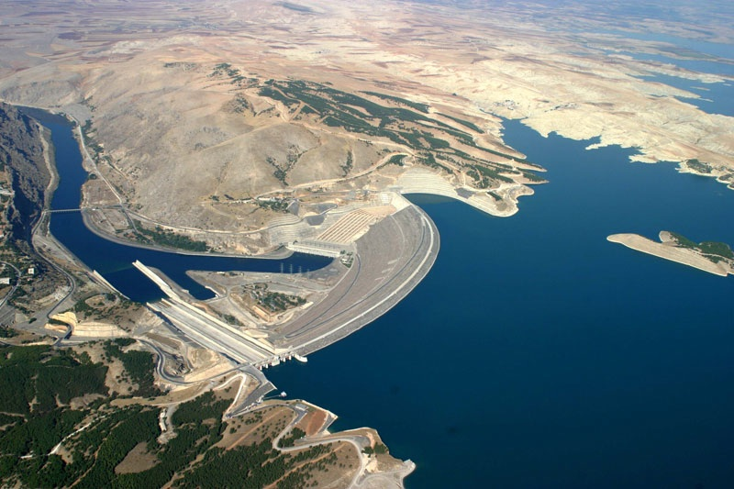
Another factor causing the unequal distribution of water in the Middle East is the building of dams.
Notes:
Instructional Approach(s): The teacher should present the information on the slide while the students record the important information on their notes.

Slide 18
According to the International Rivers Organization, Dams are used for the following:
To generate electricity
To supply water for agriculture, industries and households
To control flooding
To assist river navigation by providing regular flows and drowning rapids.
Other reasons for building large dams include reservoir fisheries and leisure activities such as boating
Notes:
Instructional Approach(s): The teacher should present the information on the slide.

Slide 19
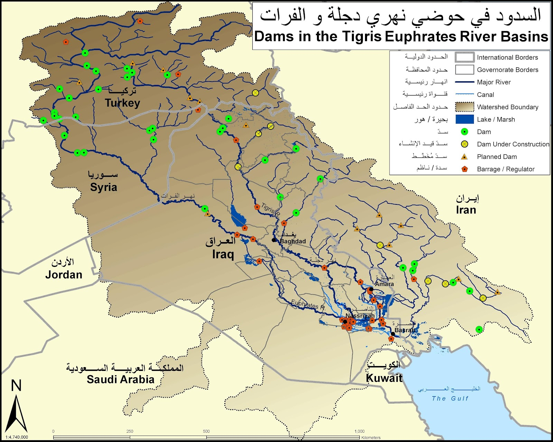
Dams along the Tigris and Euphrates Rivers
Green
Dots
Notes:
Instructional Approach(s): The teacher should use the diagram to show the number of dams along the two main sources of water.

Slide 20
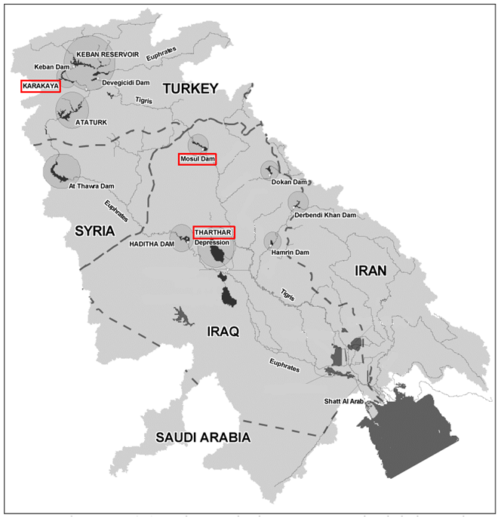
What happens to the availability of water as it flows from Turkey to the Persian Gulf?
Notes:
Instructional Approach(s): The teacher should use the diagram to discuss with the class what happens to the availability of water as it flows from Turkey to the Persian Gulf.

Slide 21
Water Scarcity and Agriculture
Agriculture uses about 85 percent of water in the Middle East. It is common to misuse land by heavy irrigation.
The overuse of water in agriculture is affecting the already scarce water resources.
Notes:
Instructional Approach(s): The teacher should present the information on the slide

Slide 22
Water Scarcity and Agriculture
Water scarcity and water use affect agriculture (crop choice, growing seasons, and pests), fisheries, forestry, and livestock (pastures and pests).
These factors impact incomes and food security.
Notes:
Instructional Approach(s): The teacher should present the information on the slide.

Slide 23
Distributed Summarizing: On your Middle East Water Issues Graphic Organizer identify the causes and effects of Unequal Water Distribution of Water in the Middle East.
Notes:
Instructional Approach(s): The teacher should present the information on the slide while the students record the important information on their notes.

Slide 24
Unequal Distribution of Water
Causes
The Middle East is an arid (dry) region where little rain falls
Rivers are the main source of water and there are few rivers
The building of dams
Notes:
Instructional Approach(s): The teacher should present the information on the slide that reviews the causes of unequal distribution of water in the Middle East.

Slide 25
Unequal Distribution of Water
Effects
The existing ground and surface water resources are not enough to meet the needs of the growing population [drinking water, irrigation of crops]
The building of dams along rivers make the rivers less powerful and much smaller for countries down the river
Notes:
Instructional Approach(s): The teacher should present the information on the slide while the students summarize the important points on their graphic organizer.

Slide 26
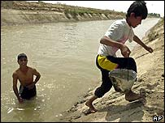
Water Pollution in the Middle East
Notes:
Instructional Approach(s): Transition slide

Slide 27
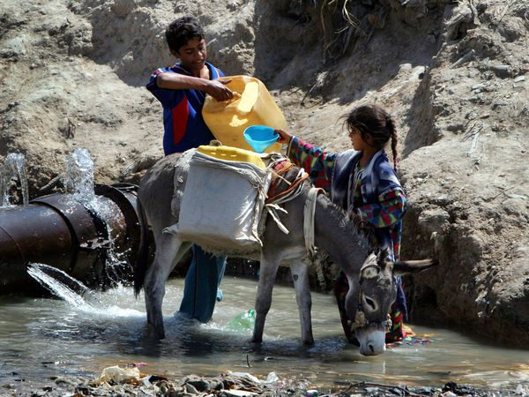
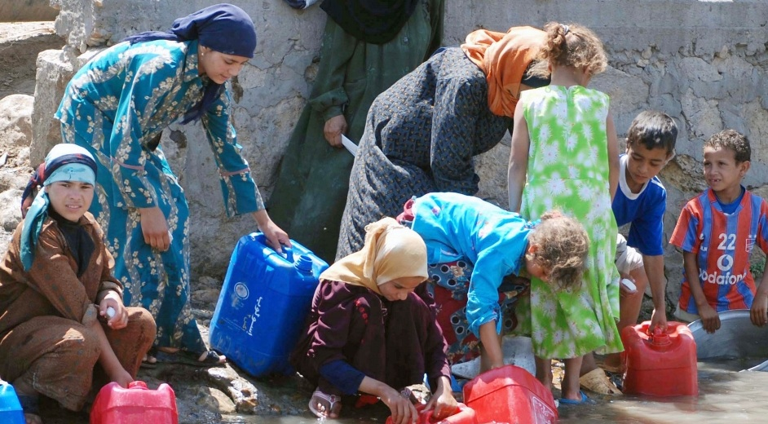
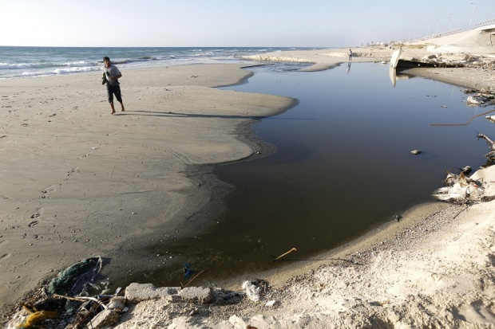
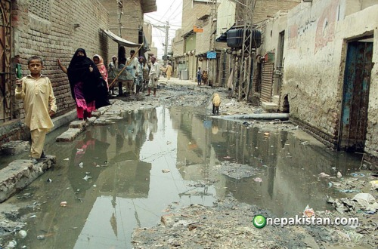
Notes:
Instructional Approach(s): The teacher should use the images to show the pollution of water in the Middle East.

Slide 28
Use Middle East Water Issues Graphic Organizer to record the causes and effects of Water Pollution in the Middle East.
Notes:
Instructional Approach(s): The teacher should make sure each student has a copy of the graphic organizer [with unequal distribution already completed] to use to record the causes and effects of water pollution in the Middle East.

Slide 29
Causes of Water Pollution in the Middle East
Dams have reduced fresh water inflow that would reduce pollution
Salt water mixing with fresh water (salination) or soil degradation (ruin)
Depletion and contamination of underground and surface water resources
Pollution from raw sewage, industrial waste, and agricultural waste
Notes:
Instructional Approach(s): The teacher should present the information on the slide while the students summarize the important information on their graphic organizer.

Slide 30
Causes of Water Pollution in the Middle East
Burning oil wells during the Persian Gulf War created significant air pollution which disrupted ecosystems, spoiled food webs, and contaminated drinking water
Oil rigs cause pollution by leaking oil through old equipment, illegal dumping, and accidental spills
Notes:
Instructional Approach(s): The teacher should present the information on the slide while the students summarize the important information on their graphic organizer.

Slide 31
Effects of Water Pollution in the Middle East
Economic Impact
There is a limited supply of clean water for the irrigation of crops
Polluted water can reduce the production of food and pose health risks
Impact on the Population
Polluted water is unsafe for drinking [causing health problems and in some cases death]
Polluted water is unsafe for livestock and fish [which can be passed up the food chain]
Notes:
Instructional Approach(s): The teacher should present the information on the slide while the students summarize the important information on their graphic organizer.

Slide 32
Summarizing Strategy: 3-2-1
Identify 3 causes of the unequal distribution of water in the Middle East
Identify 2 causes of water pollution in the Middle East
Identify 1 reason that the Middle East’s water problems are getting worse
Notes:
Instructional Approach(s): Each student should complete the summarizer. The teacher should use the summarizer to determine the level of student mastery and if differentiation is needed.

