Slide 1
Unit 3: Government/Civics Understanding
Unitary
Confederation
Federal

Slide 2
What is a unitary government?
In a unitary government, the central government has much authority/ decision-making power.
Local governing bodies simply serve as arms of the central government

Slide 3
Unitary government notes
unitary state is a state governed as one single unit in which the central government is supreme
United Kingdom is an example of a unitary state. (Scotland, Wales, Northern Ireland and England are 4 countries of UK)
Ukraine is another example of a unitary state

Slide 4
Federal Government

Slide 5
Confederation
A confederation (or confederacy), is a union of political units for common action
Confederations tend to be established for dealing with critical issues (such as; defense, trade, foreign affairs, or currency)

Slide 6
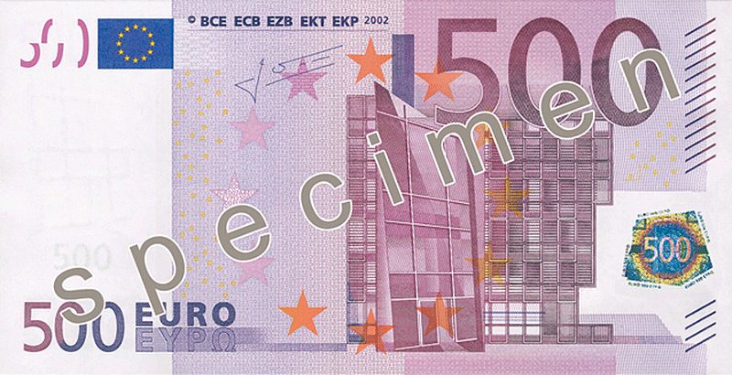
Confederation Examples
Confederate states of America
European Union
Defense/ trade/ currency

Slide 8
Federal Government
A government based on the principle of federalism, power is shared between the federal government/state governments
The federal government is composed of 3 branches: legislative, executive and judicial.

Slide 9
Federal government
Powers are vested by a Constitution, a Congress, the President, and the federal courts/Supreme Court.
US, Mexico and Austria

Slide 10
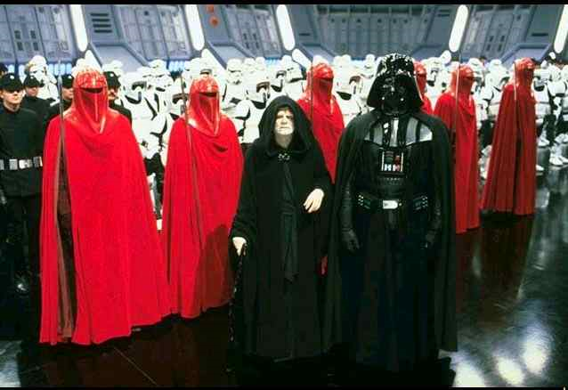
The Galactic Empire

