Slide 1
Unit 6 Geography of Latin America SS6G1,2,3
Vocabulary Terms

Slide 2
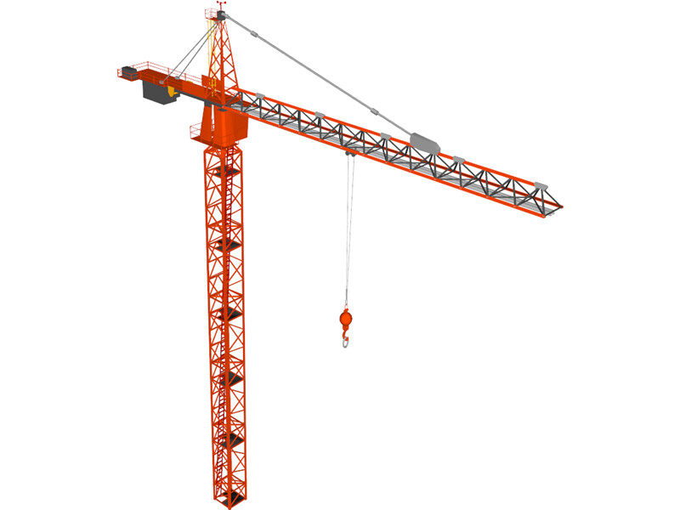
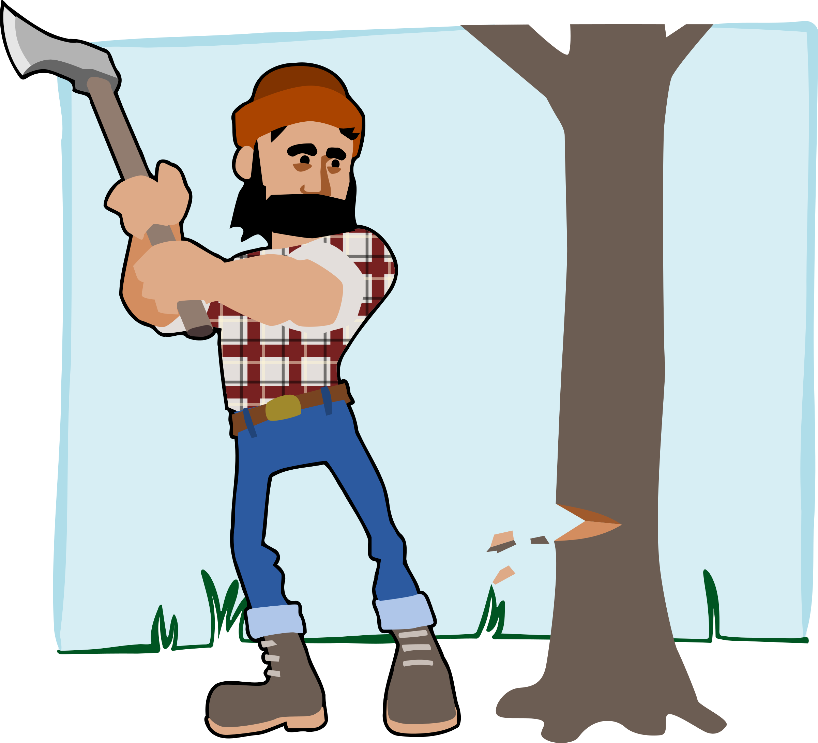
Unit 6 Vocabulary Terms Graphic Organizer
Industrial Growth
Lumber
Definition:
the economy experiencing a higher-than-average growth rate.
Example:
Definition:
Wood that has been cut into planks for commercial construction use.
Example:

Slide 3
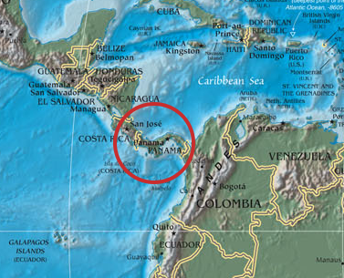
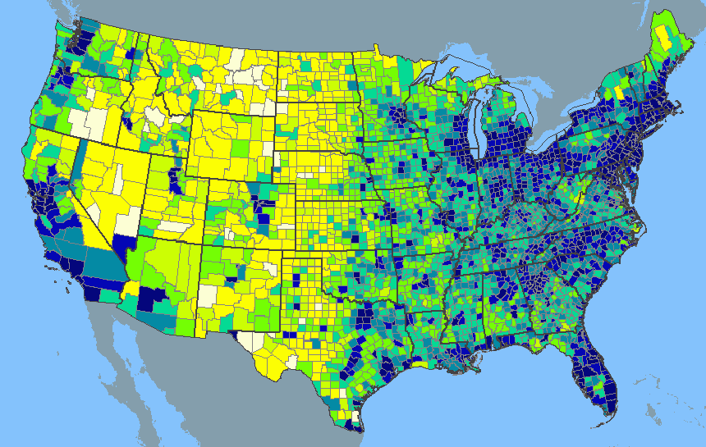
Unit 6 Vocabulary Terms Graphic Organizer
Population Density
Isthmus
Definition:
density is a measurement of population per unit area or unit volume.
Example:
Definition:
A narrow strip of land with sea on either side.
Example:

Slide 4
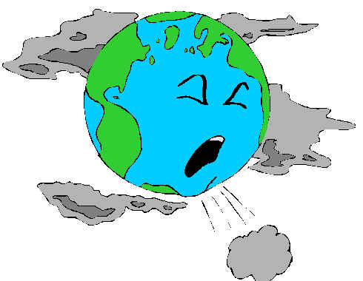
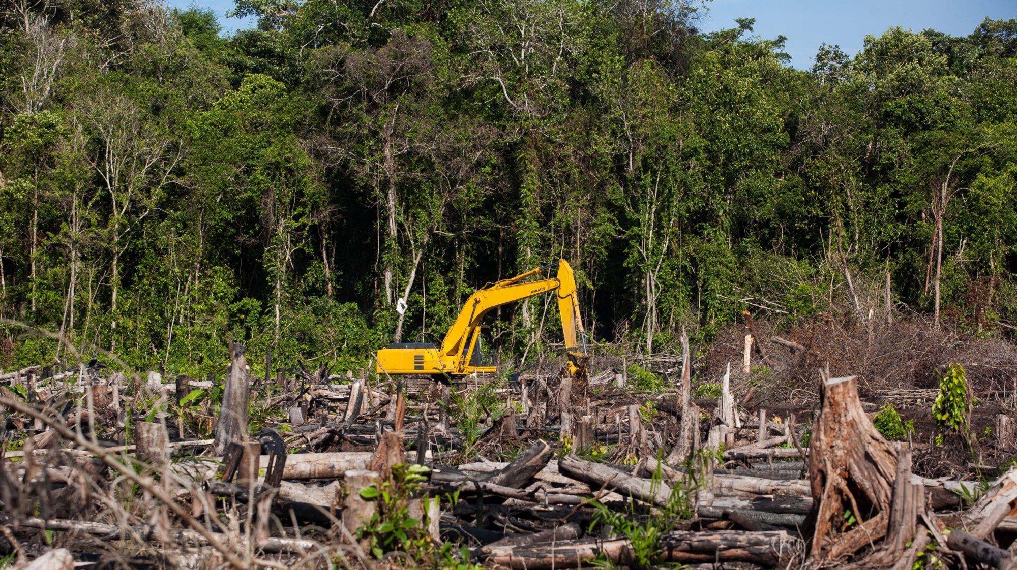
Unit 6 Vocabulary Terms Graphic Organizer
Smog
Deforestation
Definition:
An atmospheric phenomenon whereby vehicle exhaust and factory smoke combine with fog.
Example:
Definition:
The destruction of a forested area, typically as a result of human activities.
Example:
.

Slide 5
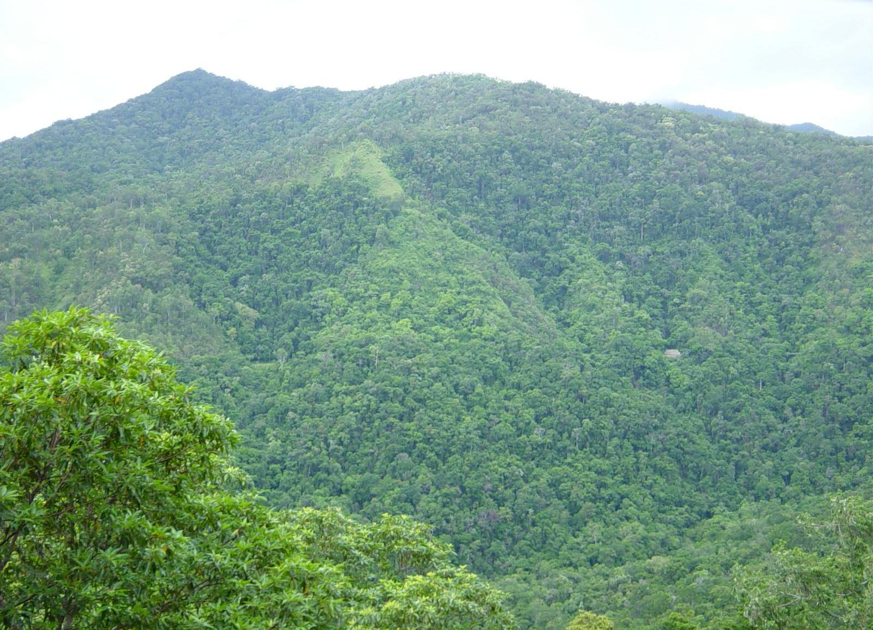
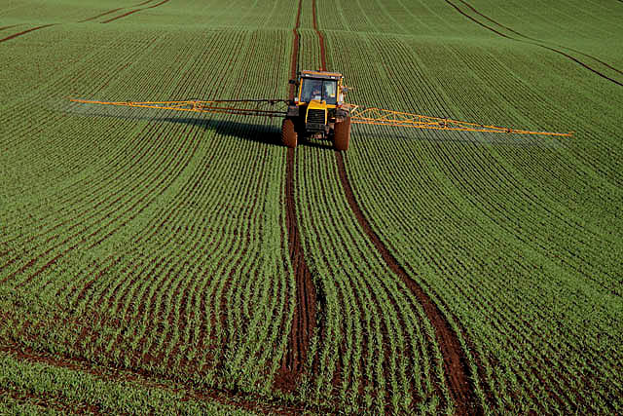
Unit 6 Vocabulary Terms Graphic Organizer
Rainforest
Arable
Definition:
A dense forest rich in biodiversity trees and plant.
Example:
Definition:
Suitable for farming
Example:

Slide 6
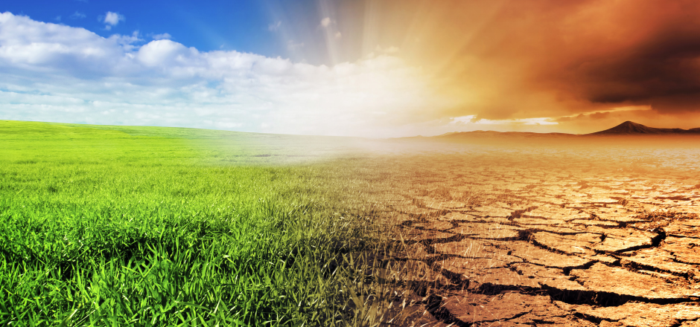
Unit 6 Vocabulary Terms Graphic Organizer
Climate
Commodities
Definition:
the average annual weather conditions in each location
Example:
Definition:
any raw material or agricultural product that is bought and sold
Example:

Slide 7
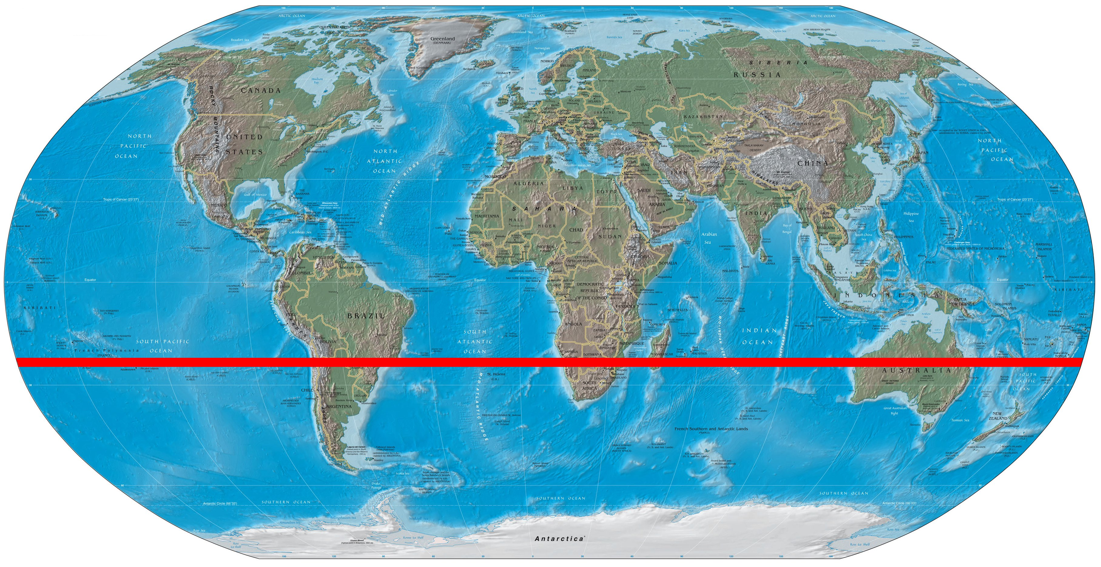
Unit 6 Vocabulary Terms Graphic Organizer
Temperate
Tropic of Capricorn
Definition:
climate characterized by mild temperatures
Example:
Definition:
a parallel latitude located south of the equator at 23.5º S
Example:

Slide 8
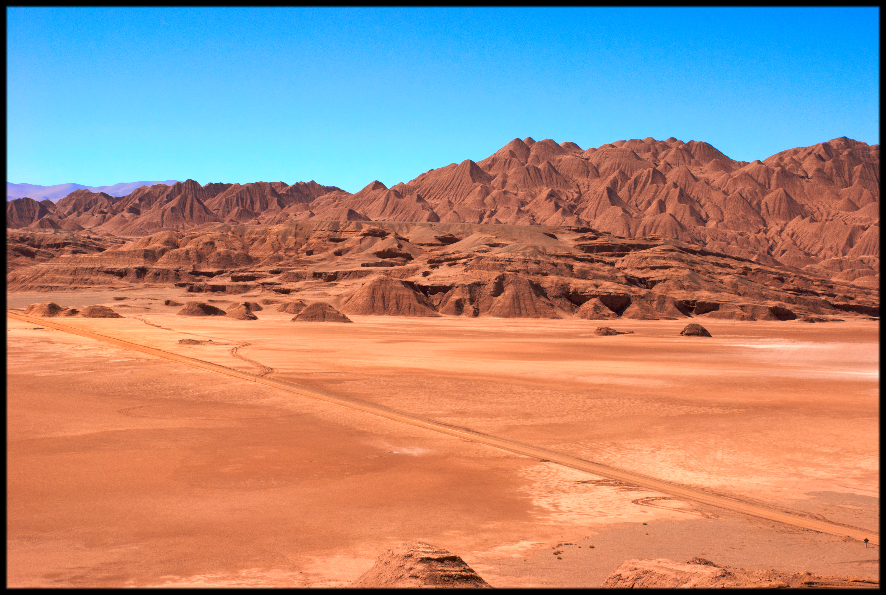
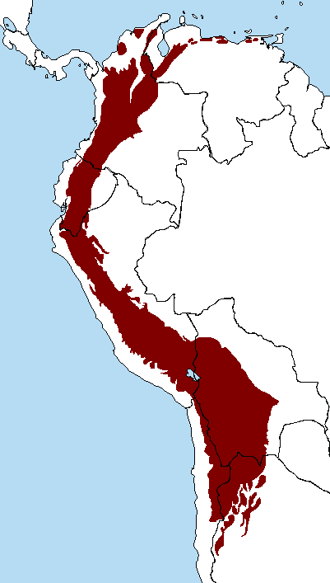
Unit 6 Vocabulary Terms Graphic Organizer
Atacama Desert
Andes Mountains
Definition:
This desert, located primarily in Chile, is over 600 square miles in size and is the driest place on Earth
Example:
Definition:
Located in South America extend down the western side of the entire continent for nearly 4,500 miles. Example:

Slide 9
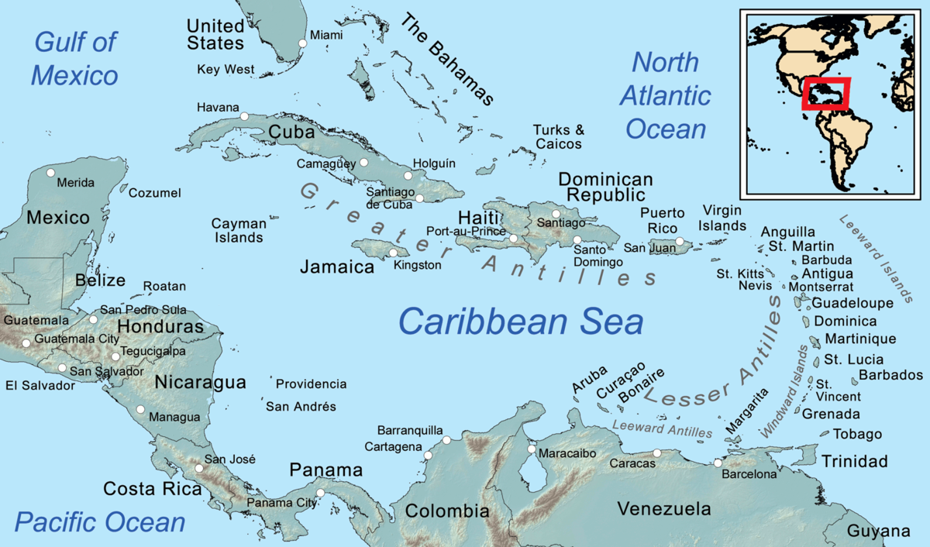
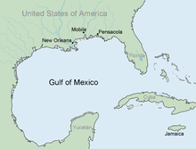
Unit 6 Vocabulary Terms Graphic Organizer
Caribbean Sea
Gulf of Mexico
Definition:
located east of Central America and north of South America.
Example:
Definition:
Body of water located off the eastern coast of Mexico
Example:

Slide 10
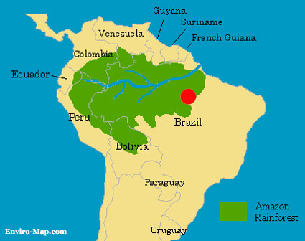
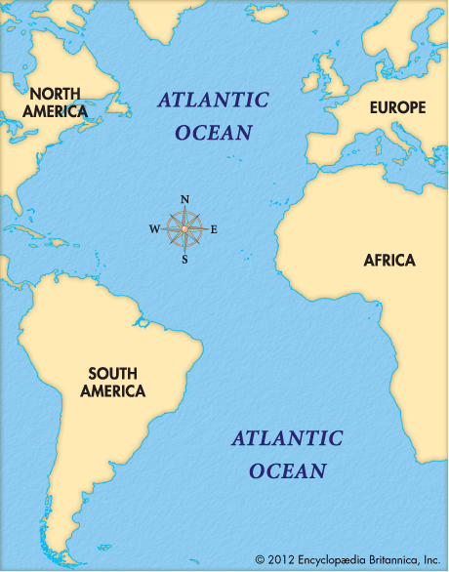
Unit 6 Vocabulary Terms Graphic Organizer
Amazon River
Atlantic Ocean
Definition:
Located primarily in Brazil, the nearly 4,000-mile long Amazon is the world’s second longest river after the Nile (which is located in eastern Africa.)
Example:
Definition:
an ocean bordered by North America and South America in the Western Hemisphere and by Europe and Africa in the Eastern Hemisphere.
Example:
This Photo by Unknown Author is licensed under CC BY

Slide 11
Unit 6 Vocabulary Terms Graphic Organizer
Pacific Ocean
Narcotics
Definition:
an ocean bordered by the Americans, Asia, and Australia: largest ocean in the world; divided by the equator into the North Pacific and the South Pacific.
Example:
Definition:
Any controlled, non-medicinal substance (especially drugs)
Example:

