Slide 1
Zapatista Guerrilla Movement in Mexico

Slide 2
What is Guerrilla Warfare?
Warfare and combat in which a small group use mobile tactics (ambushes, raids, etc.) to combat a larger and less mobile army. The guerrilla army uses ambush (stealth and surprise) and movement in attacking vulnerable targets in enemy territory.

Slide 3
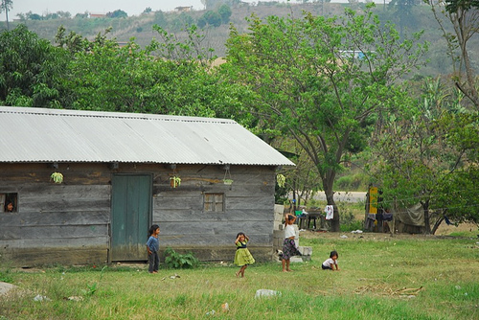
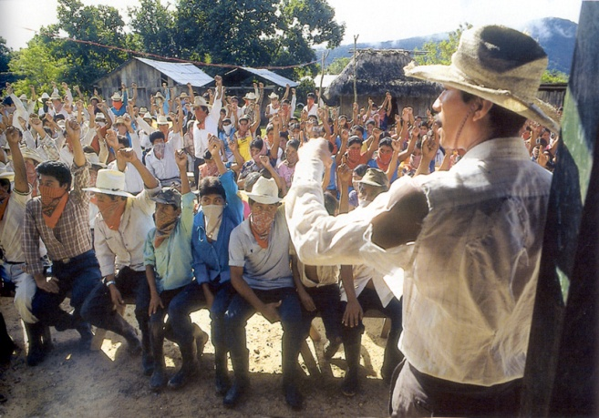
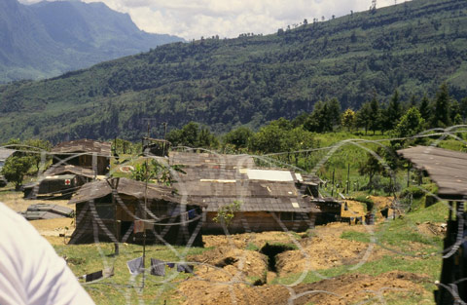
Who?
Zapatista Army of National Liberation
Ejercito Zapatista de Liberacion Nacional (ELN)
Natives that were coffee growers
Poor people of the Chiapas
Named after Emiliano Zapata- supporter of the Mexican Revolution

Slide 4
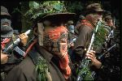
What?
Zapatista Army declared war on the Mexican state of Chiapas.
They got the world’s attention by taken over several Mexican cities and attacking their military posts.
The Mexican government sent soldiers and small battles took place.
The Zapatista’s uprising failed, but they did get attention from the world.

Slide 5
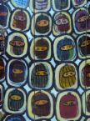
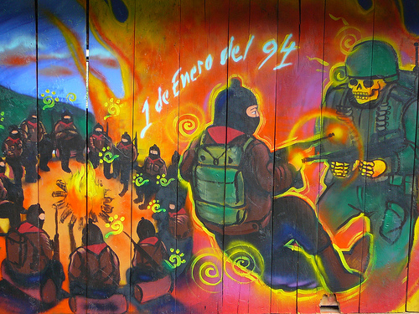
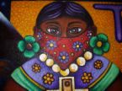
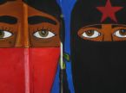
When?
January 1, 1994

Slide 6
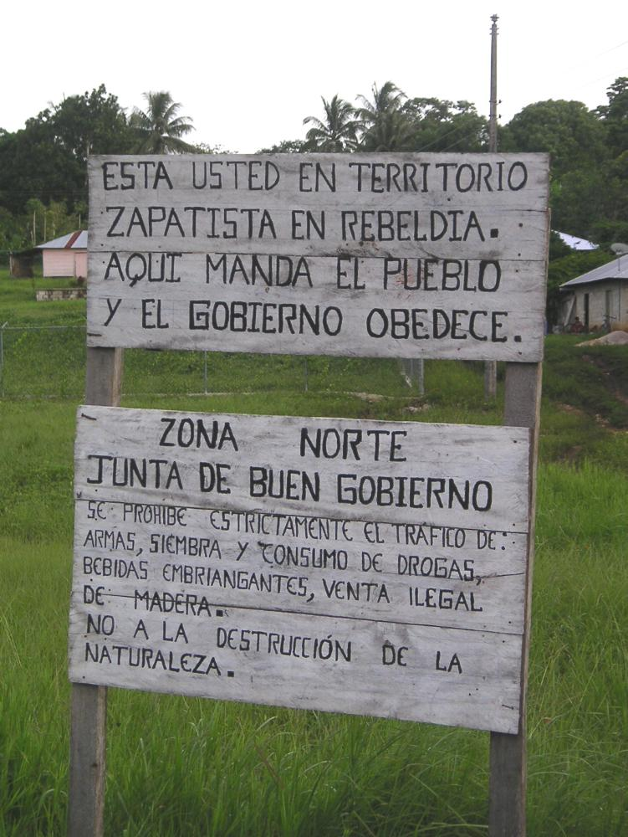
Where?
Chiapas, Mexico
Some of Mexico’s richest land
Hydroelectric power
Natural Gas
Oil
Coffee
The sign reads:
You are in Zapatista rebel territory. Here the people give orders and the government obeys.

Slide 7
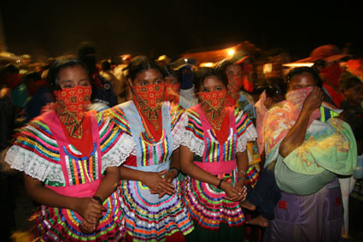
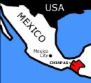
This makes the Chiapas home to some of the poorest people in Mexico.
Hardest hit are people of Mayan descent.
Most do not speak Spanish
Small farms
Little access to education and healthcare

Slide 8
Why?
They wanted more land.
NAFTA (North America Free Trade Agreement)
They thought it would increase poverty
Indigenous people (native americans) in the Chiapas felt that they were being treated like second class citizens
They wanted more political democracy.
They felt that they were being ignored by the government.
Ther best land for farming and ranching is controlled by a few wealthy land owners and they worked with the government to benefit themselves. (Think: Oligarchy)
They wanted more money to help with poverty.

Slide 9
Outcome
The world agreed with the Zapatistas.
The Mexican government has not done much to help.
They adopted non-violent strategies to get their voice heard.
Internet
International speaking-educated people in Mexico and around the world
The indigenous (natives) and peasants of Chiapas have started their own health and education programs.
The uprising was a reminder of what can happen if people are ignored.

